Slide 1

Python Quick Tutorial
(4)-Function definition and function call
Hsueh-Ting Chu

Slide 2
Function definition and function call
1) Define functions and call functions
2) Import module import, import as and from import
3) Crawler practice

Slide 3
(1) Program Elements: Data Structure and Algorithm
Algorithm: the calculation steps which can be written by hand
Calculate the greatest common divisorGCD of 240 and 96, using enthalpy division
By hand：
240÷96=2…48
96÷48=2…0
When the remainder is 0,
the divisor is gcd
So, gcd of 240 and 96 is 48
Algorithm：
a=240; b=96
r=a%b
while r!=0:
a=b;b=r
r=a%b
print("gcd=",b)
As a function：
def gcd(a, b):
r=a%b
while r!=0:
a=b;b=r
r=a%b
return b

Slide 4
(1.b) Function definition and call
def gcd(a, b):
....
return b
def gcd(a, b):
r=a%b
while r!=0:
a=b;b=r
r=a%b
return b
print("gcd(240, 96)=", gcd(240, 96))

Slide 5
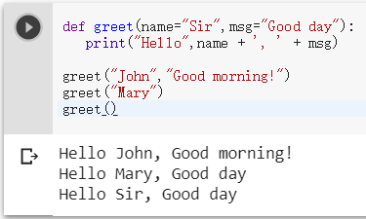
(1.c) Default parameters of the function
def foo(para1=“…",para2=“…"):
def greet(name="Sir",msg="Good day"):
print("Hello",name + ', ' + msg)
greet("John","Good morning!")
greet("Mary")
greet()

Slide 6
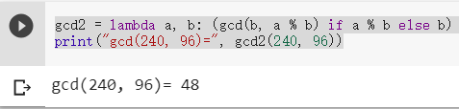
(1.d) lamda function
def foo(para1,para2): statements
foo=lambda para1,para2: expression
Hint:
#A lambda function can take any number of arguments, but can only have one expression.
gcd2 = lambda a, b: (gcd(b, a % b) if a % b else b)
print("gcd(240, 96)=", gcd2(240, 96))

Slide 7
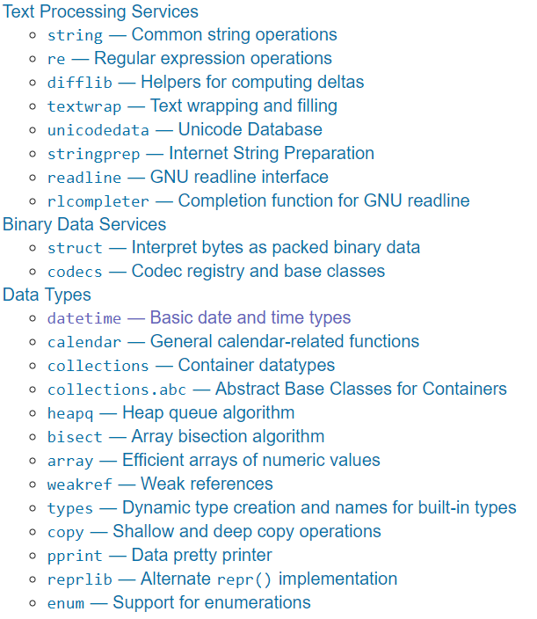
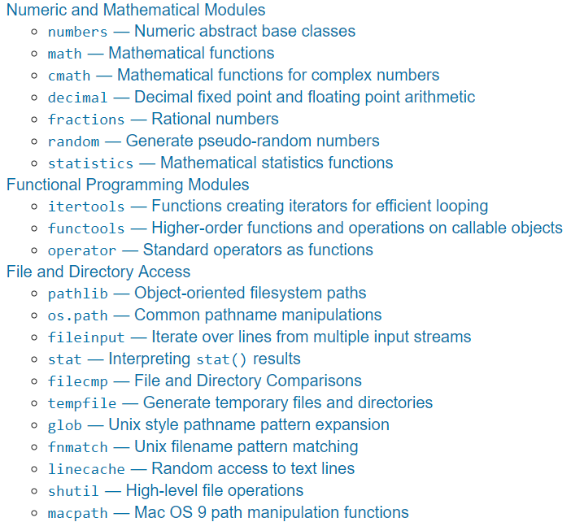
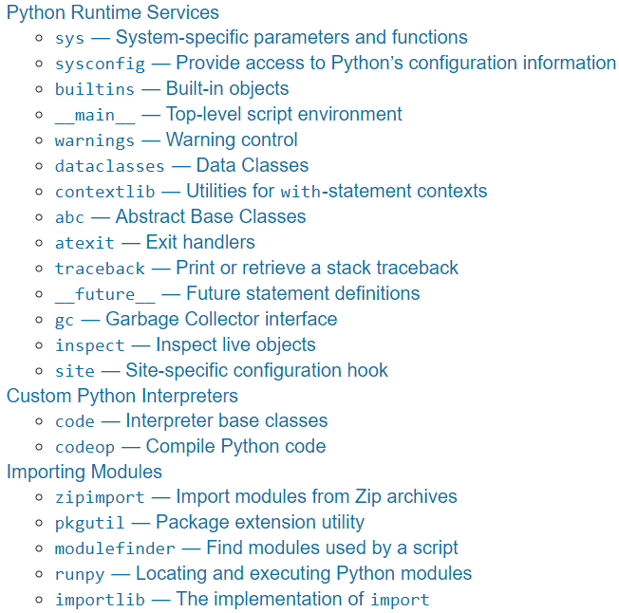
(2.a) Using Libraries
The Python Standard Library

Slide 8
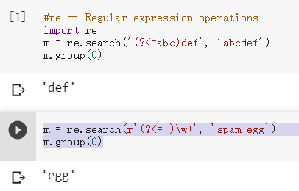
(2.b)re Regular expression
import re
m = re.search('(?<=abc)def', 'abcdef')
import re
m = re.search(r'(?<=-)\w+', 'spam-egg')
m.group(0)
(?<=…) Match the contents of the string that match ... 。
(?<!…) Match the contents of the string that don't match ... 。

Slide 9
(2.c) random --- Generate random numbers
import random as rd
a=rd.random()
#random ---
import random as rd
a=rd.random() # Random float: 0.0 <= x < 1.0
b=rd.uniform(2.5, 10.0) # Random float: 2.5 <= x < 10.0
c=rd.randrange(10) # Integer from 0 to 9 inclusive
d=rd.choice(['win', 'lose', 'draw']) # Single random element from a sequence
print(a,b,c,d)。

Slide 10
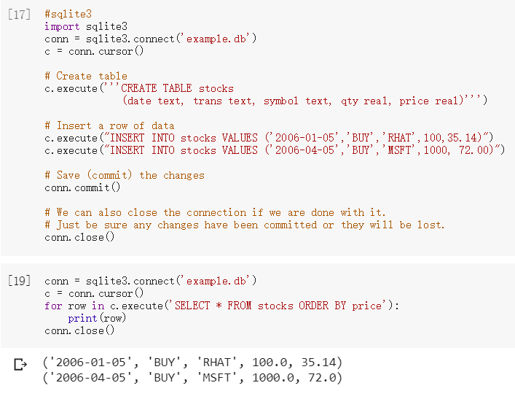
(2.d) sqlite3 --- SQLite database
import sqlite3
conn = sqlite3.connect('example.db')
conn = sqlite3.connect('example.db')
c = conn.cursor()
c.Execute()
conn.commit()
conn.close()

Slide 11
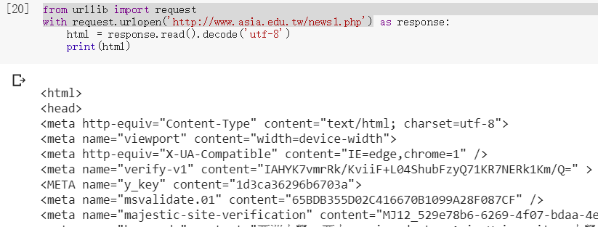
(2.e) urllib --- URL
from urllib import request
request.urlopen('http://…')
from urllib import request
with request.urlopen('http://www.asia.edu.tw/news1.php') as response:
html = response.read().decode('utf-8')
print(html)

Slide 12
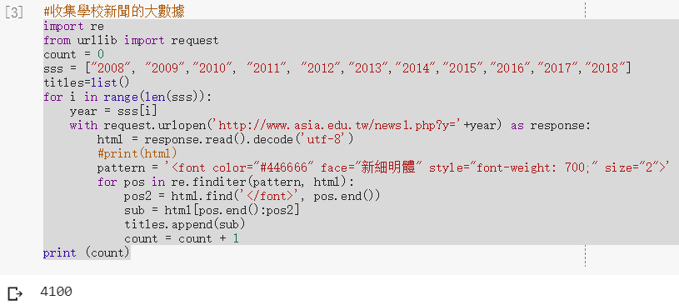
(3.a) Collect school news
from urllib import request
import urllib.request
import re
from urllib import request
count = 0
sss = ["2008", "2009","2010", "2011", "2012","2013","2014","2015","2016","2017","2018"]
titles=list()
for i in range(len(sss)):
year = sss[i]
with request.urlopen('http://www.asia.edu.tw/news1.php?y='+year) as response:
html = response.read().decode('utf-8')
#print(html)
pattern = '<font color="#446666" face="新細明體" style="font-weight: 700;" size="2">'
for pos in re.finditer(pattern, html):
pos2 = html.find('</font>', pos.end())
sub = html[pos.end():pos2]
titles.append(sub)
count = count + 1
print (count)

Slide 13
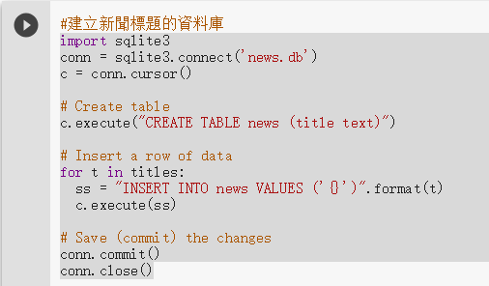
(3.b) Create a database of news titles
for t in titles:
ss = "INSERT INTO news VALUES ('{}')".format(t)
c.execute(ss)
import sqlite3
conn = sqlite3.connect('news.db')
c = conn.cursor()
# Create table
c.execute("CREATE TABLE news (title text)")
# Insert a row of data
for t in titles:
ss = "INSERT INTO news VALUES ('{}')".format(t)
c.execute(ss)
# Save (commit) the changes
conn.commit()
conn.close()

Slide 14
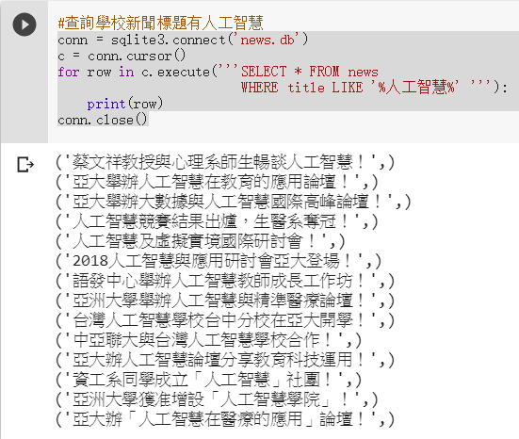
(3.c) Query school news headlines with artificial intelligence
for row in c.execute('''SELECT * FROM news
WHERE title LIKE '%artificial intelligence%' '''):
conn = sqlite3.connect('news.db')
c = conn.cursor()
for row in c.execute('''SELECT * FROM news
WHERE title LIKE '%artificial intelligence%' '''):
print(row)
conn.close()

Slide 15
REVIEWS：
(1) What are the keywords that define the function?
(2) What is the difference between import and import from?
(3) What kind of functions does the urllib library provide?
(4) Query the various SQL syntax of SELECT LIKE online.

Slide 16
Unit 4 exercises ：
Change step (3.a), find the time of the news title from html
Change step (3.c) to query the school news with the name of Jeffrey.

