Slide 1

Python Quick Tutorial
(5)-Flow control and string/time processing
Hsueh-Ting Chu

Slide 2
Flow control and string/time processing
1) Flow control
2) string processing
3) time processing

Slide 3
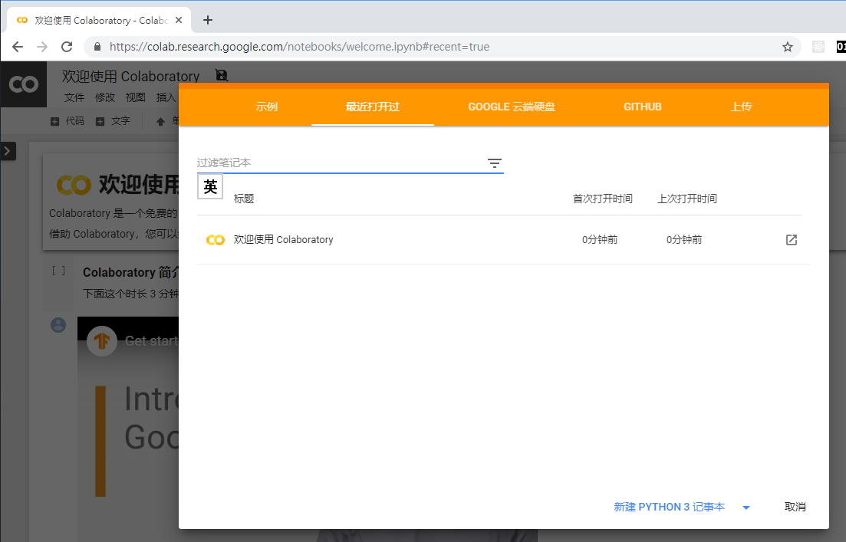
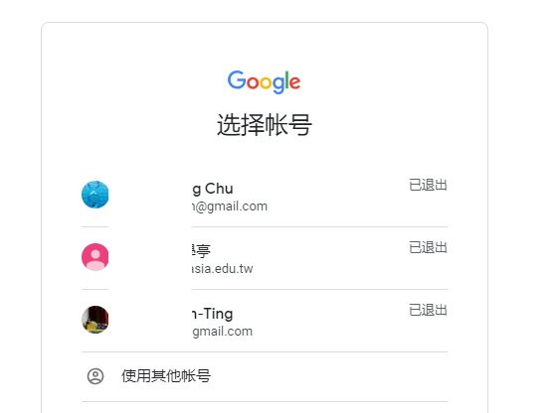
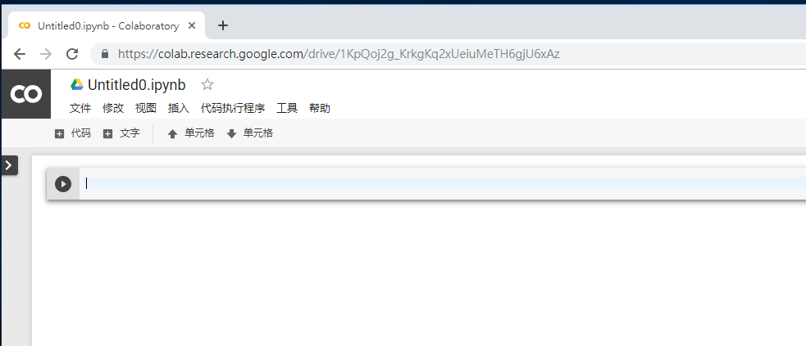
(1.a)Open Colab

Slide 4
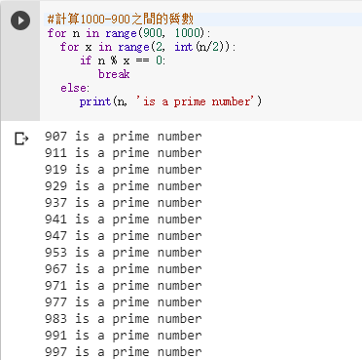
(1.b) Calculate the prime number between 900-1000
for x in range(2, int(n/2)):
if n % x == 0:
break
#for n in range(900, 1000):
for x in range(2, int(n/2)):
if n % x == 0:
break
else:
print(n, 'is a prime number')

Slide 5
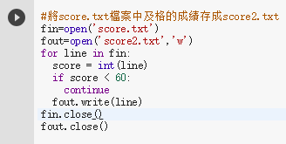
(1.c) Read score.txt
for line in fin:
if score < 60:
continue
# Save the pass scores in the score.txt file as score2.txt
fin=open('score.txt')
fout=open('score2.txt','w')
for line in fin:
score = int(line)
if score < 60:
continue
fout.write(line)
fin.close()
fout.close()

Slide 6
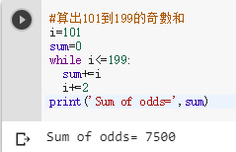
(1.d) Calculate the odd sum of 101 to 199
while i<=199:
i=101
sum=0
while i<=199:
sum+=i
i+=2
print('Sum of odds=',sum)

Slide 7
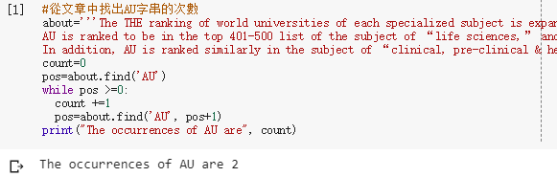
(2.a) Find the number of AU strings from the article
pos=about.find('AU')
while pos >=0:
pos=about.find('AU', pos+1)
about='''The THE ranking of world universities of each specialized subject is expanded this year to include the top 500 ones.
AU is ranked to be in the top 401-500 list of the subject of “life sciences,” and is the No.3 private university in Taiwan in this specialized area.
In addition, AU is ranked similarly in the subject of “clinical, pre-clinical & health,” and is the No.4 private university in Taiwan in this area.'''
count=0
pos=about.find('AU')
while pos >=0:
count +=1
pos=about.find('AU', pos+1)
print("The occurrences of AU are", count)

Slide 8
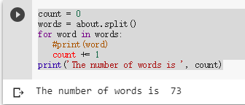
(2.b) Count the number of words in the article
words = about.split()
count = 0
words = about.split()
for word in words:
#print(word)
count += 1
print('The number of words is ', count)

Slide 9
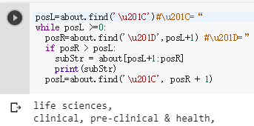
(2.c) Find the string in " "
Unicode character '\u201C'
subStr = about[posL+1:posR]
posL=about.find('\u201C')#\u201C=“
while posL >=0:
posR=about.find('\u201D',posL+1) #\u201D=”
if posR > posL:
subStr = about[posL+1:posR]
print(subStr)
posL=about.find('\u201C', posR + 1)
Substring :
string[start: end: step]

Slide 10
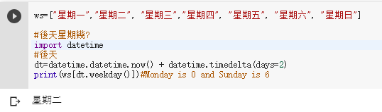
(3.a) What day is the day after tomorrow?
datetime.now()
datetime.timedelta(days=2)
datetime.datetime
#
import datetime
# the day after tomorrow
dt=datetime.datetime.now() + datetime.timedelta(days=2)
print(ws[dt.weekday()])#Monday is 0 and Sunday is 6

Slide 11
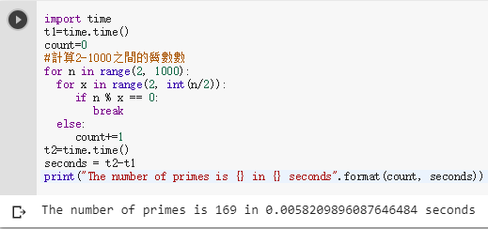
(3.b) How long did a program run?
t1=time.time() 1970/1/1,0:00
seconds = t2-t1
import time
t1=time.time()
count=0
#計算2-1000之間的質數數
for n in range(2, 1000):
for x in range(2, int(n/2)):
if n % x == 0:
break
else:
count+=1
t2=time.time()
seconds = t2-t1
print("The number of primes is {} in {} seconds".format(count, seconds))

Slide 12
REVIEWS：
(1) What is the effect of break on the for loop?
(2) What is the effect of continue on the for loop?
(3) What is the role of split()?
(4) find() If you can't find the string you are looking for?

Slide 13
Unit 5 exercises ：
Find out if there are several in words in the about string of step (2.a)?
Change step (3.a) to yesterday's day of the week?

