Slide 1


Scikit-learn Quick Tutorial
Pandas01-Data Science Basics
Hsueh-Ting Chu

Slide 2
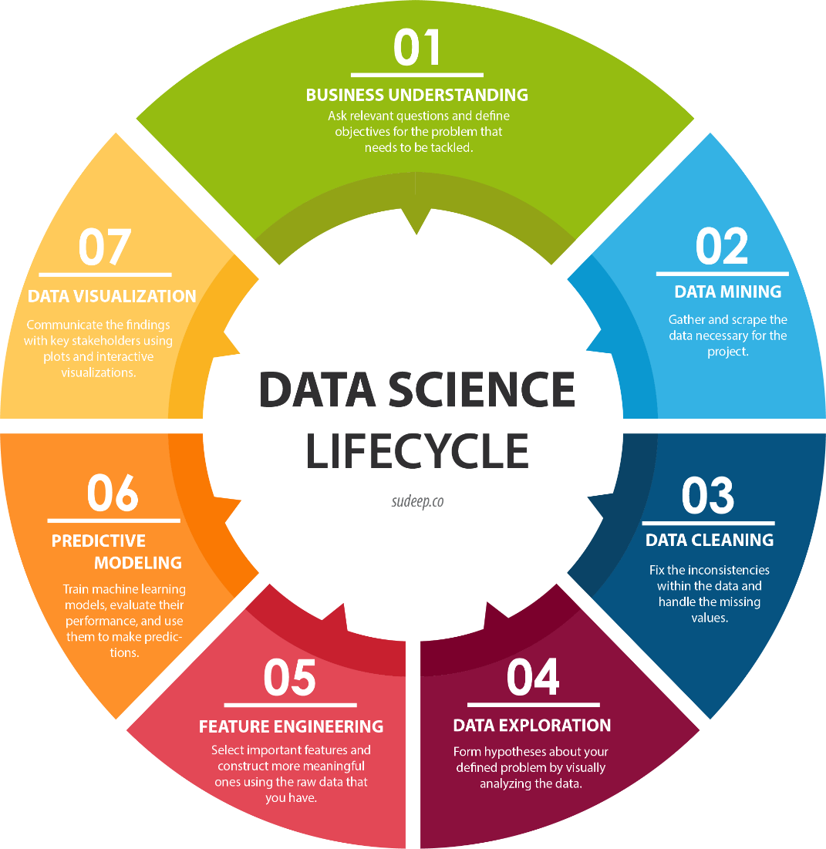
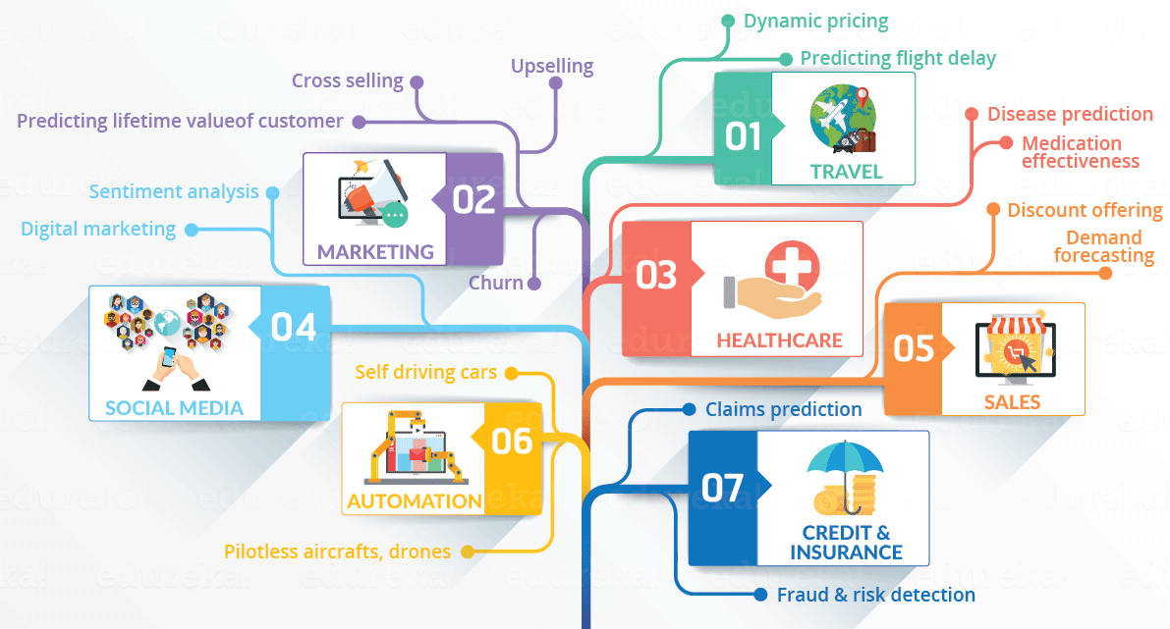
Data Science

Slide 3
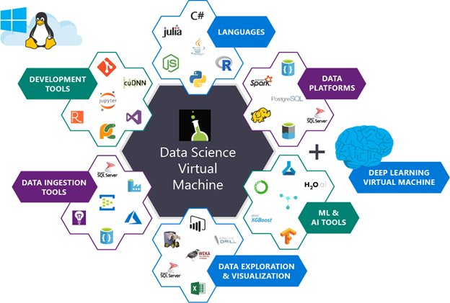

AI and Data Science

Slide 4

Pandas Python Data Analysis Library
df = pd.read_csv(‘xxx.csv')
print(df)
df.head()
df.plot()

Slide 5
Q&A
T
hanks!

