Slide 1


Scikit-learn Quick Tutorial
Pandas02-DataFrame
Hsueh-Ting Chu

Slide 2
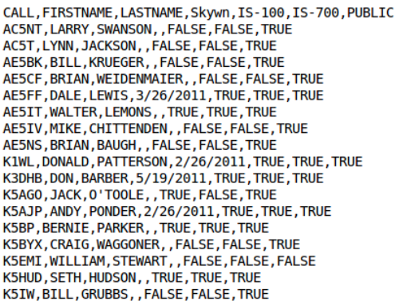
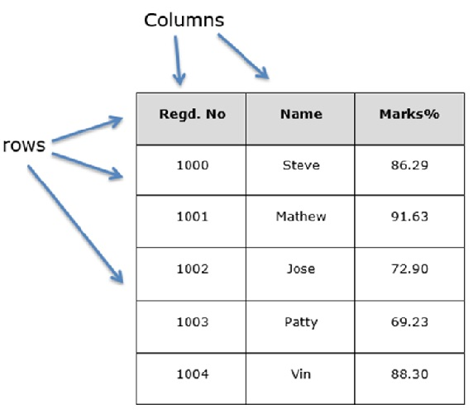
Read data as a DataFrame
df = pd.read_csv(‘xxx.csv')
df.head()
df.tail()

Slide 3
Read a CSV file
import pandas as pd
# 讀入 csv 文字檔
csv_file = "https://storage.googleapis.com/learn_pd_like_tidyverse/df.csv"
df = pd.read_csv(csv_file)
print(type(df))
df.head()

Slide 4
Filtering and select
df[df['country'] == 'Taiwan’]
df[df[(df['year'] == 2007) & (df['continent'] == 'Asia')]]
df[['country', 'continent']]

Slide 5
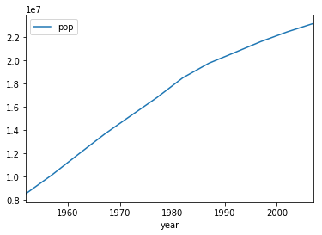
df.Plot()
df[df['country'] == 'Taiwan'].plot(x='year',y='pop')

Slide 6
df.iterrows() and np.nditer(a)
for index, row in df.iterrows():
a = row[1:-1]
y = row[-1]
s = ''
for x in np.nditer(a):
#print (x,)
s+=str(x)
cc = ss[s]

Slide 7
Q&A
T
hanks!

