Slide 1


Scikit-learn Quick Tutorial
Scikit01-Machine learning basics
Hsueh-Ting Chu

Slide 2
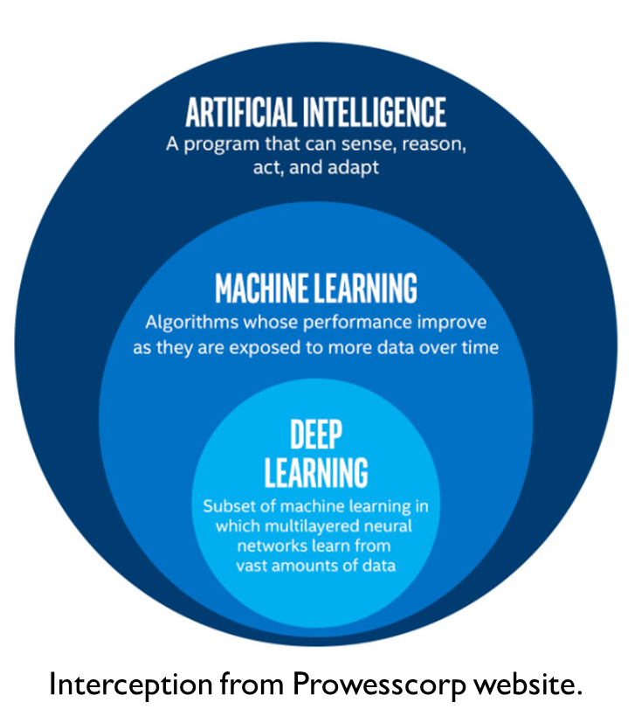
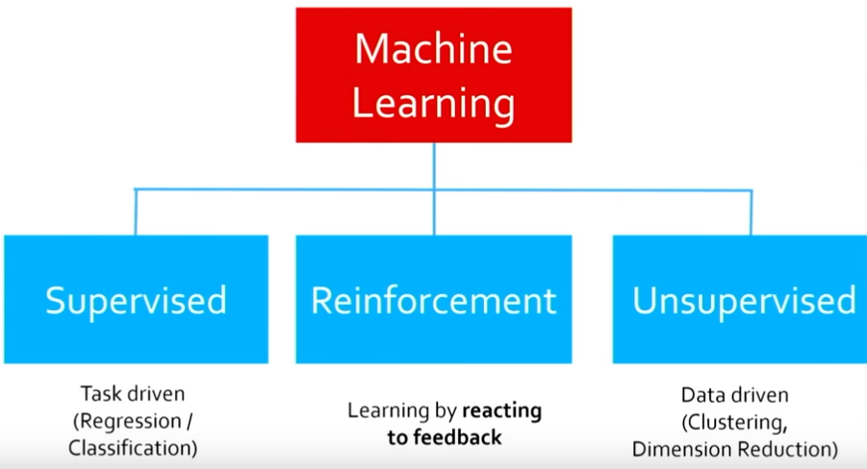
AI, ML and DL

Slide 3
Machine Learning
Supervised learning
Training set/Test set
Unsupervised learning
Reinforcement learning
Test Dataset
Classification algorithms

Slide 4
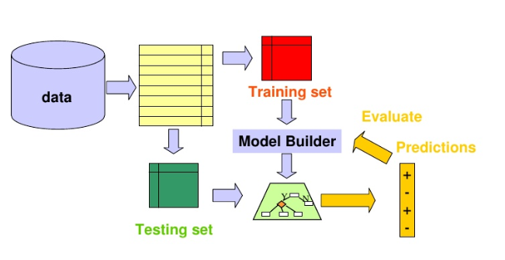
Machine Learning

Slide 5
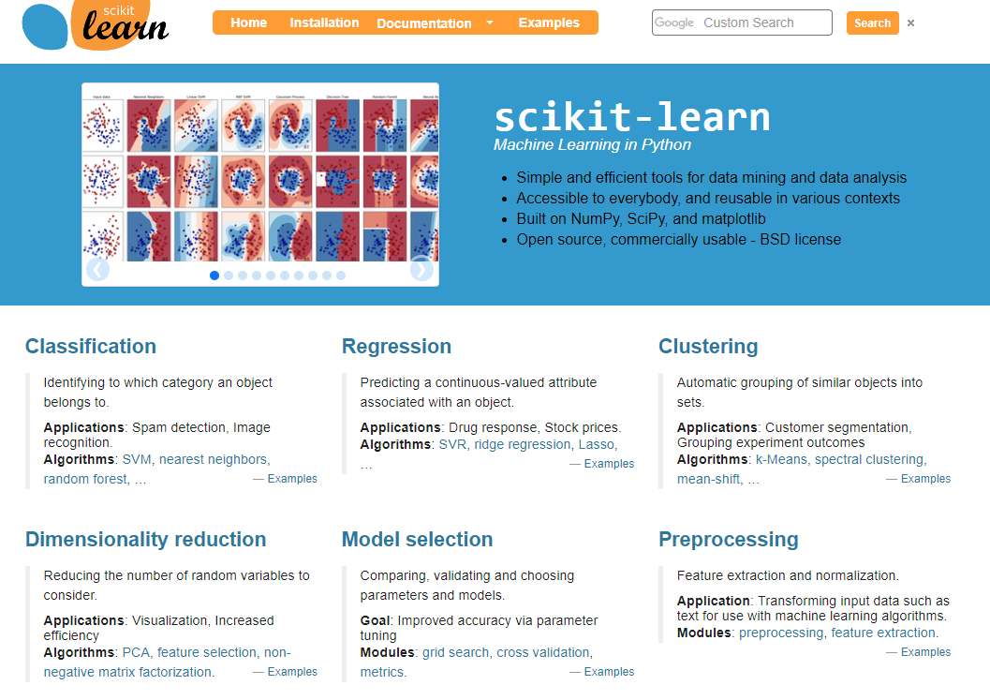
scikit-learn Machine Learning in Python

Slide 6

Choosing the right estimator

Slide 7
Q&A
T
hanks!

