Slide 1


Scikit-learn Quick Tutorial
Scikit02-Using Datasets
Hsueh-Ting Chu

Slide 2
Scikit-learn datasets
Scikit-learn
http://scikit-learn.org/stable/index.html
Toy datasets
load_boston([return_X_y]) Load and return the boston house-prices dataset (regression).
load_iris([return_X_y]) Load and return the iris dataset (classification).
load_diabetes([return_X_y]) Load and return the diabetes dataset (regression).
load_digits([n_class, return_X_y]) Load and return the digits dataset (classification).
load_linnerud([return_X_y]) Load and return the linnerud dataset (multivariate regression).
load_wine([return_X_y]) Load and return the wine dataset (classification).
load_breast_cancer([return_X_y]) Load and return the breast cancer wisconsin dataset (classification).

Slide 3
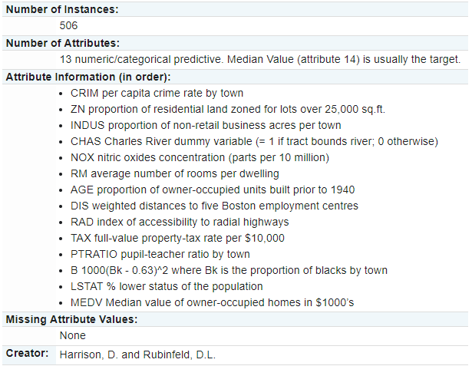
Boston house prices dataset

Slide 4
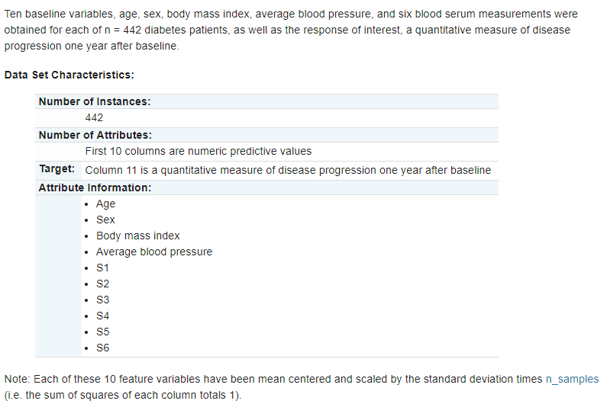
Diabetes dataset

Slide 5
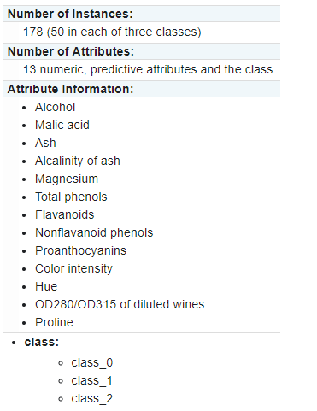
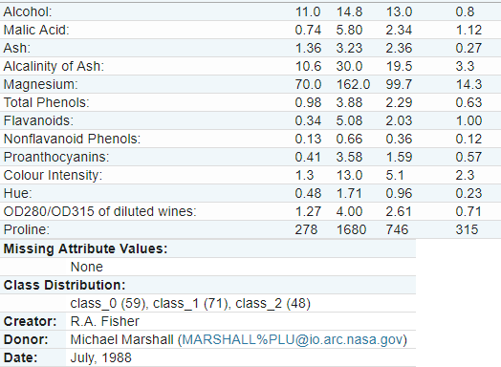
Wine recognition dataset

Slide 6
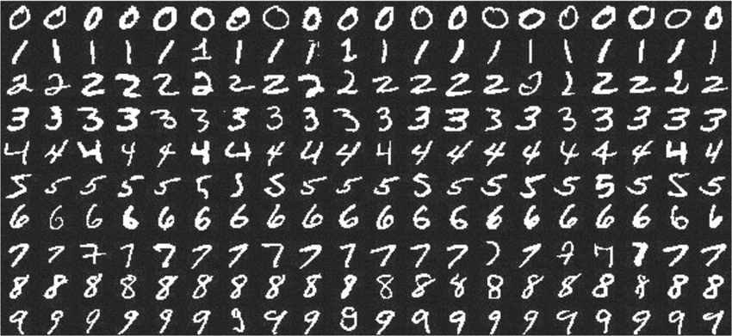
MNIST handwritten digit database

Slide 7
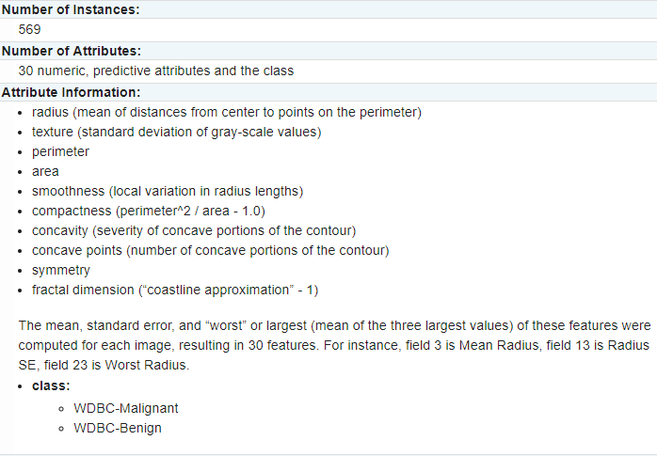
Breast cancer wisconsin (diagnostic) dataset

Slide 8
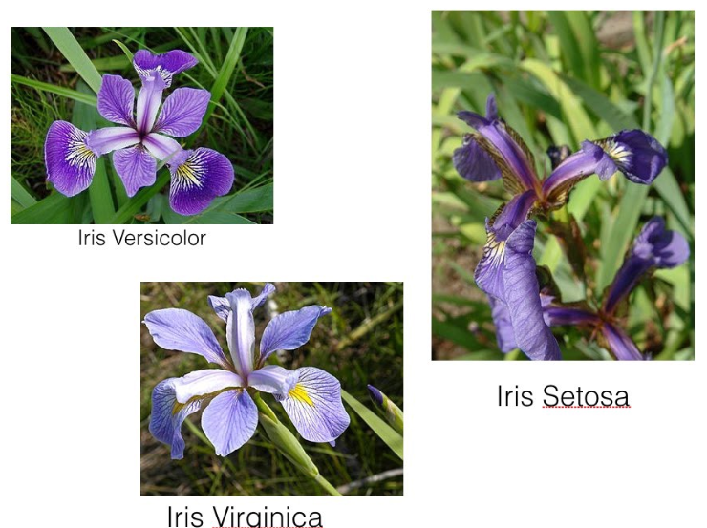
Iris data
from sklearn import datasets
iris = datasets.load_iris()
1. sepal length in cm 2. sepal width in cm 3. petal length in cm 4. petal width in cm 5. class: -- Iris Setosa -- Iris Versicolour -- Iris Virginica
Classes | 3
Samples per class | 50
Samples total | 150
Dimensionality | 4
Features | real, positive

Slide 9
Training set/Test set
from sklearn.model_selection import train_test_split
from sklearn import datasets
iris = datasets.load_iris()
#print(iris.keys)
X = iris.data[:,0:4]
y = iris.target
X_train, X_test, y_train, y_test =
train_test_split(X, y, test_size=0.333)

Slide 10
Q&A
T
hanks!

