Slide 1


Scikit-learn Quick Tutorial
Scikit03-PCA&TSNE
Hsueh-Ting Chu

Slide 2
Principal component analysis (PCA)
Widely used method for unsupervised, linear dimensionality reduction
GOAL: account for variance of data in as few dimensions as possible (using linear projection)

Slide 3
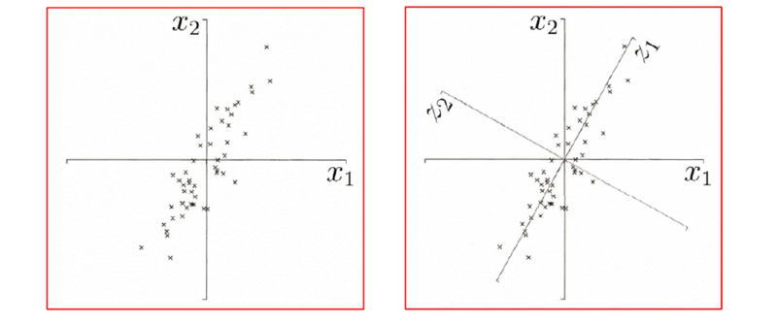
Geometric picture of principal components (PCs)
First PC is the projection direction that maximizes the variance of the projected data
Second PC is the projection direction that is orthogonal to the first PC and maximizes variance of the projected data

Slide 4
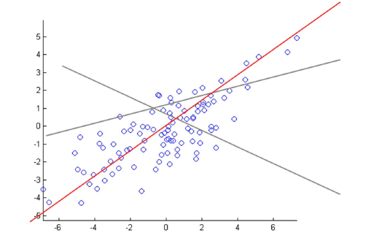
PCA: conceptual algorithm
Find a line, such that when the data is projected onto that line, it has the maximum variance.

Slide 5
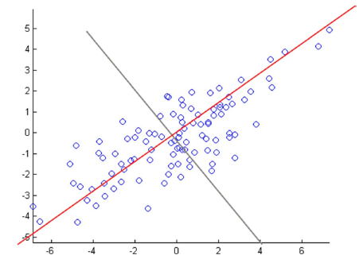
PCA: conceptual algorithm
Find a second line, orthogonal to the first, that has maximum projected variance.

Slide 6
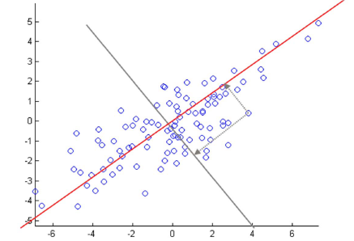
PCA: conceptual algorithm
Repeat until have k orthogonal lines
The projected position of a point on these lines gives the coordinates in the k-dimensional reduced space.

Slide 7
T-Stochastic neighbor embedding (t-SNE)
Visualizes high-dimensional data in a 2- or 3-dimensional map.
Better than existing techniques at creating a single map that reveals structure at many different scales.
Particularly good for high-dimensional data that lie on several different, but related, low-dimensional manifolds.
Example: images of objects from multiple classes seen from multiple viewpoints.

Slide 8
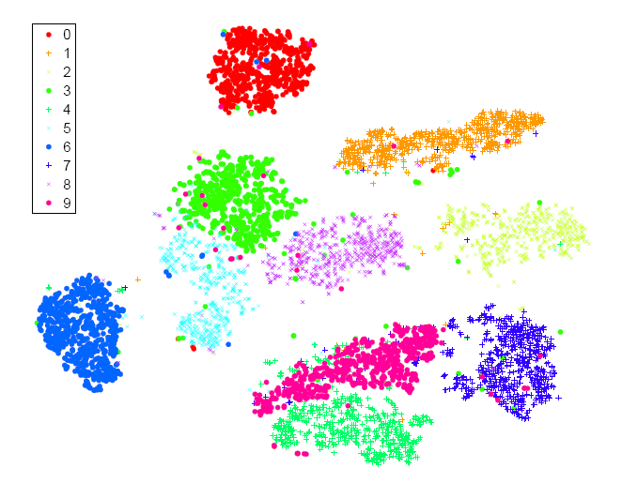
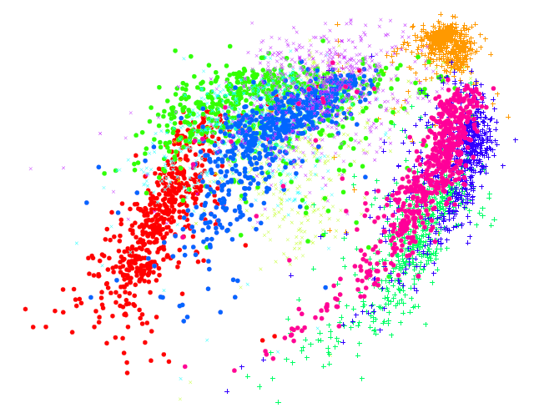
Visualization of classes in MNIST data
t-SNE
ISOMAP

Slide 9
Q&A
T
hanks!

