Slide 1


Scikit-learn Quick Tutorial
Scikit04-SupervisedMethods
Hsueh-Ting Chu

Slide 2
Classification algorithms
KNN: K-nearest neighbors,
SVM: Support vector machine
RF: Random forest
DT: Decision tree
NN: Neural network (MLP)
http://scikit-learn.org/stable/modules/generated/sklearn.neighbors.KNeighborsClassifier.html

Slide 3
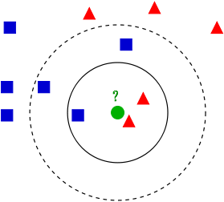
KNN: K-nearest neighbors
In k-NN classification, an object is classified by a majority vote of its neighbors, with the object being assigned to the class most common among its k nearest neighbors.

Slide 4
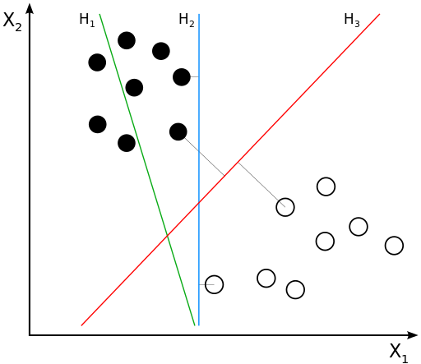
SVM: Support vector machine
A support vector machine constructs a hyperplane or set of hyperplanes in a high- or infinite-dimensional space

Slide 5
RF: Random forest
Random forests are an ensemble learning method that operate by constructing a multitude of decision trees at training time and outputting the class that is the mode of the classes (classification) or mean prediction (regression) of the individual trees.

Slide 6
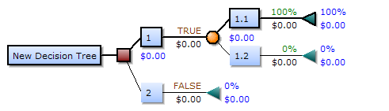
DT: Decision tree
A decision tree is a decision support tool that uses a tree-like graph or model of decisions and their possible consequences.

Slide 7
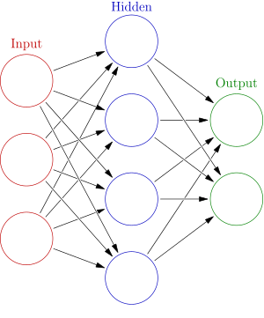
NN: Neural network (MLP)
A multilayer perceptron (MLP) is a class of feedforward artificial neural network.

Slide 8
Q&A
T
hanks!

