Slide 1


AOI Project Demo
AOI-Steps
Hsueh-Ting Chu

Slide 2
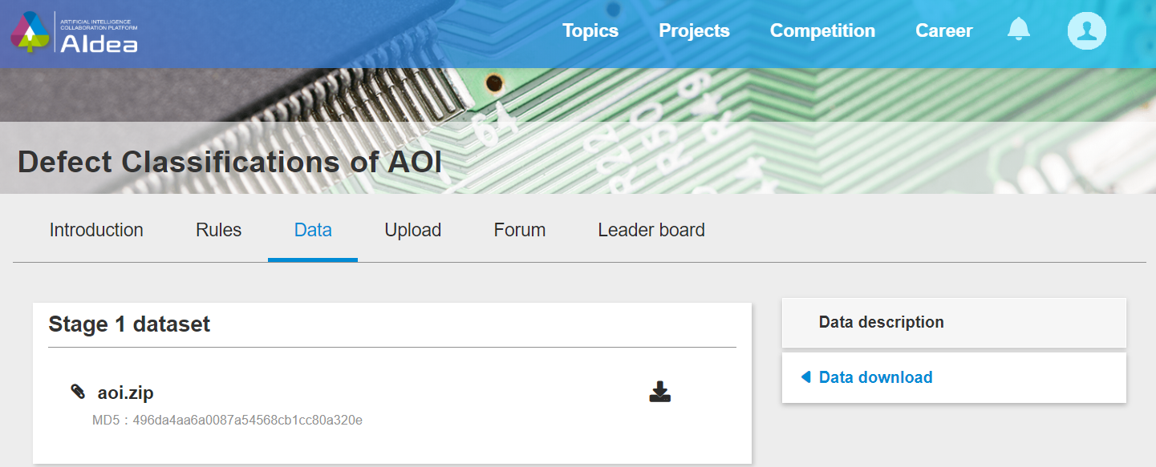
Download the AOI Dataset
https://aidea-web.tw/topic/a49e3f76-69c9-4a4a-bcfc-c882840b3f27

Slide 3
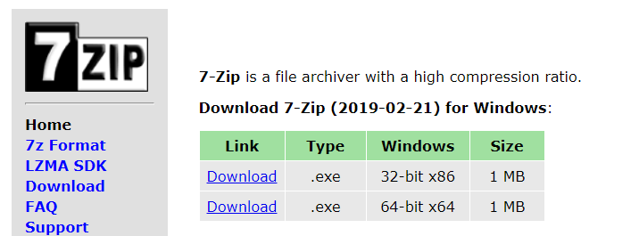
Check the dataset
aoi.zip→unzip
test.csv
test_images.zip →unzip
train.csv
train_images.zip →unzip

Slide 4
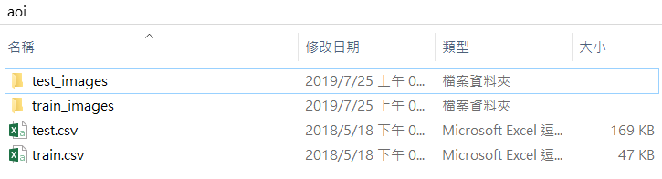
The folders and files

Slide 5
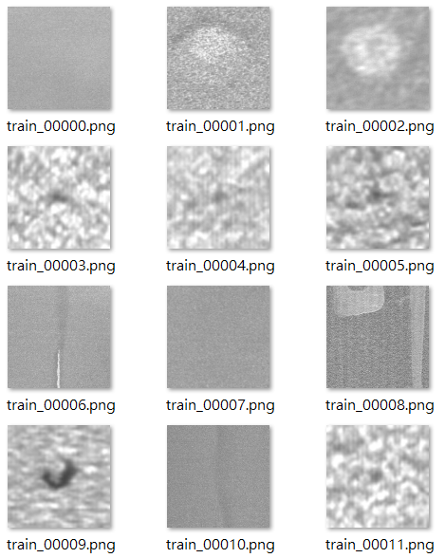
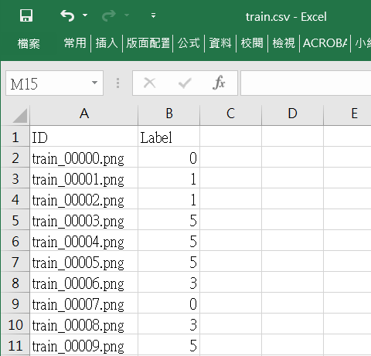
The training dataset - train.csv

Slide 6
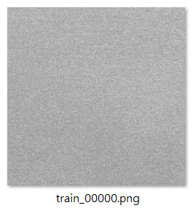
Notebook 1-Preprocessing (1) Resizing images
512x512
224x224

Slide 7
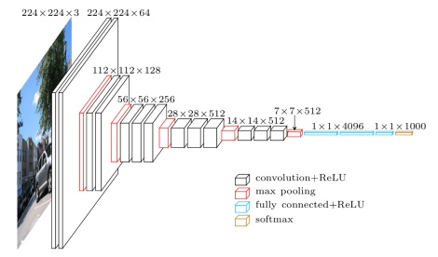
Notebook 2-Traing Deep Learning model

Slide 8
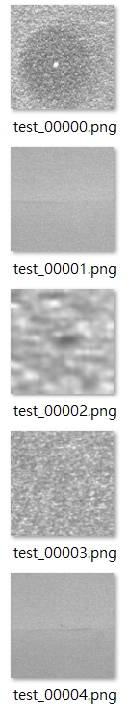
Notebook 3-Prediction of test dataset
1
0
Deep Learning model
Predict
2
0
4

Slide 9
Q&A
T
hanks!

