Slide 1


TensorFlow Quick Tutorial
TF01-MachineLearning4Mnist
Hsueh-Ting Chu

Slide 2
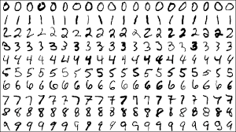
HANDWRITTEN DIGIT RECOGNITION
HELLO WORLD of machine learning
mnist handwritten dataset
Notes:
Computer vision is one of many applications of learning, and it’s where we’ll start. The ability for computers to “see” and “understand” enables them to better help us solve problems.
Computers are great with numbers, but it doesn’t see these handwritten digits as numbers. Instead, it sees them as groups of pixels. If we can create a mapping from an image of a handwritten digit to the number it represents, we could solve all kinds of problems.
This problem was initially attacked by Yann LeCun in the 90s. He was working to help the US Postal Service sort mail faster. Years of research and millions of dollars were allocated to this project and Yann is now the director of AI for Facebook. We’re going to stand on Yann’s shoulders and solve this problem in less than an hour.

Slide 3
WHAT THIS LAB IS
An introduction to:
Deep Learning
Keras and TensorFlow
Using the DL model (save/load)
Hands-on exercises using Colab
Notes:
Even though this is an introductory lab, experienced attendees will recognize the ease of use and value of DIGITS.

Slide 4
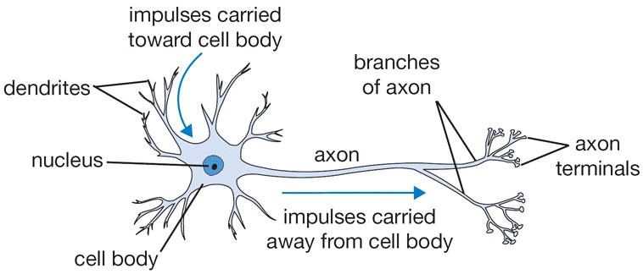
Biological neuron
Notes:
Picture from http://cs231n.github.io/neural-networks-1/

Slide 5
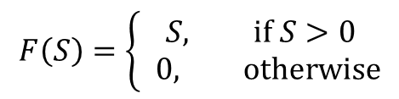
A “mathematical” neuron
x₁
w₁
x₂
w₂
output
inputs
…
F(.)
y
w_{N}
x_{N}
F (ReLU)
S
Notes:
The function F is called activation, and the particular form F=0 if S < 0 and F=S is called rectified linear unit or reLU.

Slide 6
(feedforward) Neural network
Y₁
X (input layer)
Y₂
x₁
Y (output layer)
x₂
x₃

Slide 7
Supervised learning
Determine the W^{(i)} and b^{(i)} with a training set of inputs {x} to minimize the predicted differences.
Least square errors: we minimize (y^{(j)} is the output of j-th sample and d^{(j)} is expected value):

Slide 8
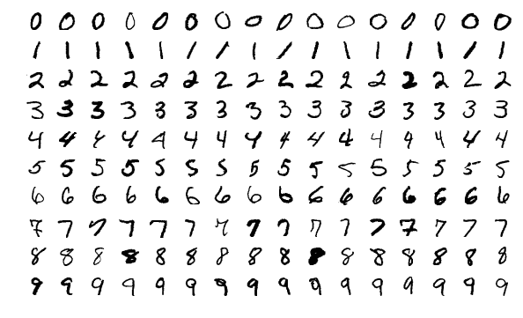
Classification problems
Hand written digits in 28x28 black/white pixels
With 10 output neutrons answering the question: is it 0? is it 1? …, is it 9?
60000 for a training set, 10000 examples for testing set.
Notes:
From MNIST dataset.

Slide 9
Network
x₁
y₀
x₂
y₁
The input “2” is a 28x28 bitmap of x_{i} of 0 and 1 of 784 numbers.
…
…
…
x₇₈₄
y₉
The predicted digit is j such that y_{j} is a maximum, i.e., y gives a score for each of the 10 possibilities. The last step does not apply the F function.

Slide 10
Hinge loss function
Example: Given an image for 2, the 10 outputs (scores), let’s say, are 10, 2, 8, …, 13 for j = 0, 1, .., 9. Clearly, j = 2 should be the correct answer. Let take Δ=1. Then the loss is max(0, 10-8+1) + max(0,2-8+1) + … + max(0,13-8+1) = 3 + 6 = 9. {Incorrect scores get a large penalty}
The learning algorithm tries to minimize total L summed over each sample i with a “regularization” term:
Notes:
Lambda is called super-parameter and is not changed.

Slide 11
Softmax or cross-entropy loss
Softmax method for judging the correctness of result is given by the following formula for the i-th sample. We can interpret P_{j} as a probability of having value j.

Slide 12
Update the network
The steepest descent or (stochastic) gradient descent
W
Notes:
To evaluate the gradient efficiently we use something called back propagation on the network.

Slide 13
The gradient

Slide 14
Preventing under-fit and over-fit by adjust λ
Notes:
From “Deep learning”, Goodfellow, et al, page 119.

Slide 15
Convolutional network
Convolutional networks are simply neural networks that use convolution in place of general matrix multiplication (Wx) in at least one of their layers.
Pooling: replace the results by some static
Notes:
From Figure 9.8 in Goodfellow, et al, page 358.

Slide 16
Convolution
Convolution in math sense
x₁
x₂
x₃
Each neuron is connected to only three inputs based on locality. Three weights w₁, w₂, w₃ are the same on all of the neurons.
…
x₇₈₄

Slide 17
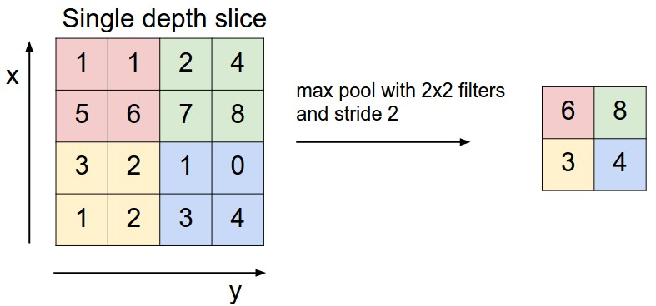
Max Pool
This is very much like the real space RG transform in physics.
Notes:
From http://cs231n.github.io/convolutional-networks/

Slide 18
Tensorflow
TensorFlow is an open source software library from google for high performance numerical computation.
an open-source machine learning library for research and production.
In Python, C++, javaScript

Slide 19
Q&A
T
hanks!

