Slide 1


TensorFlow Quick Tutorial
TF02-TensorFlow and Keras
Hsueh-Ting Chu

Slide 2

TensorFlow and Keras

Slide 3
Keras
Model
the Sequential model (a linear stack of layers)
Model class used with the functional API. (given input/output tensors)
Layer
Core Layers
Convolutional Layers
Pooling Layers
Recurrent Layers
Embedding Layers

Slide 4
Keras core layers
Dense: regular densely-connected NN layer.
Activation: Applies an activation function to an output.
Dropout: Setting some input to 0 during training time.
Flatten: Flattens the input.
Input: Instantiate a Keras tensor.
Reshape: Reshapes an output to a certain shape.

Slide 5
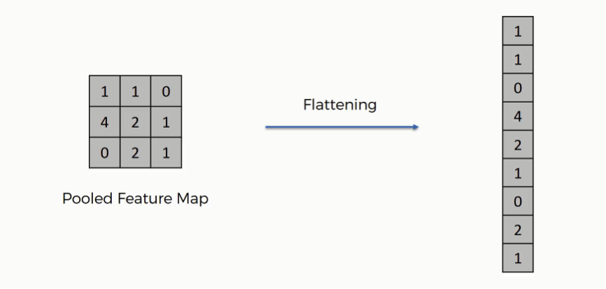
Flatten

Slide 6
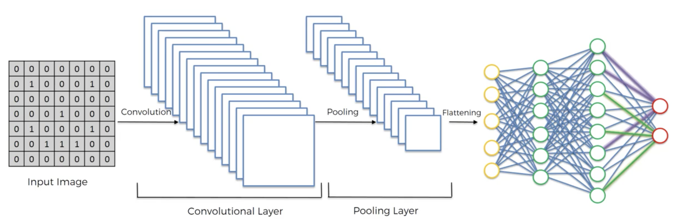
Convolutional Layer and Pooling Layer

Slide 7
Convolutional Layer and Pooling Layer
Conv1D
Conv2D
MaxPooling1D
MaGlobalMaxPooling2D
xPooling2D
GlobalMaxPooling1D
GlobalAveragePooling1D
GlobalMaxPooling2D
GlobalAveragePooling2D

Slide 8
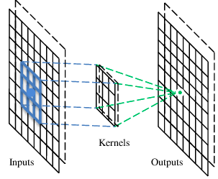
Convolution
1 | -1 | -1
-1 | 1 | -1
-1 | -1 | 1
Filter 1
stride=1
Beak detector
1 | 0 | 0 | 0 | 0 | 1
0 | 1 | 0 | 0 | 1 | 0
0 | 0 | 1 | 1 | 0 | 0
1 | 0 | 0 | 0 | 1 | 0
0 | 1 | 0 | 0 | 1 | 0
0 | 0 | 1 | 0 | 1 | 0
Dot
product
3
-1
A filter
6 x 6 image

Slide 9
Max Pooling
1 | -1 | -1
-1 | 1 | -1
-1 | -1 | 1
-1 | 1 | -1
-1 | 1 | -1
-1 | 1 | -1
Filter 1
Filter 2
3
-1
-3
-1
-1
-1
-1
-1
-3
1
0
-3
-1
-1
-2
1
-3
-3
0
1
-1
-1
-2
1
3
-2
-2
-1
-1
0
-4
3

Slide 10
Keras Loss, Metrics and Opimizer
A Loss function: mean_squared_error, crossentropy, hinge loss, softmax loss
A metric: categorical_accuracy
Optimizers
SGD: Stochastic gradient descent optimizer
RMSprop: RMSProp optimizer
Adam: Adam optimizer.

Slide 11
Keras Activation Layer
softmax: Softmax activation function.
elu: Exponential linear unit.
relu: Rectified Linear Unit.
tanh: Hyperbolic tangent activation function.
sigmoid: Sigmoid activation function.
exponential: Exponential activation function.
linear: Linear (i.e. identity) activation function.

Slide 12
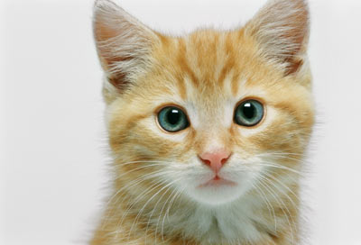
The whole CNN
3
0
-1
1
Convolution
3
1
0
3
Max Pooling
Can repeat many times
A new image
Convolution
Smaller than the original image
The number of channels is the number of filters
Max Pooling

Slide 13
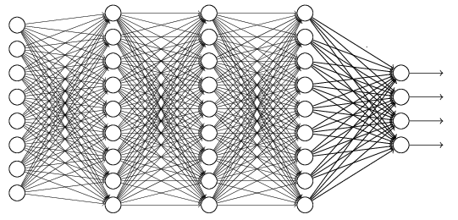
The whole CNN
cat dog ……
Convolution
Max Pooling
Fully Connected Feedforward network
A new image
Convolution
Max Pooling
Flattened
A new image

Slide 14
Flattening
3
0
1
3
0
-1
1
3
3
1
-1
0
3
Flattened
1
Fully Connected Feedforward network
0
3

Slide 15


CNN in Keras
Only modified the network structure and input format (vector -> 3-D tensor)
input
Convolution
1 | -1 | -1
-1 | 1 | -1
-1 | -1 | 1
-1 | 1 | -1
-1 | 1 | -1
-1 | 1 | -1
There are 25 3x3 filters.
……
Max Pooling
Input_shape = ( 28 , 28 , 1)
28 x 28 pixels
1: black/white, 3: RGB
Convolution
3
-1
3
Max Pooling
-3
1

Slide 16
CNN in Keras
Only modified the network structure and input format (vector -> 3-D array)
Input
1 x 28 x 28
Convolution
How many parameters for each filter?
9
25 x 26 x 26
Max Pooling
25 x 13 x 13
Convolution
How many parameters
for each filter?
225=
25x9
50 x 11 x 11
Max Pooling
50 x 5 x 5

Slide 17
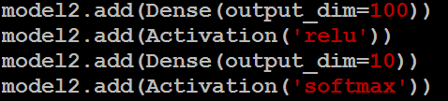
CNN in Keras
Only modified the network structure and input format (vector -> 3-D array)
Input
1 x 28 x 28
Output
Convolution
25 x 26 x 26
Fully connected feedforward network
Max Pooling
25 x 13 x 13
Convolution
50 x 11 x 11
Max Pooling
1250
50 x 5 x 5
Flattened

Slide 18
Q&A
T
hanks!

