Slide 1
Condor-G
A Quick Introduction
Alan De Smet
Condor Project
University of Wisconsin - Madison

Slide 2

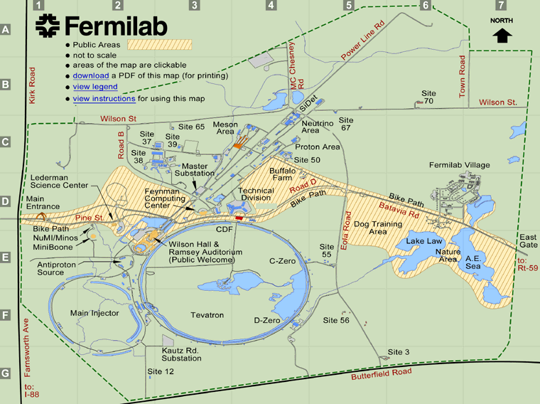
Condor-G
“I want to hand jobs to someone else, but still manage them locally”
Earth from NASA
http://en.wikipedia.org/wiki/File:Winkel-tripel-projection.jpg
Map of Fermilab
http://www.fnal.gov/pub/visiting/map/site.html

Slide 3
Condor-G
Globus, CREAM, remote Condor, Nordugrid, Unicore, PBS, LSF
Condor-G only does the technical side. You’ll need to get permission for these resources.
Submit Computer
Remote Computer
Condor-G
job1, 2, 3…
Globus, Condor, CREAM, etc…

Slide 4
Condor-G to Globus
Submit Computer
Remote Computer
Condor-G
job1
job2
job3
…
globus-gatekeeper
Condor, or PBS, or LSF, or …
Compute Cluster

Slide 5

Identity and Authorization
Who are you?
Are you allowed to use these computers?
Fermilab uses Kerberos
Globus uses x509 certificates and proxies
“Mystery Man” © 2006 srqpix. Used under Creative Commons License
http://www.flickr.com/photos/crobj/134829197/

Slide 6

x509 Certificates
Your x509 certificate is like your online passport.
“Indian passport” © 2009 Robol Goraya used under a Creative Commons license
http://www.flickr.com/photos/codenamerob/3627395035/

Slide 7
x509 Certificates at Fermilab
Fermilab will make one based on our Kerberos.
  $ kx509
  $ kxlist -p
  Service kx509/certificate
  issuer= /DC=gov/DC=fnal/O=Fermilab/OU=Certificate Authorities/CN=Kerberized CA HSM
  subject= /DC=gov/DC=fnal/O=Fermilab/OU=People/CN=Alan A. De smet/CN=UID:adesmet
  serial=01C05555
  hash=e7635e83
Valid for 1 week. No prob, make a new one!

Slide 8
x509 Certificates Elsewhere
Many groups issue x509 certificates
Many US research organizations use the DOE Grids Certificate Authority
Typically renewed yearly
You can make your own
  But like a passport from Alanland, no one likely to accept it.

Slide 9
x509 Proxies
You frequently need to hand your certificate to remote servers.
What if the remote server is compromised!
Having your x509 certificate stolen is bad!
To limit risk, you make “Proxies:” short lived, limited copies.

Slide 10
x509 VOMS Proxies
Your proxy can be signed by a “Virtual Organization Membership Service” or VOMS.
Grants specific permissions at some grid sites.
A sort of entrance visa for the grid.

Slide 11
Proxy Management Tools
Basic proxy tools
  grid-proxy-init
  grid-proxy-info
  grid-proxy-destroy
Or with VOMS support
  voms-proxy-init
  voms-proxy-info
  voms-proxy-destroy

Slide 12
voms-proxy-init
Creates a proxy
$ voms-proxy-init
Enter GRID pass phrase:
Your identity: /DC=org/DC=doegrids/OU=People/CN=Alan De Smet 949996
Creating proxy .................................... Done
Your proxy is valid until Fri Jul 23 04:45:47 2010

Slide 13
voms-proxy-init -valid
Only valid for 12 hours by default
-valid hours:minutes
$ voms-proxy-init -valid 168:0
Enter GRID pass phrase:
Your identity: /DC=org/DC=doegrids/OU=People/CN=Alan De Smet 949996
Creating proxy ............................... Done
Your proxy is valid until Thu Jul 29 16:47:12 2010

Slide 14
voms-proxy-init –voms
Doesn’t come with VOMS attributes by default, you need to ask for them.
-voms

Slide 15
voms-proxy-init -voms
$ voms-proxy-init -valid 24:0 -voms fermilab:/fermilab
Enter GRID pass phrase:
Your identity: /DC=org/DC=doegrids/OU=People/CN=Alan De Smet 949996
Creating temporary proxy .................... Done
Contacting voms.fnal.gov:15001 [/DC=org/DC=doegrids/OU=Services/CN=http/voms.fnal.gov] "fermilab" Done
Creating proxy ............................... Done
Your proxy is valid until Fri Jul 23 16:48:50 2010

Slide 16
voms-proxy-info
$ voms-proxy-info –all
subject : /DC=org/DC=doegrids/OU=People/CN=Alan De Smet 949996/CN=proxy
issuer : /DC=org/DC=doegrids/OU=People/CN=Alan De Smet 949996
identity : /DC=org/DC=doegrids/OU=People/CN=Alan De Smet 949996
type : proxy
strength : 1024 bits
path : /tmp/x509up_u3014
timeleft : 23:59:43
=== VO fermilab extension information ===
VO : fermilab
subject : /DC=org/DC=doegrids/OU=People/CN=Alan De Smet 949996
issuer : /DC=org/DC=doegrids/OU=Services/CN=http/voms.fnal.gov
attribute : /fermilab/Role=NULL/Capability=NULL
attribute : /fermilab/nees/Role=NULL/Capability=NULL
timeleft : 23:59:43
uri : voms.fnal.gov:15001
Need -all to see the VOMS information.

Slide 17
voms-proxy-destroy
$ voms-proxy-destroy
$ voms-proxy-info -all
Couldn't find a valid proxy.

Slide 18
Resource names (At least Globus)
Identify the remote server
fgitbgkc2.fnal.gov/jobmanager-condor
fgitbgkc2.fnal.gov/jobmanager-fork
  Don't abuse fork! Generally don't use!

Slide 19
globusrun -a -r
Very low level Globus tool.
We're using it as a basic check
$ globusrun -a -r fgitbgkc2.fnal.gov/jobmanager-fork
GRAM Authentication test successful

Slide 20
Run a very simple job
Must already by on remote server!
$ globus-job-run fgitbgkc2.fnal.gov/jobmanager-fork /bin/hostname
fgitbgkc2.fnal.gov
$ globus-job-run fgitbgkc2.fnal.gov/jobmanager-fork /bin/date
Sun Jul 25 15:11:03 CDT 2010

Slide 21
Running a job by hand
% globus-job-submit fgitbgkc2.fnal.gov/jobmanager-fork /bin/date
https://fgitbgkc2.fnal.gov:44282/7815/1279835873/
% globus-job-status https://fgitbgkc2.fnal.gov:44282/7815/1279835873/
DONE
% globus-job-get-output https://fgitbgkc2.fnal.gov:44282/7815/1279835873/
Thu Jul 22 16:57:53 CDT 2010
% globus-job-clean https://fgitbgkc2.fnal.gov:44282/7815/1279835873/
WARNING: Cleaning a job means:
- Kill the job if it still running, and
- Remove the cached output on the remote resource
Are you sure you want to cleanup the job now (Y/N) ?
Y
Not designed for bulk work

Slide 22
Old Condor job
executable = my_program
output = output.txt
error = error.txt
log = log.txt
notification = never
universe = vanilla
queue

Slide 23
New Condor-G job
executable = my_program
output = output.txt
error = error.txt
log = log.txt
notification = never
universe = grid
grid_resource = gt2 fgitbgkc2.fnal.gov/jobmanager-fork
queue

Slide 24
Where's my output?
universe=grid doesn't know.
transfer_output_files=a_file,another_file
Error if a file is missing!
  touch a_file another_file
  Then add to your submit file
  transfer_input_files=a_file,another_file

Slide 25
Proxy updates
Jobs taking longer than your proxy's lifespan? Just update your proxy occasionally, Condor will handle it.

Slide 26
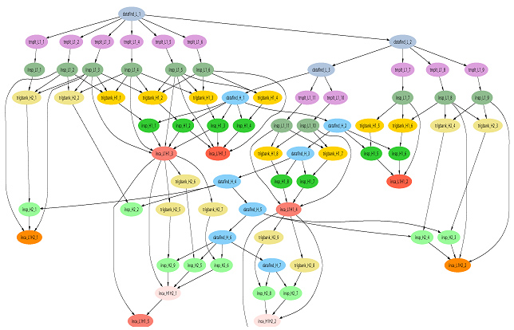
Scaling Up
Can manage ten of thousands of jobs
Can manage complex workflows with DAGMan
Actual workflow for LIGO http://www.isgtw.org/?pid=1000449

Slide 27
Scaling Up
Can automatically use multiple grid sites
  powerful, but complex, see "Matchmaking in the Grid Universe" in the Condor manual
Automatic recovery for many problems
Includes optimizations to reduce network traffic and gatekeeper load

