Slide 1
MW – A framework to support master-worker style applications
Overview
Challenges
Directions
C
ondor
http://www.cs.wisc.edu/condor/mw

Slide 2
What’s MW?
An OO framework for building master-worker style parallel applications
  in a distributed opportunistic environment.
  Supports multiple infrastructures
    Condor, PVM, Globus, etc
  Provides multiple message passing implementations
    PVM, File, Socket, memcpy()
  Handles fault and environment dynamism
    Worker management (join/leaving/suspension/resume)
    Checkpointing and restarting
http://www.cs.wisc.edu/condor/mw

Slide 3
Why MW?
It’s simple
    hides the complexity of distributing & managing parallel computation in meta-computing environments;
    Scientists can focus on their algorithms;
It’s inexpensive
    using hundreds of machines for free;
It solves hard scientific problems
    Nug30 (hard optimization problem) solved in 6 days;
    Large stochastic programming problems (8.5M rows and 35M columns)

Slide 4
MW’s layered architecture
Application classes
API
MW abstract classes
MW
App.
IPI
M
W
Infrastructure Provider’s Interface
Resource Mgr
Message Passing Layer
Underlying infrastructure

Slide 5
MW’s Runtime Structure
Master Process
Worker
Process
ToDo
tasks
Running
tasks
Workers
Worker
Process
……
Worker
Process
Tasks are communicated between the master and workers;
A task is generated and added into Todo list, then sent to an idle worker (Todo -> Running), performed by the worker, and finally sent back to the master with result.

Slide 6
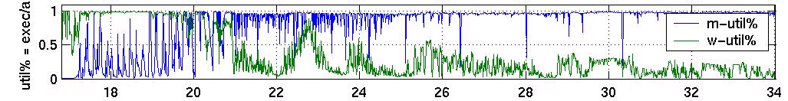
MW Challenges (1)
Scalability
  Can the master manage hundreds of workers?
    He can be easily overwhelmed by only 200 workers :-(
  How about thousands of workers?
    The NUG 30 pool had 2510 processors!
Adaptability
  How to adapt with changing network connectivity/host load?
  How to adapt the worker number with pool utilization?
  How to exploit the heterogeneity of workers and tasks?

Slide 7
MW Challenges (2)
Error handling
  How to correctly propagate error messages across different layers/components?
  How to unify the error handling mechanisms used by different software layers?
  How to make the error reports persistent when remote process is down? How to gather and analyze them?
Smarter Scheduling
  How to assign tasks to suitable workers?
  How to schedule a “task cluster”?
  How to adapt the policy when situation changes?

Slide 8
MW Challenges (3)
Performance measurement
  We know little about MW’s performance
  To collect performance info at runtime
  To predict future performance based on the recent past
Software Engineering
  What API should be exposed to the application?
  How to debug MW applications?
    First use a single-process version to screen bugs; and then ??
  Test suite (documentation/examples) needed.
These challenges are common to many meta-computing software!

Slide 9
Future directions
To collect more information, and understand/formulate the problems;
To make MW more robust, efficient,
and easy-to-use;
To use MW as a test-bed for solving common meta-computing problem;
To solve more and harder computation problems!

