Slide 1
Using Condor
An Introduction
FermiLab July 2010

Slide 2
The Condor Project (Established ‘85)
Research and Development in the Distributed High Throughput Computing field
Team of ~35 faculty, full time staff and students
  Face software engineering challenges in a distributed UNIX/Linux/NT environment
  Are involved in national and international grid collaborations
  Actively interact with academic and commercial entities and users
  Maintain and support large distributed production environments
  Educate and train students

Slide 3
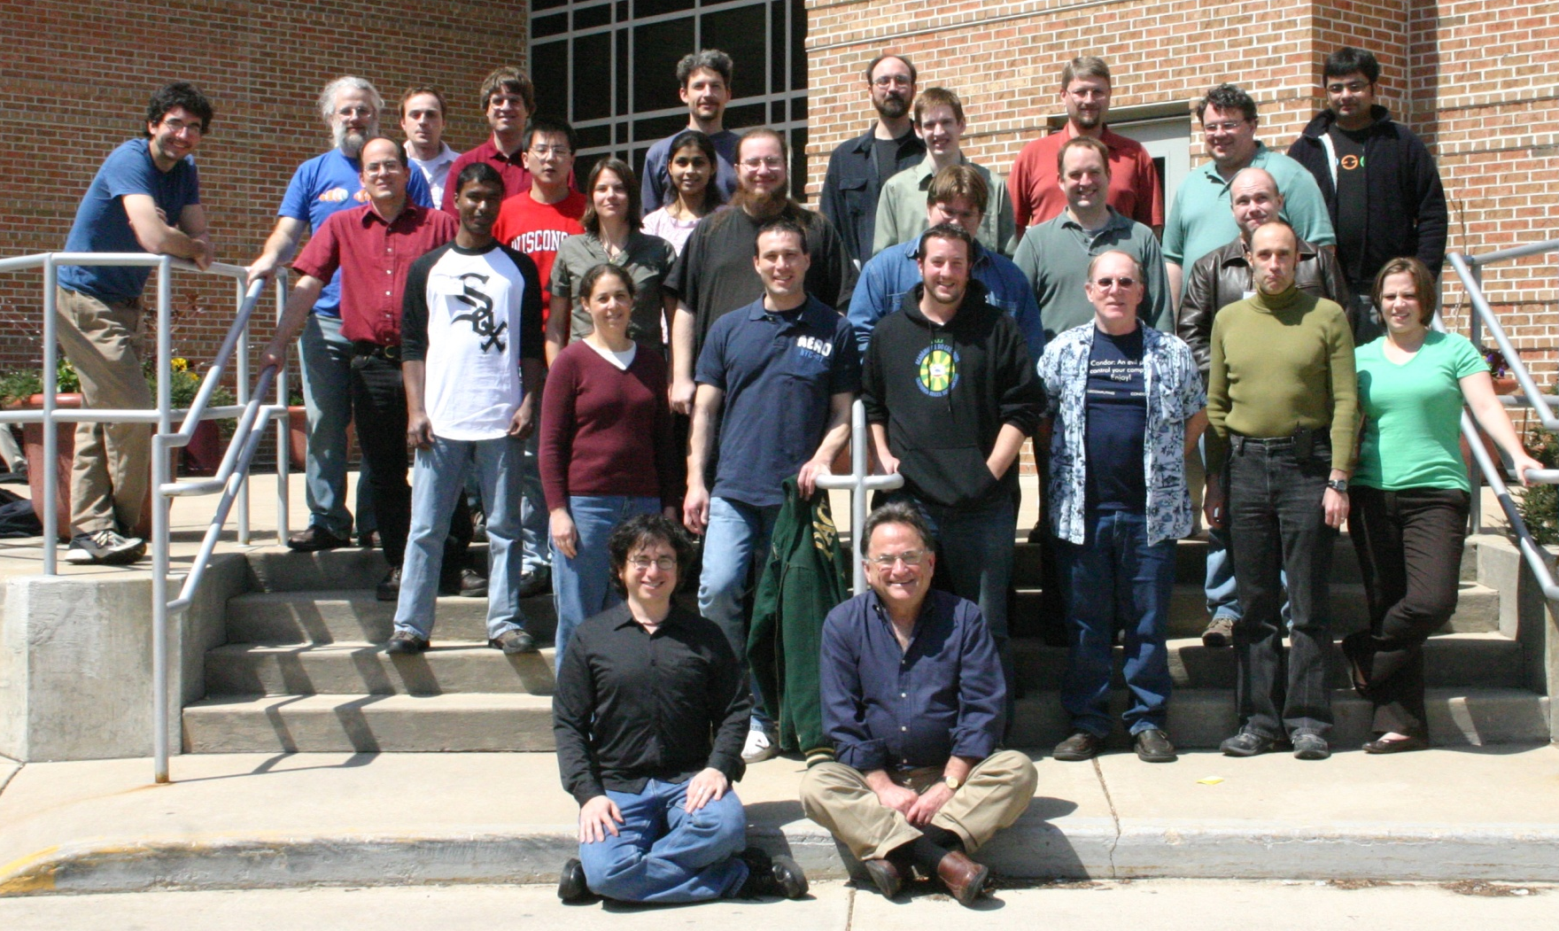
The Condor Team

Slide 4
Some free software produced by the Condor Project
Condor System
VDT
Metronome
ClassAd Library
DAGMan
GCB & CCB
MW
NeST / LotMan
And others… all as open source

Slide 5
High-Throughput Computing
High-Throughput Computing:
  Allows for many computational tasks to be done over a long period of time
  Concerned largely with the number of compute resources that are available to people who wish to use the system
  Very useful system for researchers and other users who are more concerned with the number of computations they can do over long spans of time than they are with short-burst computations

Slide 6
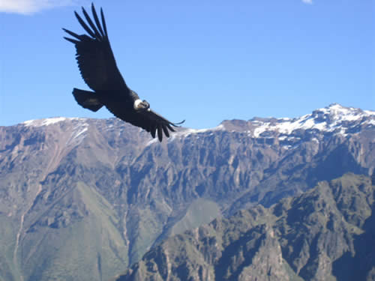
Condor

Slide 7
What is Condor?
Classic High-Throughput Computing system
An integral part of many computational grids around the world

Slide 8
Full featured system
Flexible scheduling policy engine via ClassAds
  Preemption, suspension, requirements, preferences, groups, quotas, settable fair-share, system hold…
Facilities to manage BOTH dedicated CPUs (clusters) and non-dedicated resources (desktops)
Transparent Checkpoint/Migration for many types of serial jobs
No shared file-system required
Federate clusters w/ a wide array of Grid Middleware

Slide 9
Full featured system
Workflow management (inter-dependencies)
Support for many job types – serial, parallel, etc.
Fault-tolerant: can survive crashes, network outages, no single point of failure.
Development APIs: via SOAP / web services, DRMAA (C), Perl package, GAHP, flexible command-line tools, MW
Platforms:
  Linux i386 / IA64 / X86-64 / PPC
  Windows XP / Vista / 7
  MacOS X
  Solaris
  HP-UX
  AIX

Slide 10

The Problem
Our esteemed scientist, while visiting Madison, needs to run a “small” simulation.

Slide 11

The Simulation
Run a simulation of the evolution of the cosmos with various properties

Slide 12
The Simulation Details
Varying values for the value of:
  G (the gravitational constant): 100 values
  Rμν (the cosmological constant): 100 values
  c (the speed of light): 100 values
  100 × 100 × 100 = 1,000,000 jobs

Slide 13
Running the Simulation
Each simulation:
  Requires up to 4GB of RAM
  Requires 20MB of input
  Requires 2 – 500 hours of computing time
  Produces up to 10GB of output
Estimated total:
  15,000,000 hours!
  1,700 compute YEARS
  10 Petabytes of output

Slide 14
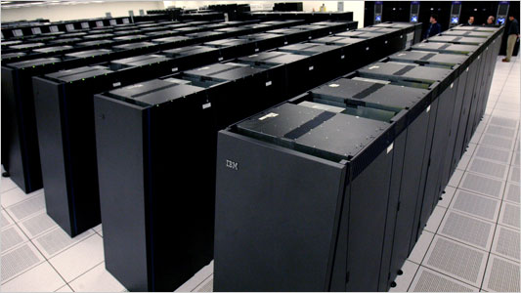
NSF won’t fund the Blue Gene that I requested.

Slide 15

While sharing a beverage with some colleagues, Carl asks “Have you tried Condor? It’s free, available for you to use, and you can use our CHTC pool. Condor's been used to run billions and billions of jobs.”

Slide 16
Condor and CHTC
Center for High Throughput Computing
  Approved in August 2006
  Numerous resources at its disposal to keep up with the computational needs of UW Madison
  These resources are being funded by:
    National Institute of Health (NIH)
    Department of Energy (DOE)
    National Science Foundation (NSF)
    Various grants from the University itself

Slide 17
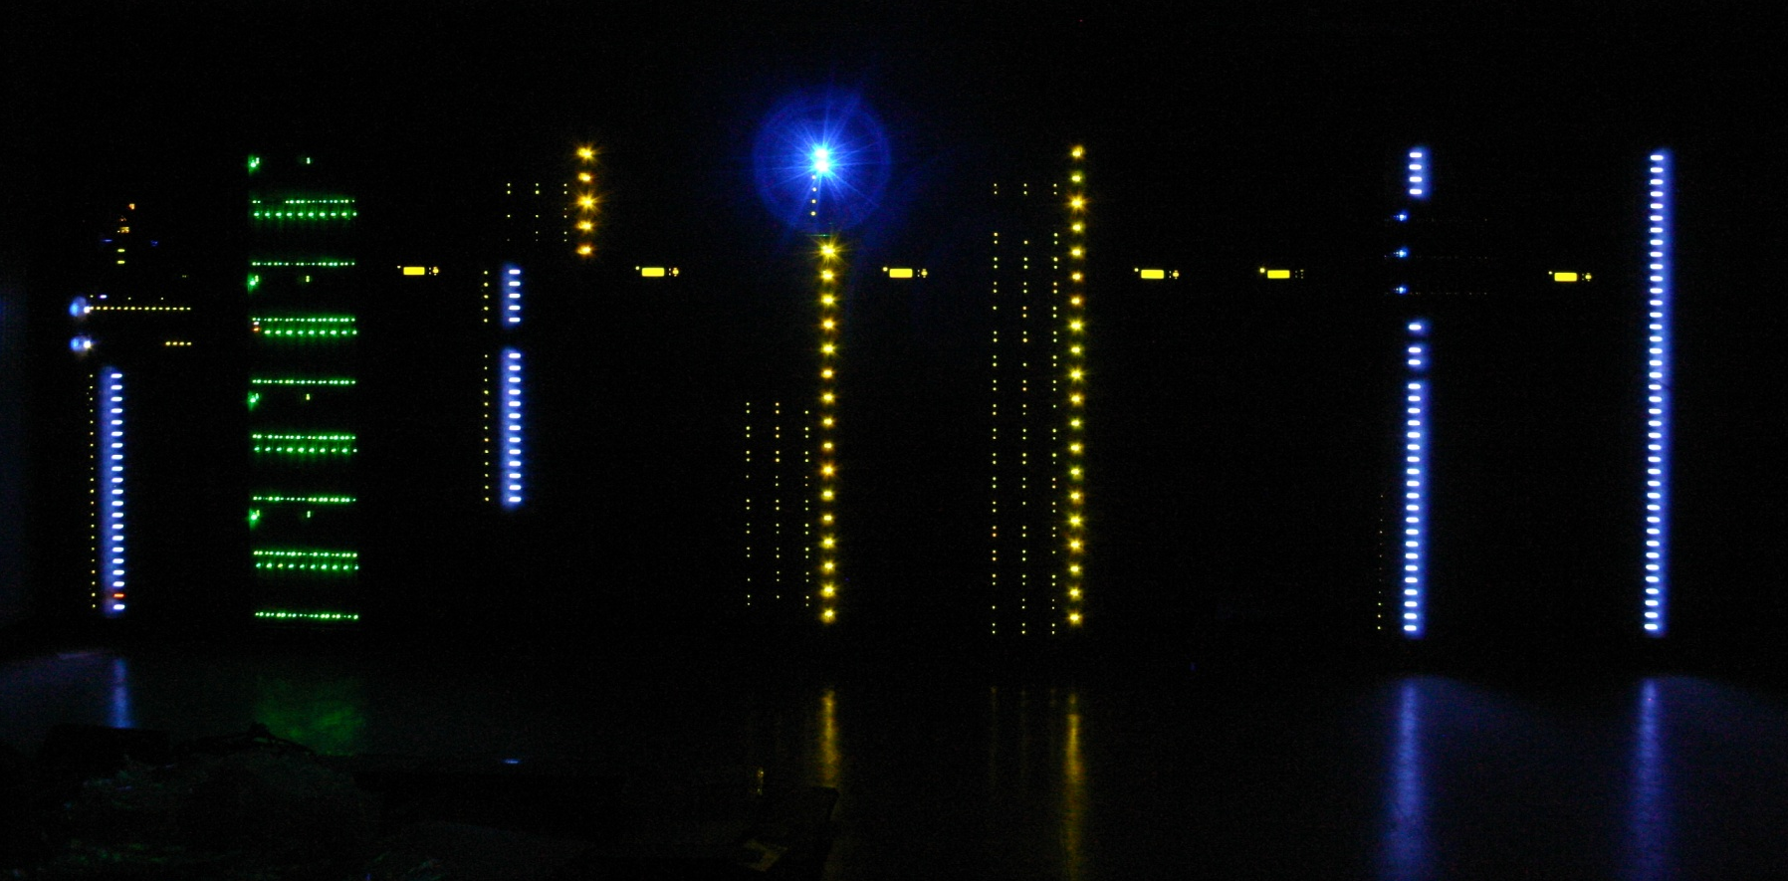
B240
One of the CTHC Clusters

Slide 18
But... Will my jobs be safe?
No worries!!
  Condor will take care of your jobs for you
  Jobs are queued in a safe way
    More details later
  Condor will make sure that your jobs run, return output, etc.
    You can even specify what defines “OK”
  Like money in the (FDIC insured) bank

Slide 19
Condor will ...
Keep an eye on your jobs and will keep you posted on their progress
Implement your policy on the execution order of the jobs
Keep a log of your job activities
Add fault tolerance to your jobs
Implement your policy on when the jobs can run on your workstation

Slide 20

Condor Doesn’t Play Dice with My Universes!

Slide 21
Definitions
Job
  The Condor representation of your work (next slide)
Machine
  The Condor representation of computers and that can perform the work
ClassAd
  Condor’s internal data representation
Match Making
  Matching a job with a machine “Resource”
Central Manager
  Central repository for the whole pool
  Performs job / machine matching, etc.

Slide 22
Job
Condor’s quanta of work
  Like a UNIX process
  Can be an element of a workflow

Slide 23
Jobs Have Wants & Needs
Jobs state their requirements and preferencs:
  Requirements:
    I require a Linux/x86 platform
  Preferences ("Rank"):
    I prefer the machine with the most memory
    I prefer a machine in the chemistry department

Slide 24
Machines Do Too!
Machines specify:
  Requirements:
    Require that jobs run only when there is no keyboard activity
    Never run jobs belonging to Dr. Heisenberg
  Preferences ("Rank"):
    I prefer to run Albert’s jobs
  Custom Attributes:
    I am a machine in the physics department

Slide 25

Condor ClassAds

Slide 26
What is a ClassAd?
Condor’s internal data representation
  Similar to a classified ad in a paper
    Their namesake
  Represent an object & its attributes
    Usually many attributes
  Can also describe what an object matches with

Slide 27
ClassAd Types
Condor has many types of ClassAds
  A "Job Ad" represents your job to Condor
  A "Machine Ad" represents the various compute resources in your Condor pool
  Others represent other pieces of your Condor pool

Slide 28
ClassAds Explained
ClassAds can contain a lot of details
  The job’s executable is “cosmos”
  The machine’s load average is 5.6
ClassAds can specify requirements
  My job requires a machine with Linux
ClassAds can specify preferences
  This machine prefers to run jobs from the physics group

Slide 29
ClassAd Structure
ClassAds are:
  semi-structured
  user-extensible
  schema-free
ClassAd contents:
  Attribute = Value
  Attribute = Expression

Slide 30
The Pet Exchange
Pet Ad
Type = “Dog”
Color = “Brown”
Price = 75
Sex = "Male"
AgeWeeks = 8
Breed = "Saint Bernard"
Size = "Very Large"
Weight = 27
Buyer Ad
. . .
Requirements =
(Type == “Dog”) &&
(Price <= 100) &&
( Size == "Large" ||
Size == "Very Large" )
Rank =
(Breed == "Saint Bernard")
. . .

Slide 31
The Magic of Matchmaking
The Condor "match maker" matches Job Ads with Machine Ads
  Requirements:
    Enforces both machine AND job requirements expressions
  Preferences:
    Considers both job AND machine rank expressions
  Priorities:
    Takes into account user and group priorities

Slide 32
Back to our Simulation..

Slide 33
Getting Started:
Submitting Jobs to Condor
Get access to submit host
Choose a “Universe” for your job
Make your job “batch-ready”
  Includes making your data available to your job
Create a submit description file
Run condor_submit to put your job(s) in the queue
Relax while Condor manages and watches over your job(s)

Slide 34
Access to CHTC
(UW Specific)
Send email to chtc@cs.wisc.edu
An account will be set up for you
ssh into our submit head node:
  From UNIX / Linux:
    ssh einstein@submit.chtc.wisc.edu
  From Windows:
    Install Putty or similar SSH client
    Use Putty to ssh into submit.cht.wisc.edu

Slide 35
If You’re not at UW…
Work with your Condor Administrator to get access
Login to your Condor submit host…

Slide 36

2. Choose the “Universe”
Controls how Condor handles jobs
Condors many universes include:
  Vanilla
  Standard
  Grid
  Java
  Parallel
  VM

Slide 37

Using the Vanilla Universe
Allows running almost any “serial” job
Provides automatic file transfer, etc.
Like vanilla ice cream
  Can be used in just about any situation

Slide 38

3. Make your job batch-ready
Must be able to run in the background
No interactive input
No GUI/window clicks
  We don't need no stinkin' mouse!
No music ;^)

Slide 39
Batch-Ready:
Input & Output
Job can still use STDIN, STDOUT, and STDERR (the keyboard and the screen), but files are used for these instead of the actual devices
Similar to UNIX shell:
$ ./myprogram <input.txt >output.txt

Slide 40
Make your Data Available
Condor can:
  Transfer your data files to your job
  Transfer your results files back from your job
You need to:
  Put your data files in a place where Condor can access them

Slide 41
4. Create a Submit Description File
A plain ASCII text file
Condor does not care about file extensions
  Most people use ".sub" or ".submit", though
Tells Condor about your job:
  Which executable, universe, input, output and error files to use, command-line arguments, environment variables, any special requirements or preferences (more on this later)
Can describe many jobs at once (a “cluster”), each with different input, arguments, output, etc.

Slide 42
Input, output & error files
Controlled by submit file settings
You can define the job’s standard input, standard output and standard error:
  Read job’s standard input from “input_file”:
    Input = input_file
    Shell equivalent: $ program <input_file
  Write job’s standard ouput to “output_file”:
    Output = output_file
    Shell equivalent: $ program >output_file
  Write job’s standard error to “error_file”:
    Error = error_file
    Shell equivalent: $ program 2>error_file

Slide 43
Simple Submit File
# Simple condor_submit input file
# (Lines beginning with # are comments)
# NOTE: the words on the left side are not
# case sensitive, but filenames are!
Universe = vanilla
Executable = cosmos ·Job's executable
Output = cosmos.out ·Job's STDOUT
Input = cosmos.in ·Job's STDIN
Log = cosmos.log ·Log the job's activities
Queue ·Put the job in the queue!

Slide 44
Logging your Job's Activities
Create a log of job events
Add to submit description file:
log = cosmos.log
The Life Story of a Job
  Shows all events in the life of a job
Always have a log file

Slide 45
Sample Condor User Log
000 (0101.000.000) 05/25 19:10:03 Job submitted from host: <128.105.146.14:1816>
...
001 (0101.000.000) 05/25 19:12:17 Job executing on host: <128.105.146.14:1026>
...
005 (0101.000.000) 05/25 19:13:06 Job terminated.
(1) Normal termination (return value 0)
...

Slide 46
5. Submit the Job to Condor
Run condor_submit:
  Provide the name of the submit file you have created on the command line:
  condor_submit:
    Parses the submit file, checks for errors
    Creates one or more job ad(s) that describes your job(s)
    Hands the job ad(s) off to the schedd
$ condor_submit cosmos.submit

Slide 47
The Job Ad
Example:
MyType = "Job"
TargetType = "Machine"
ClusterId = 1
ProcId = 0
IsPhysics = True
Owner = "einstein"
Cmd = "cosmos“
Requirements = (Arch == "INTEL")
…
String
Number
Boolean
Boolean
Expression

Slide 48
Submitting The Job
[einstein@submit ~]$ condor_submit cosmos.submit-file
Submitting job(s).
2 job(s) submitted to cluster 100.
[einstein@submit ~]$ condor_q
-- Submitter: submit.chtc.wisc.edu : <128.104.55.9:51883> : submit.chtc.wisc.edu
ID OWNER SUBMITTED RUN_TIME ST PRI SIZE CMD
1.0 sagan 7/22 14:19 172+21:28:36 H 0 22.0 checkprogress.cron
2.0 heisenberg 1/13 13:59 0+00:00:00 I 0 0.0 env
3.0 hawking 1/15 19:18 0+04:29:33 H 0 0.0 script.sh
4.0 hawking 1/15 19:33 0+00:00:00 H 0 0.0 script.sh
5.0 hawking 1/15 19:33 0+00:00:00 H 0 0.0 script.sh
6.0 hawking 1/15 19:34 0+00:00:00 H 0 0.0 script.sh
...
96.0 bohr 4/5 13:46 0+00:00:00 I 0 0.0 c2b_dops.sh
97.0 bohr 4/5 13:46 0+00:00:00 I 0 0.0 c2b_dops.sh
98.0 bohr 4/5 13:52 0+00:00:00 I 0 0.0 c2b_dopc.sh
99.0 bohr 4/5 13:52 0+00:00:00 I 0 0.0 c2b_dopc.sh
100.0 einstein 4/5 13:55 0+00:00:00 I 0 0.0 cosmos
557 jobs; 402 idle, 145 running, 10 held
[einstein@submit ~]$

Slide 49
The Job Queue
condor_submit sends your job’s ClassAd(s) to the schedd
The schedd (more details later):
  Manages the local job queue
  Stores the job in the job queue
    Atomic operation, two-phase commit
    “Like money in the (FDIC insured) bank”
View the queue with condor_q

Slide 50
CHTC Condor Pool
Other user’s jobs
Einstein’s new job
submit.chtc.wisc.edu
CHTC
[einstein@submit ~]$
submit
cm
cosmos.sub
Job
Queue
$ condor_submit
Job Ad
Condor
schedd

Slide 51
Condor File Transfer Lists
Transfer_Input_Files
  List of files that you want Condor to transfer to the execute machine
Transfer_Output_Files
  List of files that you want Condor to transfer from the execute machine
  If not specified, Condor will transfer back all “new” files in the execute directory

Slide 52
Condor File Transfer Controls
ShouldTransferFiles
  YES: Always transfer files to execution site
  NO: Always rely on a shared filesystem
  IF_NEEDED: Condor will automatically transfer the files if the submit and execute machine are not in the same FileSystemDomain (Use shared file system if available)
When_To_Transfer_Output
  ON_EXIT: Transfer the job's output files back to the submitting machine only when the job completes
  ON_EXIT_OR_EVICT: Like above, but also when the job is evicted

Slide 53
Simple File Transfer Example
# Example submit file using file transfer
Universe = vanilla
Executable = cosmos
Log = cosmos.log
ShouldTransferFiles = IF_NEEDED
Transfer_input_files = cosmos.dat
Transfer_output_files = results.dat
When_To_Transfer_Output = ON_EXIT
Queue

Slide 54
Need Command Line Args?
You can specify command line arguments to pass to your program with the arguments directive:
arguments = -arg1 -arg2 foo
# Example submit file with command line arguments
Universe = vanilla
Executable = cosmos
Arguments = -c 299792458 –G 6.67300e-112 -f cosmos.dat
log = cosmos.log
Input = cosmos.in
Output = cosmos.out
Error = cosmos.err
Queue

Slide 55
InitialDir
With InitialDir, you can give jobs a directory with respect to file input and output.
Also provides a directory (on the submit machine) for the user log, when a full path is not specified.
Executable is not relative to InitialDir
# Example submit input file with InitialDir
Universe = vanilla
InitialDir = /home/einstein/cosmos/run
Executable = cosmos ·NOT Relative to InitialDir
Log = cosmos.log ·Is Relative to InitialDir
Input = cosmos.in ·Is Relative to InitialDir
Output = cosmos.out ·Is Relative to InitialDir
Error = cosmos.err ·Is Relative to InitialDir
TransferInputFiles=cosmos.dat ·Is Relative to InitialDir
Arguments = -f cosmos.dat
Queue

Slide 56
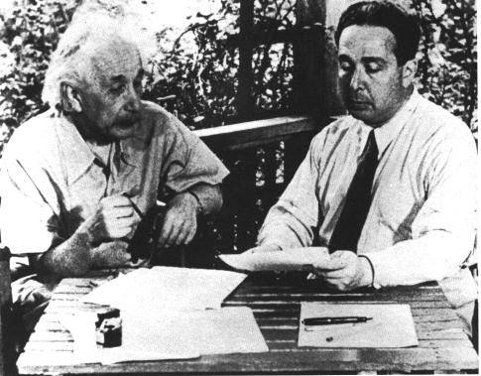
Need More Feedback?
Condor sends email about job events to the submitting user
Specify “notification” in your submit file to control which events:
Notification = complete
Notification = never
Notification = error
Notification = always
Default

Slide 57
Jobs, Clusters, and Processes
If your submit file describes multiple jobs, we call this a “cluster”
Each cluster has a “cluster number”
  The cluster number is unique to the schedd
Each individual job in a cluster is called a “process”
  Process numbers always start at zero
A Condor “Job ID” is the cluster number, a period, and the process number (i.e. 2.1)
  A cluster can have a single process
    Job ID = 20.0 ·Cluster 20, process 0
  Or, a cluster can have more than one process
    Job IDs: 21.0, 21.1, 21.2 ·Cluster 21, process 0, 1, 2

Slide 58
Submit File for a Cluster
# Example submit file for a cluster of 2 jobs
# with separate input, output, error and log files
Universe = vanilla
Executable = cosmos
Arguments = -f cosmos_0.dat
log = cosmos_0.log
Input = cosmos_0.in
Output = cosmos_0.out
Error = cosmos_0.err
Queue ·Job 102.0 (cluster 102, process 0)
Arguments = -f cosmos_1.dat
log = cosmos_1.log
Input = cosmos_1.in
Output = cosmos_1.out
Error = cosmos_1.err
Queue ·Job 102.1 (cluster 102, process 1)

Slide 59
Submitting The Job
[einstein@submit ~]$ condor_submit cosmos.submit-file
Submitting job(s).
2 job(s) submitted to cluster 101.
[einstein@submit ~]$ condor_q
-- Submitter: submit.chtc.wisc.edu : <128.104.55.9:51883> : submit.chtc.wisc.edu
ID OWNER SUBMITTED RUN_TIME ST PRI SIZE CMD
1.0 sagan 7/22 14:19 172+21:28:36 H 0 22.0 checkprogress.cron
2.0 heisenberg 1/13 13:59 0+00:00:00 I 0 0.0 env
3.0 hawking 1/15 19:18 0+04:29:33 H 0 0.0 script.sh
4.0 hawking 1/15 19:33 0+00:00:00 H 0 0.0 script.sh
5.0 hawking 1/15 19:33 0+00:00:00 H 0 0.0 script.sh
6.0 hawking 1/15 19:34 0+00:00:00 H 0 0.0 script.sh
...
102.0 einstein 4/5 13:55 0+00:00:00 I 0 0.0 cosmos –f cosmos.dat
102.1 einstein 4/5 13:55 0+00:00:00 I 0 0.0 cosmos –f cosmos.dat
557 jobs; 402 idle, 145 running, 10 held
[einstein@submit ~]$

Slide 60
1,000,000 jobs...
We could put all input, output, error & log files in the one directory
  One of each type for each job
  4,000,000+ files (4 files × 1,000,000 jobs)
  Submit file: 6,000,000+ lines, ~128M
  Difficult (at best) to sort through
Better: Create a subdirectory for each run
  Take advantage of InitialDir directive

Slide 61

Organize your files and directories for big runs
Create subdirectories for each “run”
  run_0, run_1, … run_999999
Create input files in each of these
  run_0/(cosmos.in,cosmos.dat)
  run_1/(cosmos.in,cosmos.dat)
  …
  run_999999/(cosmos.in,cosmos.dat)
The output, error & log files for each job will be created by Condor from your job’s output

Slide 62
More Data Files
Move the values of G, c & Rμν for each run to a data file
  Let’s call it cosmos.in
  Each run directory would contain a unique cosmos.in file
The common cosmos.dat file could be shared by all jobs
  Can be symlinks to a common file

Slide 63
cosmos.in files
These cosmos.in files can easily be generated programmatically using Python or Perl
run_0/cosmos.in
c = 299792408
G = 6.67300e-112
R = 10.00e−29
run_999998/cosmos.in
c = 299792508
G = 6.67300e-100
R = 10.49e−29
…
run_1/cosmos.in
c = 299792409
G = 6.67300e-112
R = 10.00e−29
run_999999/cosmos.in
c = 299792508
G = 6.67300e-100
R = 10.50e−29

Slide 64
Einstein’s simulation directory
cosmos
cosmos.sub
cosmos.dat
cosmos.in
cosmos.dat ·(symlink)
User or script creates black files
run_0
cosmos.out
cosmos.err
cosmos.log
cosmos.in
cosmos.dat ·(symlink)
Condor creates purple files
for you
run_999999
cosmos.out
cosmos.err
cosmos.log

Slide 65
Submit Description File for 1,000,000 Jobs
# Cluster of 1,000,000 jobs with different directories
Universe = vanilla
Executable = cosmos
Log = cosmos.log
Output = cosmos.out
Input = cosmos.in
Arguments = –f cosmos.dat
TransferInputFiles = cosmos.dat
...
InitialDir = run_0 ·Log, input, output & error files -> run_0
Queue ·Job 103.0 (Cluster 103, Process 0)
InitialDir = run_1 ·Log, input, output & error files -> run_1
Queue ·Job 103.1 (Cluster 103, Process 1)
·Do this 999,998 more times…………

Slide 66
Submit File for a Big Cluster of Jobs
We just submitted 1 cluster with 1,000,000 processes
All the input/output files will be in different directories
The submit file still is pretty unwieldy
  2,000,000+ lines, ~32M
Isn’t there a better way?

Slide 67
The Better Way
We can queue all 1,000,000 in 1 “Queue” directive
  Queue 1000000
Condor provides $(Process) and $(Cluster)
  $(Process) will be expanded to the process number for each job in the cluster
    0, 1, … 999999
  $(Cluster) will be expanded to the cluster number
    Will be the same for all jobs in the cluster
    104 in our example

Slide 68
Using $(Process)
The initial directory for each job can be specified using $(Process)
  InitialDir = run_$(Process)
  Condor will expand these to:
    “run_0”, “run_1”, … “run_999999” directories
Similarly, arguments can be variable
  Arguments = -n $(Process)
  Condor will expand these to:
    “-n 0”, “-n 1”, … “-n 999999”

Slide 69
Better Submit File for 1,000,000 Jobs
# Example condor_submit input file that defines
# a cluster of 100000 jobs with different directories
Universe = vanilla
Executable = cosmos
Log = cosmos.log
Input = cosmos.in
Output = cosmos.out
Error = cosmos.err
Arguments = –f cosmos.dat ·All share arguments
InitialDir = run_$(Process) ·run_0 … run_999999
Queue 1000000 ·Jobs 104.0 … 104.999999

Slide 70
Now, we submit it…
[einstein@submit ~]$ condor_submit cosmos.submit
Submitting job(s) ...............................................................................................................................................................................................................................................................
Logging submit event(s) ...............................................................................................................................................................................................................................................................
1000000 job(s) submitted to cluster 104.

Slide 71
Check the Job Queue
[einstein@submit ~]$ condor_q
-- Submitter: submit.chtc.wisc.edu : <128.104.55.9:51883> : submit.chtc.wisc.edu
ID OWNER SUBMITTED RUN_TIME ST PRI SIZE CMD
104.0 einstein 4/20 12:08 0+00:00:05 R 0 9.8 cosmos –f cosmos.dat
104.1 einstein 4/20 12:08 0+00:00:03 I 0 9.8 cosmos –f cosmos.dat
104.2 einstein 4/20 12:08 0+00:00:01 I 0 9.8 cosmos –f cosmos.dat
104.3 einstein 4/20 12:08 0+00:00:00 I 0 9.8 cosmos –f cosmos.dat
...
104.999998 einstein 4/20 12:08 0+00:00:00 I 0 9.8 cosmos –f cosmos.dat
104.999999 einstein 4/20 12:08 0+00:00:00 I 0 9.8 cosmos –f cosmos.dat
999999 jobs; 999998 idle, 1 running, 0 held

Slide 72
CHTC Condor Pool
Other user’s jobs
Einstein’s jobs
submit.chtc.wisc.edu
CHTC
[einstein@submit ~]$
Job
Queue
submit
cm.chtc.
wisc.edu
cosmos.sub
$ condor_submit
Job Ad
Job Ad
Job Ad
Condor
schedd

Slide 73
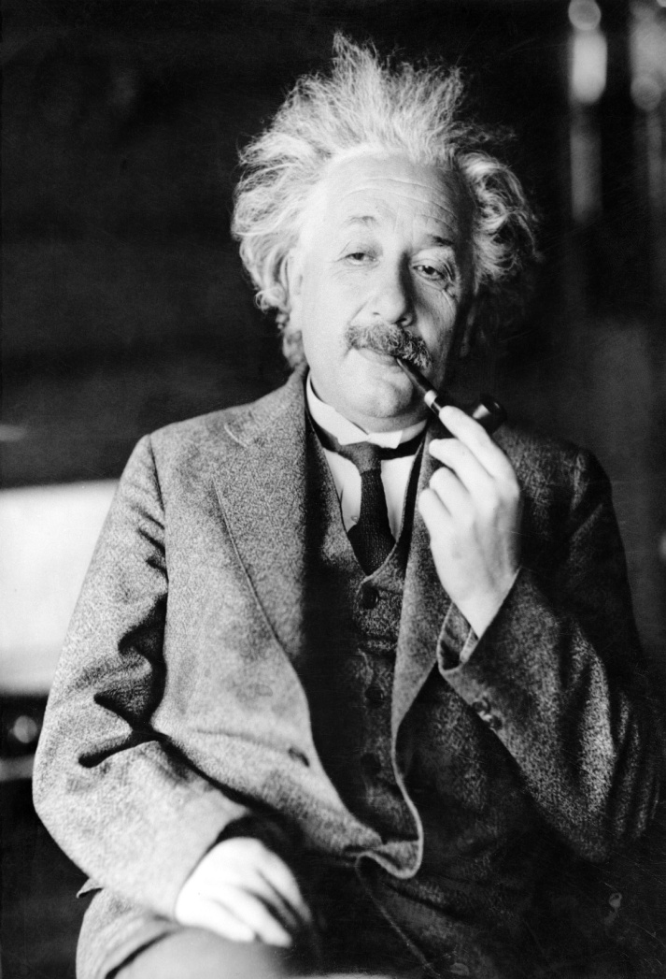
6. Relax
Condor is watching over your jobs
  Will restart them if required, etc.
While I’m waiting…
  Is there more that I can do with Condor?

Slide 74
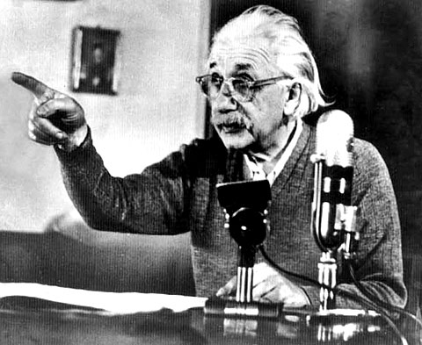
Oh <censored>!!!
My Biggest Blunder Ever
Albert removes Rμν (Cosmological Constant) from his equations, and needs to remove his running jobs
We’ll just ignore that modern cosmologists may have re-introduced Rμν (so called “dark energy”)

Slide 75
Removing Jobs
If you want to remove a job from the Condor queue, you use condor_rm
You can only remove jobs that you own
Privileged user can remove any jobs
  “root” on UNIX
  “administrator” on Windows

Slide 76
Removing jobs (continued)
Remove an entire cluster:
  condor_rm 4 ·Removes the whole cluster
Remove a specific job from a cluster:
  condor_rm 4.0 ·Removes a single job
Or, remove all of your jobs with “-a”
  condor_rm -a ·Removes all jobs / clusters

Slide 77
How can I tell Condor that my jobs are Physics related?
In the submit description file, introduce an attribute for the job
+Department = “physics”
Causes the Job Ad to contain
Department = “physics”
Machines can be configured to:
  Give higher rank to physics jobs
  Pre-empt non-physics jobs when a physics job comes along
  See Alan's "Administering Condor" tutorial for more about machine "policy expressions"

Slide 78
How Can I Control Where my Jobs Run?
Some of the machines in the pool can’t successfully run my jobs
  Not enough RAM
  Not enough scratch disk space
  Required software not installed
  Etc.

Slide 79
Specify Job Requirements
A boolean expression (syntax similar to C or Java)
Must evaluate to True for a match to be made
Universe = vanilla
Executable = cosmos
Log = cosmos.log
InitialDir = run_$(Process)
Input = cosmos.in
Output = cosmos.out
Error = cosmos.err
Requirements = ( (Memory >= 4096) && \
(Disk > 10000) )
Queue 1000000

Slide 80
Advanced Requirements
Requirements can match custom attributes in your Machine Ad
  Can be added by hand to each machine
  Or, automatically using the “Hawkeye” mechanism
Universe = vanilla
Executable = cosmos
Log = cosmos.log
InitialDir = run_$(Process)
Input = cosmos.in
Output = cosmos.out
Error = cosmos.err
Requirements = ((Memory >= 4096) && \
(Disk > 10000) && \
(CosmosData =!= UNDEFINED))
Queue 1000000

Slide 81
CosmosData =!= UNDEFINED ???
What’s this “=!=” and “UNDEFINED” business?
  Is this like the state of Schrödinger’s Cat?
Introducing ClassAd Meta Operators:
  Allow you to test if a attribute is in a ClassAd
  Is identical to operator: “=?=”
  Is not identical to operator: “=!=”
  Behave similar to == and !=, but are not strict
  Somewhat akin to Python’s “is NONE” and “is not NONE”
  Without these, ANY expression with an UNDEFINED in it will always evaluate to UNDEFINED

Slide 82
Meta Operator Examples
Expression | Evaluates to
10 == UNDEFINED | UNDEFINED
UNDEFINED == UNDEFINED | UNDEFINED
10 =?= UNDEFINED | False
UNDEFINED =?= UNDEFINED | True
UNDEFINED =!= UNDEFINED | False

Slide 83
More Meta Operator Examples
Expression | X | Evaluates to
X == 10 | 10 | True
 | 5 | False
 | “ABC” | ERROR
 | * | UNDEFINED
X =!= UNDEFINED | 5 | True
 | 10 | True
 | “ABC” | True
 | * | False
*: X is not present in the ClassAd

Slide 84
One Last Meta Example
Expression | X | Evaluates to
( (X =!= UNDEFINED) && (X == 10) ) Is logically equivalent to: (X =?= 10) | 10 | True
 | 5 | False
 | 11 | False
 | * | False
( (X =?= UNDEFINED) || (X != 10) ) Is logically equivalent to: (X =!= 10) | 10 | False
 | 5 | True
 | 11 | True
 | * | True
*: X is not present in the ClassAd

Slide 85
Using Attributes from the Machine Ad
You can use attributes from the matched Machine Ad in your job submit file
  $$(<attribute>) will be replaced by the value of the specified attribute in the Machine Ad
Example:
  Matching Machine Ad has:
CosmosData = "/local/cosmos/data"
  Submit file has:
Executable = cosmos
Requirements = (CosmosData =!= UNDEFINED)
Arguments = -d $$(CosmosData)
  Resulting command line:
cosmos –d /local/cosmos/data

Slide 86
Specify Job Rank
Rank:
  Numerical expression
  All matches which meet the requirements can be sorted by preference with a Rank expression..
  Higher values match first
Universe = vanilla
Executable = cosmos
Log = cosmos.log
Arguments = -arg1 –arg2
InitialDir = run_$(Process)
Requirements = (Memory >= 4096) && (Disk > 10000)
Rank = (KFLOPS*10000) + Memory
Queue 1000000

Slide 87
Need More Control of Your Job?
Exit status isn't always a good indicator of job success
What if my job gets a signal?
  SIGSEGV
  SIGBUS
...

Slide 88
Job Policy Expressions
User can supply job policy expressions in the submit file.
Can be used to describe a successful run.
on_exit_remove = <expression>
on_exit_hold = <expression>
periodic_remove = <expression>
periodic_hold = <expression>

Slide 89
Job Policy Examples
Do not remove if exits with a signal:
on_exit_remove = ExitBySignal == False
Place on hold if exits with nonzero status or ran for less than an hour:
on_exit_hold =
( (ExitBySignal==False) && (ExitSignal != 0) ) ||
( (ServerStartTime - JobStartDate) < 3600)
Place on hold if job has spent more than 50% of its time suspended:
periodic_hold =
( CumulativeSuspensionTime >
(RemoteWallClockTime / 2.0) )

Slide 90

How can my jobs access their data files?

Slide 91
Access to Data in Condor
Condor can transfer files
  We’ve already seen examples of this
  Can automatically send back changed files
  Atomic transfer of multiple files
  Can be encrypted over the wire
NFS / AFS
HDFS
Remote I/O Socket (parrot)
Standard Universe can use remote system calls (more on this later)

Slide 92
NFS / AFS
Condor can be configured to allow access to NFS and AFS shared resources
AFS is available on most of CHTC
Your program can access /afs/...
Note: Condor runs without AFS credentials
  At UW Computer Sciences, you must grant net:cs access to all Condor job input, output, and log files stored in AFS directories.
  Elsewhere, you'll have to do something similar

Slide 93
I Need to run
LOTS of Short Jobs
Condor is a High Throughput system, designed for long running jobs
Starting a job in Condor is somewhat expensive
There are some configuration parameters that may be able to help
  Contact a Condor staff person for more

Slide 94
What else can I do to run my Short Jobs with Condor?
Batch your short jobs together
  Write a wrapper script that will run a number of them in series
  Submit your wrapper script as your job
Explore Condor’s parallel universe

Slide 95

Parallel Universes

Slide 96
MW: A Master-Worker Grid Toolkit
Provides a mechanism for controlling parallel algorithms
  Fault tolerant
  Allows for resources to come and go
  Ideal for Computational Grid settings
To use, write your software using the MW API
http://www.cs.wisc.edu/condor/mw/

Slide 97
MPI jobs
# Example condor_submit input file that for MPI
# jobs
universe = parallel
executable = mp1script
arguments = my_mpich_linked_executable arg1 arg2
machine_count = 4
should_transfer_files = yes
when_to_transfer_output = on_exit
transfer_input_files = my_mpich_linked_executable
queue

Slide 98
Map Reduce
Condor provides a powerful execution environment for running parallel applications like MPI.
  The Parallel Universe (PU) of Condor is built specifically for this purpose
  The Map-Reduce (MR) is a relatively recent programming model particularly suitable for applications that require processing a large set of data on cluster of computers.
  A popular open-source implementation of MR framework is provided by Hadoop project by apache software foundation.

Slide 99
Map Reduce On Condor
Uses Condor’s Parallel Universe resource manager to select a subset of machines within a cluster
  Sets up a Hadoop MR cluster on these machines
  Submits a MR job and clean-up once the job is finished
  These machines will be available as dedicated resources for the duration of the job
  User can choose which machine should act as a master and communication channels between masters and slave nodes are also established
http://condor-wiki.cs.wisc.edu/index.cgi/wiki?p=MapReduce

Slide 100
Accessing Large Data Sets via HDFS
HDFS
  Allows disk space to be pooled into one resource
  For the CS CHTC cluster, that is on the order of a couple hundred terabytes
Can enable jobs with large I/O to run without filling up the spool on submit machine
However, HDFS has no security so cannot yet be used for sensitive data

Slide 101
HDFS @ CHTC
HDFS on CHTC
  Managed by the condor_hdfs daemon which runs under the condor_master
Command line tools are available to move files in and out of the HDFS
Soon, Condor will support having the SPOOL directory in HDFS
Plugins for Condor’s file transfer will also support HDFS
We're looking into the possibility of an overlay network to solve the security issues.
  Any of Condor's security mechanisms could then be used

Slide 102
We’ve seen how Condor can:
Keep an eye on your jobs
  Keep you posted on their progress
Implement your policy on the execution order of the jobs
Keep a log of your job activities

Slide 103
Using Condor
An Introduction
Part II
FermiLab July 2010

Slide 104
More Issues...
We need more disk space for our jobs
We have users that come and go

Slide 105
Your own Submit Host
Benefits:
  As much disk space as you need
  Manage your own users
Getting Started:
  Download & install appropriate Condor binaries
  "Flock" into CHTC and other campus pools

Slide 106
Getting Condor
Available as a free download from
http://www.cs.wisc.edu/condor
Download Condor for your operating system
  Available for most modern UNIX platforms (including Linux and Apple’s OS/X)
  Also for Windows XP / 2003 / Vista
Repositories
  YUM: RHEL 4 & 5
    $ yum install condor
  APT: Debian 4 & 5
    $ apt-get install condor

Slide 107
Condor Releases
Stable / Developer Releases
  Version numbering scheme similar to that of the (pre 2.6) Linux kernels …
Major.minor.release
  If minor is even (a.b.c): Stable series
    Very stable, mostly bug fixes
    Current: 7.4
    Examples: 7.2.5, 7.4.2
      7.4.2 just released
  If minor is odd (a.b.c): Developer series
    New features, may have some bugs
    Current: 7.5
    Examples: 7.3.2, 7.5.1
      7.5.1 just released

Slide 108
Condor Installation
Albert’s sysadmin installs Condor
  This new submit / manager machine
  On department desktop machines
    Submission points
    Non-dedicated excution machines
      Configured to only run jobs when the machine is idle
  Enables flocking to CHTC and other campus pools

Slide 109

Flocking?
Flocking is a Condor-specific technology
Allows Condor jobs to run in other friendly Condor pools
Needs to be setup on both ends
Can be bi-directional

Slide 110
Flocking to CHTC
Einstein’s jobs
Other user’s jobs
cosmos.phys.wisc.edu
CHTC
einstein@cosmos:~ $
submit
cm.chtc.
wisc.edu
Job
Queue
cosmos.sub
$ condor_submit
Job Ad
Job Ad
Job Ad
Condor
schedd

Slide 111
We STILL Need More
Condor is managing and running our jobs, but:
  Our CPU requirements are greater than our resources
  Jobs are preempted more often than we like

Slide 112

Happy Day! The Physics Department is adding a cluster!
The administrator installs Condor on all these new dedicated cluster nodes

Slide 113
Adding dedicated nodes
The administrator installs Condor on these new machines, and configures them with his machine as the central manager
  The central manager:
    Central repository for the whole pool
    Performs job / machine matching, etc.
These are dedicated nodes, meaning that they're always able run Condor jobs

Slide 114
Flocking to CHTC
Other user’s jobs
Einstein’s jobs
CS CHTC Lab
Physics CHTC Lab
submit
cm.chtc.
wisc.edu
submit
cm.physics
.wisc.edu

Slide 115
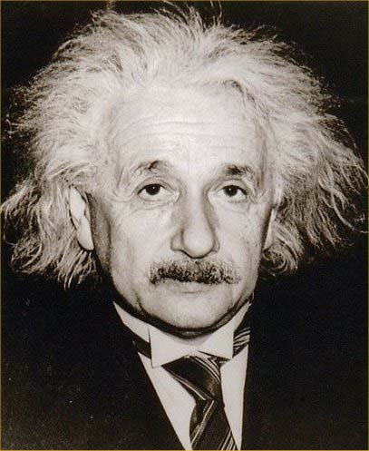
Some Good Questions…
What are all of these Condor Daemons running on my machine?
What do they do?

Slide 116
Condor Daemon Layout
Personal Condor / Central Manager
Master
schedd
negotiator
startd
collector
= Process Spawned

Slide 117
condor_master
Starts up all other Condor daemons
Runs on all Condor hosts
If there are any problems and a daemon exits, it restarts the daemon and sends email to the administrator
Acts as the server for many Condor remote administration commands:
  condor_reconfig, condor_restart
  condor_off, condor_on
  condor_config_val
  etc.

Slide 118
Central Manager:
condor_collector
Central manager: central repository and match maker for whole pool
Collects information from all other Condor daemons in the pool
  “Directory Service” / Database for a Condor pool
  Each daemon sends a periodic update ClassAd to the collector
Services queries for information:
  Queries from other Condor daemons
  Queries from users (condor_status)
Only on the Central Manager(s)
At least one collector per pool

Slide 119
Condor Pool Layout: Collector
= Process Spawned
Central Manager
= ClassAd
Communication
Pathway
Master
negotiator
Collector

Slide 120
Central Manager:
condor_negotiator
Performs “matchmaking” in Condor
Each “Negotiation Cycle” (typically 5 minutes):
  Gets information from the collector about all available machines and all idle jobs
  Tries to match jobs with machines that will serve them
  Both the job and the machine must satisfy each other’s requirements
Only one Negotiator per pool
  Ignoring HAD
Only on the Central Manager(s)

Slide 121
Condor Pool Layout: Negotiator
= Process Spawned
Central Manager
= ClassAd
Communication
Pathway
Master
negotiator
Collector

Slide 122
Execute Hosts:
condor_startd
Execute host: machines that run user jobs
Represents a machine to the Condor system
Responsible for starting, suspending, and stopping jobs
Enforces the wishes of the machine owner (the owner’s “policy”… more on this in the administrator’s tutorial)
Creates a “starter” for each running job
One startd runs on each execute node

Slide 123
Condor Pool Layout: startd
= Process Spawned
Cluster Node
= ClassAd
Communication
Pathway
Central Manager
Master
Master
startd
negotiator
Cluster Node
schedd
Master
Collector
startd
Workstation
Workstation
Master
Master
schedd
schedd
startd
startd

Slide 124
Submit Hosts:
condor_schedd
Submit hosts: machines that users can submit jobs on
Maintains the persistent queue of jobs
Responsible for contacting available machines and sending them jobs
Services user commands which manipulate the job queue:
  condor_submit, condor_rm, condor_q, condor_hold, condor_release, condor_prio, …
Creates a “shadow” for each running job
One schedd runs on each submit host

Slide 125
Condor Pool Layout: schedd
= Process Spawned
Cluster Node
= ClassAd
Communication
Pathway
Central Manager
Master
Master
startd
negotiator
Cluster Node
schedd
Master
Collector
startd
Workstation
Workstation
Master
Master
schedd
schedd
startd
startd

Slide 126
Condor Pool Layout: master
= Process Spawned
Cluster Node
= ClassAd
Communication
Pathway
Central Manager
Master
Master
startd
negotiator
Cluster Node
schedd
Master
Collector
startd
Cluster Node
Cluster Node
Master
Master
schedd
schedd
startd
startd

Slide 127
What about these “condor_shadow” processes?
The Shadow processes are Condor’s local representation of your running job
  One is started for each job
Similarly, on the “execute” machine, a condor_starter is run for each job

Slide 128
Condor Pool Layout: running a job
= Process Spawned
Submit Host
= Communication
Pathway
Master
schedd
shadow
shadow
shadow
Execute Host
Execute Host
Master
Master
startd
startd
starter
starter
starter
Job
Job
Job

Slide 129

My jobs aren’t running!!

Slide 130
Check the queue
Check the queue with condor_q:
[einstein@submit ~]$ condor_q
-- Submitter: x.cs.wisc.edu : <128.105.121.53:510> :x.cs.wisc.edu
ID OWNER SUBMITTED RUN_TIME ST PRI SIZE CMD
5.0 einstein 4/20 12:23 0+00:00:00 I 0 9.8 cosmos -arg1 –n 0
5.1 einstein 4/20 12:23 0+00:00:00 I 0 9.8 cosmos -arg1 –n 1
5.2 einstein 4/20 12:23 0+00:00:00 I 0 9.8 cosmos -arg1 –n 2
5.3 einstein 4/20 12:23 0+00:00:00 I 0 9.8 cosmos -arg1 –n 3
5.4 einstein 4/20 12:23 0+00:00:00 I 0 9.8 cosmos -arg1 –n 4
5.5 einstein 4/20 12:23 0+00:00:00 I 0 9.8 cosmos -arg1 –n 5
5.6 einstein 4/20 12:23 0+00:00:00 I 0 9.8 cosmos -arg1 –n 6
5.7 einstein 4/20 12:23 0+00:00:00 I 0 9.8 cosmos -arg1 –n 7
6.0 einstein 4/20 13:22 0+00:00:00 H 0 9.8 cosmos -arg1 –arg2
8 jobs; 8 idle, 0 running, 1 held

Slide 131
Look at jobs on hold
[einstein@submit ~]$ condor_q –hold
-- Submiter: submit.chtc.wisc.edu : <128.105.121.53:510> :submit.chtc.wisc.edu
ID OWNER HELD_SINCE HOLD_REASON
6.0 einstein 4/20 13:23 Error from starter on skywalker.cs.wisc.edu
9 jobs; 8 idle, 0 running, 1 held
Or, See full details for a job
[einstein@submit ~]$ condor_q –l 6.0

Slide 132
Check Machine's Status
[einstein@submit ~]$ condor_status
Name OpSys Arch State Activity LoadAv Mem ActvtyTime
slot1@c002.chtc.wi LINUX X86_64 Claimed Busy 1.000 4599 0+00:10:13
slot2@c002.chtc.wi LINUX X86_64 Claimed Busy 1.000 1024 1+19:10:36
slot3@c002.chtc.wi LINUX X86_64 Claimed Busy 0.990 1024 1+22:42:20
slot4@c002.chtc.wi LINUX X86_64 Claimed Busy 1.000 1024 0+03:22:10
slot5@c002.chtc.wi LINUX X86_64 Claimed Busy 1.000 1024 0+03:17:00
slot6@c002.chtc.wi LINUX X86_64 Claimed Busy 1.000 1024 0+03:09:14
slot7@c002.chtc.wi LINUX X86_64 Claimed Busy 1.000 1024 0+19:13:49
...
vm1@INFOLABS-SML65 WINNT51 INTEL Owner Idle 0.000 511 [Unknown]
vm2@INFOLABS-SML65 WINNT51 INTEL Owner Idle 0.030 511 [Unknown]
vm1@INFOLABS-SML66 WINNT51 INTEL Unclaimed Idle 0.000 511 [Unknown]
vm2@INFOLABS-SML66 WINNT51 INTEL Unclaimed Idle 0.010 511 [Unknown]
vm1@infolabs-smlde WINNT51 INTEL Claimed Busy 1.130 511 [Unknown]
vm2@infolabs-smlde WINNT51 INTEL Claimed Busy 1.090 511 [Unknown]
Total Owner Claimed Unclaimed Matched Preempting Backfill
INTEL/WINNT51 104 78 16 10 0 0 0
X86_64/LINUX 759 170 587 0 0 1 0
Total 863 248 603 10 0 1 0

Slide 133
Look in the Job Log
Look in your job log for clues:
[einstein@submit ~]$ cat cosmos.log
000 (031.000.000) 04/20 14:47:31 Job submitted from host: <128.105.121.53:48740>
...
007 (031.000.000) 04/20 15:02:00 Shadow exception!
Error from starter on gig06.stat.wisc.edu: Failed to open '/scratch.1/einstein/workspace/v67/condor-test/test3/run_0/cosmos.in' as standard input: No such file or directory (errno 2)
0 - Run Bytes Sent By Job
0 - Run Bytes Received By Job
...

Slide 134
Still not running?
Exercise a little patience
On a busy pool, it can take a while to match and start your jobs
Wait at least a negotiation cycle or two (typically a few minutes)

Slide 135
Let Condor help:
condor_q –analyze
[einstein@submit ~]$ condor_q -ana 29
The Requirements expression for your job is:
( (target.Memory > 8192) ) && (target.Arch == "INTEL") &&
(target.OpSys == "LINUX") && (target.Disk >= DiskUsage) &&
(TARGET.FileSystemDomain == MY.FileSystemDomain)
Condition Machines Matched Suggestion
--------- ----------- -------- -----------
1 ( ( target.Memory > 8192 ) ) 0 MODIFY TO 4000
2 ( TARGET.FileSystemDomain == "cs.wisc.edu" )584
3 ( target.Arch == "INTEL" ) 1078
4 ( target.OpSys == "LINUX" ) 1100
5 ( target.Disk >= 13 ) 1243

Slide 136
Learn about available resources:
[einstein@submit ~]$ condor_status –const 'Memory > 8192'
(no output means no matches)
[einstein@submit ~]$ condor_status -const 'Memory > 4096'
Name OpSys Arch State Activ LoadAv Mem ActvtyTime
vm1@s0-03.cs. LINUX X86_64 Unclaimed Idle 0.000 5980 1+05:35:05
vm2@s0-03.cs. LINUX X86_64 Unclaimed Idle 0.000 5980 13+05:37:03
vm1@s0-04.cs. LINUX X86_64 Unclaimed Idle 0.000 7988 1+06:00:05
vm2@s0-04.cs. LINUX X86_64 Unclaimed Idle 0.000 7988 13+06:03:47
Total Owner Claimed Unclaimed Matched Preempting
X86_64/LINUX 4 0 0 4 0 0
Total 4 0 0 4 0 0

Slide 137
It’s Still not Working
Verify that the submitted job runs stand alone
  We’ve had many cases in which users blame Condor, but haven’t tried running it outside of Condor

Slide 138
Interact With Your Job
Why is my job still running?
Is it stuck accessing a file?
Is it in an infinite loop?
Try this: $ condor_ssh_to_job
  Interactive debugging in UNIX
  Use ps, top, gdb, strace, lsof, …
  Forward ports, X, transfer files, etc.

Slide 139
Interactive Debug Example
einstein@phy:~$ condor_q
-- Submitter: cosmos.phy.wisc.edu : <128.105.165.34:1027> :
ID OWNER SUBMITTED RUN_TIME ST PRI SIZE CMD
1.0 einstein 4/15 06:52 1+12:10:05 R 0 10.0 cosmos
1 jobs; 0 idle, 1 running, 0 held
[einstein@submit ~]$ condor_ssh_to_job 1.0
Welcome to slot4@c025.chtc.wisc.edu!
Your condor job is running with pid(s) 15603.
$ gdb –p 15603
…

Slide 140
My new jobs can run for 20 days…
What happens when a job is forced off it’s CPU?
  Preempted by higher priority user or job
  Vacated because of user activity
How can I add fault tolerance to my jobs?

Slide 141
Condor’s Standard Universe to the rescue!
Support for transparent process checkpoint and restart
Remote system calls (remote I/O)
  Your job can read / write files as if they were local

Slide 142
Remote System Calls in
the Standard Universe
I/O system calls are trapped and sent back to the submit machine
Examples: open a file, write to a file
No source code changes typically required
Programming language independent

Slide 143
Process Checkpointing in the
Standard Universe
Condor’s process checkpointing provides a mechanism to automatically save the state of a job
The process can then be restarted from right where it was checkpointed
  After preemption, crash, etc.

Slide 144
Checkpointing:
Process Starts
checkpoint: the entire state of a program, saved in a file
  CPU registers, memory image, I/O
time

Slide 145
Checkpointing:
Process Checkpointed
time
1
2
3

Slide 146
Checkpointing:
Process Killed
Killed!
time
3
3

Slide 147
Checkpointing:
Process Resumed
goodput
badput
goodput
time
3
3

Slide 148
When will Condor checkpoint your job?
Periodically, if desired
  For fault tolerance
When your job is preempted by a higher priority job
When your job is vacated because the execution machine becomes busy
When you explicitly run condor_checkpoint, condor_vacate, condor_off or condor_restart command

Slide 149
Making the Standard Universe Work
The job must be relinked with Condor’s standard universe support library
To relink, place condor_compile in front of the command used to link the job:
% condor_compile gcc -o myjob myjob.c
- OR -
% condor_compile f77 -o myjob filea.f fileb.f
- OR -
% condor_compile make –f MyMakefile

Slide 150
Limitations of the
Standard Universe
Condor’s checkpointing is not at the kernel level.
  Standard Universe the job may not:
    Fork()
    Use kernel threads
    Use some forms of IPC, such as pipes and shared memory
Must have access to source code to relink
Many typical scientific jobs are OK
Only available on Linux platforms

Slide 151
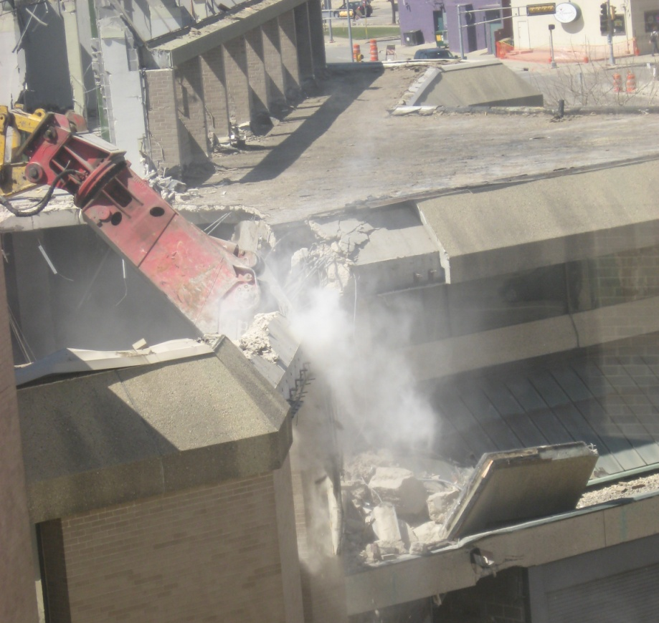
Death of the
Standard Universe

Slide 152
DMTCP & Parrot
DMTCP (Checkpointing)
  “Distributed MultiThreaded Checkpointing”
  Developed at Northeastern University
  http://dmtcp.sourceforge.net/
  See Gene Cooperman's (Northeastern University) talk tomorrow @ 2:20
Parrot (Remote I/O)
  “Parrot is a tool for attaching existing programs to remote I/O system”
  Developed by Doug Thain (now at Notre Dame)
  http://www.cse.nd.edu/~ccl/software/parrot/
  dthain@nd.edu

Slide 153
VM Universe
Runs a virtual machine instance as a job
VM Universe:
  Job sandboxing
  Checkpoint and migration
  Safe elevation of privileges
  Cross-platform

Slide 154
More on VM Universe
Supports VMware, Xen, KVM
Input files can be imported as CD-ROM image
When VM shuts down, modified disk image is returned as job output

Slide 155
Example VMware Job
This example uses the vmware_dir command to identify the location of the disk image to be executed as a Condor job.
The contents of this directory are transferred to the machine assigned to execute the Condor job.
See Jaime’s talk at 4:30 today for lots more!
universe = vm
executable = vmware_sample_job
log = simple.vm.log.txt
vm_type = vmware
vm_memory = 64
vmware_dir = C:\condor-test
vmware_should_transfer_files = True
queue

Slide 156
Albert meets The Grid
Albert also has access to grid resources he wants to use
  He has certificates and access to Globus or other resources at remote institutions
But Albert wants Condor’s queue management features for his jobs!
He installs Condor so he can submit “Grid Universe” jobs to Condor

Slide 157






“Grid” Universe
All handled in your submit file
Supports a number of “back end” types:
  Globus: GT2, GT4
  NorduGrid
  UNICORE
  Condor
  PBS
  LSF
  EC2
  NQS

Slide 158
Grid Universe & Globus 2
Used for a Globus GT2 back-end
  “Condor-G”
Format:
Grid_Resource = gt2 Head-Node
Globus_rsl = <RSL-String>
Example:
Universe = grid
Grid_Resource = gt2 beak.cs.wisc.edu/jobmanager
Globus_rsl = (queue=long)(project=atom-smasher)

Slide 159
Grid Universe & Globus 4
Used for a Globus GT4 back-end
Format:
Grid_Resource = gt4 <Head-Node> <Scheduler-Type>
Globus_XML = <XML-String>
Example:
Universe = grid
Grid_Resource = gt4 beak.cs.wisc.edu Condor
Globus_xml = <queue>long</queue><project>atom-smasher</project>

Slide 160
Grid Universe & Condor
Used for a Condor back-end
  “Condor-C”
Format:
Grid_Resource = condor <Schedd-Name> <Collector-Name>
Remote_<param> = <value>
  “Remote_” part is stripped off
Example:
Universe = grid
Grid_Resource = condor beak condor.cs.wisc.edu
Remote_Universe = standard

Slide 161
Grid Universe & NorduGrid
Used for a NorduGrid back-end
Grid_Resource = nordugrid <Host-Name>
Example:
Universe = grid
Grid_Resource = nordugrid ngrid.cs.wisc.edu

Slide 162
Grid Universe & UNICORE
Used for a UNICORE back-end
Format:
Grid_Resource = unicore <USite> <VSite>
Example:
Universe = grid
Grid_Resource = unicore uhost.cs.wisc.edu vhost

Slide 163
Grid Universe & PBS
Used for a PBS back-end
Format:
Grid_Resource = pbs
Example:
Universe = grid
Grid_Resource = pbs

Slide 164
Grid Universe & LSF
Used for a LSF back-end
Format:
Grid_Resource = lsf
Example:
Universe = grid
Grid_Resource = lsf

Slide 165
Credential Management
Condor will do The Right Thing™ with your X509 certificate and proxy
Override default proxy:
  X509UserProxy = /home/einstein/other/proxy
Proxy may expire before jobs finish executing
  Condor can use MyProxy to renew your proxy
  When a new proxy is available, Condor will forward the renewed proxy to the job
  This works for non-grid jobs, too

Slide 166
JobRouter
A Flexible Job Transformer
Acts upon jobs in queue
Policy controls when
    (jobs currently routed to site X) < max
    (idle jobs routed to site X) < max
    (rate of recent failure at site X) < max
And how
    change attribute values (e.g. Universe)
    insert new attributes (e.g. GridResource)
    other arbitrary actions in hooks
Dan, Condor Week 2008

Slide 167
Example: sending excess vanilla jobs to a grid site
original (vanilla) job
routed (grid) job
Universe = “vanilla”
Executable = “sim”
Arguments = “seed=345”
Output = “stdout.345”
Error = “stderr.345”
ShouldTransferFiles = True
WhenToTransferOutput = “ON_EXIT”
Universe = “grid”
GridType = “gt2”
GridResource = \
“cmsgrid01.hep.wisc.edu/jobmanager-condor”
Executable = “sim”
Arguments = “seed=345”
Output = “stdout”
Error = “stderr”
ShouldTransferFiles = True
WhenToTransferOutput = “ON_EXIT”
JobRouter
Routing Table:
Site 1
…
Site 2
…
final status
Dan, Condor Week 2008

Slide 168
JobRouter vs. Glidein
Glidein - Condor overlays the grid
  Job never waits in remote queue
  Full job management (e.g. condor_ssh_to_job)
  Private networks doable, but add to complexity
  Need something to submit glideins on demand
JobRouter
  Some jobs wait in remote queue (MaxIdleJobs)
  Job must be compatible with target grid semantics
  Job managed by remote batch system
  Simple to set up, fully automatic to run
Dan, Condor Week 2008

Slide 169
Condor Universes:
Scheduler and Local
Scheduler Universe
  Plug in a meta-scheduler
  Similar to Globus’s fork job manager
  Developed for DAGMan (next slides)
Local
  Very similar to vanilla, but jobs run on the local host
  Has more control over jobs than scheduler universe

Slide 170
My jobs have have dependencies…
Can Condor help solve my dependency problems?

Slide 171
Workflows – Launch and Forget
A single workflow can take days, weeks or even months
Automates tasks user could perform manually…
  But WMS takes care of automatically
Includes features such as retries in the case of failures – avoids the need for user intervention
The workflow itself can include error checking
The result: one user action can utilize many resources while maintaining complex job inter-dependencies and data flows
Maximizes compute resources / human time
Notes:
Kent added 080501 as per Miron’s request

Slide 172
Pegasus WMS
Workflow Description in XML
Properties
Replica Catalog
Pegasus
Workflow
Mapper
Site Catalog
TeraGrid
Open Science Grid Campus resources
Local machine
Transformation
Catalog
Condor
DAGMan
Condor
Schedd
Submit Host
Pegasus WMS restructures and optimizes the workflow, provides reliability

Slide 173
DAGMan Configuration
Condor configuration files
Environment variables:
  _CONDOR_<macroname>
DAGMan configuration file
condor_submit_dag command line
Notes:
Kent changed 080129 – moved this slide to agree better with exercises

Slide 174
Submit the DAG
Run:
  condor_submit_dag <file>
Creates a Condor submit file for DAGMan
Also submits it to Condor
  Unless –no_submit option is given
-f option forces overwriting of existing files

Slide 175
Condor Monitoring
Monitoring your DAG
  condor_q [–dag] [name]
  dagman.out file
[einstein@submit ~]$ condor_q –dag train15
-- Submitter: einstein@cosmos.phys.wisc.edu : <128.9.72.178:43684>
ID OWNER/NODENAME SUBMITTED RUN_TIME ST PRI SIZE CMD
1860.0 train15 5/31 10:59 0+00:00:26 R 0 9.8 condor_dagman -f -
1861.0 |-Setup 5/31 10:59 0+00:00:12 R 0 9.8 nodejob Setup node
2 jobs; 0 idle, 2 running, 0 held
Notes:
Kent changed 080430; also deleted following 2 slides
Kent changed 080415 – changed title

Slide 176
Exercise 2.6 - A simple DAG
Generate
Findrange
Findrange
Analyze

Slide 177
DAG file
Defines the DAG shown previously
Node names are case-sensitive
Keywords are not case-sensitive
# Simple DAG file.
JOB Generate generate.submit
JOB Findrange1 findrange1.submit
JOB Findrange2 findrange2.submit
JOB Analyze analyze.submit
PARENT Generate CHILD Findrange1 Findrange2
PARENT Findrange1 Findrange2 CHILD Analyze

Slide 178
DAG node
PRE script
Condor or
Stork job
Node
POST script
Treated as a unit
Job or POST script determines node success or failure

Slide 179
PRE/POST in DAGMan scripts
SCRIPT PRE|POST node script [arguments]
All scripts run on submit machine
If PRE script fails, node fails w/o running job or POST script (for now…)
If job succeeds or fails, POST script is run
If POST script fails, node fails
Special macros:
  $JOB
  $RETRY
  $JOBID (POST only)
  $RETURN (POST only)
Notes:
Kent changed 080501 – spelling fix, removed extra spaces
Kent changed 081208 – clarified wording

Slide 180
Nested DAGs
Notes:
Kent changed 080430
Kent changed 080128-2 – added this slide
Talk about why

Slide 181
VARS (per-node variables)
VARS JobName macroname="string" [macroname="string"... ]
Macroname can only contain alphanumeric characters and underscore
Value can’t contain single quotes; double quotes must be escaped
Macronames cannot begin with “queue”
Macronames are not case-sensitive
Notes:
Kent changed 080128

Slide 182
Exercise 3.4 – VARS and CONFIG
Setup
…
…
Proc1
Proc n
Proc10
Cleanup
Notes:
Kent changed 080430 – changed title
Kent changed 080415 – changed title
Kent changed 080129

Slide 183
Exercise 3.4, continued
[einstein@submit ~]$ cat dagman/vars/vars.dag
# DAG to illustrate VARS and CONFIG.
CONFIG vars.config
JOB Setup setup.submit
SCRIPT PRE Setup setup.pre
JOB Proc1 pijob.submit
VARS Proc1 ARGS = "-sleep 60 -trials 10000 -seed 1234567"
PARENT Setup CHILD Proc1
JOB Proc2 pijob.submit
VARS Proc2 ARGS = "-sleep 80 -trials 20000 -seed 7654321"
PARENT Setup CHILD Proc2
JOB Proc3 pijob.submit
PARENT Setup CHILD Proc3
VARS Proc3 ARGS = "YOUR ARGS HERE"
[....]
Notes:
Kent changed 080430
Kent changed 080129

Slide 184
Exercise 3.4, continued
[einstein@submit ~]$ cat dagman/vars/vars.config
# DAGMan configuration file for vars.dag.
DAGMAN_MAX_JOBS_SUBMITTED = 3
DAGMAN_STARTUP_CYCLE_DETECT = true
DAGMAN_SUBMIT_DEPTH_FIRST = true
[einstein@submit ~]$ cat dagman/vars/pijob.submit
# Simple Condor submit file.
Executable = ../pi/pi
Universe = scheduler
#Error = pi.err.$(cluster)
Output = output/pi.out.$(cluster)
Getenv = true
Log = pi.log
Arguments = $(ARGS)
Notification = never
Queue
Notes:
Kent added 080430

Slide 185
Throttling in DAGMan
Maxjobs (limits jobs in queue/running)
Maxidle (limits idle jobs)
Maxpre (limits PRE scripts)
Maxpost (limits POST scripts)
All limits are per DAGMan, not global for the pool
Limits can be specified as arguments to condor_submit_dag or in configuration

Slide 186
Throttling by category
CATEGORY JobName CategoryName
MAXJOBS CategoryName MaxJobsValue
Applies the maxjobs setting to only jobs assigned to the given category
Global throttles still apply
Useful with different types of jobs that cause different loads
Notes:
Kent changed 080128-2 – added slide

Slide 187
Node categories
Setup
Big job
Big job
Big job
Small job
Small job
Small job
Small job
Small job
Small job
Small job
Small job
Small job
Cleanup
Notes:
Kent added 080415

Slide 188
Node retries
RETRY JobName NumberOfRetries [UNLESS-EXIT value]
Node is retried as a whole
PRE
One node failure
– retry
Node
Job
POST
Unless-exit value
– node fails
Success
Notes:
Kent changed 080430
TO INCLUDE MONTAGE DAG SNIPPET WHICH HAS JOB RETRIES

Slide 189
Node Categories and Retries
[einstein@submit ~]$ more montage.dag
# DAG to illustrate node categories/category throttles.
MAXJOBS projection 2
CATEGORY mProjectPP_ID000002 projection
JOB mProjectPP_ID000002 mProjectPP_ID000002.sub
SCRIPT POST mProjectPP_ID000002 /nfs/software/pegasus/default/bin/exitpost …..
RETRY mProjectPP_ID000002 2
...
Notes:
TO BE CHANGED , and REPLACE BY A MONTAGE DAG THAT HAS CATEGORIES ILLUSTRATED

Slide 190
Rescue DAG
Generated when a node fails or DAGMan is condor_rm’ed
Saves state of DAG
Run the rescue DAG to restart from where you left off
Notes:
Kent changed 080415
Kent changed 080128-2
Kent changed 080129 – moved up one slide

Slide 191
Recovery/bootstrap mode
Most commonly, after condor_hold/condor_release of DAGMan
Also after DAGMan crash/restart
Restores DAG state by reading node job logs

Slide 192
Depth-first DAG traversal
Get results more quickly
Possibly clean up intermediate files more quickly
DAGMAN_SUBMIT_DEPTH_FIRST=True
Notes:
Kent changed 080128-2

Slide 193
DAG node priorities
PRIORITY JobName PriorityValue
Determines order of submission of ready nodes
Does not violate/change DAG semantics
Mostly useful when DAG is throttled
Higher Numerical value equals higher priority
Notes:
Kent changed 080415
Modified by Kent, 080411

Slide 194
VisTrails
An open-source scientific workflow and provenance management system developed at the University of Utah
We are working with the VisTrails group to add DAGMan support to VisTrails
See www.vistrails.org

Slide 195
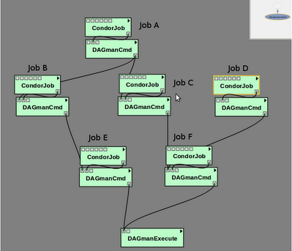
VisTrails, continued

Slide 196
Relevant Links
DAGMan: www.cs.wisc.edu/condor/dagman
For more questions: condor_admin@cs.wisc.edu
Notes:
Kent changed 080430
Kent changed 080129 – updated link for tutorial

Slide 197
SOAR
What is SOAR?
  A System Of Automatic Runs
  A framework for collecting N jobs into a DAG, submitting them to Condor and tracking the run
  A tool that lets one make these jobs complex workflows
  An environment to control production of large sets of data
  A simple web interface for tracking runs and downloading results.

Slide 198
How does SOAR work?
SOAR:
  Sweeps drop box for new job data
  Creates the run
  Periodically creates plot and reports showing progress of run
  After the DAG completes, SOAR makes your results available through the web interface

Slide 199
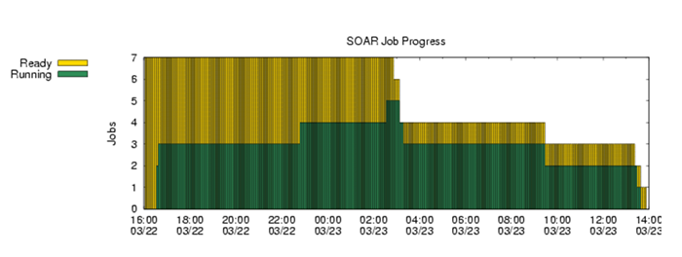
View SOAR Job Progress

Slide 200
SOAR
When is it best used?
  When a production environment is desired.
  When a researcher is Linux challenged
  When each job is a complex DAG in itself.
Web peak: www.submit.chtc.wisc.edu/SOAR/
Info: Bill Taylor bt@cs.wisc.edu CHTC Staff

Slide 201
General User Commands
condor_status View Pool Status
condor_q View Job Queue
condor_submit Submit new Jobs
condor_rm Remove Jobs
condor_prio Intra-User Prios
condor_history Completed Job Info
condor_submit_dag Submit new DAG
condor_checkpoint Force a checkpoint
condor_compile Link Condor library

Slide 202
Condor Job Universes
  Vanilla Universe
  Standard Universe
  Grid Universe
  Scheduler Universe
  Local Universe
  Virtual Machine Universe
  Java Universe
Parallel Universe
    MPICH-1
    MPICH-2
    LAM
    …

Slide 203
Why have a special Universe for Java jobs?
Java Universe provides more than just inserting “java” at the start of the execute line of a vanilla job:
  Knows which machines have a JVM installed
  Knows the location, version, and performance of JVM on each machine
  Knows about jar files, etc.
  Provides more information about Java job completion than just JVM exit code
    Program runs in a Java wrapper, allowing Condor to report Java exceptions, etc.

Slide 204
Universe Java Job
# Example Java Universe Submit file
Universe = java
Executable = Main.class
jar_files = MyLibrary.jar
Input = infile
Output = outfile
Arguments = Main 1 2 3
Queue

Slide 205
Java support, cont.
bash-2.05a$ condor_status –java
Name JavaVendor Ver State Actv LoadAv Mem
abulafia.cs Sun Microsy 1.5.0_ Claimed Busy 0.180 503
acme.cs.wis Sun Microsy 1.5.0_ Unclaimed Idle 0.000 503
adelie01.cs Sun Microsy 1.5.0_ Claimed Busy 0.000 1002
adelie02.cs Sun Microsy 1.5.0_ Claimed Busy 0.000 1002
…
Total Owner Claimed Unclaimed Matched Preempting
INTEL/LINUX 965 179 516 250 20 0
INTEL/WINNT50 102 6 65 31 0 0
SUN4u/SOLARIS28 1 0 0 1 0 0
X86_64/LINUX 128 2 106 20 0 0
Total 1196 187 687 302 20 0

Slide 206
Albert wants Condor features on remote resources
He wants to run standard universe jobs on Grid-managed resources
  For matchmaking and dynamic scheduling of jobs
  For job checkpointing and migration
  For remote system calls

Slide 207

Condor GlideIn
Albert can use the Grid Universe to run Condor daemons on Grid resources
When the resources run these GlideIn jobs, they will temporarily join his Condor Pool
He can then submit Standard, Vanilla, PVM, or MPI Universe jobs and they will be matched and run on the remote resources
Currently only supports Globus GT2
  We hope to fix this limitation

Slide 208
Globus Grid
600 Condor
jobs
PBS
LSF
your
workstation
personal
Condor
Condor Pool
glide-in jobs
Friendly Condor Pool
Condor

Slide 209
How It Works
Condor jobs
Personal Condor
Remote Resource
Master
Manager
Collector & Negotiator
Schedd
LSF
Startd
Grid Manager
Shadow
Starter
User Job
GlideIn jobs

Slide 210
GlideIn Concerns
What if the remote resource kills my GlideIn job?
  That resource will disappear from your pool and your jobs will be rescheduled on other machines
  Standard universe jobs will resume from their last checkpoint like usual
What if all my jobs are completed before a GlideIn job runs?
  If a GlideIn Condor daemon is not matched with a job in 10 minutes, it terminates, freeing the resource

Slide 211
In Review
With Condor’s help, Albert can:
  Manage his compute job workload
  Access local machines
  Access remote Condor Pools via flocking
  Access remote compute resources on the Grid via “Grid Universe” jobs
  Carve out his own personal Condor Pool from the Grid with GlideIn technology

Slide 212
Administrator Commands
condor_vacate Leave a machine now
condor_on Start Condor
condor_off Stop Condor
condor_reconfig Reconfig on-the-fly
condor_config_val View/set config
condor_userprio User Priorities
condor_stats View detailed usage accounting stats

Slide 213

My boss wants to watch what Condor is doing

Slide 214
Use CondorView!
Provides visual graphs of current and past utilization
Data is derived from Condor's own accounting statistics
Interactive Java applet
Quickly and easily view:
  How much Condor is being used
  How many cycles are being delivered
  Who is using them
  Utilization by machine platform or by user

Slide 215
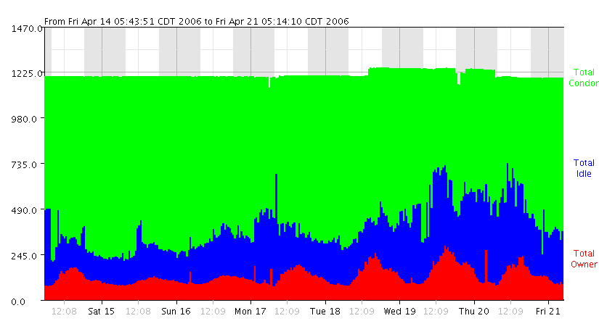
CondorView Usage Graph

Slide 216
I could also talk lots about…
GCB: Living with firewalls & private networks
Federated Grids/Clusters
APIs and Portals
MW
Database Support (Quill)
High Availability Fail-over
Compute On-Demand (COD)
Dynamic Pool Creation (“Glide-in”)
Role-based prioritization and accounting
Strong security, incl privilege separation
Data movement scheduling in workflows
…

Slide 217
Thank you!
Check us out on the Web:
http://www.condorproject.org
Email:
condor-admin@cs.wisc.edu

