Slide 1
Mechanisms for Matchmaking and Parallel High Throughput Computing in
the Condor Distributed System
Rajesh Raman, raman@cs.wisc.edu
Todd Tannenbaum, tannenba@cs.wisc.edu
http://www.cs.wisc.edu/condor
Oct 27, 1997

Slide 2
Condor Project
Overview
  What is Condor ?
  Projects and Collaborations
  High Throughput Computing
  ClassAds and MatchMaking
  Parallel Computing with Condor

Slide 3
What is Condor ?
High Throughput Computing
Distributed Resources
  Physically distributed
  Distributed ownership
Resource Management
  Increase utilization of resources
  Simple interface to execution environment
    User level interface
    Application level interface

Slide 4
Important Mechanisms
Matchmaking
Checkpointing (and migration)
  Owner policies require resource reclamation
  Need to save (resumable) state of application
Remote System Calls
  Preserves submission environment in execution environment.
Sandboxing
  Security concerns

Slide 5
The Condor Team
Prof. Miron Livny, PI
Research Staff
  Todd Tannenbaum
  Derek Wright
  Adding 2 more...

Slide 6
Condor Team, cont.
Graduate Students
  Rajesh Raman (MatchMaking)
  Jim Basney (Split Execution)
  Shrinivas Ashwin (Mr. Parallel)
  Adiel Yoaz (Accounting)
Undergraduate Students
  Tom Stanis

Slide 7
Condor Almuni
  Mike Litzkow
  David Dewitt
  Marvin Solomon
  Many others… (Produced XXX Masters and XXX PhDs]

Slide 8
Current Collaborators and Projects
NCSA
  PACI
  National Grid
UW-Flock
  Intel Sponsorship: $4.2 Million
  Graduate School, Engineering
metaNEOS: metacomputing environments for optimization
  with Prof. Michael Ferris

Slide 9
Condor Pool Installations
Universites
  U of Wisconsin, U of Illinois, U of Michigan, Dartmouth, Duke, U of Washington, U of Virginia, U of California-Berkeley
Government
  NCSA, Nasa, US Navy, NSA, NIKHEF (Amsterdam), INFN (Italy)
Commercial
  Hewlett-Packard Labs, J.P. Morgan, Mercedez-Benz, Dragon Systems

Slide 10
Power of Computing Environments
Power = Work / Time
High Performance Computing
  Fixed amount of work; how much time?
  Response time/latency oriented
  Traditional Performance metrics: FLOPS, MIPS
High Throughput Computing
  Fixed amount of time; how much work?
  Throughput oriented
  Application specific performance metrics

Slide 11
Distributed Ownership of Resources
Commodity resources
  Underutilized: 70% of a pool's cycles are not utilized
  Fragmented: owned by different people
Can provide HTC with these cycles, BUT
  Must not impact QOS to owner
Owners specify access policy
  Expressed with control expressions
    The current state of the resource (e.g., load average)
    Characteristics of the request (e.g., who wants to use it?)
    Time of day, random numbers, etc

Slide 12
Condor Architecture
Startds ( Represent owners of resources)
  Implement owner's access control policy
Schedds( Represent customers of the system)
  Maintain persistent queues of resource requests
Manager
  Collector: Database of resources
  Negotiator: Matchmaker
  Accountant: Priority maintenance

Slide 13
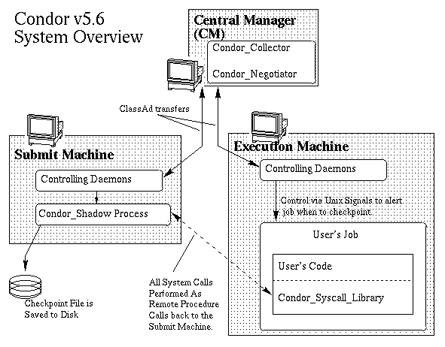
Condor Architecture, cont.

Slide 14
Matchmaking
Customers
  Require resources with certain characteristics
  Discriminating customers
  Requests place constraints on resources
Distributed ownership
  Resources service requests which match owner's policy
  Discriminating resources
  Resource offers place constraints on customers
Matchmaking is symmetric

Slide 15
Matchmaking with Classified Advertisements
Parties requiring matchmaking advertise
  Characteristics and requirements (i.e., constraints)
Advertisements matched by a Matchmaker
Matched parties contact each other to "claim”
  Communication, authentication, constraint verification, negotiation of terms, etc.
  Claiming does not involve the Matchmaker
Method is symmetric
  No client/server relation imposed

Slide 16
Classified Advertisement Matchmaking Framework
Expression and evaluation of characteristics
  ClassAd, Closure, EvaluationContext
Advertising Protocol
  Contents of advertisements
  Publication protocol
Matchmaking Algorithm
  Relates ad contents to matching process
  Priority schemes, Ranking schemes, etc.

Slide 17
Classified Advertisement Matchmaking Framework (contd.)
Matchmaking Protocol
  How are relevant parties informed of a successful match?
  What information are they given?
Claiming Protocol
  How do matched parties claim each other to cooperate?

Slide 18
ClassAd: Mechanism for expressing characteristics
A ClassAd is a set of names, each of which is bound to an expression. e.g.,
[
Name => "Joe Hacker" ; Height => 182 ; Sex => "Male" ;
Disposition => (TimeOfDay() < 600) ? "Sour" : UNDEFINED ;
Requirements => (other.Height < Height) && (other.Sex == "Female")
]
Expressions
  Constants, attribute references, function calls

Slide 19
ClassAd (contd.)
Attribute references may refer to attributes in other ads
  Attribute references "trigger" expression evaluation
  Scope resolution
  Evaluates to UNDEFINED if no such expression exists
Values
  String, integer, real, UNDEFINED and ERROR types
  Operators are total (i.e., defined over all values)

Slide 20
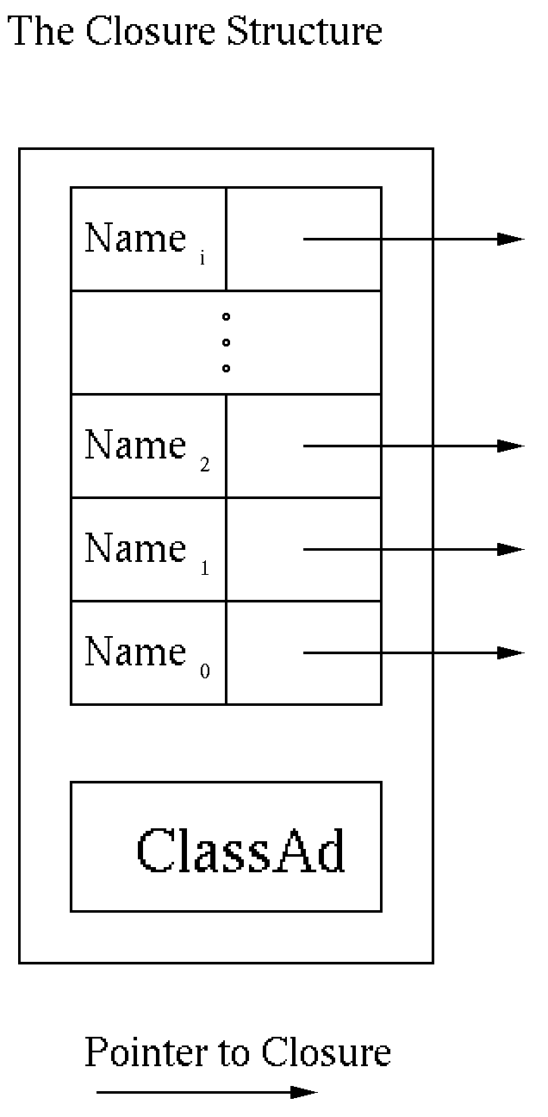
Closure: Evaluation Environment for a ClassAd
Determines which ClassAd's attributes to lookup
Closure is
  ClassAd and an ordered mapping of (scope-name, closure) pairs
  No name may be repeated

Slide 21
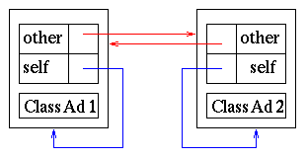
EvaluationContext: Evaluation Environment for several ClassAds
A set of closures which is self-contained
  No closure reference leaves the context
  Condor's "Standard Context" is a bit more complex
    Includes closures for a matchmaker "advertisement”

Slide 22
Matchmaking in Condor
Opportunistic Resource Exploitation
  Resource availability is unpredictable
    Exploit resources as soon as they are available
    Return resources as soon as they are unavailable
  Matchmaking performed continuously
Attractive for malleable parallel applications
  Request more resources after execution commences
    Granted immediately if resources are available, or
    As soon as resources become available

Slide 23
Matchmaking in Condor (contd.)
Advertising protocol
  Startd's, Schedd's send classads to Collector
  Must contain a "Requirements” expression
    Optionally contain a"Rank” and “CurrentRank” expressions
  Startds send a "private ad" containing a capability
Matchmaking protocol
  Give the matched Startd and Schedd the capability from the startd's private ad

Slide 24
Matchmaking in Condor (contd.)
Matchmaking Algorithm
  Request ad A matched with offer ad B “iff”
    A's "Requirements" expression evaluates to TRUE, and
    B's "Requirements" expression evaluates to TRUE, and
    B‘s"Rank" expression value is greater than "CurrentRank", and
    A’s "Rank" expression value is its greatest when evaluated against B
Claiming protocol
  Negotiate "heartbeat" frequency, checkpoint transfer, etc.

Slide 25
Condor Parallelism
Job Level
  Condor clusters of processes
  DagMan
Task Level
  Interfacing Condor and PVM
    PVM: Message Passing
    Condor: Resource Management
  PVM Resource Manager Interface
    pvm_reg_rm()

Slide 26
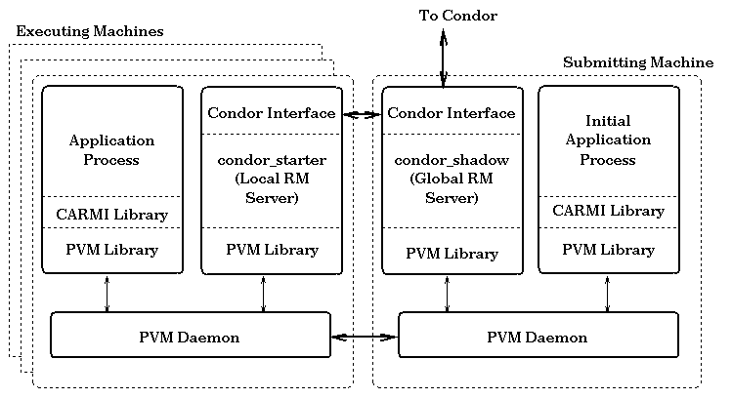
Interfacing Condor and PVM, cont.

Slide 27
Interfacing Condor and PVM, cont.
CARMI -vs- PVM
  Resource Requests
    PVM: Synchronous
    CARMI: Asynchronous
  Resource Request Mechanism
    PVM: Hostname and Type String
    CARMI: ClassAd
      CARMI Resource Class
  Task Management
    CARMI: Additional Notifications
    CARMI: Additional Operations

Slide 28
Master-Worker Model
Starter
A good fit for an opportunistic environment
Master
  Runs on Submit Machine
  Manages pool of tasks
Worker
  Runs on remote machines
  Receives pieces of work from the Master, returns answer
PVMd
Worker
Shadow
Starter
Master
PVMd
PVMd
Worker

Slide 29
Additional Condor/PVM Frameworks
CoCheck
  Checkpoint a Worker or set of Workers
  Requirements for a consistent checkpoint
    Synchronize all processes
    Flush PVM messages in transit
    Perform Checkpoint (save image)
    Remap TIDs
WoDi
  A framework for Master-Worker applications
  Performs optimizations

Slide 30
Future Work
Debug
Port
Debug
Port
Debug
Port
Debug
Port…..

Slide 31
Future Work Part II
Matchmaking
  Aggregate Resources/Requests
Accounting
  Authentication
Flocking
Java Universe
Split Execution

Slide 32
Summary
Condor is an implementation of a High Throughput Computing system in an opportunistic environment.
Major Mechanisms to achieve HTC:
  Matchmaking
  Checkpointing
  Remote system calls
  Sandboxing
Questions ?

