Slide 1
The Principals and Power of
Distributed Computing

Slide 2
10 years ago we had
“The Grid”

Slide 3
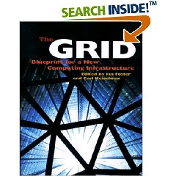
The Grid: Blueprint for a New Computing Infrastructure
Edited by Ian Foster and Carl Kesselman
July 1998, 701 pages.
The grid promises to fundamentally change the way we think about and use computing. This infrastructure will connect multiple regional and national computational grids, creating a universal source of pervasive and dependable computing power that supports dramatically new classes of applications. The Grid provides a clear vision of what computational grids are, why we need them, who will use them, and how they will be programmed.

Slide 4
“ … We claim that these mechanisms, although originally developed in the context of a cluster of workstations, are also applicable to computational grids. In addition to the required flexibility of services in these grids, a very important concern is that the system be robust enough to run in “production mode” continuously even in the face of component failures. … “
Miron Livny & Rajesh Raman, "High Throughput Resource Management", in “The Grid: Blueprint for
a New Computing Infrastructure”.

Slide 5
In the words of the
CIO of Hartford Life
Resource: What do you expect to gain from grid computing? What are your main goals?
Severino: Well number one was scalability. …
Second, we obviously wanted scalability with stability. As we brought more servers and desktops onto the grid we didn’t make it any less stable by having a bigger environment.
The third goal was cost savings. One of the most …

Slide 6
2,000 years ago we had the words of
Koheleth son of David king in Jerusalem

Slide 7
The words of Koheleth son of David, king in Jerusalem ….
  Only that shall happen
  Which has happened,
  Only that occur
  Which has occurred;
  There is nothing new
  Beneath the sun!
Ecclesiastes Chapter 1 verse 9

Slide 8
35 years ago we had
The ALOHA network

Slide 9
One of the early computer networking designs, the ALOHA network was created at the University of Hawaii in 1970 under the leadership of Norman Abramson. Like the ARPANET group, the ALOHA network was built with DARPA funding. Similar to the ARPANET group, the ALOHA network was built to allow people in different locations to access the main computer systems. But while the ARPANET used leased phone lines, the ALOHA network used packet radio.
ALOHA was important because it used a shared medium for transmission. This revealed the need for more modern contention management schemes such as CSMA/CD, used by Ethernet. Unlike the ARPANET where each node could only talk to a node on the other end, in ALOHA everyone was using the same frequency. This meant that some sort of system was needed to control who could talk at what time. ALOHA's situation was similar to issues faced by modern Ethernet (non-switched) and Wi-Fi networks.
This shared transmission medium system generated interest by others. ALOHA's scheme was very simple. Because data was sent via a teletype the data rate usually did not go beyond 80 characters per second. When two stations tried to talk at the same time, both transmissions were garbled. Then data had to be manually resent. ALOHA did not solve this problem, but it sparked interest in others, most significantly Bob Metcalfe and other researchers working at Xerox PARC. This team went on to create the Ethernet protocol.

Slide 10
30 years ago we had
Distributed
Processing
Systems

Slide 11
Claims for “benefits” provided by Distributed Processing Systems
P.H. Enslow, “What is a Distributed Data Processing System?” Computer, January 1978
  High Availability and Reliability
  High System Performance
  Ease of Modular and Incremental Growth
  Automatic Load and Resource Sharing
  Good Response to Temporary Overloads
  Easy Expansion in Capacity and/or Function

Slide 12
Definitional Criteria for a Distributed Processing System
P.H. Enslow and T. G. Saponas “”Distributed and Decentralized Control in Fully Distributed Processing Systems” Technical Report, 1981
  Multiplicity of resources
  Component interconnection
  Unity of control
  System transparency
  Component autonomy

Slide 13
Multiplicity of resources
The system should provide a number of assignable resources for any type of service demand. The greater the degree of replication of resources, the better the ability of the system to maintain high reliability and performance

Slide 14
Component interconnection
A Distributed System should include a communication subnet which interconnects the elements of the system. The transfer of information via the subnet should be controlled by a two-party, cooperative protocol (loose coupling).

Slide 15
Unity of Control
All the component of the system should be unified in their desire to achieve a common goal. This goal will determine the rules according to which each of these elements will be controlled.

Slide 16
System transparency
From the users point of view the set of resources that constitutes the Distributed Processing System acts like a “single virtual machine”. When requesting a service the user should not require to be aware of the physical location or the instantaneous load of the various resources

Slide 17
Component autonomy
The components of the system, both the logical and physical, should be autonomous and are thus afforded the ability to refuse a request of service made by another element. However, in order to achieve the system’s goals they have to interact in a cooperative manner and thus adhere to a common set of policies. These policies should be carried out by the control schemes of each element.

Slide 18
Challenges
Race Conditions…
Name spaces …
Distributed ownership …
Heterogeneity …
Object addressing …
Data caching …
Object Identity …
Trouble shooting …
Circuit breakers …

Slide 19
24 years ago I wrote a Ph.D. thesis –
“Study of Load Balancing Algorithms for Decentralized Distributed Processing Systems”
http://www.cs.wisc.edu/condor/doc/livny-dissertation.pdf

Slide 20
BASICS OF A M/M/1 SYSTEM
Expected # of customers is 1/(1-ρ), where (ρ = λ/μ) is the utilization
λ
When utilization is 80%,
you wait on the average 4 units
for every unit of service
μ

Slide 21
BASICS OF TWO M/M/1 SYSTEMS
When utilization is 80%,
you wait on the average 4 units
for every unit of service
λ
λ
When utilization is 80%,
25% of the time a customer is
waiting for service while
a server is idle
μ
μ

Slide 22
Wait while Idle (WwI) in m*M/M/1
1
m = 20
m = 10
Prob
(WwI)
m = 5
m = 2
0
0
Utilization
1

Slide 23
“ … Since the early days of mankind the primary motivation for the establishment of communities has been the idea that by being part of an organized group the capabilities of an individual are improved. The great progress in the area of inter-computer communication led to the development of means by which stand-alone processing sub-systems can be integrated into multi-computer ‘communities’. … “
Miron Livny, “ Study of Load Balancing Algorithms for Decentralized Distributed Processing Systems.”,
Ph.D thesis, July 1983.

Slide 24
20 years ago we had
“Condor”

Slide 25
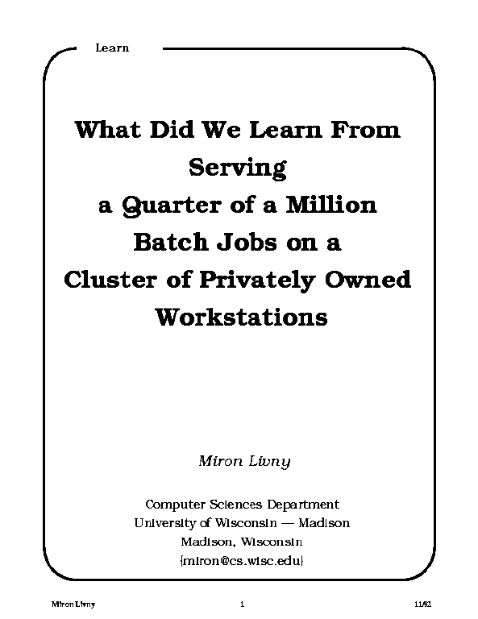
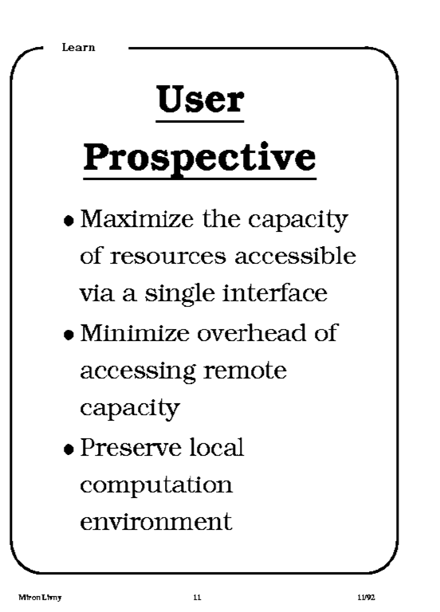
1992

Slide 26
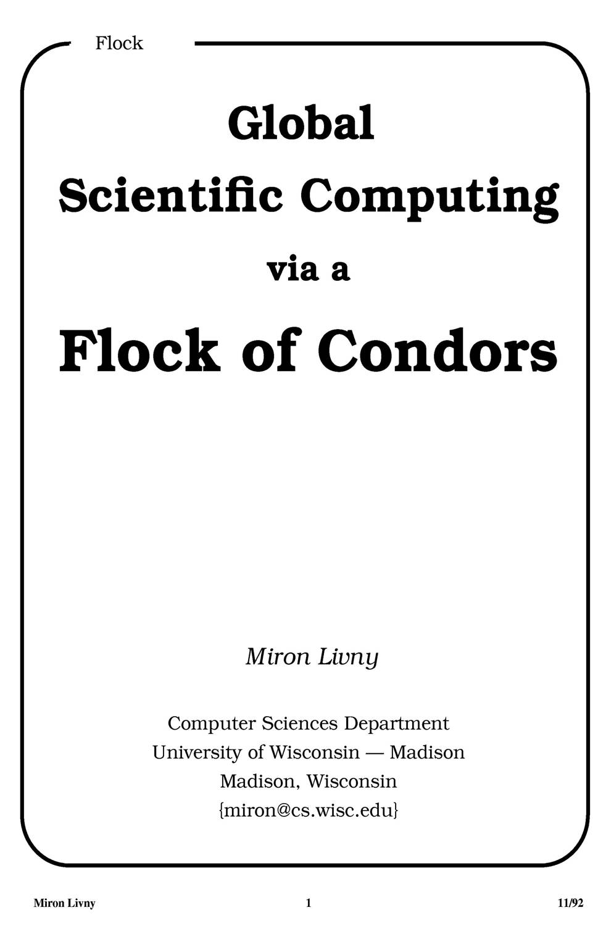
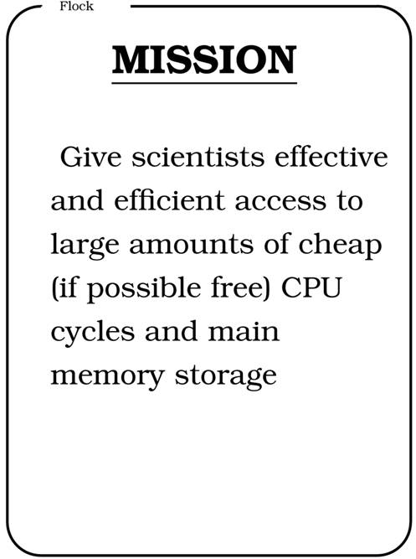
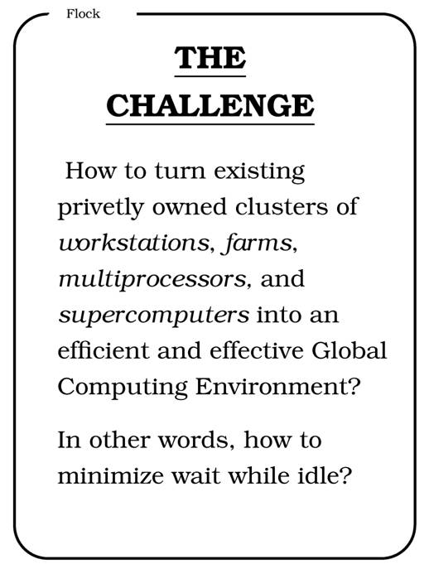
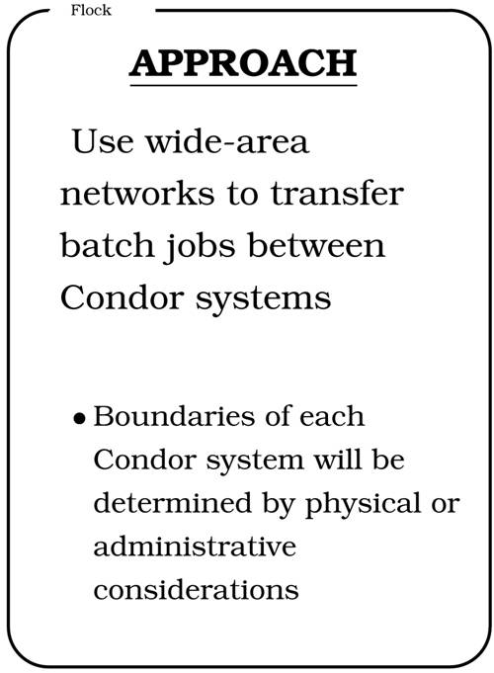
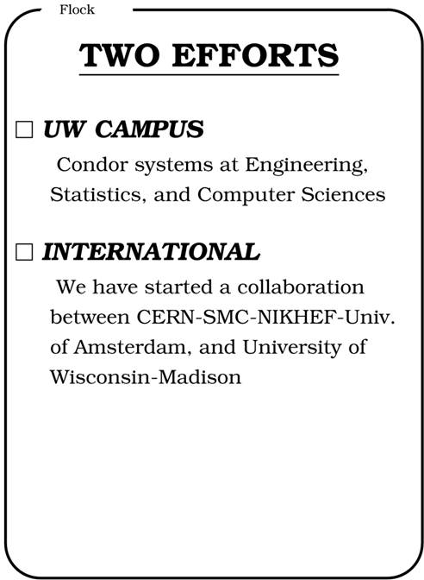
CERN 92

Slide 27
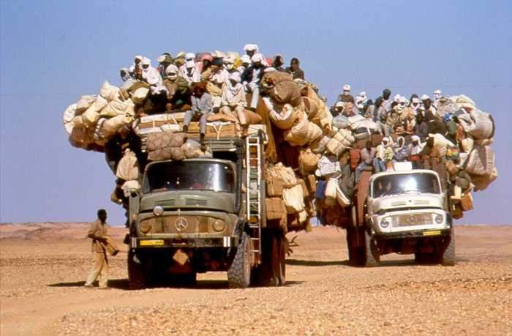
We are still very busy

Slide 28
1986-2006
Celebrating
20 years since we first installed Condor in our department

Slide 29
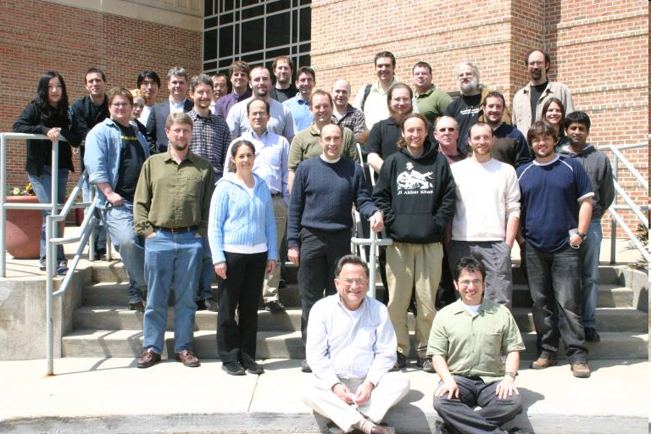
Condor Team 2008

Slide 30
The Condor Project (Established ‘85)
Distributed Computing research performed by a team of ~40 faculty, full time staff and students who
  face software/middleware engineering challenges in a UNIX/Linux/Windows/OS X environment,
  involved in national and international collaborations,
  interact with users in academia and industry,
  maintain and support a distributed production environment (more than 5000 CPUs at UW),
  and educate and train students.

Slide 31
Excellence
S
u
p
p
o
r
t
Software Functionality
Research

Slide 32
Main Threads of Activities
Distributed Computing Research – develop and evaluate new concepts, frameworks and technologies
Keep the Condor system “flight worthy” and support our users
The Grid Laboratory Of Wisconsin (GLOW) – build, maintain and operate a distributed computing and storage infrastructure on the UW campus
The Open Science Grid (OSG) – build and operate a national distributed computing and storage infrastructure
The NSF Middleware Initiative (NMI) – develop, build and operate a national Build and Test facility

Slide 33
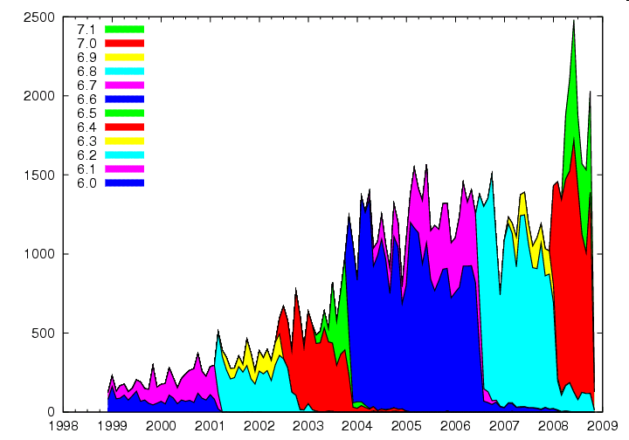
Condor Monthly Downloads

Slide 34
Open Source Code
Large open source code base mostly in C and C++
  680,000+ lines of code (LOC) written by the Condor Team.
  Including “externals”, building Condor as we ship it will compile over 9 million lines.
  Interesting comparisons:
  Apache Web Server: ~60,000 LOC
  Linux TCP/IP network stack: ~80,000 LOC
  Entire Linux Kernel v2.6.0 : ~5.2 million LOC
  Windows XP (complete) : ~40 million LOC

Slide 35
A very dynamic code base
A typical month sees
  A new release of Condor to the public
  Over 200 commits to the codebase
  Modifications to over 350 source code files
  ~20,000 lines of code changing
  ~2,000 builds of the code…
  …running of 1.2 million regression tests
Many tools required to make a quality release, and expertise in using tools effectively
  Git, Coverity, Metronome, Gittrac, MySQL to store build/test results, Microsoft Developer Network, Compuware DevPartner, valgrind, perfgrind, CVS, Rational Purify, many more…

Slide 36
Grid Laboratory of Wisconsin
2003 Initiative funded by NSF(MIR)/UW at $1.5M. Second phase funded in 2007 by NSF(MIR)/UW at $1.5M.
Six Initial GLOW Sites
Computational Genomics, Chemistry
Amanda, Ice-cube, Physics/Space Science
High Energy Physics/CMS, Physics
Materials by Design, Chemical Engineering
Radiation Therapy, Medical Physics
Computer Science
Diverse users with different deadlines and usage patterns.

Slide 37
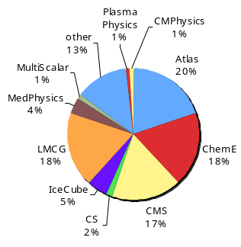
GLOW Usage 4/04-11/07
Over 35M
CPU hours served!

Slide 38
The search for SUSY*
Sanjay Padhi is a UW Chancellor Fellow who is working at the group of Prof. Sau Lan Wu at CERN
Using Condor Technologies he established a “grid access point” in his office at CERN
Through this access-point he managed to harness in 3 month (12/05-2/06) more that 500 CPU years from the LHC Computing Grid (LCG) the Open Science Grid (OSG) and UW Condor resources
* SUSY – Super Symmetry

Slide 39
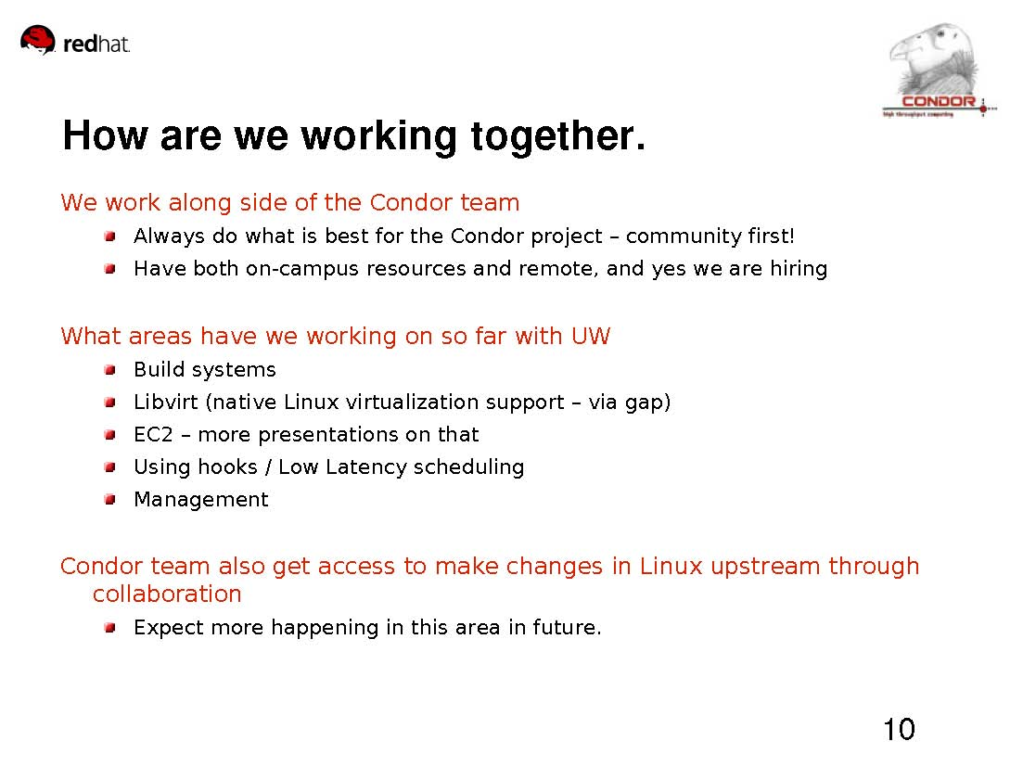
CW 2008

Slide 40
High Throughput Computing
We first introduced the distinction between High Performance Computing (HPC) and High Throughput Computing (HTC) in a seminar at the NASA Goddard Flight Center in July of 1996 and a month later at the European Laboratory for Particle Physics (CERN). In June of 1997 HPCWire published an interview on High Throughput Computing.

Slide 41
Why HTC?
For many experimental scientists, scientific progress and quality of research are strongly linked to computing throughput. In other words, they are less concerned about instantaneous computing power. Instead, what matters to them is the amount of computing they can harness over a month or a year --- they measure computing power in units of scenarios per day, wind patterns per week, instructions sets per month, or crystal configurations per year.

Slide 42
High Throughput Computing is a
24-7-365 activity
FLOPY ≠ (60*60*24*7*52)*FLOPS

Slide 43
Obstacles to HTC
(Sociology)
(Education)
(Robustness)
(Portability)
(Technology)
Ownership Distribution
Customer Awareness
Size and Uncertainties
Technology Evolution
Physical Distribution

Slide 44
Focus on the problems that are unique to HTC not the latest/greatest technology

Slide 45
HTC on the Internet (1993)
Retrieval of atmospheric temperature and humidity profiles from 18 years of data from the TOVS sensor system.
  200,000 images
  ~5 minutes per image
Executed on Condor pools at the University of Washington, University of Wisconsin and NASA. Controlled by DBC (Distributed Batch Controller). Execution log visualized by DEVise

Slide 46
U of Washington
U of Wisconsin
NASA
Jobs per Pool
(5000 total)
Exec time
vs.
Turn around
Time line
(6/5-6/9)

Slide 47
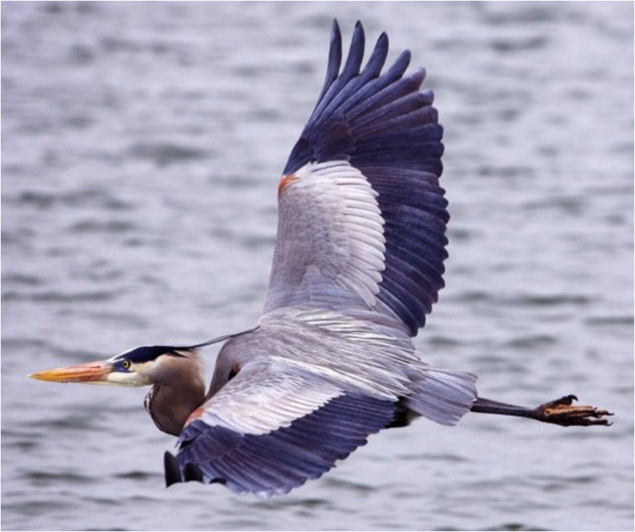
Blue Heron Project
IBM Rochester: Tom Budnik: tbudnik@us.ibm.com
Amanda Peters: apeters@us.ibm.com
Condor: Greg Thain
With contributions from:
IBM Rochester: Mark Megerian, Sam Miller,
Brant Knudson and Mike Mundy
Other IBMers: Patrick Carey, Abbas Farazdel,
Maria Iordache and Alex Zekulin
UW-Madison Condor: Dr. Miron Livny
April 30, 2008

Slide 48


and Blue Gene Collaboration
Both IBM and Condor teams engaged in adapting code to bring Condor and Blue Gene technologies together
Previous Activities (BG/L)
  Prototype/research Condor running HTC workloads
Current Activities (BG/P)
  Blue Heron Project
    Partner in design of HTC services
    Condor supports HTC workloads using static partitions
Future Collaboration (BG/P and BG/Q)
  Condor supports dynamic machine partitioning
  Condor supports HPC (MPI) jobs
  I/O Node exploitation with Condor
  Persistent memory support (data affinity scheduling)
  Petascale environment issues

Slide 49
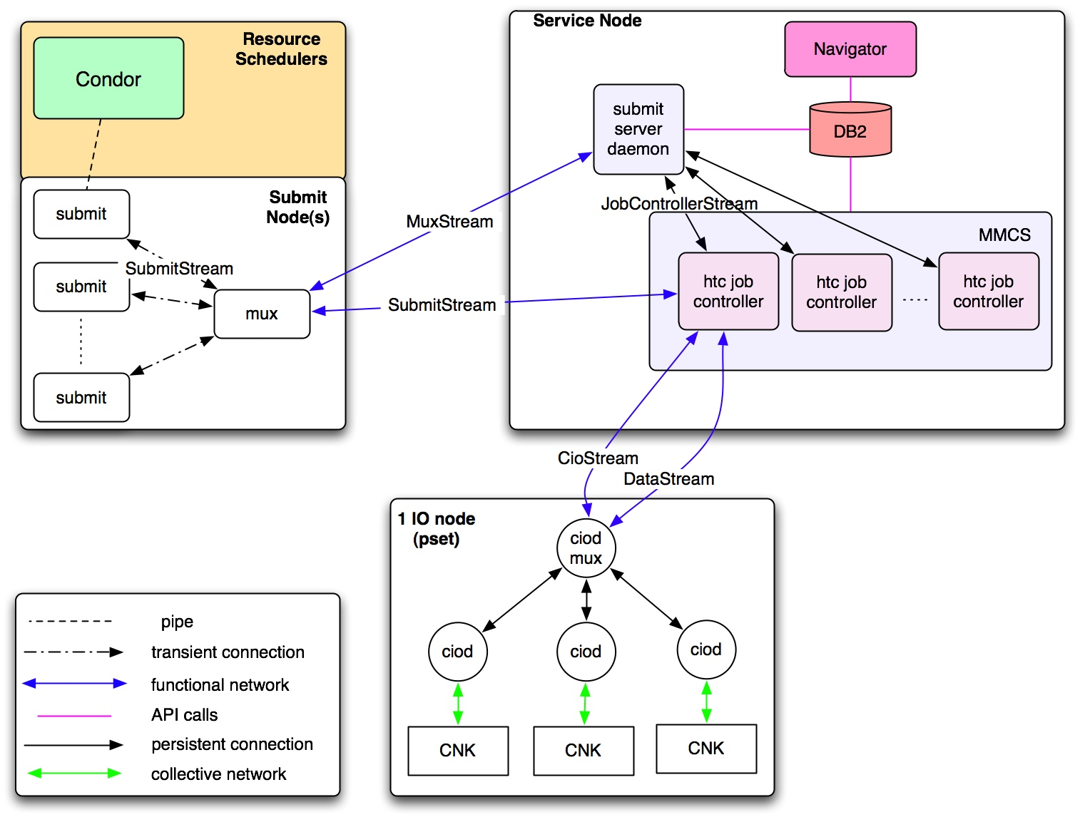
How does Blue Heron work?
“Software Architecture Viewpoint”
Design Goals:
Lightweight
Extreme scalability
Flexible scalability
High throughput (fast)

Slide 50
10 years ago we had
“The Grid”

Slide 51
Introduction
“The term “the Grid” was coined in the mid 1990s to denote a proposed distributed computing infrastructure for advanced science and engineering [27]. Considerable progress has since been made on the construction of such an infrastructure (e.g., [10, 14, 36, 47]) but the term “Grid” has also been conflated, at least in popular perception, to embrace everything from advanced networking to artificial intelligence. One might wonder if the term has any real substance and meaning. Is there really a distinct “Grid problem” and hence a need for new “Grid technologies”? If so, what is the nature of these technologies and what is their domain of applicability? While numerous groups have interest in Grid concepts and share, to a significant extent, a common vision of Grid architecture, we do not see consensus on the answers to these questions.”
“The Anatomy of the Grid - Enabling Scalable Virtual Organizations” Ian Foster, Carl Kesselman and Steven Tuecke 2001.

Slide 52
Global Grid Forum (March 2001)
The Global Grid Forum (Global GF) is a community-initiated forum of individual researchers and practitioners working on distributed computing, or "grid" technologies. Global GF focuses on the promotion and development of Grid technologies and applications via the development and documentation of "best practices," implementation guidelines, and standards with an emphasis on rough consensus and running code.
Global GF efforts are also aimed at the development of a broadly based Integrated Grid Architecture that can serve to guide the research, development, and deployment activities of the emerging Grid communities. Defining such an architecture will advance the Grid agenda through the broad deployment and adoption of fundamental basic services and by sharing code among different applications with common requirements.
Wide-area distributed computing, or "grid" technologies, provide the foundation to a number of large scale efforts utilizing the global Internet to build distributed computing and communications infrastructures..

Slide 53
Summary
“We have provided in this article a concise statement of the “Grid problem,” which we define as controlled resource sharing and coordinated resource use in dynamic, scalable virtual organizations. We have also presented both requirements and a framework for a Grid architecture, identifying the principal functions required to enable sharing within VOs and defining key relationships among these different functions.”
“The Anatomy of the Grid - Enabling Scalable Virtual Organizations” Ian Foster, Carl Kesselman and Steven Tuecke 2001.

Slide 54
What makes an
“O” a
“VO”?

Slide 55
What is new beneath the sun?
Distributed ownership – who defines the “system’s common goal”? No more one system.
Many administrative domains – authentication, authorization and trust.
Demand is real – many have computing needs that can not be addressed by centralized locally owned systems
Expectations are high – Regardless of the question, distributed technology is “the” answer.
Distributed computing is once again “in”.

Slide 56
Benefits to Science
Democratization of Computing – “you do not have to be a SUPER person to do SUPER computing.” (accessibility)
Speculative Science – “Since the resources are there, lets run it and see what we get.” (unbounded computing power)
Function shipping – “Find the image that has a red car in this 3 TB collection.” (computational mobility)

Slide 57
The NUG30 Quadratic Assignment Problem (QAP)
Solved!
(4 Scientists +
1 Linux Box)
30
i=1
30
j=1
∑
∑
a_{ij}b_{p(i)p(j)}
min
p∈∏

Slide 58
NUG30 Personal Grid …
Managed by one Linux box at Wisconsin
Flocking: -- the main Condor pool at Wisconsin (500 processors)
-- the Condor pool at Georgia Tech (284 Linux boxes)
-- the Condor pool at UNM (40 processors)
-- the Condor pool at Columbia (16 processors)
-- the Condor pool at Northwestern (12 processors)
-- the Condor pool at NCSA (65 processors)
-- the Condor pool at INFN Italy (54 processors)
Glide-in: -- Origin 2000 (through LSF ) at NCSA. (512 processors)
-- Origin 2000 (through LSF) at Argonne (96 processors)
Hobble-in: -- Chiba City Linux cluster (through PBS) at Argonne
(414 processors).

Slide 59
Solution Characteristics.
Scientists | 4
Workstations | 1
Wall Clock Time | 6:22:04:31
Avg. # CPUs | 653
Max. # CPUs | 1007
Total CPU Time | Approx. 11 years
Nodes | 11,892,208,412
LAPs | 574,254,156,532
Parallel Efficiency | 92%

Slide 60
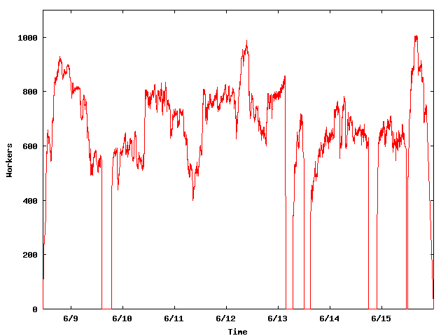
The NUG30 Workforce
System
Upgrade
Condor crash
Workers
Application
Upgrade

Slide 61
WWW
Grid
Client
Master
Server
Worker

Slide 62
“ … Grid computing is a partnership between clients and servers. Grid clients have more responsibilities than traditional clients, and must be equipped with powerful mechanisms for dealing with and recovering from failures, whether they occur in the context of remote execution, work management, or data output. When clients are powerful, servers must accommodate them by using careful protocols.… “
Douglas Thain & Miron Livny, "Building Reliable Clients and Servers", in “The Grid: Blueprint for a New Computing
Infrastructure”,2nd edition

Slide 63
Being a Master
Customer “delegates” task(s) to the master who is responsible for:
  Obtaining allocation of resources
  Deploying and managing workers on allocated resources
  Delegating work unites to deployed workers
  Receiving and processing results
  Delivering results to customer

Slide 64
Master must be …
Persistent – work and results must be safely recorded on non-volatile media
Resourceful – delegates “DAGs” of work to other masters
Speculative – takes chances and knows how to recover from failure
Self aware – knows its own capabilities and limitations
Obedience – manages work according to plan
Reliable – can mange “large” numbers of work items and resource providers
Portable – can be deployed “on the fly” to act as a “sub master”

Slide 65
Master should not do …
Predictions …
Optimal scheduling …
Data mining …
Bidding …
Forecasting …

Slide 66
The Ethernet Protocol
IEEE 802.3 CSMA/CD - A truly distributed (and very effective) access control protocol to a shared service.
  Client responsible for access control
  Client responsible for error detection
  Client responsible for fairness

Slide 67
Never assume that what you know is still true and that what you ordered did actually happen.

Slide 68
Resource Allocation
(resource -> job) vs.
Work Delegation
(job -> resource)

Slide 69
Delegate work
Delegate work
Delegate work
W
R
W
R
Allocate Resource
Allocate Resource
Allocate Resource

Slide 70
Resource Allocation
A limited assignment of the “ownership” of a resource
  Owner is charged for allocation regardless of actual consumption
  Owner can allocate resource to others
  Owner has the right and means to revoke an allocation
  Allocation is governed by an “agreement” between the client and the owner
  Allocation is a “lease”
  Tree of allocations

Slide 71
Garbage collection is the cornerstone of resource allocation

Slide 72
Work Delegation
A limited assignment of the responsibility to perform the work
  Delegation involved a definition of these “responsibilities”
  Responsibilities my be further delegated
  Delegation consumes resources
  Delegation is a “lease”
  Tree of delegations

Slide 73
Every Community can benefit from the services of
Matchmakers!
eBay is a matchmaker

Slide 74
Why? Because ...
.. someone has to bring together community members who have requests for goods and services with members who offer them.
  Both sides are looking for each other
  Both sides have constraints
  Both sides have preferences

Slide 75
Being a Matchmaker
Symmetric treatment of all parties
Schema “neutral”
Matching policies defined by parties
“Just in time” decisions
Acts as an “advisor” not “enforcer”
Can be used for “resource allocation” and “job delegation”

Slide 76
The Condor ‘way’ of resource management –
Be matched, claim (+maintain), and then delegate

Slide 77

startD
DAGMan
3
starter
schedD
1
3
Globus
1
2
3
4
5
6
4
shadow
EC2
5
1
3
grid
manager
4
5
6
GAHP-
EC2
4
startD
DAGMan
schedD
schedD
starter
6
BLAH-
EC2
6
Globus
5
shadow
NorduGrid
grid
manager
GAHP
Globus
GAHP-
Condor
schedD
GAHP
NorduGrid
6
GAHP
Condor

Slide 78
Overlay Resource Managers
Ten years ago we introduced the concept of Condor glide-ins as a tool to support ‘just in time scheduling’ in a distributed computing infrastructure that consists of recourses that are managed by (heterogeneous) autonomous resource managers. By dynamically deploying a distributed resource manager on resources provisioned by the local resource managers, the overlay resource manager can implement a unified resource allocation policy.

Slide 79
PSE or User
Condor
MM
C-app
Local
SchedD (Condor G)
MM
Grid Tools
MM
MM
MM
SchedD
(Condor C)
SchedD
(Condor C)
SchedD
(Condor C)
MM
MM
LSF
PBS
Condor
Condor
StartD
(Glide-in)
StartD
(Glide-in)
StartD
(Glide-in)
Remote
C-app
C-app
G-app
C-app
G-app
C-app
G-app

Slide 80
Managing Job Dependencies
15 years ago we introduced a simple language and a scheduler that use Directed Acyclic Graphs (DAGs) to capture and execute interdependent jobs. The scheduler (DAGMan) is a Condor job and interacts with the Condor job scheduler (SchedD) to run the jobs.
DAGMan has been adopted by the Laser Interferometer Gravitational Wave Observatory (LIGO) Scientific Collaboration (LSC).

Slide 81

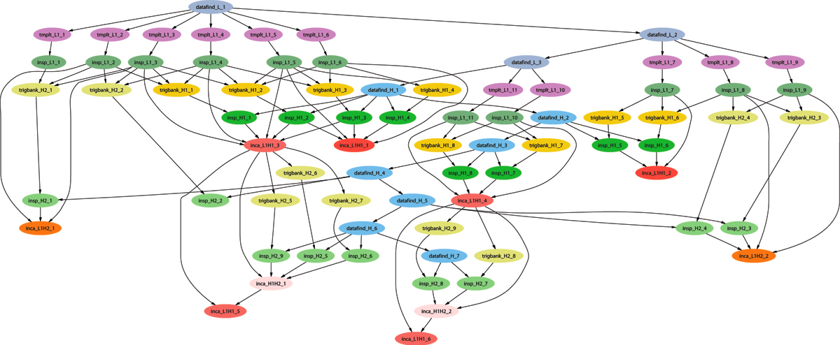
Example of a LIGO Inspiral DAG

Slide 82
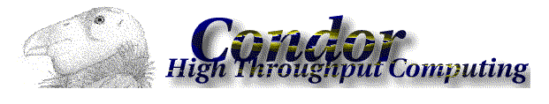
Use of Condor by the LIGO Scientific Collaboration
Condor handles 10’s of millions of jobs per year running on the LDG, and up to 500k jobs per DAG.
Condor standard universe check pointing widely used, saving us from having to manage this.
At Caltech, 30 million jobs processed using 22.8 million CPU hrs. on 1324 CPUs in last 30 months.
For example, to search 1 yr. of data for GWs from the inspiral of binary neutron star and black hole systems takes ~2 million jobs, and months to run on several thousand ~2.6 GHz nodes.

Slide 83
A proven computational protocol for genome-wide predictions and annotations of intergenic bacterial sRNA-encoding genes
NCBI FTP
ORFs
t/rRNAs
IGRExtract3
genomes
RNAMotif
FindTerm
TransTerm
ROI IGRs
All other IGRs
BLAST
Terminators
Conservation
Known sRNAs,
riboswitches
sRNAPredict
BLAST
sRNA candidates
FFN parse
TFBS
matrices
BLAST
BLAST
ORFs flanking
candidates
ORFs flanking
known sRNAs
Homology
to known
Paralogues
QRNA
Patser
BLAST
2º conservation
TFBSs
sRNA Annotate
Synteny
Annotated candidate sRNA-encoding genes

Slide 84


Using SIPHT, searches for sRNA-encoding genes were conducted in 556 bacterial genomes (936 replicons)
This kingdom-wide search:
was launched with a single command line and required no further user intervention
consumed >1600 computation hours and was completed in < 12 hours
involved 12,710 separate program executions
yielded 125,969 predicted loci, inlcluding ~75% of the 146 previously confirmed sRNAs and 124,925 previously unannotated candidate genes
The speed and ease of running SIPHT allow kingdom-wide searches to be repeated often incorporating updated databases; the modular design of the SIPHT protocol allow it to be easily modified to incorporate new programs and to execute improved algorithms

Slide 85
How can we accommodate an unbounded need for computing and an unbounded amount of data with an unbounded amount of resources?

