Slide 1
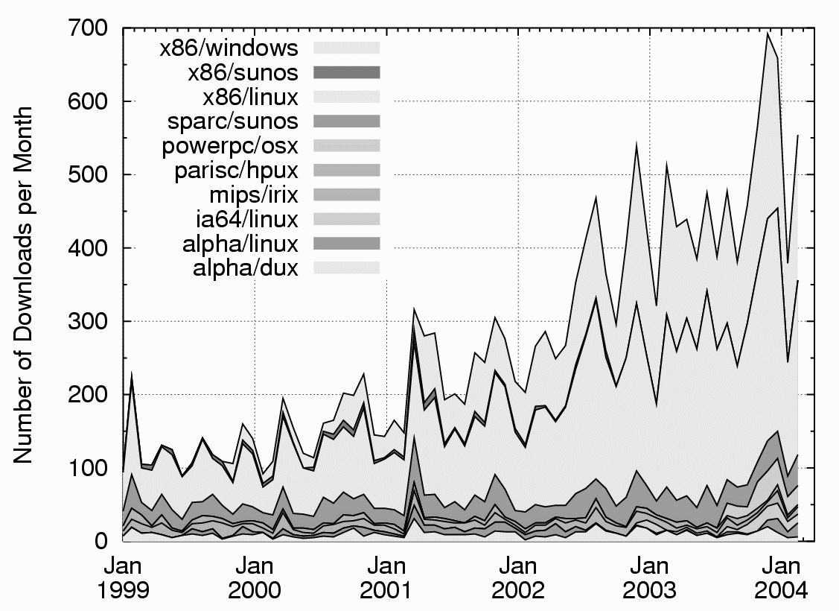
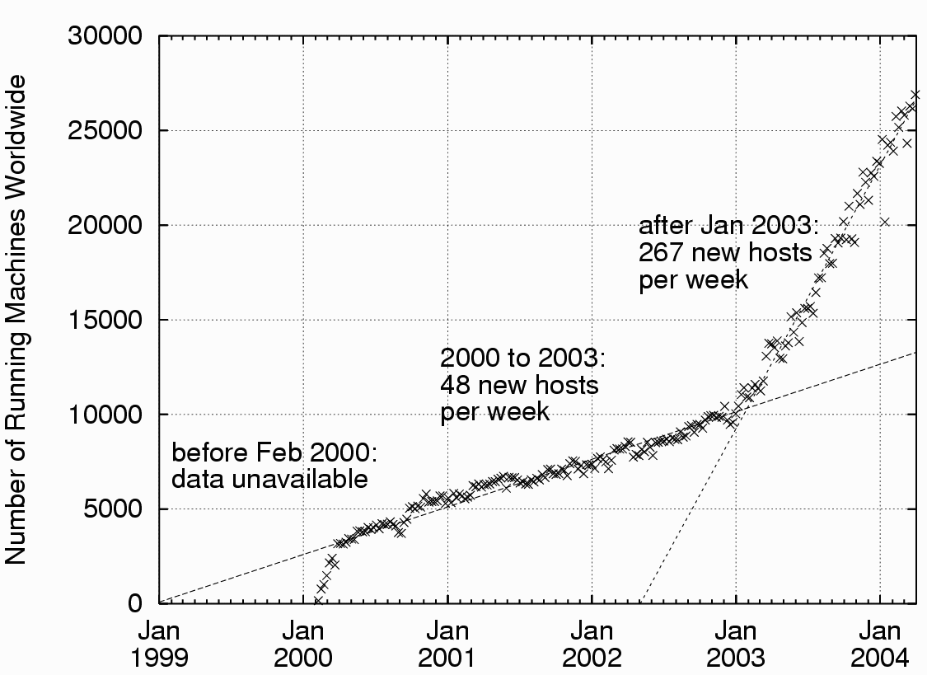
Getting popular
Figure 1: Condor downloads by platform
Figure 2: Known # of Condor hosts

Slide 2
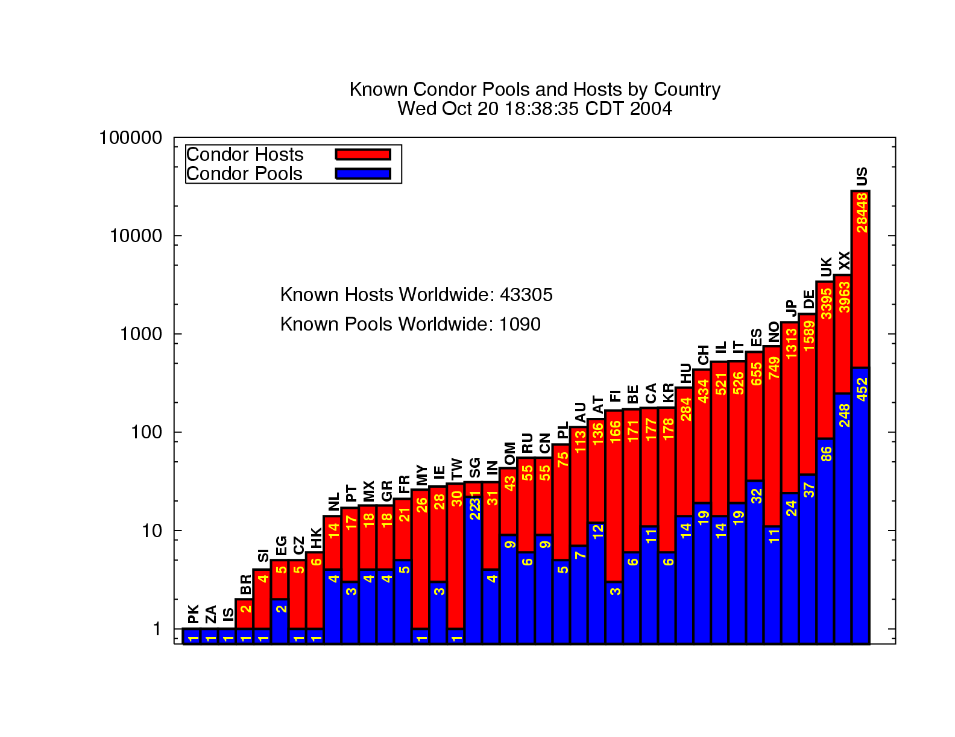

Slide 3
Interfacing Applications w/ Condor
Suppose you have an application which needs a lot of compute cycles
You want this application to utilize a pool of machines
How can this be done?

Slide 4
Some Condor APIs
Command Line tools
  condor_submit, condor_q, etc
SOAP
DRMAA
Condor GAHP
MW
Condor Perl Module
Ckpt API

Slide 5
Command Line Tools
Don’t underestimate them
Your program can create a submit file on disk and simply invoke condor_submit:
  system(“echo universe=VANILLA > /tmp/condor.sub”);
  system(“echo executable=myprog >> /tmp/condor.sub”);
  . . .
  system(“echo queue >> /tmp/condor.sub”);
  system(“condor_submit /tmp/condor.sub”);

Slide 6
Command Line Tools
Your program can create a submit file and give it to condor_submit through stdin:
  PERL: fopen(SUBMIT, “|condor_submit”);
  print SUBMIT “universe=VANILLA\n”;
  . . .
  C/C++: int s = popen(“condor_submit”, “r+”);
  write(s, “universe=VANILLA\n”, 17/*len*/);
  . . .

Slide 7
Command Line Tools
Using the +Attribute with condor_submit:
universe = VANILLA
executable = /bin/hostname
output = job.out
log = job.log
+webuser = “zmiller”
queue

Slide 8
Command Line Tools
Use -constraint and –format with condor_q:
% condor_q -constraint ‘webuser==“zmiller”’
-- Submitter: bio.cs.wisc.edu : <128.105.147.96:37866> : bio.cs.wisc.edu
ID OWNER SUBMITTED RUN_TIME ST PRI SIZE CMD
213503.0 zmiller 10/11 06:00 0+00:00:00 I 0 0.0 hostname
% condor_q -constraint 'webuser=="zmiller"' -format "%i\t" ClusterId -format "%s\n" Cmd
213503 /bin/hostname

Slide 9
Command Line Tools
condor_wait will watch a job log file and wait for a certain (or all) jobs to complete:
system(“condor_wait job.log”);

Slide 10
Command Line Tools
condor_q and condor_status –xml option
So it is relatively simple to build on top of Condor’s command line tools alone, and can be accessed from many different languages (C, PERL, python, PHP, etc).
However…

Slide 11
DRMAA
DRMAA is a GGF standardized job-submission API
Has C (and now Java) bindings
Is not Condor-specific -- your app could submit to any job scheduler with minimal changes (probably just linking in a different library)

Slide 12
DRMAA
Unfortunately, the DRMAA API does not support some very important features, such as:
  Two-phase commit
  Fault tolerance
  Transactions

Slide 13

Condor GAHP
The Condor GAHP is a relatively low-level protocol based on simple ASCII messages through stdin and stdout
Supports a rich feature set including two-phase commits, transactions, and optional asynchronous notification of events
Is available in Condor 6.7.X

Slide 14
GAHP, cont
Example:
R: $GahpVersion: 1.0.0 Nov 26 2001 NCSA\ CoG\ Gahpd $
S: GRAM_PING 100 vulture.cs.wisc.edu/fork
R: E
S: RESULTS
R: E
S: COMMANDS
R: S COMMANDS GRAM_JOB_CANCEL GRAM_JOB_REQUEST GRAM_JOB_SIGNAL GRAM_JOB_STATUS GRAM_PING INITIALIZE_FROM_FILE QUIT RESULTS VERSION
S: VERSION
R: S $GahpVersion: 1.0.0 Nov 26 2001 NCSA\ CoG\ Gahpd $
S: INITIALIZE_FROM_FILE /tmp/grid_proxy_554523.txt
R: S
S: GRAM_PING 100 vulture.cs.wisc.edu/fork
R: S
S: RESULTS
R: S 0
S: RESULTS
R: S 1
R: 100 0
S: QUIT
R: S

Slide 15
SOAP
Simple Object Access Protocol
Mechanism for doing RPC using XML
  typically over HTTP
A World Wide Web Consortium (W3C) standard

Slide 16
Benefits of a Condor SOAP API
Condor becomes a service
  Can be accessed with standard web service tools
Condor accessible from platforms where its command-line tools are not supported
Talk to Condor with your favorite language and SOAP toolkit

Slide 17
Condor SOAP API functionality
Submit jobs
Retrieve job output
Remove/hold/release jobs
Query machine status
Query job status

Slide 18
Getting machine status via SOAP
Your program
condor_collector
queryStartdAds()
Machine List
SOAP library
SOAP
over HTTP

Slide 19
Getting machine status via
SOAP (in Java with Axis)
locator = new CondorCollectorLocator();
collector = locator.getcondorCollector(new
URL(“http://machine:port”));
ads = collector.queryStartdAds(“Memory>512“);
Because we give you WSDL information you don’t
have to write any of these functions.

Slide 20
Submitting jobs
Begin transaction
Create cluster
Create job
Send files
Describe job
Commit transaction
  Two phase commit for reliability
}
Wash, rinse, repeat

Slide 21
MW
MW is a tool for making a master-worker style application that works in the distributed, opportunistic environment of Condor.
Use either Condor-PVM or MW-File a file-based, remote I/O scheme for message passing.
Motivation: Writing a parallel application for use in the Condor system can be a lot of work.
  Workers are not dedicated machines, they can leave the computation at any time.
  Machines can arrive at any time, too, and they can be suspended and resume computation.
  Machines can also be of varying architechtures and speeds.
MW will handle all this variation and uncertainly in the opportunistic environment of Condor.

Slide 22
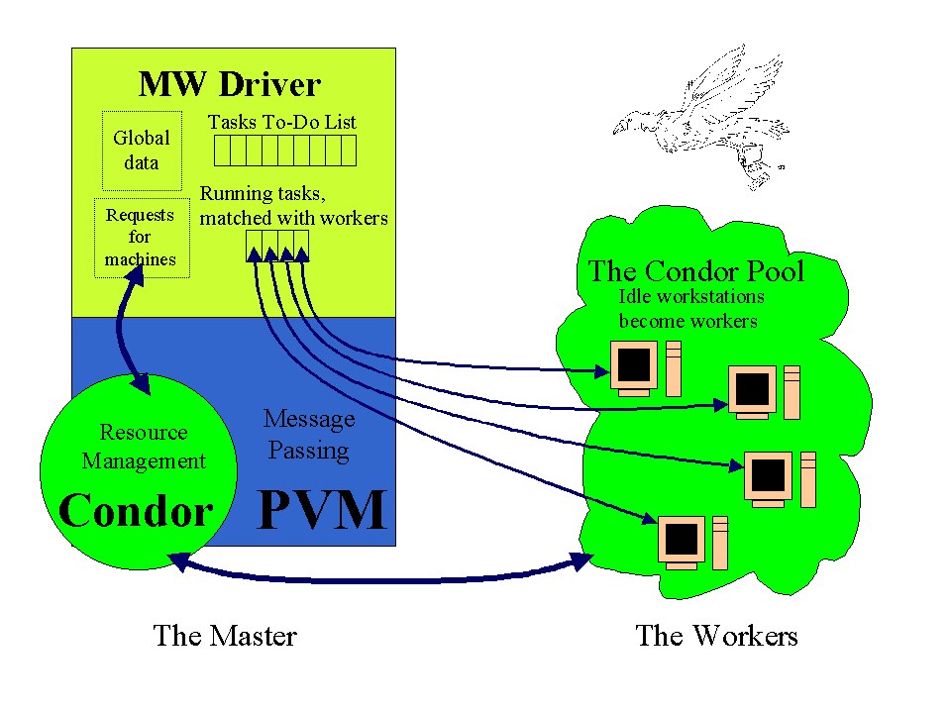

Slide 23
MW and NUG30
  quadratic assignment problem
  30 facilities, 30 locations
    minimize cost of transferring materials between them
  posed in 1968 as challenge, long unsolved
  but with a good pruning algorithm & high-throughput computing...
Notes:
http://www-unix.mcs.anl.gov/metaneos/nug30/pr.html

Slide 24
NUG30 Solved on the Grid with Condor + Globus
Resource simultaneously utilized:
the Origin 2000 (through LSF ) at NCSA.
the Chiba City Linux cluster at Argonne
the SGI Origin 2000 at Argonne.
the main Condor pool at Wisconsin (600 processors)
the Condor pool at Georgia Tech (190 Linux boxes)
the Condor pool at UNM (40 processors)
the Condor pool at Columbia (16 processors)
the Condor pool at Northwestern (12 processors)
the Condor pool at NCSA (65 processors)
the Condor pool at INFN (200 processors)

Slide 25
NUG30 - Solved!!!
Sender: goux@dantec.ece.nwu.edu
Subject: Re: Let the festivities begin.
Hi dear Condor Team,
you all have been amazing. NUG30 required 10.9 years of Condor Time. In just seven days !
More stats tomorrow !!! We are off celebrating !
condor rules !
cheers,
JP.

Slide 26
Condor Perl Module
Perl module to parse the “job log file”
Recommended instead of polling w/ condor_q
Call-back event model
(Note: job log can be written in XML)

Slide 27
“Standalone” Checkpointing
Can use Condor Project’s checkpoint technology outside of Condor…
  SIGTSTP = checkpoint and exit
  SIGUSR2 = periodic checkpoint
condor_compile cc myapp.c –o myapp
myapp -_condor_ckpt foo-image.ckpt
…
myapp -_condor_restart foo-image.ckpt

Slide 28
Checkpoint Library Interface
void init image with file name( char *ckpt file name )
void init image with file descriptor( int fd )
void ckpt()
void ckpt and exit()
void restart()
void condor ckpt disable()
void condor ckpt enable()
int condor warning config( const char *kind,const char *mode)
extern int condor compress ckpt
Notes:
void init image with file name( char *ckpt file name )
This function explicitly sets a le name to use when producing or using a checkpoint. ckpt()
or ckpt and exit() must be called to produce the checkpoint, and restart() must be
called to perform the actual restart.
void init image with file descriptor( int fd )
This function explicitly sets a le descriptor to use when producing or using a checkpoint.
ckpt() or ckpt and exit() must be called to produce the checkpoint, and restart()
must be called to perform the actual restart.
void ckpt()
This function causes a checkpoint image to be written to disk. The program will continue to
execute. This is identical to sending the program a SIGUSR2 signal.
void ckpt and exit()
This function causes a checkpoint image to be writtent to disk. The program will then exit.
This is identical to sending the program a SIGTSTP signal.
void restart()
This function causes the program to read the checkpoint image and to resume execution of the
program from the point where the checkpoint was taken. This function does not return.
void condor ckpt disable()
This function temporarily disables checkpointing. This can be handy if your program does
something that is not checkpoint-safe. For example, if a program must not be interrupted
while accessing a special le, call condor ckpt disable(), access the le, and then
call condor ckpt enable(). Some program actions, such as opening a socket or a pipe,
implicitly cause checkpointing to be disabled.
void condor ckpt enable()
This function re-enables checkpointing after a call to condor ckpt disable(). If
a checkpointing signal arrived while checkpointing was disabled, the checkpoint will occur
when this function is called. Disabling and enabling of checkpointing must occur
Condor Version 6.5.3 Manual
4.3. The Condor Perl Module 236
in matched pairs. condor ckpt enable() must be called once for every time that
condor ckpt disable() is called.
int condor warning config( const char *kind, const char *mode
)
This function controls what warnings are displayed by Condor. The kind and mode
arguments are the same as for the - condor warning option described in section 4.2.3.
This function returns true if the arguments are understood and accepted. Otherwise, it returns
false.
extern int condor compress ckpt
Setting this variable to one causes checkpoint images to be compressed. Setting it to zero
disables compression.

