Slide 1
Condor Tutorial
Asia Pacific Grid Workshop
Tokyo, Japan
October 2001

Slide 2
Tutorial Outline
Overview
The Story of Frieda, the Scientist
  Using Condor to manage jobs
  Using Condor to manage resources
  Condor Architecture and Mechanisms
  Condor on the Grid
    Flocking
    Condor-G
Case Study: Distributed TeraFlop

Slide 3
What is Condor?
Condor converts collections of distributively owned workstations and dedicated clusters into a distributed high-throughput computing facility.
Condor uses ClassAd Matchmaking to make sure that everyone is happy.

Slide 4
The Condor System
Unix and NT
Operational since 1986
Manages more than 1300 CPUs at UW-Madison
Software available free on the web
More than 150 Condor installations worldwide in academia and industry

Slide 5
Upgrade to Condor-G
A Grid-enabled version of Condor that provides robust job management for Globus.
  Robust replacement for globusrun
  Provides extensive fault-tolerance
  Brings Condor’s job management features to Globus jobs

Slide 6

Meet Frieda.
She is a scientist. But she has a big
problem.

Slide 7
Frieda’s Application …
Simulate the behavior of F(x,y,z) for 20 values of x, 10 values of y and 3 values of z (20*10*3 = 600 combinations)
  F takes on the average 3 hours to compute on a “typical” workstation (total = 1800 hours)
  F requires a “moderate” (128MB) amount of memory
  F performs “moderate” I/O - (x,y,z) is 5 MB and F(x,y,z) is 50 MB

Slide 8

I have 600 simulations to run.
Where can I get help?

Slide 9
Install a
Personal Condor!

Slide 10
Installing Condor
Download Condor for your operating system
Available as a free download from
http://www.cs.wisc.edu/condor
Stable –vs- Developer Releases
  Naming scheme similar to the Linux Kernel…
Available for most Unix platforms and Windows NT

Slide 11
So Frieda Installs Personal Condor on her machine…
What do we mean by a “Personal” Condor?
  Condor on your own workstation, no root access required, no system administrator intervention needed
So after installation, Frieda submits her jobs to her Personal Condor…

Slide 12
600 Condor
jobs
your
workstation
personal
Condor

Slide 13
Personal Condor?!
What’s the benefit of a Condor “Pool” with just one user and one machine?

Slide 14
Your Personal Condor will ...
… keep an eye on your jobs and will keep you posted on their progress
… implement your policy on the execution order of the jobs
… keep a log of your job activities
… add fault tolerance to your jobs
… implement your policy on when the jobs can run on your workstation

Slide 15
Getting Started: Submitting Jobs to Condor
Choosing a “Universe” for your job
  Just use VANILLA for now
Make your job “batch-ready”
Creating a submit description file
Run condor_submit on your submit description file

Slide 16
Making your job batch-ready
Must be able to run in the background: no interactive input, windows, GUI, etc.
Can still use STDIN, STDOUT, and STDERR (the keyboard and the screen), but files are used for these instead of the actual devices
Organize data files

Slide 17
Creating a Submit Description File
A plain ASCII text file
Tells Condor about your job:
  Which executable, universe, input, output and error files to use, command-line arguments, environment variables, any special requirements or preferences (more on this later)
Can describe many jobs at once (a “cluster”) each with different input, arguments, output, etc.

Slide 18
Simple Submit Description File
# Simple condor_submit input file
# (Lines beginning with # are comments)
# NOTE: the words on the left side are not
# case sensitive, but filenames are!
Universe = vanilla
Executable = my_job
Queue

Slide 19
Running condor_submit
You give condor_submit the name of the submit file you have created
condor_submit parses the file, checks for errors, and creates a “ClassAd” that describes your job(s)
Sends your job’s ClassAd(s) and executable to the condor_schedd, which stores the job in its queue
  Atomic operation, two-phase commit
View the queue with condor_q

Slide 20
Running condor_submit
% condor_submit my_job.submit-file
Submitting job(s).
1 job(s) submitted to cluster 1.
% condor_q
-- Submitter: perdita.cs.wisc.edu : <128.105.165.34:1027> :
ID OWNER SUBMITTED RUN_TIME ST PRI SIZE CMD
1.0 frieda 6/16 06:52 0+00:00:00 I 0 0.0 my_job
1 jobs; 1 idle, 0 running, 0 held
%

Slide 21
Another Submit Description File
# Example condor_submit input file
# (Lines beginning with # are comments)
# NOTE: the words on the left side are not
# case sensitive, but filenames are!
Universe = vanilla
Executable = /home/wright/condor/my_job.condor
Input = my_job.stdin
Output = my_job.stdout
Error = my_job.stderr
Arguments = -arg1 -arg2
InitialDir = /home/wright/condor/run_1
Queue

Slide 22
“Clusters” and “Processes”
If your submit file describes multiple jobs, we call this a “cluster”
Each job within a cluster is called a “process” or “proc”
If you only specify one job, you still get a cluster, but it has only one process
A Condor “Job ID” is the cluster number, a period, and the process number (“23.5”)
Process numbers always start at 0

Slide 23
Example Submit Description File for a Cluster
# Example condor_submit input file that defines
# a cluster of two jobs with different iwd
Universe = vanilla
Executable = my_job
Arguments = -arg1 -arg2
InitialDir = run_0
Queue ← Becomes job 2.0
InitialDir = run_1
Queue ← Becomes job 2.1

Slide 24
% condor_submit my_job.submit-file
Submitting job(s).
2 job(s) submitted to cluster 2.
% condor_q
-- Submitter: perdita.cs.wisc.edu : <128.105.165.34:1027> :
ID OWNER SUBMITTED RUN_TIME ST PRI SIZE CMD
1.0 frieda 6/16 06:52 0+00:02:11 R 0 0.0 my_job
2.0 frieda 6/16 06:56 0+00:00:00 I 0 0.0 my_job
2.1 frieda 6/16 06:56 0+00:00:00 I 0 0.0 my_job
3 jobs; 2 idle, 1 running, 0 held
%

Slide 25
Submit Description File for a BIG Cluster of Jobs
The initial directory for each job is specified with the $(Process) macro, and instead of submitting a single job, we use “Queue 600” to submit 600 jobs at once
$(Process) will be expanded to the process number for each job in the cluster (from 0 up to 599 in this case), so we’ll have “run_0”, “run_1”, … “run_599” directories
All the input/output files will be in different directories!

Slide 26
Submit Description File for a BIG Cluster of Jobs
# Example condor_submit input file that defines
# a cluster of 600 jobs with different iwd
Universe = vanilla
Executable = my_job
Arguments = -arg1 –arg2
InitialDir = run_$(Process)
Queue 600

Slide 27
Using condor_rm
If you want to remove a job from the Condor queue, you use condor_rm
You can only remove jobs that you own (you can’t run condor_rm on someone else’s jobs unless you are root)
You can give specific job ID’s (cluster or cluster.proc), or you can remove all of your jobs with the “-a” option.

Slide 28
Temporarily halt a Job
Use condor_hold to place a job on hold
  Kills job if currently running
  Will not attempt to restart job until released
Use condor_release to remove a hold and permit job to be scheduled again

Slide 29
Using condor_history
Once your job completes, it will no longer show up in condor_q
You can use condor_history to view information about a completed job
The status field (“ST”) will have either a “C” for “completed”, or an “X” if the job was removed with condor_rm

Slide 30
Getting Email from Condor
By default, Condor will send you email when your jobs completes
  With lots of information about the run
If you don’t want this email, put this in your submit file:
  notification = never
If you want email every time something happens to your job (preempt, exit, etc), use this:
  notification = always

Slide 31
Getting Email from Condor (cont’d)
If you only want email in case of errors, use this:
  notification = error
By default, the email is sent to your account on the host you submitted from. If you want the email to go to a different address, use this:
  notify_user = email@address.here

Slide 32
A Job’s life story: The “User Log” file
A UserLog must be specified in your submit file:
  Log = filename
You get a log entry for everything that happens to your job:
  When it was submitted, when it starts executing, preempted, restarted, completes, if there are any problems, etc.
Very useful! Highly recommended!

Slide 33
Sample Condor User Log
000 (8135.000.000) 05/25 19:10:03 Job submitted from host: <128.105.146.14:1816>
...
001 (8135.000.000) 05/25 19:12:17 Job executing on host: <128.105.165.131:1026>
...
005 (8135.000.000) 05/25 19:13:06 Job terminated.
(1) Normal termination (return value 0)
Usr 0 00:00:37, Sys 0 00:00:00 - Run Remote Usage
Usr 0 00:00:00, Sys 0 00:00:05 - Run Local Usage
Usr 0 00:00:37, Sys 0 00:00:00 - Total Remote Usage
Usr 0 00:00:00, Sys 0 00:00:05 - Total Local Usage
9624 - Run Bytes Sent By Job
7146159 - Run Bytes Received By Job
9624 - Total Bytes Sent By Job
7146159 - Total Bytes Received By Job
...

Slide 34
Uses for the User Log
Easily read by human or machine
  C++ library and Perl Module for parsing UserLogs is available
Event triggers for meta-schedulers
  Like DagMan…
Visualizations of job progress
  Condor JobMonitor Viewer

Slide 35
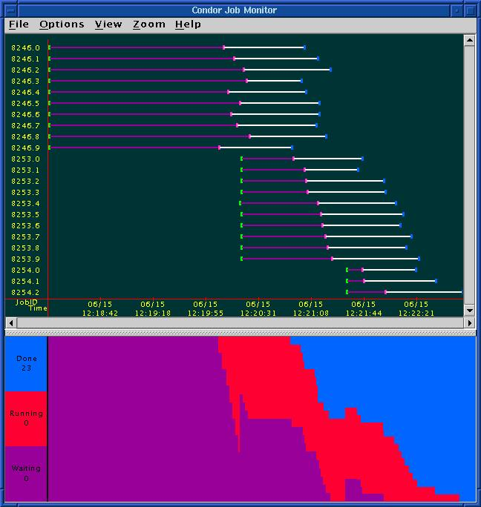
Condor JobMonitor
Screenshot

Slide 36
Job Priorities w/ condor_prio
condor_prio allows you to specify the order in which your jobs are started
Higher the prio #, the earlier the job will start
% condor_q
-- Submitter: perdita.cs.wisc.edu : <128.105.165.34:1027> :
ID OWNER SUBMITTED RUN_TIME ST PRI SIZE CMD
1.0 frieda 6/16 06:52 0+00:02:11 R 0 0.0 my_job
% condor_prio +5 1.0
% condor_q
-- Submitter: perdita.cs.wisc.edu : <128.105.165.34:1027> :
ID OWNER SUBMITTED RUN_TIME ST PRI SIZE CMD
1.0 frieda 6/16 06:52 0+00:02:13 R 5 0.0 my_job

Slide 37
Want other Scheduling possibilities?
Use the Scheduler Universe
In addition to VANILLA, another job universe is the Scheduler Universe.
Scheduler Universe jobs run on the submitting machine and serve as a meta-scheduler.
DAGMan meta-scheduler included

Slide 38
DAGMan
Directed Acyclic Graph Manager
DAGMan allows you to specify the dependencies between your Condor jobs, so it can manage them automatically for you.
(e.g., “Don’t run job “B” until job “A” has completed successfully.”)
Notes:
In the simplest case…

Slide 39
What is a DAG?
A DAG is the data structure used by DAGMan to represent these dependencies.
Each job is a “node” in the DAG.
Each node can have any number of “parent” or “children” nodes – as long as there are no loops!
Job A
Job B
Job C
Job D
Notes:
a DAG is the best data structure to represent a workflow of jobs with dependencies
children may not run until their parents have finished – this is why the graph is a directed graph … there’s a direction to the flow of work
In this example, called a “diamond” dag, job A must run first; when it finishes, jobs B and C can run together; when they are both finished, D can run; when D is finished the DAG is finished
Loops, where two jobs are both descended from one another, are prohibited because they would lead to deadlock – in a loop, neither node could run until the other finished, and so neither would start – this restriction is what makes the graph acyclic

Slide 40
Defining a DAG
A DAG is defined by a .dag file, listing each of its nodes and their dependencies:
  # diamond.dag
  Job A a.sub
  Job B b.sub
  Job C c.sub
  Job D d.sub
  Parent A Child B C
  Parent B C Child D
each node will run the Condor job specified by its accompanying Condor submit file
Job A
Job B
Job C
Job D
Notes:
This is all it takes to specify the example “diamond” dag

Slide 41
Submitting a DAG
To start your DAG, just run condor_submit_dag with your .dag file, and Condor will start a personal DAGMan daemon which to begin running your jobs:
  % condor_submit_dag diamond.dag
condor_submit_dag submits a Scheduler Universe Job with DAGMan as the executable.
Thus the DAGMan daemon itself runs as a Condor job, so you don’t have to baby-sit it.
Notes:
Just like any other Condor job, you get fault tolerance in case the machine crashes or reboots, or if there’s a network outage
And you’re notified when it’s done, and whether it succeeded or failed
% condor_q
-- Submitter: foo.bar.edu : <128.105.175.133:1027> : foo.bar.edu
ID OWNER SUBMITTED RUN_TIME ST PRI SIZE CMD
2456.0 user 3/8 19:22 0+00:00:02 R 0 3.2 condor_dagman -f -

Slide 42
Running a DAG
DAGMan acts as a “meta-scheduler”, managing the submission of your jobs to Condor based on the DAG dependencies.
DAGMan
A
Condor
Job
Queue
.dag
File
A
B
C
D
Notes:
First, job A will be submitted alone…

Slide 43
Running a DAG (cont’d)
DAGMan holds & submits jobs to the Condor queue at the appropriate times.
DAGMan
A
Condor
Job
Queue
B
B
C
C
D
Notes:
Once job A completes successfully, jobs B and C will be submitted at the same time…

Slide 44
Running a DAG (cont’d)
In case of a job failure, DAGMan continues until it can no longer make progress, and then creates a “rescue” file with the current state of the DAG.
DAGMan
A
Condor
Job
Queue
Rescue
File
B
X
D
Notes:
If job C fails, DAGMan will wait until job B completes, and then will exit, creating a rescue file. Job D will not run.
In its log, DAGMan will provide additional details of which node failed and why.

Slide 45
Recovering a DAG
Once the failed job is ready to be re-run, the rescue file can be used to restore the prior state of the DAG.
DAGMan
A
Condor
Job
Queue
Rescue
File
B
C
C
D
Notes:
Since jobs A and B have already completed, DAGMan will start by re-submitting job C

Slide 46
Recovering a DAG (cont’d)
Once that job completes, DAGMan will continue the DAG as if the failure never happened.
DAGMan
A
Condor
Job
Queue
B
C
D
D

Slide 47
Finishing a DAG
Once the DAG is complete, the DAGMan job itself is finished, and exits.
DAGMan
A
Condor
Job
Queue
B
C
D
Notes:
If job C fails, DAGMan will wait until job B completes, and then will exit, creating a rescue file.

Slide 48
Additional DAGMan Features
Provides other handy features for job management…
  nodes can have PRE & POST scripts
  failed nodes can be automatically re-tried a configurable number of times
  job submission can be “throttled”

Slide 49
We’ve seen how Condor will
… keep an eye on your jobs and will keep you posted on their progress
… implement your policy on the execution order of the jobs
… keep a log of your job activities
… add fault tolerance to your jobs ?

Slide 50

What if each job needed to run for 20 days?
What if I wanted to interrupt a job with a higher priority job?

Slide 51
Condor’s Standard Universe to the rescue!
Condor can support various combinations of features/environments in different “Universes”
Different Universes provide different functionality for your job:
  Vanilla – Run any Serial Job
  Scheduler – Plug in a meta-scheduler
  Standard – Support for transparent process checkpoint and restart

Slide 52
Process Checkpointing
Condor’s Process Checkpointing mechanism saves all the state of a process into a checkpoint file
  Memory, CPU, I/O, etc.
The process can then be restarted from right where it left off
Typically no changes to your job’s source code needed – however, your job must be relinked with Condor’s Standard Universe support library

Slide 53
Relinking Your Job for submission to the
Standard Universe
To do this, just place “condor_compile” in front of the command you normally use to link your job:
condor_compile gcc -o myjob myjob.c
OR
condor_compile f77 -o myjob filea.f fileb.f
OR
condor_compile make –f MyMakefile

Slide 54
Limitations in the
Standard Universe
Condor’s checkpointing is not at the kernel level. Thus in the Standard Universe the job may not
  Fork()
  Use kernel threads
  Use some forms of IPC, such as pipes and shared memory
Many typical scientific jobs are OK

Slide 55
When will Condor checkpoint your job?
Periodically, if desired
  For fault tolerance
To free the machine to do a higher priority task (higher priority job, or a job from a user with higher priority)
  Preemptive-resume scheduling
When you explicitly run condor_checkpoint, condor_vacate, condor_off or condor_restart command

Slide 56
What Condor Daemons are running on my machine, and what do they do?

Slide 57
Condor Daemon Layout
= Process Spawned
Personal Condor / Central Manager
master
startd
negotiator
schedd
collector

Slide 58
condor_master
Starts up all other Condor daemons
If there are any problems and a daemon exits, it restarts the daemon and sends email to the administrator
Checks the time stamps on the binaries of the other Condor daemons, and if new binaries appear, the master will gracefully shutdown the currently running version and start the new version

Slide 59
condor_master (cont’d)
Acts as the server for many Condor remote administration commands:
  condor_reconfig, condor_restart, condor_off, condor_on, condor_config_val, etc.

Slide 60
condor_startd
Represents a machine to the Condor system
Responsible for starting, suspending, and stopping jobs
Enforces the wishes of the machine owner (the owner’s “policy”… more on this soon)

Slide 61
condor_schedd
Represents users to the Condor system
Maintains the persistent queue of jobs
Responsible for contacting available machines and sending them jobs
Services user commands which manipulate the job queue:
  condor_submit,condor_rm, condor_q, condor_hold, condor_release, condor_prio, …

Slide 62
condor_collector
Collects information from all other Condor daemons in the pool
  “Directory Service” / Database for a Condor pool
Each daemon sends a periodic update called a “ClassAd” to the collector
Services queries for information:
  Queries from other Condor daemons
  Queries from users (condor_status)

Slide 63
condor_negotiator
Performs “matchmaking” in Condor
Gets information from the collector about all available machines and all idle jobs
Tries to match jobs with machines that will serve them
Both the job and the machine must satisfy each other’s requirements

Slide 64

Happy Day! Frieda’s organization purchased a Beowulf Cluster!
Frieda Installs Condor on all the dedicated Cluster nodes, and configures them with her machine as the central manager…
Now her Condor Pool can run multiple jobs at once

Slide 65
600 Condor
jobs
your
workstation
personal
Condor
Condor Pool

Slide 66
Layout of the Condor Pool
= Process Spawned
Cluster Node
Central Manager (Frieda’s)
= ClassAd
Communication
Pathway
master
master
startd
startd
negotiator
Cluster Node
schedd
collector
master
startd

Slide 67
condor_status
% condor_status
Name OpSys Arch State Activity LoadAv Mem ActvtyTime
haha.cs.wisc. IRIX65 SGI Unclaimed Idle 0.198 192 0+00:00:04
antipholus.cs LINUX INTEL Unclaimed Idle 0.020 511 0+02:28:42
coral.cs.wisc LINUX INTEL Claimed Busy 0.990 511 0+01:27:21
doc.cs.wisc.e LINUX INTEL Unclaimed Idle 0.260 511 0+00:20:04
dsonokwa.cs.w LINUX INTEL Claimed Busy 0.810 511 0+00:01:45
ferdinand.cs. LINUX INTEL Claimed Suspended 1.130 511 0+00:00:55
vm1@pinguino. LINUX INTEL Unclaimed Idle 0.000 255 0+01:03:28
vm2@pinguino. LINUX INTEL Unclaimed Idle 0.190 255 0+01:03:29

Slide 68
Frieda tries out parallel jobs…
MPI Universe & PVM Universe
Schedule and start an MPICH job on dedicated resources
Executable = my-mpi-job
Universe = MPI
Machine_count = 8
queue

Slide 69

The Boss says Frieda can add her co-workers’ desktop machines into her Condor pool as well… but only if they can also submit jobs.
(Boss Fat Cat)

Slide 70
Layout of the Condor Pool
= Process Spawned
Cluster Node
Central Manager (Frieda’s)
= ClassAd
Communication
Pathway
master
master
startd
startd
negotiator
Cluster Node
schedd
collector
master
startd
Desktop
Desktop
master
master
startd
startd
schedd
schedd

Slide 71
Some of the machines in the Pool do not have enough memory or scratch disk space to run my job!

Slide 72
Specify Requirements!
An expression (syntax similar to C or Java)
Must evaluate to True for a match to be made
Universe = vanilla
Executable = my_job
InitialDir = run_$(Process)
Requirements = Memory >= 256 && Disk > 10000
Queue 600

Slide 73
Specify Rank!
All matches which meet the requirements can be sorted by preference with a Rank expression.
Higher the Rank, the better the match
Universe = vanilla
Executable = my_job
Arguments = -arg1 –arg2
InitialDir = run_$(Process)
Requirements = Memory >= 256 && Disk > 10000
Rank = (KFLOPS*10000) + Memory
Queue 600

Slide 74
How can my jobs access their data files?

Slide 75
Access to Data in Condor
Use Shared Filesystem if available
No shared filesystem?
  Condor can transfer files
    Automatically send back changed files
    Atomic transfer of multiple files
  Standard Universe can use Remote System Calls

Slide 76
Remote System Calls
I/O System calls trapped and sent back to submit machine
Allows Transparent Migration Across Administrative Domains
  Checkpoint on machine A, restart on B
No Source Code changes required
Language Independent
Opportunities for Application Steering
  Example: Condor tells customer process “how” to open files

Slide 77
Job Startup
Schedd
Startd
Starter
Customer Job
Shadow
Submit
Condor
Syscall Lib

Slide 78
condor_q -io
c01(69)% condor_q -io
-- Submitter: c01.cs.wisc.edu : <128.105.146.101:2996> : c01.cs.wisc.edu
ID OWNER READ WRITE SEEK XPUT BUFSIZE BLKSIZE
72.3 edayton [ no i/o data collected yet ]
72.5 edayton 6.8 MB 0.0 B 0 104.0 KB/s 512.0 KB 32.0 KB
73.0 edayton 6.4 MB 0.0 B 0 140.3 KB/s 512.0 KB 32.0 KB
73.2 edayton 6.8 MB 0.0 B 0 112.4 KB/s 512.0 KB 32.0 KB
73.4 edayton 6.8 MB 0.0 B 0 139.3 KB/s 512.0 KB 32.0 KB
73.5 edayton 6.8 MB 0.0 B 0 139.3 KB/s 512.0 KB 32.0 KB
73.7 edayton [ no i/o data collected yet ]
0 jobs; 0 idle, 0 running, 0 held

Slide 79
I am adding nodes to the Cluster… but the Engineering Department has priority on these nodes.
Policy Configuration
(Boss Fat Cat)

Slide 80
The Machine (Startd) Policy Expressions
START – When is this machine willing to start a job
RANK - Job Preferences
SUSPEND - When to suspend a job
CONTINUE - When to continue a suspended job
PREEMPT – When to nicely stop running a job
KILL - When to immediately kill a preempting job

Slide 81
Freida’s Current Settings
START = True
RANK =
SUSPEND = False
CONTINUE =
PREEMPT = False
KILL = False

Slide 82
Freida’s New Settings for the Chemistry nodes
START = True
RANK = Department == “Chemistry”
SUSPEND = False
CONTINUE =
PREEMPT = False
KILL = False

Slide 83
Submit file with Custom Attribute
Executable = charm-run
Universe = standard
+Department = Chemistry
queue

Slide 84
What if “Department” not specified?
START = True
RANK = Department =!= UNDEFINED && Department == “Chemistry”
SUSPEND = False
CONTINUE =
PREEMPT = False
KILL = False

Slide 85
Another example
START = True
RANK = Department =!= UNDEFINED && ((Department == “Chemistry”)*2 + Department == “Physics”)
SUSPEND = False
CONTINUE =
PREEMPT = False
KILL = False

Slide 86
The Cluster is fine. But not the desktop machines. Condor can only use the desktops when they would otherwise be idle.
Policy Configuration, cont
(Boss Fat Cat)

Slide 87
So Frieda decides she wants the desktops to:
START jobs when their has been no activity on the keyboard/mouse for 5 minutes and the load average is low
SUSPEND jobs as soon as activity is detected
PREEMPT jobs if the activity continues for 5 minutes or more
KILL jobs if they take more than 5 minutes to preempt

Slide 88
Desktop Machine Policy
START = $(CPU_Idle) && KeyboardIdle > 300
SUSPEND = $(MachineBusy)
CONTINUE = $(CPU_Idle) && KeyboardIdle > 120
PREEMPT = (Activity == "Suspended") && $(ActivityTimer) > 300
KILL = $(ActivityTimer) > 300

Slide 89
Policy Review
Users submitting jobs can specify Requirements and Rank expressions
Administrators can specify Startd Policy expressions individually for each machine (Start,Suspend,etc)
Expressions can use any job or machine ClassAd attribute
Custom attributes easily added
Bottom Line: Enforce almost any policy!

Slide 90
General User Commands
condor_status View Pool Status
condor_q View Job Queue
condor_submit Submit new Jobs
condor_rm Remove Jobs
condor_prio Intra-User Prios
condor_history Completed Job Info
condor_submit_dag Specify Dependencies
condor_checkpoint Force a checkpoint
condor_compile Link Condor library

Slide 91
Administrator Commands
condor_vacate Leave a machine now
condor_on Start Condor
condor_off Stop Condor
condor_reconfig Reconfig on-the-fly
condor_config_val View/set config
condor_userprio User Priorities
condor_stats View detailed usage accounting stats

Slide 92
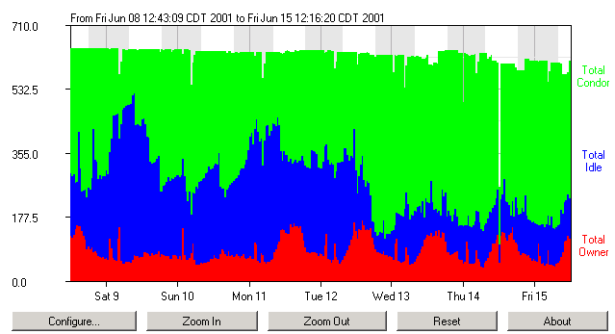
CondorView Usage Graph

Slide 93

Back to the Story…
Frieda Needs Remote Resources…

Slide 94
Frieda Goes to the Grid!
First Frieda takes advantage of her Condor friends!
She knows people with their own Condor pools, and gets permission to access their resources
She then configures her Condor pool to “flock” to these pools

Slide 95
600 Condor
jobs
your
workstation
personal
Condor
Condor Pool
Friendly Condor Pool

Slide 96
How Flocking Works
Add a line to your condor_config :
  FLOCK_HOSTS = Pool-Foo, Pool-Bar
Collector
Collector
Collector
Negotiator
Negotiator
Negotiator
Submit
Machine
Central
Manager
(CONDOR_HOST)
Pool-Foo
Central
Manager
Pool-Bar
Central
Manager
Schedd

Slide 97
Condor Flocking
Remote pools are contacted in the order specified until jobs are satisfied
The list of remote pools is a property of the Schedd, not the Central Manager
  So different users can Flock to different pools
  And remote pools can allow specific users
User-priority system is “flocking-aware”
  A pool’s local users can have priority over remote users “flocking” in.

Slide 98
Condor Flocking, cont.
Flocking is “Condor” specific technology…
Frieda also has access to Globus resources she wants to use
  She has certificates and access to Globus gatekeepers at remote institutions
But Frieda wants Condor’s queue management features for her Globus jobs!
She installs Condor-G so she can submit “Globus Universe” jobs to Condor

Slide 99


Condor-G: Globus + Condor
Globus
middleware deployed across entire Grid
remote access to computational resources
dependable, robust data transfer
Condor
job scheduling across multiple resources
strong fault tolerance with checkpointing and migration
layered over Globus as “personal batch system” for the Grid

Slide 100
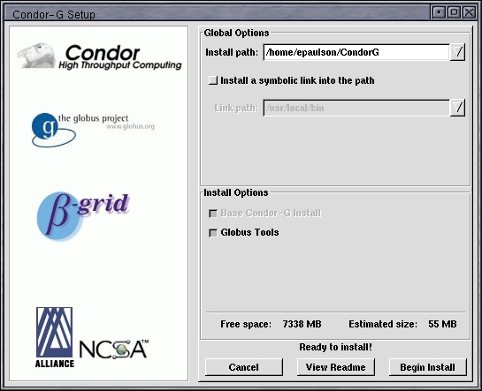
Condor-G Installation: Tell it what you need…

Slide 101
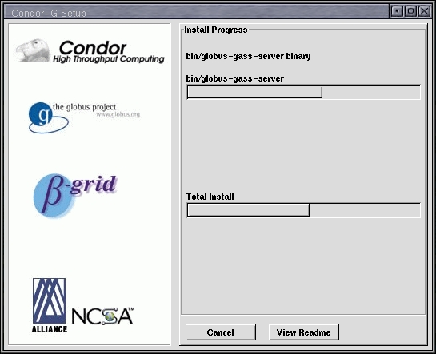
… and watch it go!

Slide 102
Frieda Submits a Globus Universe Job
In her submit description file, she specifies:
  Universe = Globus
  Which Globus Gatekeeper to use
  Optional: Location of file containing your Globus certificate
  universe = globus
  globusscheduler = beak.cs.wisc.edu/jobmanager
  executable = progname
  queue

Slide 103
How It Works
Personal Condor
Globus Resource
Schedd
LSF

Slide 104
How It Works
600 Globus
jobs
Personal Condor
Globus Resource
Schedd
LSF

Slide 105
How It Works
600 Globus
jobs
Personal Condor
Globus Resource
Schedd
LSF
GridManager

Slide 106
How It Works
600 Globus
jobs
Personal Condor
Globus Resource
JobManager
Schedd
LSF
GridManager

Slide 107
How It Works
600 Globus
jobs
Personal Condor
Globus Resource
JobManager
Schedd
LSF
GridManager
User Job

Slide 108
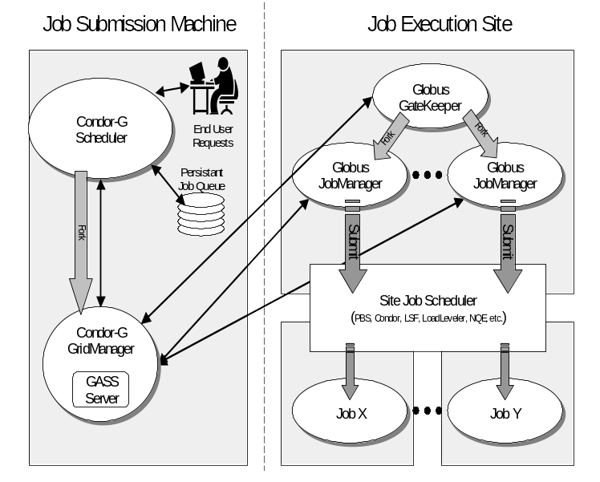
Condor Globus Universe

Slide 109
Globus Universe Concerns
What about Fault Tolerance?
  Local Crashes
    What if the submit machine goes down?
  Network Outages
    What if the connection to the remote Globus jobmanager is lost?
  Remote Crashes
    What if the remote Globus jobmanager crashes?
    What if the remote machine goes down?

Slide 110
Changes to the Globus JobManager for Fault Tolerance
Ability to restart a JobManager
Enhanced two-phase commit submit protocol

Slide 111
Globus Universe Fault-Tolerance: Submit-side Failures
All relevant state for each submitted job is stored persistently in the Condor job queue.
This persistent information allows the Condor GridManager upon restart to read the state information and reconnect to JobManagers that were running at the time of the crash.
If a JobManager fails to respond…

Slide 112
Globus Universe Fault-Tolerance:
Lost Contact with Remote Jobmanager
Can we contact gatekeeper?
Yes - jobmanager crashed
No – retry until we can talk to gatekeeper again…
Can we reconnect to jobmanager?
No – machine crashed or job completed
Yes – network was down
Restart jobmanager
Has job completed?
No – is job still running?
Yes – update queue

Slide 113
Globus Universe Fault-Tolerance: Credential Management
Authentication in Globus is done with limited-lifetime X509 proxies
Proxy may expire before jobs finish executing
Condor can put jobs on hold and email user to refresh proxy
Todo: Interface with MyProxy…

Slide 114
But Frieda Wants More…
She wants to run standard universe jobs on Globus-managed resources
  For matchmaking and dynamic scheduling of jobs
  For job checkpointing and migration
  For remote system calls

Slide 115
Solution: Condor GlideIn
Frieda can use the Globus Universe to run Condor daemons on Globus resources
When the resources run these GlideIn jobs, they will temporarily join her Condor Pool
She can then submit Standard, Vanilla, PVM, or MPI Universe jobs and they will be matched and run on the Globus resources

Slide 116
How It Works
600 Condor
jobs
Personal Condor
Globus Resource
Schedd
LSF
Collector

Slide 117
How It Works
600 Condor
jobs
Personal Condor
Globus Resource
Schedd
LSF
Collector
GlideIn jobs

Slide 118
How It Works
600 Condor
jobs
Personal Condor
Globus Resource
Schedd
LSF
GridManager
Collector
GlideIn jobs

Slide 119
How It Works
600 Condor
jobs
Personal Condor
Globus Resource
JobManager
Schedd
LSF
GridManager
Collector
GlideIn jobs

Slide 120
How It Works
600 Condor
jobs
Personal Condor
Globus Resource
JobManager
Schedd
LSF
GridManager
Startd
Collector
GlideIn jobs

Slide 121
How It Works
600 Condor
jobs
Personal Condor
Globus Resource
JobManager
Schedd
LSF
GridManager
Startd
Collector
GlideIn jobs

Slide 122
How It Works
600 Condor
jobs
Personal Condor
Globus Resource
JobManager
Schedd
LSF
GridManager
Startd
Collector
User Job
GlideIn jobs

Slide 123
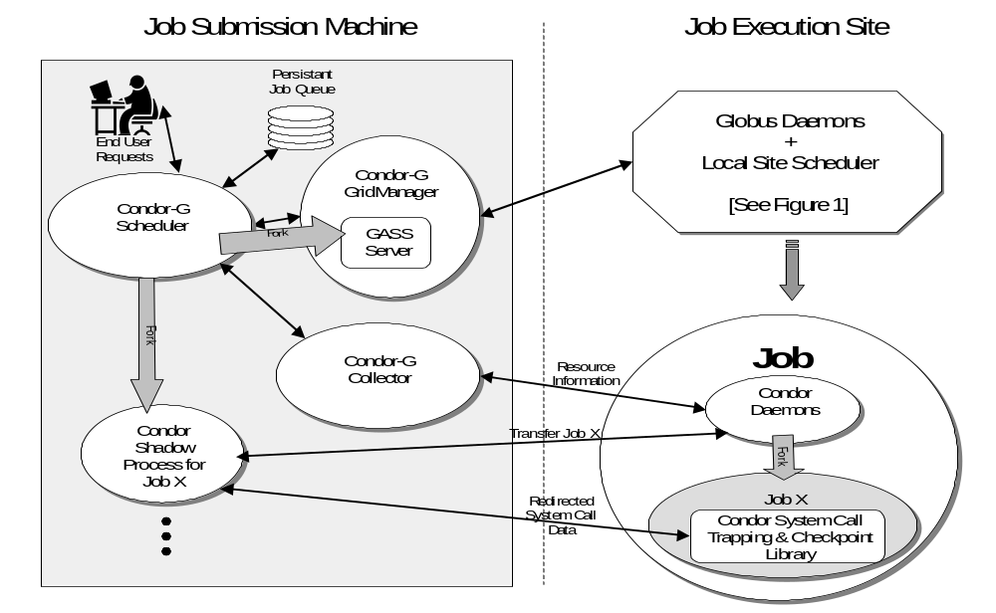

Slide 124
GlideIn Concerns
What if a Globus resource kills my GlideIn job?
  That resource will disappear from your pool and your jobs will be rescheduled on other machines
  Standard universe jobs will resume from their last checkpoint like usual
What if all my jobs are completed before a GlideIn job runs?
  If a GlideIn Condor daemon is not matched with a job in 10 minutes, it terminates, freeing the resource

Slide 125
Common Questions, cont.
My Personal Condor is flocking with a bunch of Solaris machines, and also doing a GlideIn to a Silicon Graphics O2K. I do not want to statically partition my jobs.
Solution: In your submit file, say:
Executable = myjob.$$(OpSys).$$(Arch)
The “$$(xxx)” notation is replaced with attributes from the machine ClassAd which was matched with your job.

Slide 126
In Review
With Condor Frieda can…
  … manage her compute job workload
  … access local machines
  … access remote Condor Pools via flocking
  … access remote compute resources on the Grid via Globus Universe jobs
  … carve out her own personal Condor Pool from the Grid with GlideIn technology

Slide 127
Globus Grid
600 Condor
jobs
PBS
LSF
your
workstation
personal
Condor
Condor Pool
glide-in jobs
Friendly Condor Pool
Condor

Slide 128
Case Study: CMS Production
An ongoing collaboration between:
  Physicists & Computer Scientists
    Vladimir Litvin (Caltech CMS)
    Scott Koranda, Bruce Loftis, John Towns (NCSA)
    Miron Livny, Peter Couvares, Todd Tannenbaum, Jamie Frey (UW-Madison Condor)
  Software
    Condor, Globus, CMS

Slide 129
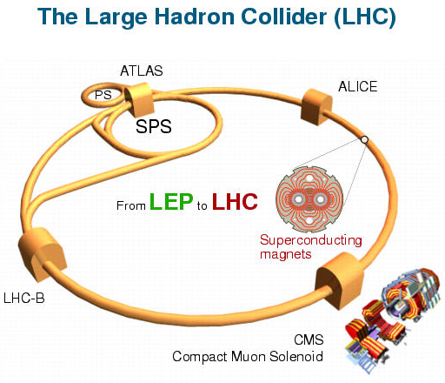
CMS Physics
The CMS detector at the LHC will probe fundamental forces in our Universe and search for the yet-undetected Higgs Boson
  Detector expected to come online 2006

Slide 130
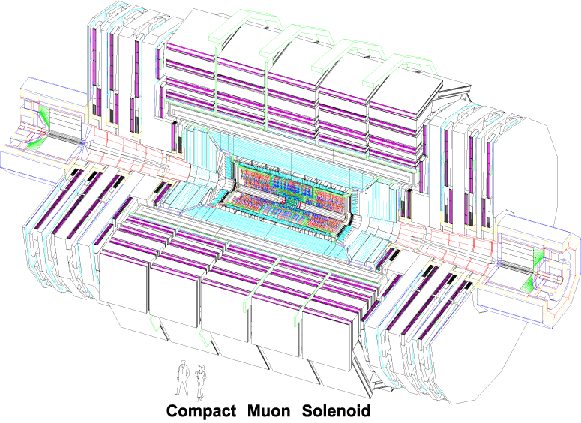
CMS Physics
Notes:
Here’s a picture of the detector itself… ooooh, aaaaah.

Slide 131
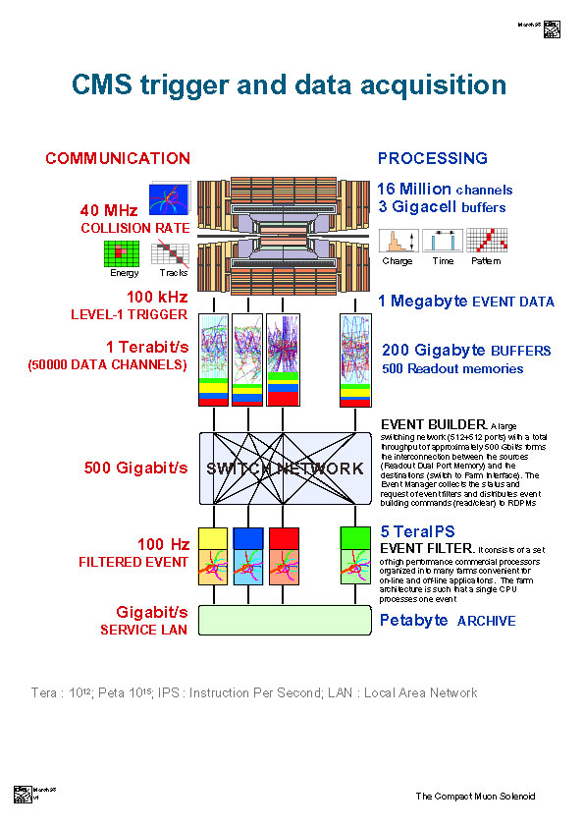
ENORMOUS Data Challenges Ahead
One sec of CMS running will equal data volume equivalent to 10,000 Encyclopaedia Britannicas
Data rate handled by the CMS event builder (~500 Gbit/s) will be equivalent to amount of data currently exchanged by the world's telecom networks
Number of processors in the CMS event filter will equal number of workstations at CERN today (~4000)
Notes:
Ignore left-hand side – go through diagram quickly – 1 Tb/s to 500 Gb/s to 1 Gb/s archived - Lots of data to analyze later.

Slide 132
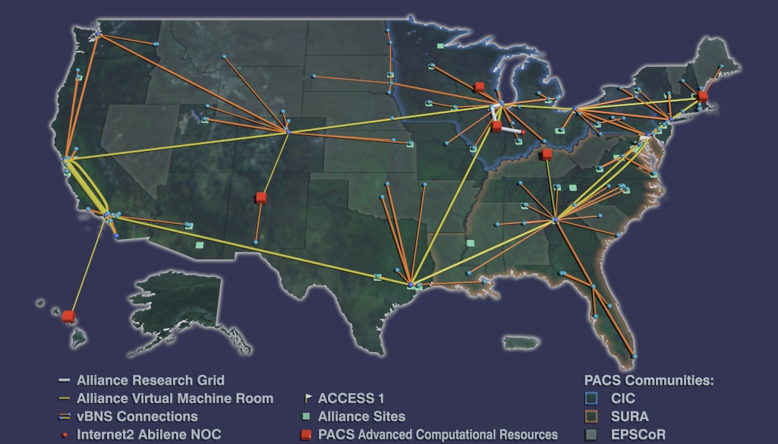
Leveraging Grid Resources
The Caltech CMS group is using Grid resources today for detector simulation and data processing prototyping
Even during this simulation and prototyping phase the computational and data challenges are substantial…

Slide 133
Challenges of a CMS Run
CMS run naturally divided into two phases
Specific challenges
  each run generates ~100 GB of data to be moved and archived elsewhere
  many, many runs necessary
  simulation & reconstruction jobs at different sites
  this can require major human effort starting & monitoring jobs, moving data
  Monte Carlo detector response simulation
    100’s of jobs per run
    each generating ~ 1 GB
    all data passed to next phase and archived
  physics reconstruction from simulated data
    100’s of jobs per run
    jobs coupled via Objectivity database access
    ~100 GB data archived

Slide 134


CMS Run on the Grid
Caltech CMS staff prepares input files on local workstation
Pushes “one button” to submit a DAGMan job to Condor
DAGMan job at Caltech submits secondary DAGMan job to UW Condor pool (~700 CPUs)
Input files transferred by Condor to UW pool using Globus GASS file transfer
Condor DAGMan job running at Caltech
Caltech workstation
Input files via Globus GASS
UW Condor pool

Slide 135
CMS Run on the Grid
Secondary DAGMan job launches 100 Monte Carlo jobs on Wisconsin Condor pool
  each job runs 12~24 hours
  each generates ~1GB data
  Condor handles checkpointing & migration
  no staff intervention
Condor DAGMan job running at Caltech
Globus
Globus
Secondary Condor DAGMan job on WI pool
100 Monte Carlo jobs on Wisconsin Condor pool

Slide 136
CMS Run on the Grid
100 Monte Carlo jobs on Wisconsin Condor pool
When each Monte Carlo job completes, data automatically transferred to UniTree at NCSA by a POST script
  each file ~ 1 GB
  transferred by calling Globus-enabled FTP client “gsiftp”
  NCSA UniTree runs Globus-enabled FTP server
  authentication to FTP server on user’s behalf using digital certificate
100 data files transferred via Globus gsiftp (~ 1 GB each)
NCSA UniTree with
Globus-enabled FTP server

Slide 137
CMS Run on the Grid
When all Monte Carlo jobs complete, Condor DAGMan at UW reports success to DAGMan at Caltech
DAGMan at Caltech submits another Globus-universe job to Condor to stage data from NCSA UniTree to NCSA Linux cluster
  data transferred using Globus-enabled FTP
  authentication on user’s behalf using digital certificate
Condor DAGMan job running at Caltech
Secondary DAGMan reports success
Secondary Condor DAGMan job on WI pool
Condor starts job via Globus jobmanager on cluster to stage data
NCSA Linux cluster
gsiftp fetches data from UniTree

Slide 138
CMS Run on the Grid
Master Condor job running at Caltech
Condor DAGMan at Caltech launches physics reconstruction jobs on NCSA Linux cluster
  job launched via Globus jobmanager on NCSA cluster
  no user intervention required
  authentication on user’s behalf using digital certificate
Master starts reconstruction jobs via Globus jobmanager on cluster
NCSA Linux cluster

Slide 139
CMS Run on the Grid
When reconstruction jobs at NCSA complete, data automatically archived to NCSA UniTree
  data transferred using Globus-enabled FTP
After data transferred, DAGMan run is complete, and Condor at Caltech emails notification to staff
NCSA Linux cluster
data files transferred via Globus gsiftp to UniTree for archiving

Slide 140
CMS Run Details
Condor + Globus
allows Condor to submit jobs to remote host via a Globus jobmanager
any Globus-enabled host reachable (with authorization)
Condor jobs run in the “Globus” universe
use familiar Condor classads for submitting jobs
universe = globus
globusscheduler
= beak.cs.wisc.edu/jobmanager-
condor-INTEL-LINUX
environment = CONDOR_UNIVERSE=scheduler
executable = CMS/condor_dagman_run
arguments = -f -t -l . -Lockfile cms.lock
-Condorlog cms.log -Dag
cms.dag -Rescue cms.rescue
input = CMS/hg_90.tar.gz
remote_initialdir
= Prod2001
output = CMS/hg_90.out
error = CMS/hg_90.err
log = CMS/condor.log
notification = always
queue

Slide 141
CMS Run Details
At Caltech, DAGMan ensures reconstruction job B runs only after simulation job A completes successfully & data is transferred
At UW, no job dependencies, but DAGMan POST scripts used to stage out data
# Caltech: main.dag
Job jobA_632 Prod2000/hg_90_gen_632.cdr
Job jobB_632 Prod2000/hg_90_sim_632.cdr
Script pre jobA_632 Prod2000/pre_632.csh
Script post jobB_632 Prod2000/post_632.csh
PARENT jobA_632 CHILD jobB_632
# UW: simulation.dag
Job sim_0 sim_0.cdr
Script post sim_0 post_0.csh
Job sim_1 sim_1.cdr
Script post sim_1 post_1.csh
# ...
Job sim_98 sim98.cdr
Script post sim_98 post_98.csh
Job sim_99 sim_99.cdr
Script post sim_99 post_99.csh

Slide 142
Future Directions
Master Condor job running at Caltech
Include additional sites in both steps:
  allow Monte Carlo jobs at Wisconsin to “glide-in” to Grid sites not running Condor
  add path so that physics reconstruction jobs may run on other sites in addition to NCSA cluster
Secondary Condor job on WI pool
25 Monte Carlo jobs on LosLobos via Condor glide-in
75 Monte Carlo jobs on Wisconsin Condor pool

Slide 143

1) Submit DAGMan to Condor
2) Launch secondary DAGMan job on UW pool; input files via Globus GASS
Condor DAGMan running at Caltech
Secondary Condor DAGMan job on UW pool
5) UW DAGMan reports success to Caltech DAGMan
Caltech workstation
6) DAGMan starts reconstruction jobs via Globus jobmanager on cluster
3) Monte Carlo jobs on UW Condor pool
9) Reconstruction job reports success to DAGMan
4) data files transferred via gsiftp, ~ 1 GB each
7) gsiftp fetches data from UniTree
NCSA Linux cluster OR
UNM Linux Cluster
8) Processed objectivity database stored to UniTree
NCSA UniTree - Globus-enabled FTP server

Slide 144
Thank you!
Check us out on the Web:
http://www.cs.wisc.edu/condor
Email:
condor-admin@cs.wisc.edu

