Slide 1
High Throughput
Computing

Slide 2
10 years ago we had
“The Grid”

Slide 3
The Grid: Blueprint for a New Computing Infrastructure
Edited by Ian Foster and Carl Kesselman
July 1998, 701 pages.
The grid promises to fundamentally change the way we think about and use computing. This infrastructure will connect multiple regional and national computational grids, creating a universal source of pervasive and dependable computing power that supports dramatically new classes of applications. The Grid provides a clear vision of what computational grids are, why we need them, who will use them, and how they will be programmed.

Slide 4
“ … We claim that these mechanisms, although originally developed in the context of a cluster of workstations, are also applicable to computational grids. In addition to the required flexibility of services in these grids, a very important concern is that the system be robust enough to run in “production mode” continuously even in the face of component failures. … “
Miron Livny & Rajesh Raman, "High Throughput Resource Management", in “The Grid: Blueprint for
a New Computing Infrastructure”.

Slide 5
In the words of the
CIO of Hartford Life
Resource: What do you expect to gain from grid computing? What are your main goals?
Severino: Well number one was scalability. …
Second, we obviously wanted scalability with stability. As we brought more servers and desktops onto the grid we didn’t make it any less stable by having a bigger environment.
The third goal was cost savings. One of the most …

Slide 6
2,000 years ago we had the words of
Koheleth son of David king in Jerusalem

Slide 7
The words of Koheleth son of David, king in Jerusalem ….
  Only that shall happen
  Which has happened,
  Only that occur
  Which has occurred;
  There is nothing new
  Beneath the sun!
Ecclesiastes Chapter 1 verse 9

Slide 8
35 years ago we had
The ALOHA network

Slide 9
One of the early computer networking designs, the ALOHA network was created at the University of Hawaii in 1970 under the leadership of Norman Abramson. Like the ARPANET group, the ALOHA network was built with DARPA funding. Similar to the ARPANET group, the ALOHA network was built to allow people in different locations to access the main computer systems. But while the ARPANET used leased phone lines, the ALOHA network used packet radio.
ALOHA was important because it used a shared medium for transmission. This revealed the need for more modern contention management schemes such as CSMA/CD, used by Ethernet. Unlike the ARPANET where each node could only talk to a node on the other end, in ALOHA everyone was using the same frequency. This meant that some sort of system was needed to control who could talk at what time. ALOHA's situation was similar to issues faced by modern Ethernet (non-switched) and Wi-Fi networks.
This shared transmission medium system generated interest by others. ALOHA's scheme was very simple. Because data was sent via a teletype the data rate usually did not go beyond 80 characters per second. When two stations tried to talk at the same time, both transmissions were garbled. Then data had to be manually resent. ALOHA did not solve this problem, but it sparked interest in others, most significantly Bob Metcalfe and other researchers working at Xerox PARC. This team went on to create the Ethernet protocol.

Slide 10
30 years ago we had
Distributed
Processing
Systems

Slide 11
Claims for “benefits” provided by Distributed Processing Systems
P.H. Enslow, “What is a Distributed Data Processing System?” Computer, January 1978
  High Availability and Reliability
  High System Performance
  Ease of Modular and Incremental Growth
  Automatic Load and Resource Sharing
  Good Response to Temporary Overloads
  Easy Expansion in Capacity and/or Function

Slide 12
Definitional Criteria for a Distributed Processing System
P.H. Enslow and T. G. Saponas “”Distributed and Decentralized Control in Fully Distributed Processing Systems” Technical Report, 1981
  Multiplicity of resources
  Component interconnection
  Unity of control
  System transparency
  Component autonomy

Slide 13
Multiplicity of resources
The system should provide a number of assignable resources for any type of service demand. The greater the degree of replication of resources, the better the ability of the system to maintain high reliability and performance

Slide 14
Component interconnection
A Distributed System should include a communication subnet which interconnects the elements of the system. The transfer of information via the subnet should be controlled by a two-party, cooperative protocol (loose coupling).

Slide 15
Unity of Control
All the component of the system should be unified in their desire to achieve a common goal. This goal will determine the rules according to which each of these elements will be controlled.

Slide 16
System transparency
From the users point of view the set of resources that constitutes the Distributed Processing System acts like a “single virtual machine”. When requesting a service the user should not require to be aware of the physical location or the instantaneous load of the various resources

Slide 17
Component autonomy
The components of the system, both the logical and physical, should be autonomous and are thus afforded the ability to refuse a request of service made by another element. However, in order to achieve the system’s goals they have to interact in a cooperative manner and thus adhere to a common set of policies. These policies should be carried out by the control schemes of each element.

Slide 18
Challenges
Name spaces …
Distributed ownership …
Heterogeneity …
Object addressing …
Data caching …
Object Identity …
Trouble shooting …
Circuit breakers …

Slide 19
24 years ago I wrote a Ph.D. thesis –
“Study of Load Balancing Algorithms for Decentralized Distributed Processing Systems”
http://www.cs.wisc.edu/condor/doc/livny-dissertation.pdf

Slide 20
BASICS OF A M/M/1 SYSTEM
Expected # of customers is 1/(1-ρ), where (ρ = λ/μ) is the utilization
λ
When utilization is 80%,
you wait on the average 4 units
for every unit of service
μ

Slide 21
BASICS OF TWO M/M/1 SYSTEMS
When utilization is 80%,
you wait on the average 4 units
for every unit of service
λ
λ
When utilization is 80%,
25% of the time a customer is
waiting for service while
a server is idle
μ
μ

Slide 22
Wait while Idle (WwI) in m*M/M/1
1
m = 20
m = 10
Prob
(WwI)
m = 5
m = 2
0
0
Utilization
1

Slide 23
“ … Since the early days of mankind the primary motivation for the establishment of communities has been the idea that by being part of an organized group the capabilities of an individual are improved. The great progress in the area of inter-computer communication led to the development of means by which stand-alone processing sub-systems can be integrated into multi-computer ‘communities’. … “
Miron Livny, “ Study of Load Balancing Algorithms for Decentralized Distributed Processing Systems.”,
Ph.D thesis, July 1983.

Slide 24
20 years ago we had
“Condor”

Slide 25
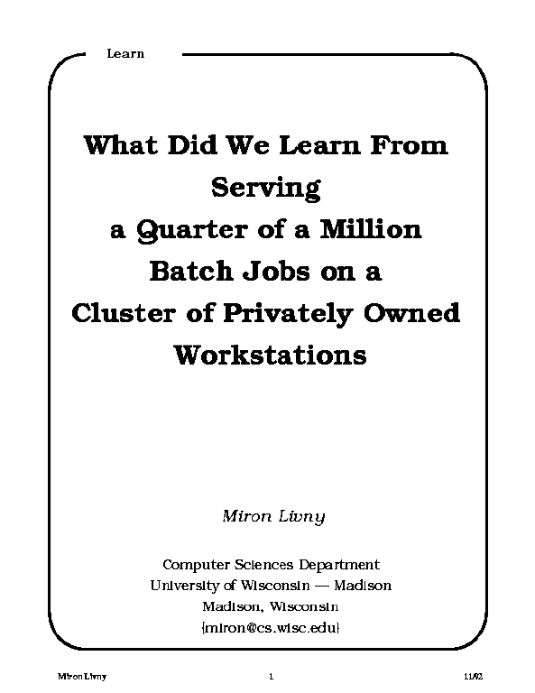
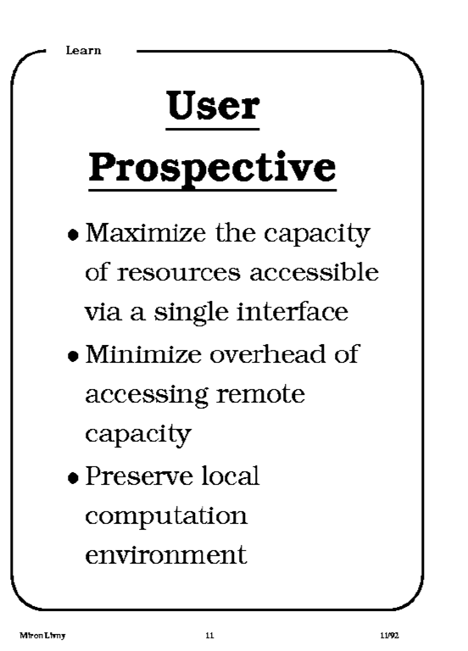
1992

Slide 26
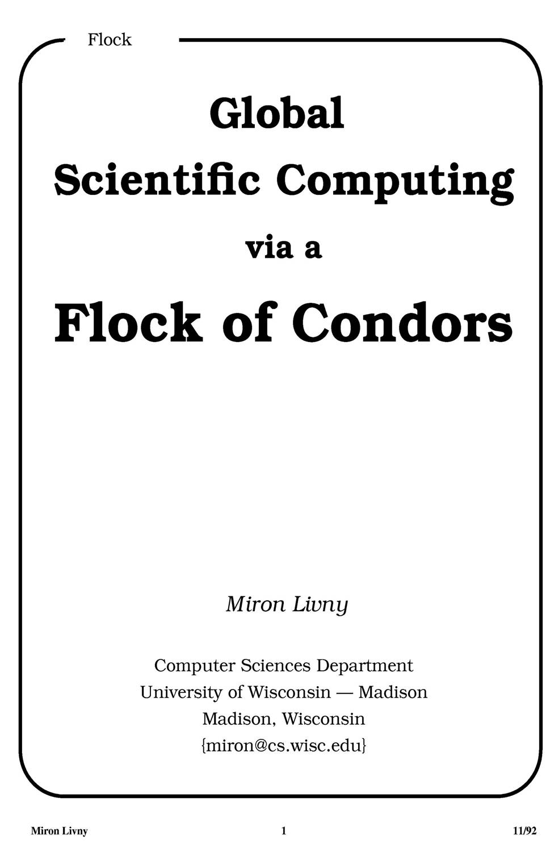
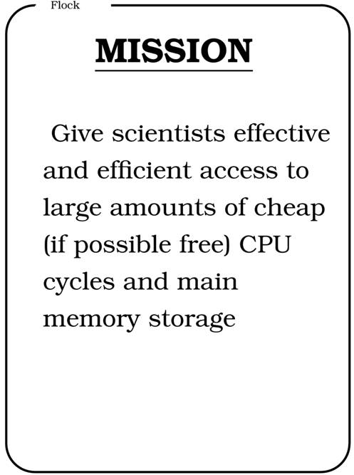
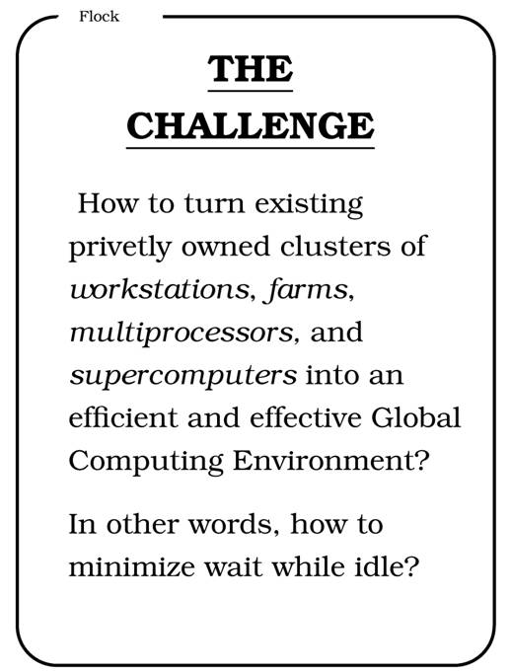
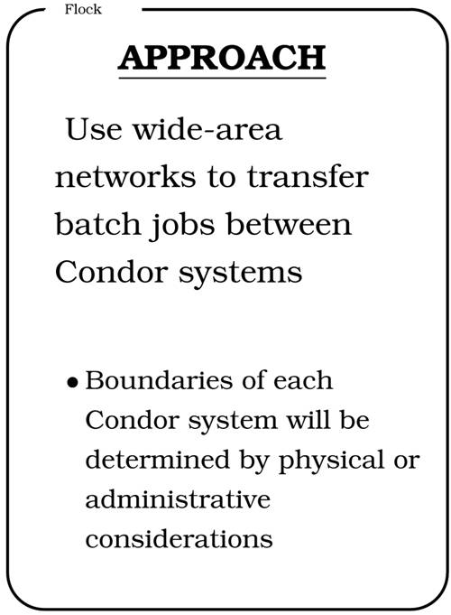
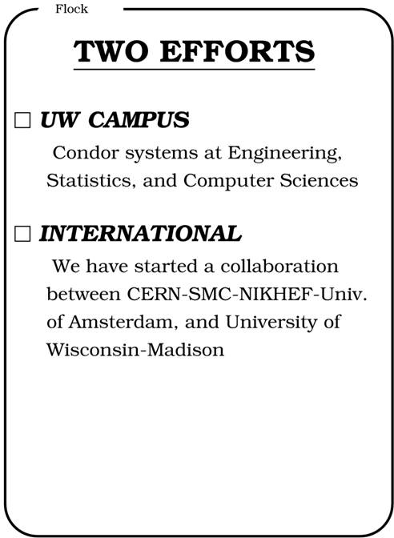
CERN 92

Slide 27
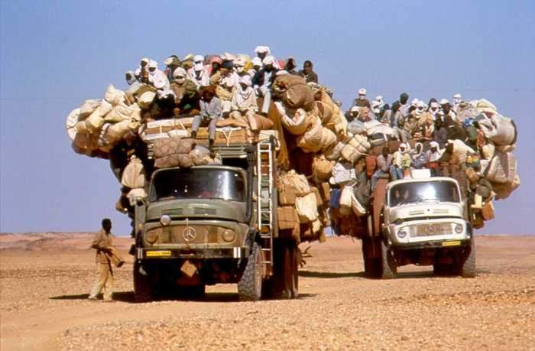
We are still very busy

Slide 28
1986-2006
Celebrating
20 years since we first installed Condor in our department

Slide 29
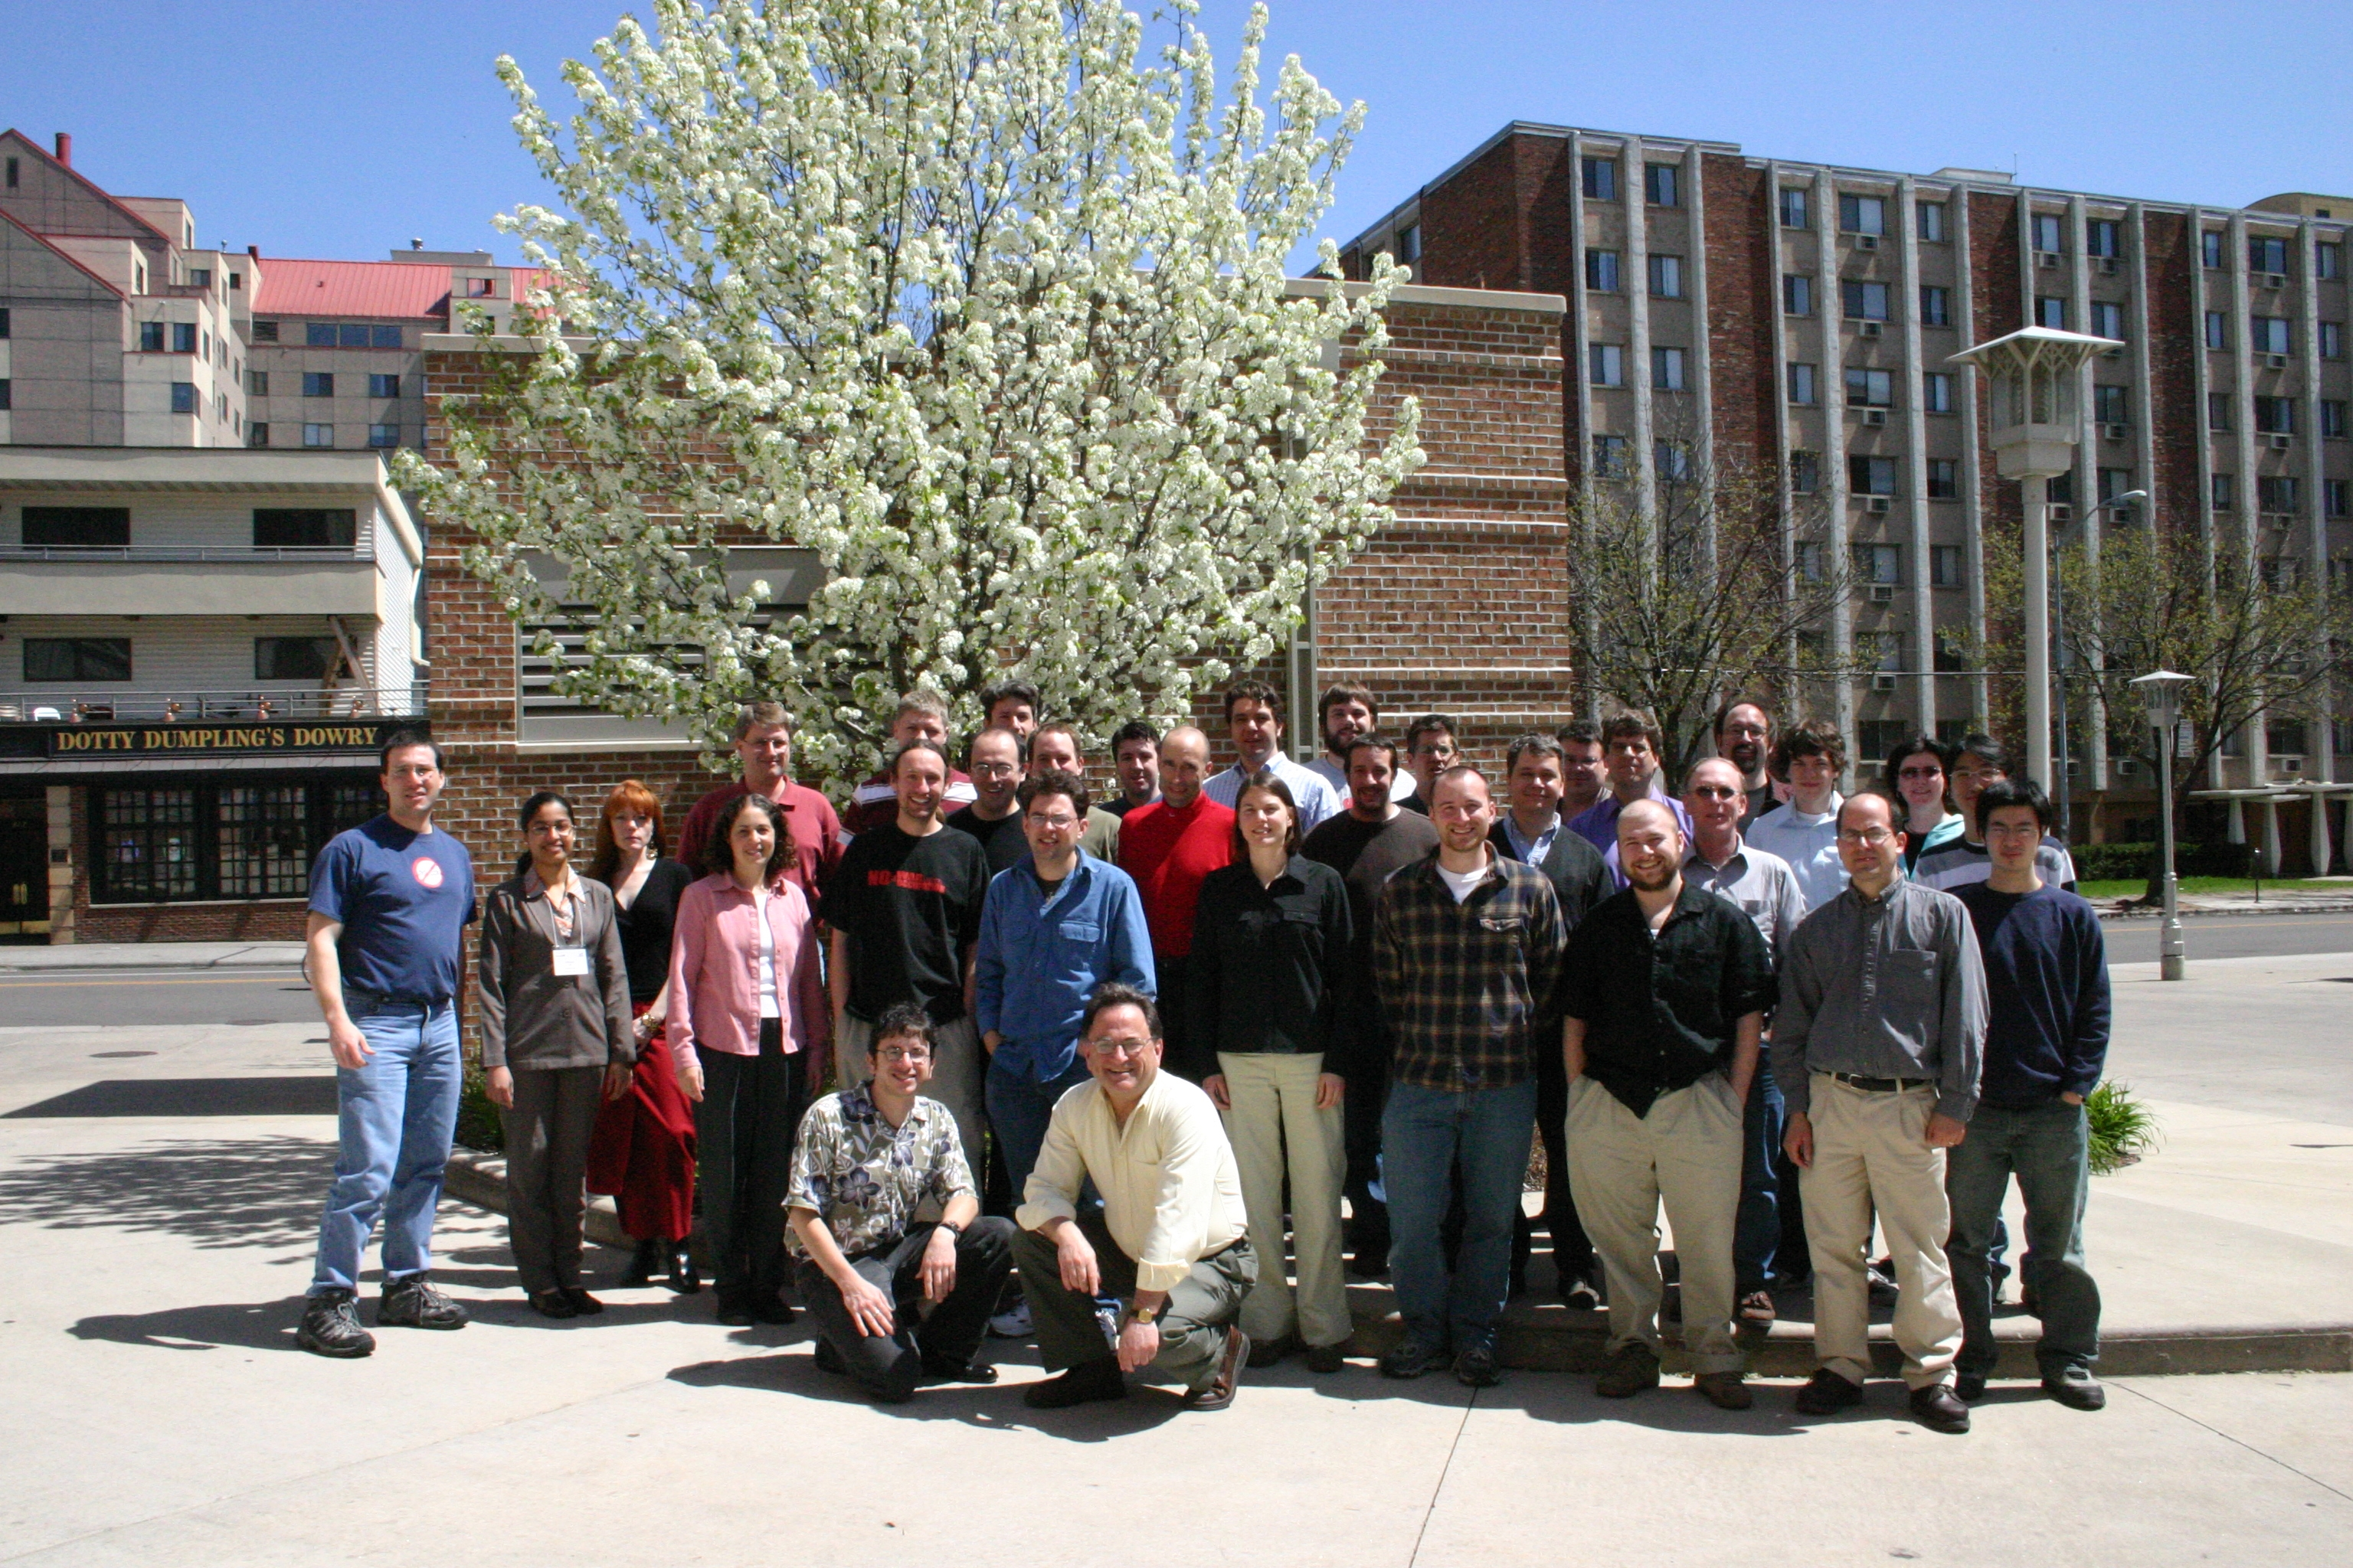
Welcome to CW 2007!!!

Slide 30
The Condor Project (Established ‘85)
Distributed Computing research performed by a team of ~40 faculty, full time staff and students who
  face software/middleware engineering challenges in a UNIX/Linux/Windows/OS X environment,
  involved in national and international collaborations,
  interact with users in academia and industry,
  maintain and support a distributed production environment (more than 4000 CPUs at UW),
  and educate and train students.

Slide 31
Excellence
S
u
p
p
o
r
t
Software Functionality
Research

Slide 32
Main Threads of Activities
Distributed Computing Research – develop and evaluate new concepts, frameworks and technologies
Keep Condor “flight worthy” and support our users
The Open Science Grid (OSG) – build and operate a national High Throughput Computing infrastructure
The Grid Laboratory Of Wisconsin (GLOW) – build, maintain and operate a distributed computing and storage infrastructure on the UW campus The NSF Middleware Initiative
Develop, build and operate a national Build and Test facility powered by Metronome

Slide 33
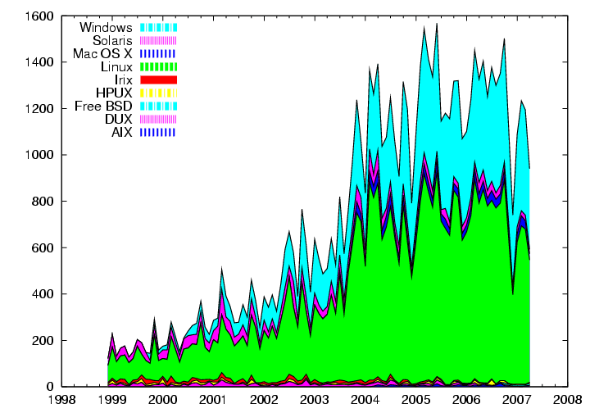
Downloads per month

Slide 34
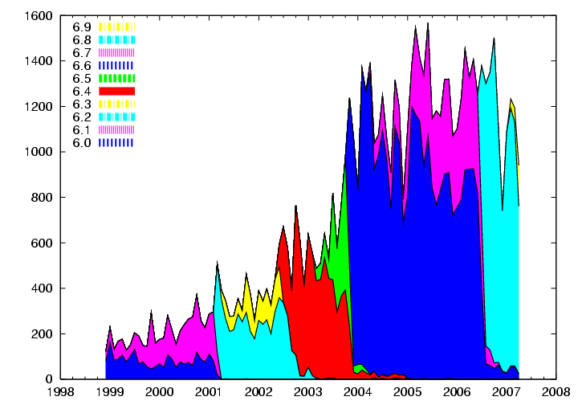
Downloads per month

Slide 35
Grid Laboratory of Wisconsin
2003 Initiative funded by NSF(MIR)/UW at ~ $1.5M
Six Initial GLOW Sites
Computational Genomics, Chemistry
Amanda, Ice-cube, Physics/Space Science
High Energy Physics/CMS, Physics
Materials by Design, Chemical Engineering
Radiation Therapy, Medical Physics
Computer Science
Diverse users with different deadlines and usage patterns.

Slide 36
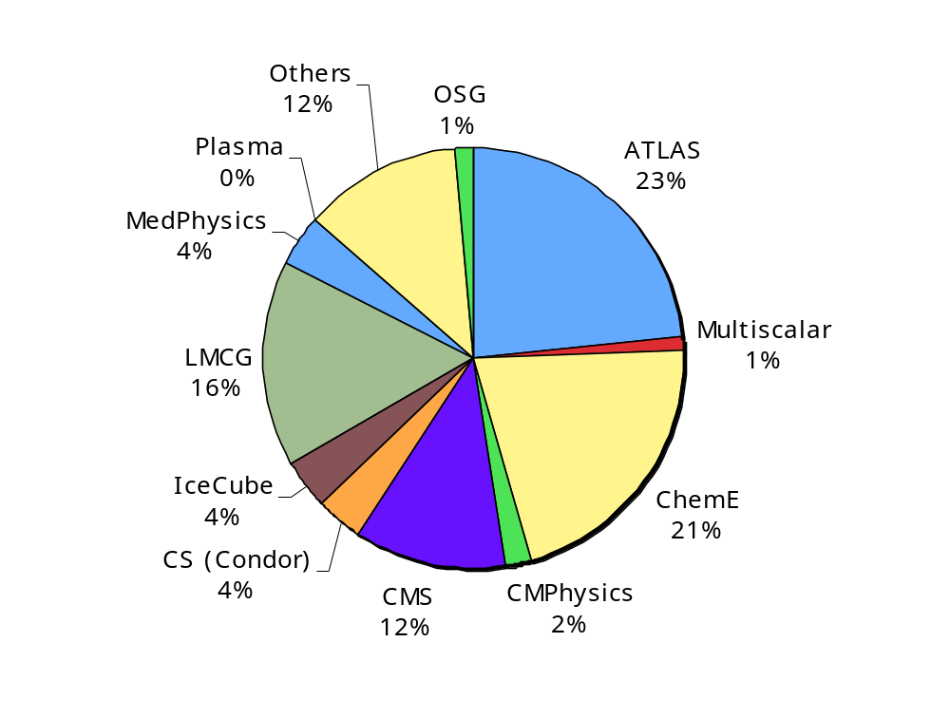
GLOW Usage 4/04-12/06
Over 23.4M
CPU hours served!

Slide 37
The search for SUSY
Sanjay Padhi is a UW Chancellor Fellow who is working at the group of Prof. Sau Lan Wu at CERN
Using Condor Technologies he established a “grid access point” in his office at CERN
Through this access-point he managed to harness in 3 month (12/05-2/06) more that 500 CPU years from the LHC Computing Grid (LCG) the Open Science Grid (OSG) and UW Condor resources

Slide 38
Some Reports From the Field
Condor at Micron
Condor at BNL
Condor at JPMorgan
Condor at the Hartford
Most production grid jobs (EGEE and OSG) are managed by Condor-G and related technologies

Slide 39
Integrating Linux Technology with Condor
Kim van der Riet
Principal Software Engineer

Slide 40



What will Red Hat be doing?
Red Hat will be investing into the Condor project locally in Madison WI, in addition to driving work required in upstream and related projects. This work will include:
  Engineering on Condor features & infrastructure
    Should result in tighter integration with related technologies
    Tighter kernel integration
  Information transfer between the Condor team and Red Hat engineers working on things like Messaging, Virtualization, etc.
  Creating and packaging Condor components for Linux distributions
  Support for Condor packaged in RH distributions
All work goes back to upstream communities, so this partnership will benefit all.
  Shameless plug: If you want to be involved, Red Hat is hiring...

Slide 41
High Throughput Computing
We first introduced the distinction between High Performance Computing (HPC) and High Throughput Computing (HTC) in a seminar at the NASA Goddard Flight Center in July of 1996 and a month later at the European Laboratory for Particle Physics (CERN). In June of 1997 HPCWire published an interview on High Throughput Computing.

Slide 42
Why HTC?
For many experimental scientists, scientific progress and quality of research are strongly linked to computing throughput. In other words, they are less concerned about instantaneous computing power. Instead, what matters to them is the amount of computing they can harness over a month or a year --- they measure computing power in units of scenarios per day, wind patterns per week, instructions sets per month, or crystal configurations per year.

Slide 43
High Throughput Computing is a
24-7-365 activity
FLOPY ≠ (60*60*24*7*52)*FLOPS

Slide 44
Obstacles to HTC
(Sociology)
(Education)
(Robustness)
(Portability)
(Technology)
Ownership Distribution
Customer Awareness
Size and Uncertainties
Technology Evolution
Physical Distribution

Slide 45
Focus on the problems that are unique to HTC not the latest/greatest technology

Slide 46
HTC on the Internet (1993)
Retrieval of atmospheric temperature and humidity profiles from 18 years of data from the TOVS sensor system.
  200,000 images
  ~5 minutes per image
Executed on Condor pools at the University of Washington, University of Wisconsin and NASA. Controlled by DBC (Distributed Batch Controller). Execution log visualized by DEVise

Slide 47
U of Washington
U of Wisconsin
NASA
Jobs per Pool
(5000 total)
Exec time
vs.
Turn around
Time line
(6/5-6/9)

Slide 48
High Throughput Computing on Blue Gene
IBM Rochester: Amanda Peters, Tom Budnik
With contributions from:
IBM Rochester: Mike Mundy, Greg Stewart, Pat McCarthy
IBM Watson Research: Alan King, Jim Sexton
UW-Madison Condor: Greg Thain, Miron Livny, Todd Tannenbaum

Slide 49
Condor and IBM Blue Gene Collaboration
Both IBM and Condor teams engaged in adapting code to bring Condor and Blue Gene technologies together
Initial Collaboration (Blue Gene/L)
  Prototype/research Condor running HTC workloads on Blue Gene/L
    Condor developed dispatcher/launcher running HTC jobs
    Prototype work for Condor being performed on Rochester On-Demand Center Blue Gene system
Mid-term Collaboration (Blue Gene/L)
  Condor supports HPC workloads along with HTC workloads on Blue Gene/L
Long-term Collaboration (Next Generation Blue Gene)
  I/O Node exploitation with Condor
  Partner in design of HTC services for Next Generation Blue Gene
    Standardized launcher, boot/allocation services, job submission/tracking via database, etc.
  Study ways to automatically switch between HTC/HPC workloads on a partition
  Data persistence (persisting data in memory across executables)
    Data affinity scheduling
  Petascale environment issues

Slide 50
10 years ago we had
“The Grid”

Slide 51
Introduction
“The term “the Grid” was coined in the mid 1990s to denote a proposed distributed computing infrastructure for advanced science and engineering [27]. Considerable progress has since been made on the construction of such an infrastructure (e.g., [10, 14, 36, 47]) but the term “Grid” has also been conflated, at least in popular perception, to embrace everything from advanced networking to artificial intelligence. One might wonder if the term has any real substance and meaning. Is there really a distinct “Grid problem” and hence a need for new “Grid technologies”? If so, what is the nature of these technologies and what is their domain of applicability? While numerous groups have interest in Grid concepts and share, to a significant extent, a common vision of Grid architecture, we do not see consensus on the answers to these questions.”
“The Anatomy of the Grid - Enabling Scalable Virtual Organizations” Ian Foster, Carl Kesselman and Steven Tuecke 2001.

Slide 52
Global Grid Forum (March 2001)
The Global Grid Forum (Global GF) is a community-initiated forum of individual researchers and practitioners working on distributed computing, or "grid" technologies. Global GF focuses on the promotion and development of Grid technologies and applications via the development and documentation of "best practices," implementation guidelines, and standards with an emphasis on rough consensus and running code.
Global GF efforts are also aimed at the development of a broadly based Integrated Grid Architecture that can serve to guide the research, development, and deployment activities of the emerging Grid communities. Defining such an architecture will advance the Grid agenda through the broad deployment and adoption of fundamental basic services and by sharing code among different applications with common requirements.
Wide-area distributed computing, or "grid" technologies, provide the foundation to a number of large scale efforts utilizing the global Internet to build distributed computing and communications infrastructures..

Slide 53
Summary
“We have provided in this article a concise statement of the “Grid problem,” which we define as controlled resource sharing and coordinated resource use in dynamic, scalable virtual organizations. We have also presented both requirements and a framework for a Grid architecture, identifying the principal functions required to enable sharing within VOs and defining key relationships among these different functions.”
“The Anatomy of the Grid - Enabling Scalable Virtual Organizations” Ian Foster, Carl Kesselman and Steven Tuecke 2001.

Slide 54
What makes an
“O” a
“VO”?

Slide 55
What is new beneath the sun?
Distributed ownership – who defines the “system’s common goal”? No more one system.
Many administrative domains – authentication, authorization and trust.
Demand is real – many have computing needs that can not be addressed by centralized locally owned systems
Expectations are high – Regardless of the question, distributed technology is “the” answer.
Distributed computing is once again “in”.

Slide 56
Benefits to Science
Democratization of Computing – “you do not have to be a SUPER person to do SUPER computing.” (accessibility)
Speculative Science – “Since the resources are there, lets run it and see what we get.” (unbounded computing power)
Function shipping – “Find the image that has a red car in this 3 TB collection.” (computational mobility)

Slide 57
The NUG30 Quadratic Assignment Problem (QAP)
Solved!
(4 Scientists +
1 Linux Box)
30
i=1
30
j=1
∑
∑
a_{ij}b_{p(i)p(j)}
min
p∈∏

Slide 58
NUG30 Personal Grid …
Managed by one Linux box at Wisconsin
Flocking: -- the main Condor pool at Wisconsin (500 processors)
-- the Condor pool at Georgia Tech (284 Linux boxes)
-- the Condor pool at UNM (40 processors)
-- the Condor pool at Columbia (16 processors)
-- the Condor pool at Northwestern (12 processors)
-- the Condor pool at NCSA (65 processors)
-- the Condor pool at INFN Italy (54 processors)
Glide-in: -- Origin 2000 (through LSF ) at NCSA. (512 processors)
-- Origin 2000 (through LSF) at Argonne (96 processors)
Hobble-in: -- Chiba City Linux cluster (through PBS) at Argonne
(414 processors).

Slide 59
Solution Characteristics.
Scientists | 4
Workstations | 1
Wall Clock Time | 6:22:04:31
Avg. # CPUs | 653
Max. # CPUs | 1007
Total CPU Time | Approx. 11 years
Nodes | 11,892,208,412
LAPs | 574,254,156,532
Parallel Efficiency | 92%

Slide 60
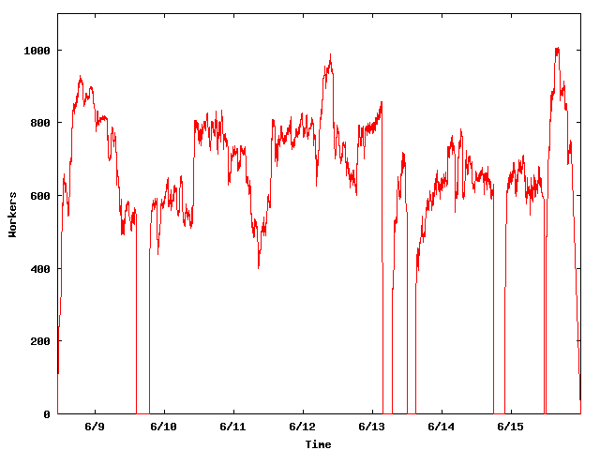
The NUG30 Workforce
System
Upgrade
Condor crash
Workers
Application
Upgrade

Slide 61
WWW
Grid
Client
Master
Server
Worker

Slide 62
“ … Grid computing is a partnership between clients and servers. Grid clients have more responsibilities than traditional clients, and must be equipped with powerful mechanisms for dealing with and recovering from failures, whether they occur in the context of remote execution, work management, or data output. When clients are powerful, servers must accommodate them by using careful protocols.… “
Douglas Thain & Miron Livny, "Building Reliable Clients and Servers", in “The Grid: Blueprint for a New Computing
Infrastructure”,2nd edition

Slide 63
Being a Master
Customer “delegates” task(s) to the master who is responsible for:
  Obtaining allocation of resources
  Deploying and managing workers on allocated resources
  Delegating work unites to deployed workers
  Receiving and processing results
  Delivering results to customer

Slide 64
Master must be …
Persistent – work and results must be safely recorded on non-volatile media
Resourceful – delegates “DAGs” of work to other masters
Speculative – takes chances and knows how to recover from failure
Self aware – knows its own capabilities and limitations
Obedience – manages work according to plan
Reliable – can mange “large” numbers of work items and resource providers
Portable – can be deployed “on the fly” to act as a “sub master”

Slide 65
Master should not do …
Predictions …
Optimal scheduling …
Data mining …
Bidding …
Forecasting …

Slide 66
The Ethernet Protocol
IEEE 802.3 CSMA/CD - A truly distributed (and very effective) access control protocol to a shared service.
  Client responsible for access control
  Client responsible for error detection
  Client responsible for fairness

Slide 67
Never assume that what you know is still true and that what you ordered did actually happen.

Slide 68
Every Community can benefit from the services of
Matchmakers!
eBay is a matchmaker

Slide 69
Why? Because ...
.. someone has to bring together community members who have requests for goods and services with members who offer them.
  Both sides are looking for each other
  Both sides have constraints
  Both sides have preferences

Slide 70
Being a Matchmaker
Symmetric treatment of all parties
Schema “neutral”
Matching policies defined by parties
“Just in time” decisions
Acts as an “advisor” not “enforcer”
Can be used for “resource allocation” and “job delegation”

Slide 71
Bringing it all
Together

Slide 72
world
region
campus
building
floor
desktop

Slide 73
From
Condor to
Condor-G to
Condor-C

Slide 74
The Layers of Condor
Application
Submit
(master)
Application Agent
Customer Agent (schedD)
Matchmaker
Owner Agent (startD)
Execute
(worker)
Remote Execution Agent
Local Resource Manager
Resource

Slide 75
Be matched, claim (+maintain), and then delegate

Slide 76
Job Submission Options
leave_in_queue = <ClassAd Boolean Expression>
on_exit_remove = <ClassAd Boolean Expression>
on_exit_hold = <ClassAd Boolean Expression>
periodic_remove = <ClassAd Boolean Expression>
periodic_hold = <ClassAd Boolean Expression>
periodic_release = <ClassAd Boolean Expression>
noop_job = <ClassAd Boolean Expression>

Slide 77

startD
DAGMan
3
starter
schedD
1
3
Globus
1
2
3
4
5
6
4
shadow
LSF
5
1
3
grid
manager
4
5
6
GAHP-
Globus
4
startD
DAGMan
schedD
schedD
starter
6
BLAH-
LSF
6
Globus
5
shadow
NorduGrid
grid
manager
GAHP
Globus
GAHP-
Condor
schedD
GAHP
NorduGrid
6
GAHP
Condor

Slide 78
PSE or User
Condor
MM
C-app
Local
SchedD (Condor G)
MM
Grid Tools
MM
MM
MM
SchedD
(Condor C)
SchedD
(Condor C)
SchedD
(Condor C)
MM
MM
LSF
PBS
Condor
Condor
StartD
(Glide-in)
StartD
(Glide-in)
StartD
(Glide-in)
Remote
C-app
C-app
G-app
C-app
G-app
C-app
G-app

Slide 79
How can we accommodate an unbounded need for computing with an unbounded amount of resources?

Slide 80
The words of Koheleth son of David, king in Jerusalem ….
  Only that shall happen
  Which has happened,
  Only that occur
  Which has occurred;
  There is nothing new
  Beneath the sun!
Ecclesiastes Chapter 1 verse 9

Slide 81
Close by storage is small and fast faraway storage is big and slow

Slide 82
Many data challenges …
Managing data is a hard problem. Doing it in a distributed environment does not make it easier or simpler:
  Catalogs and metadata
  Access control
  Consistency and coherency
  Revocation and auditing
  Replication/cashing management
  Planning (optimization?)

Slide 83
Almost everything we do requires a dependable data placement mechanism

Slide 84
We are making progress …
The Storage Resource Management (SRM) protocol – management of file copies and support for space reservations
The Reliable File Transfer (RFT) service – management of large numbers of GridFTP requests
The File Transfer Service (FTS) – manages file transfer requests and supports the concept of “channels”
The Planning for Execution in Grids (Pegasus) planner – supports data placement steps in the workflow

Slide 85
High capacity networks are deployed all over the world and almost everyone is concerned about how to allocated their bandwidth. However, is bandwidth the real issue?

Slide 86
ESnet4 Target Configuration
Core networks: 40-50 Gbps in 2009, 160-400 Gbps in 2011-2012
Canada
(CANARIE)
Europe
(GEANT)
CERN (30 Gbps)
Asia-Pacific
Canada
(CANARIE)
Asia Pacific
CERN (30 Gbps)
GLORIAD (Russia and China)
Europe
(GEANT)
Asia-Pacific
Seattle
Science Data Network Core
Cleveland
Boston
Australia
IP Core
Chicago
Boise
New York
Kansas City
Sunnyvale
Denver
Washington
DC
Atlanta
Tulsa
LA
Albuquerque
Australia
San Diego
South America
(AMPATH)
South America
(AMPATH)
Jacksonville
IP core hubs
Production IP core (10Gbps)
SDN core (20-30-40Gbps)
MANs (20-60 Gbps) or backbone loops for site access
International connections
SDN hubs
Houston
Primary DOE Labs
High Speed Cross connects with Ineternet2/Abilene
Possible hubs
Fiber path is ~ 14,000 miles / 24,000 km

Slide 87
Main trend
The ratio between the size of the organization and the volume (and complexity) of the data/information/knowledge the organization owns/manages/depends on will continue to dramatically increase
  Ownership cost of managed storage capacity goes down
  Data/information/knowledge generated and consumed goes up
  Network capacity goes up
  Distributed computing technology matures and is more widely adopted

Slide 88
Managed Object Placement
Management of storage space and bulk data transfers plays a key role in the end-to-end effectiveness of many scientific applications:
  Object Placement operations must be treated as “first class” tasks and explicitly expressed in the work flow
  Fabric must provide services to manage storage space
  Object Placement schedulers and matchmakers are needed
  Object Placement and computing must be coordinated
  Smooth transition of Compute/Placement interleaving across software layers and granularity of compute tasks and object size
  Error handling and garbage collection

Slide 89
Customer requests:
Place y = F(x) at L!
System delivers.

Slide 90
Simple plan for y=F(x)L
Allocate (size(x)+size(y)+size(F)) at SE_{i}
Place x from SE_{j} at SE_{i}
Place F on CE_{k}
Compute F(x) at CE_{k}
Move y from SE_{i} at L
Release allocated space at SE_{i}
Storage Element (SE); Compute Element (CE)

Slide 91
The Basic Approach*
Compute
Task
Queue
DaP A A.submit
DaP B B.submit
Job C C.submit
…..
Parent A child B
Parent B child C
Parent C child D, E
…..
DAG specification
C
DAG-Manager
Object-
Placement
Task
Queue
D
F
A
B
C
E
E
* DAG – Directed Acyclic Graph

Slide 92
Stork-A possible solution
A portable, flexible and extensible Object Placement Scheduler.
  Uses ClassAds to capture jobs and policies (just like Condor)
  Supports matchmaking (just like Condor)
  Provides a suite of data transfer jobs that interface with a broad collection of storage systems and protocols and provide end-to-end reliability
  Supports storage allocate/release jobs

Slide 93
Planner
MM
DAGMan
SchedD
Stork
GRAM
StartD
SchedD
Parrot
Application
SRB
SRM
NeST
GridFTP
RFT

Slide 94
Customer requests:
Place y@S at L!
System delivers.

Slide 95
Basic step for y@SL
Allocate size(y) at L,
Allocate resources (disk bandwidth, memory, CPU, outgoing network bandwidth) on S
Allocate resources (disk bandwidth, memory, CPU, incoming network bandwidth) on L
Match S and L

Slide 96
Or in other words, it takes two (or more) to Tango
(or to place an object)!

Slide 97
When the
“source” plays “nice” it “asks” in advance for permission to place an object at the
“destination”

Slide 98
MatchMaker
Match!
Match!
I am S and am looking for L to place a file
I am L and I have what it takes to place a file
S
GridFTP Control
L
GridFTP Put File

Slide 99
The SC’05 effort
Joint with the
Globus GridFTP team

Slide 100
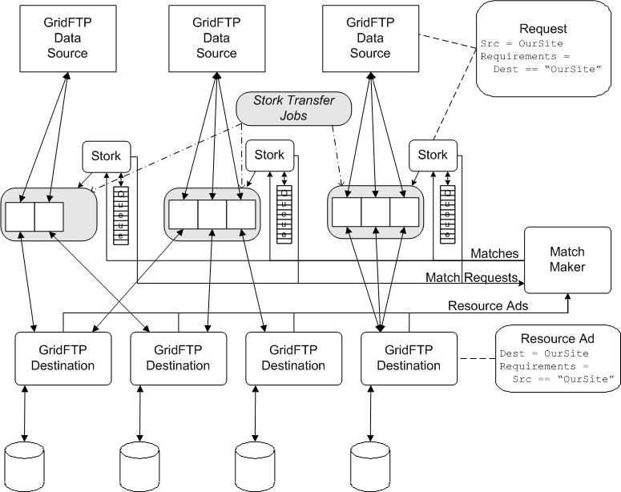
Stork controls
number of
outgoing
connections
Destination
advertises
incoming
connections

Slide 101
A Master Worker view of the same effort

Slide 102
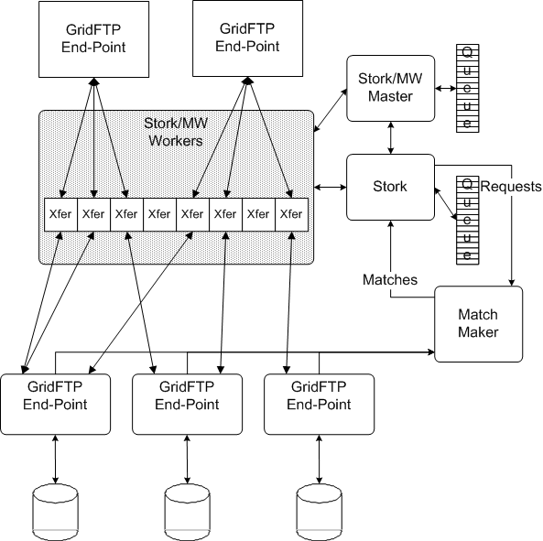
Master
Files
Worker
For
Workers

Slide 103
When the
“source” does not play “nice”, destination must protect itself

Slide 104
NeST
Manages storage space and connections for a GridFTP server with commands like:
  ADD_NEST_USER
  ADD_USER_TO_LOT
  ATTACH_LOT_TO_FILE
  TERMINATE_LOT

Slide 105
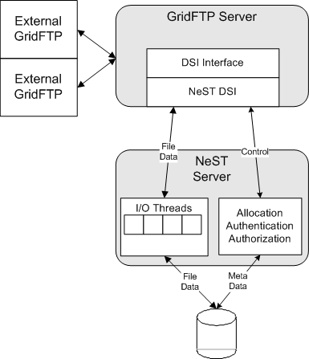
GridFTP
Chirp

Slide 106
How can we accommodate an unbounded amount of data with an unbounded amount of storage and network bandwidth?

