Slide 1
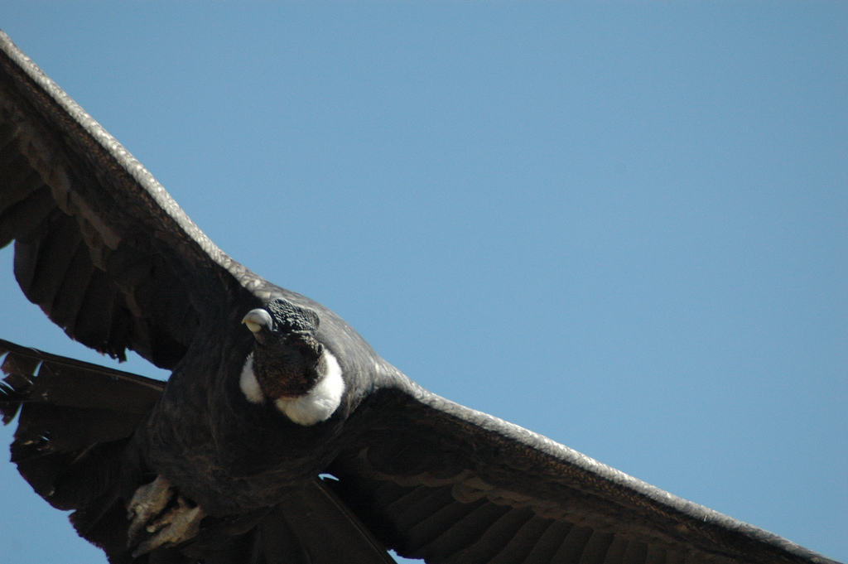
Administrating Condor
Alan De Smet
Condor Project
adesmet@cs.wisc.edu
http://www.cs.wisc.edu/condor
“Condor - Colca Canyon-” by “Raultimate” © 2006 Licensed under the Creative Commons Attribution 2.0 license.
http://www.flickr.com/photos/7428244@N06/427485954/ http://www.webcitation.org/5g6wqrJPx

Slide 2
The next 90 minutes…
Condor Daemons
  Job Startup
Configuration Files
ClassAds
Policy Expressions
  Startd (Machine)
  Negotiator
Priorities
Security
Useful Tools
Log Files
Debugging Jobs

Slide 3

Condor Daemons
Title unknown, by Hans Holbein the Younger, from Historiarum Veteris Testamenti icones, 1543

Slide 4
Condor Daemons
negotiator
collector
master
shadow
schedd
procd
startd
starter
kbdd
exec

Slide 5
condor_master
You start it, it starts up the other Condor daemons
If a daemon exits unexpectedly, restarts deamon and emails administrator
If a daemon binary is updated (timestamp changed), restarts the daemon

Slide 6
condor_master
Provides access to many remote administration commands:
  condor_reconfig, condor_restart, condor_off, condor_on, etc.
Default server for many other commands:
  condor_config_val, etc.

Slide 7
condor_master
Periodically runs condor_preen to clean up any files Condor might have left on the machine
  Emails you notification of deleted files
  Backup behavior, the other daemons clean up after themselves

Slide 8

condor_procd
Tracks processes
Automatically started as needed
  No DAEMON_LIST entry necessary
  Behind the scenes
Part of privilege separation security enhancements
“IMG 0960” by Eva Schiffer © 2008 Used with permission http://www.digitalchangeling.com/pictures/ourCats2008/january2008/IMG_0960.html

Slide 9
condor_startd
Represents a machine willing to run jobs to the Condor pool
Run on any machine you want to run jobs on
Enforces the wishes of the machine owner (the owner’s “policy”)

Slide 10
condor_startd
Starts, stops, suspends jobs
Spawns the appropriate condor_starter, depending on the type of job
Provides other administrative commands (for example, condor_vacate)
Aided by condor_kbdd

Slide 11
condor_starter
Spawned by the condor_startd
  Don’t add to DAEMON_LIST
Handles all the details of starting and managing the job
  Transfer job’s binary to execute machine
  Send back exit status
  Etc.

Slide 12
condor_starter
One per running job
The default configuration is willing to run one job per CPU

Slide 13
condor_kbdd
Monitors physical keyboard and mouse so the condor_startd can make decisions based on local usage.

Slide 14
condor_schedd
Represents jobs to the Condor pool
Maintains persistent queue of jobs
  Queue is not strictly first-in-first-out (priority based)
  Each machine running condor_schedd maintains its own independent queue
Run on any machine you want to submit jobs from

Slide 15
condor_schedd
Responsible for contacting available machines and spawning waiting jobs
  When told to by condor_negotiator
Services most user commands:
  condor_submit, condor_rm, condor_q
Notes:
Also: condor_hold, condor_release

Slide 16
condor_shadow
Represents job on the submit machine
Spawned by condor_schedd
  Don’t add to DAEMON_LIST
Services requests from standard universe jobs for remote system calls
  including all file I/O
Makes decisions on behalf of the job
  for example: where to store the checkpoint file

Slide 17
condor_shadow Impact
One condor_shadow running on submit machine for each actively running Condor job
Minimal load on submit machine
  Usually blocked waiting for requests from the job or doing I/O
  Relatively small memory footprint
  Can throttle, see MAX_JOBS_RUNNING and SHADOW_RENICE_INCREMENT in the manual

Slide 18
condor_exec.exe
A running job.
When user executable binaries are transferred to the execution side, they are renamed condor_exec.exe.

Slide 19
condor_collector
Collects information from all other Condor daemons in the pool
condor_collector
Each daemon sends a periodic update called a ClassAd to the collector
  Old ClassAds removed after a time out
Services queries for information:
  Queries from other Condor daemons
  Queries from users (condor_status)

Slide 20
condor_negotiator
Performs matchmaking in Condor
  Pulls list of available machines and job queues from condor_collector
  Matches jobs with available machines
  Both the job and the machine must satisfy each other’s requirements (2-way matching)
Handles user priorities

Slide 21
Condor Daemons
You only have to run the daemons for the services you need to provide
DAEMON_LIST is a comma separated list of daemons to start
  DAEMON_LIST=MASTER,SCHEDD,STARTD

Slide 22
Central Manager
The Central Manager is the machine running the collector and negotiator
DAEMON_LIST = MASTER, COLLECTOR, NEGOTIATOR
Defines a Condor pool.
CONDOR_HOST = centralmanager.example.com

Slide 23
Typical Condor Pool
= Process Spawned
Execute-Only
Central Manager
= ClassAd
Communication
Pathway
master
master
startd
startd
negotiator
Execute-Only
schedd
Submit-Only
collector
master
master
startd
schedd
Regular Node
Regular Node
master
master
startd
startd
schedd
schedd
Notes:
Here we have a small pool with six machines. Like most Condor pools, there is a Central Manager, identifiable by the presence of the condor_negotiator and condor_collector. In this case the Central Manger is also allowed to run jobs (presence of condor_startd), and jobs can be submitted from the Central Manager (presence of condor_schedd)
This pool has one node only useful for submitting jobs (it is only running the condor_schedd), and two nodes only used for executing jobs (only running condor_startd). There are two nodes both able to submit and execute jobs (both startd and schedd)

Slide 24
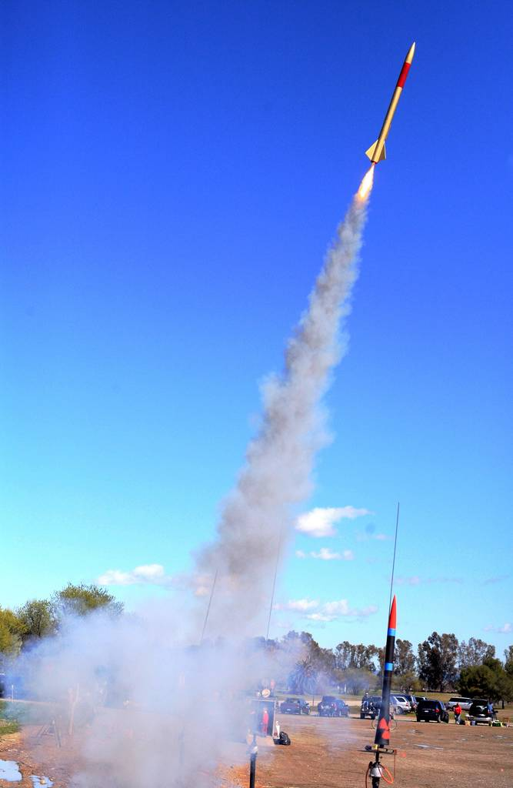
Job Startup
“LUNAR Launch” by Steve Jurvertson (“jurvetson”) © 2006
Licensed under the Creative Commons Attribution 2.0 license.
http://www.flickr.com/photos/jurvetson/114406979/
http://www.webcitation.org/5XIfTl6tX

Slide 25
Job Startup
Central Manager
Q
Negotiator
Collector
J
S
S
Submit Machine
Execute Machine
J
S
S
Q
Schedd
Startd
S
J
J
Starter
Job
J
Submit
Shadow
Condor
Syscall Lib
Notes:
Steps
1. Startd sends collector ClassAd describing itself. (The Schedd does as well, but it has nothing interesting to say yet.)
2. The user calls condor_submit to submit a job. The job is handed off to the schedd and condor_submit returns.
3. The schedd alerts the collector that it now has a job waiting.
4. The negotiator asks the collector for a list machines able to run jobs and schedd queues with waiting jobs.
5. The negotiator contacts the schedd to learn about the waiting job.
6. The negotiator matches the waiting job with the waiting machine.
7. The negotiator alerts the schedd and the startd that there is a match.
8. The schedd contacts the startd to claim the match.
9. The schedd starts a shadow to monitor the job.
10. The startd starts a starter to start the job.
11. The starter and the shadow contact each other.
11. The starter starts the job.
12. If the job is using the Condor syscall library (typically through being condor_compiled), it will contact the shadow to access necessary files.

Slide 26
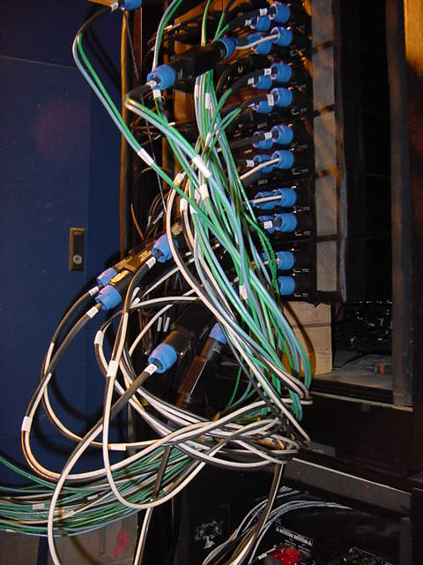
Configuration Files
“amp wiring” by “fbz_” © 2005
Licensed under the Creative Commons Attribution 2.0 license
http://www.flickr.com/photos/fbz/114422787/

Slide 27
Global Configuration File
Found either in file pointed to with the CONDOR_CONFIG environment variable, /etc/condor/condor_config, or ~condor/condor_config
All settings can be in this file
“Global” on assumption it’s shared between machines. NFS, automated copies, etc.

Slide 28
Other Configuration Files
You can configure a number of other shared configuration files:
  Organize common settings (for example, all policy expressions)
  Platform-specific configuration files
  Machine specific settings
    Local policy for a particular machine’s owner
    Different daemons to run. For example, the Central Manager

Slide 29
Other Configuration Files
LOCAL_CONFIG_FILE macro
  Comma separated, processed in order
  LOCAL_CONFIG_FILE = \
  /var/condor/config.local,\
  /var/condor/policy.local,\
  /shared/condor/config.$(HOSTNAME),\
  /shared/condor/config.$(OPSYS)

Slide 30
Per-Machine Configuration Files
Can be on local disk of each machine
/var/adm/condor/condor_config.local
Can be in a shared directory
  Use $(HOSTNAME) which expands to the machine’s name
/shared/condor/config.$(HOSTNAME)
/shared/condor/hosts/$(HOSTNAME)/ config.local

Slide 31
Per-Platform Configuration Files
Use macros like $(OPSYS) which expand to the operating system
/shared/condor/config.$(OPSYS)
$(OPSYS) will expand into entries like LINUX, WINNT51, SOLARIS28
See “Pre-Defined Macros” in the Manual for a list of options

Slide 32
Configuration File Syntax
# at start of line is a comment
  not allowed in names, confuses Condor.
\ at the end of line is a line-continuation
  Both lines are treated as one big entry
  Works in comments!
    # This comment eats the next line \
    EXAMPLE_SETTING=TRUE

Slide 33
Configuration File Macros
Macros have the form:
  Attribute_Name = value
    Names are case insensitive
    Values are case sensitive
You reference other macros with:
  A = $(B)
Can create additional macros for organizational purposes

Slide 34
Configuration File Macros
Can append to macros:
  A=abc
  A=$(A),def
Don’t let macros recursively define each other!
  A=$(B)
  B=$(A)

Slide 35
Configuration File Macros
Later macros in a file overwrite earlier ones
  B will evaluate to 2:
  A=1
  B=$(A)
  A=2

Slide 36
Macros and Expressions Gotcha
These are simple replacement macros
Put parentheses around expressions
  TEN=5+5
  HUNDRED=$(TEN)*$(TEN)
    HUNDRED becomes 5+5*5+5 or 35!
  TEN=(5+5)
  HUNDRED=($(TEN)*$(TEN))
    ((5+5)*(5+5)) = 100

Slide 37

ClassAds
“05041200.JPG” by Jonathan Lundqvist (“jturn”) © 2005 Licensed under the Creative Commons Attribution 2.0 license
http://www.flickr.com/photos/jturn/9157307/ http://www.webcitation.org/5XIh3HIs6

Slide 38
ClassAds
“Classified Advertisements”
Set of key-value pairs
  MyType = "Machine"
  TargetType = "Job"
  Name = "slot1@puffin.cs.wisc.edu"
  Rank = 0.000000
  MyCurrentTime = 1271097865
  IsInstructional = FALSE

Slide 39
ClassAds
Values can be expressions
  Price=Gallons*PerGallonCost
  Gallons=9.1232
  PerGallonCost=2.499

Slide 40
ClassAds
Can be matched against each other
  Requirements and Rank
    MY.name – Looks for “name” in local ClassAd
    TARGET.name – Looks for “name” in the other ClassAd
    Name – Looks for “name” in the local ClassAd, then the other ClassAd

Slide 41
ClassAd matching
MyType = "GasPump"
Requirements = TARGET.Credit > (TARGET.GallonsNeeded * MY.PricePerGallon)
PricePerGallon = 2.99
Octane = 93
MyType = "Car"
Requirements = Octane > 87
GallonsNeeded = 9
Credit = 35.50
Rank = Octane

Slide 42
ClassAd Expressions
Some configuration file macros specify expressions for the Machine’s ClassAd
  Notably START, RANK, SUSPEND, CONTINUE, PREEMPT, KILL
Can contain a mixture of macros and ClassAd references

Slide 43
ClassAd Expressions
+, -, *, /, <, <=,>, >=, ==, !=, &&, and || all work as expected
TRUE==1 and FALSE==0 (guaranteed)
  (3 == (2+1)) is identical to 1
  (TRUE*30) is identical to 30
  (3 == 1) is identical to 0

Slide 44
Special Values:
UNDEFINED and ERROR
Special values
Passed through most operators
  Anything == UNDEFINED is UNDEFINED
&& and || eliminate if possible.
  UNDEFINED && FALSE is FALSE
  UNDEFINED && TRUE is UNDEFINED

Slide 45
ClassAd Expressions:
=?= and =!=
  =?= and =!= are similar to == and !=
  =?= tests if operands have the same type and the same value.
    10 == UNDEFINED -> UNDEFINED
    UNDEFINED == UNDEFINED -> UNDEFINED
    10 =?= UNDEFINED -> FALSE
    UNDEFINED =?= UNDEFINED -> TRUE
  =!= inverts =?=

Slide 46
ClassAd Functions
ClassAds offer a variety of useful functions for string manipulation, date formatting, list management, and more.

Slide 47
ClassAd Expressions
Further information: Section 4.1, “Condor's ClassAd Mechanism,” in the Condor Manual.

Slide 48

Policy
“Don't even think about it” by Kat “tyger_lyllie” © 2005
Licensed under the Creative Commons Attribution 2.0 license
http://www.flickr.com/photos/tyger_lyllie/59207292/
http://www.webcitation.org/5XIh5mYGS

Slide 49
Policy
Allows machine owners to specify job priorities, restrict access, and implement other local policies

Slide 50
Policy Expressions
Specified in condor_config
  Ends up startd/machine ClassAd
Policy evaluates both a machine ClassAd and a job ClassAd together
  Policy can reference items in either ClassAd (See manual for list)
Can reference condor_config macros: $(MACRONAME)

Slide 51
Machine (Startd) Policy Expressions
START
RANK
SUSPEND
CONTINUE
PREEMPT
KILL

Slide 52
START
START is the primary policy
When FALSE the machine enters the Owner state and will not run jobs
Acts as the Requirements expression for the machine, the job must satisfy START
  Can reference job ClassAd values including Owner and ImageSize

Slide 53
RANK
Indicates which jobs a machine prefers
  Jobs can also specify a rank
Floating point number
  Larger numbers are higher ranked
  Typically evaluate attributes in the Job ClassAd
  Typically use + instead of &&

Slide 54
RANK
Often used to give priority to owner of a particular group of machines
Claimed machines still advertise looking for higher ranked job to preempt the current job

Slide 55

SUSPEND and CONTINUE
When SUSPEND becomes true, the job is suspended
When CONTINUE becomes true a suspended job is released
“DSC03753” by Eva Schiffer © 2008 Used with permission http://www.digitalchangeling.com/pictures/ourCats2008/january2008/DSC03753.html

Slide 56
PREEMPT and KILL
When PREEMPT becomes true, the job will be politely shut down
  Vanilla universe jobs get SIGTERM
    Or user requested signal
  Standard universe jobs checkpoint
When KILL becomes true, the job is SIGKILLed
  Checkpointing is aborted if started

Slide 57
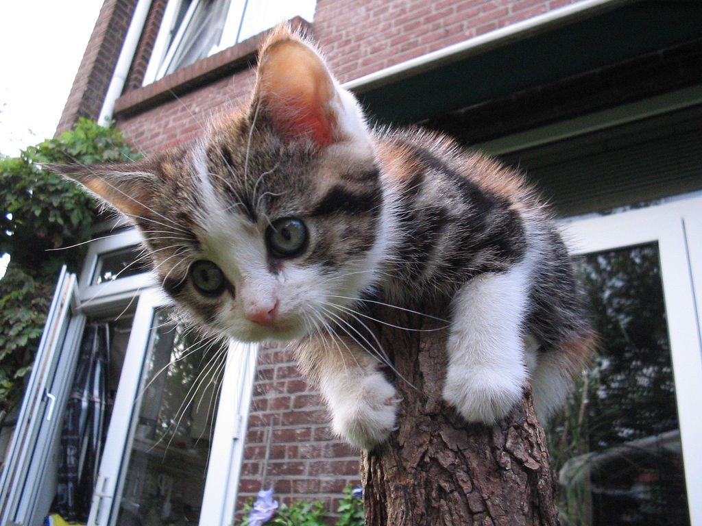
Minimal Settings
Always runs jobs
  START = True
  RANK =
  SUSPEND = False
  CONTINUE = True
  PREEMPT = False
  KILL = False
“Lonely at the top” by Guyon Moree (“gumuz”) © 2005
Licensed under the Creative Commons Attribution 2.0 license
http://www.flickr.com/photos/gumuz/7340411/ http://www.webcitation.org/5XIh8s0kI

Slide 58

Policy Configuration
I am adding nodes to the Cluster… but the Chemistry Department has priority on these nodes
“I R BIZNESS CAT” by “VMOS” © 2007
Licensed under the Creative Commons Attribution 2.0 license
http://www.flickr.com/photos/vmos/2078227291/ http://www.webcitation.org/5XIff1deZ

Slide 59
New Settings for the Chemistry nodes
Prefer Chemistry jobs
  START = True
  RANK = Department == "Chemistry"
  SUSPEND = False
  CONTINUE = True
  PREEMPT = False
  KILL = False

Slide 60
Submit file with Custom Attribute
Prefix an entry with “+” to add to job ClassAd
  Executable = charm-run
  Universe = standard
  +Department = "Chemistry"
  queue

Slide 61
What if “Department” not specified?
  START = True
  RANK = Department =!= UNDEFINED && Department == "Chemistry"
  SUSPEND = False
  CONTINUE = True
  PREEMPT = False
  KILL = False

Slide 62
More Complex RANK
Give the machine’s owners (adesmet and roy) highest priority, followed by the Chemistry department, followed by the Physics department, followed by everyone else.
  Can use automatic Owner attribute in job attribute to identify adesmet and roy

Slide 63
More Complex RANK
  IsOwner = (Owner == "adesmet" || Owner == "roy")
  IsChem =(Department =!= UNDEFINED && Department == "Chemistry")
  IsPhys =(Department =!= UNDEFINED && Department == "Physics")
  RANK = $(IsOwner)*20 + $(IsChem)*10 + $(IsPhys)

Slide 64
Policy Configuration
Cluster is okay, but... Condor can only use the desktops when they would otherwise be idle
“I R BIZNESS CAT” by “VMOS” © 2007
Licensed under the Creative Commons Attribution 2.0 license
http://www.flickr.com/photos/vmos/2078227291/ http://www.webcitation.org/5XIff1deZ

Slide 65
Defining Idle
One possible definition:
  No keyboard or mouse activity for 5 minutes
  Load average below 0.3

Slide 66
Desktops should
START jobs when the machine becomes idle
SUSPEND jobs as soon as activity is detected
PREEMPT jobs if the activity continues for 5 minutes or more
KILL jobs if they take more than 5 minutes to preempt

Slide 67
Useful Attributes
LoadAvg
  Current load average
CondorLoadAvg
  Current load average generated by Condor
KeyboardIdle
  Seconds since last keyboard or mouse activity

Slide 68
Useful Attributes
CurrentTime
  Current time, in Unix epoch time (seconds since midnight Jan 1, 1970)
EnteredCurrentActivity
  When did Condor enter the current activity, in Unix epoch time

Slide 69
Macros in Configuration Files
NonCondorLoadAvg = (LoadAvg - CondorLoadAvg)
BgndLoad = 0.3
CPU_Busy = ($(NonCondorLoadAvg) >= $(BgndLoad))
CPU_Idle = ($(NonCondorLoadAvg) < $(BgndLoad))
KeyboardBusy = (KeyboardIdle < 10)
KeyboardIsIdle = (KeyboardIdle > 300)
MachineBusy = ($(CPU_Busy) || $(KeyboardBusy))
ActivityTimer = \
(CurrentTime - EnteredCurrentActivity)

Slide 70
Desktop Machine Policy
START = $(CPU_Idle) && $(KeyboardIsIdle)
SUSPEND = $(MachineBusy)
CONTINUE = $(CPU_Idle) && KeyboardIdle > 120
PREEMPT = (Activity == "Suspended") && \
$(ActivityTimer) > 300
KILL = $(ActivityTimer) > 300

Slide 71

Mission Accomplished
Smiles and kittens for everyone!
“Autumn and Blue Eyes” by Paul Lewis (“PJLewis”) © 2005 Licensed under the Creative Commons Attribution 2.0 license
http://www.flickr.com/photos/pjlewis/46134047/ http://www.webcitation.org/5XIhBzDR2

Slide 72
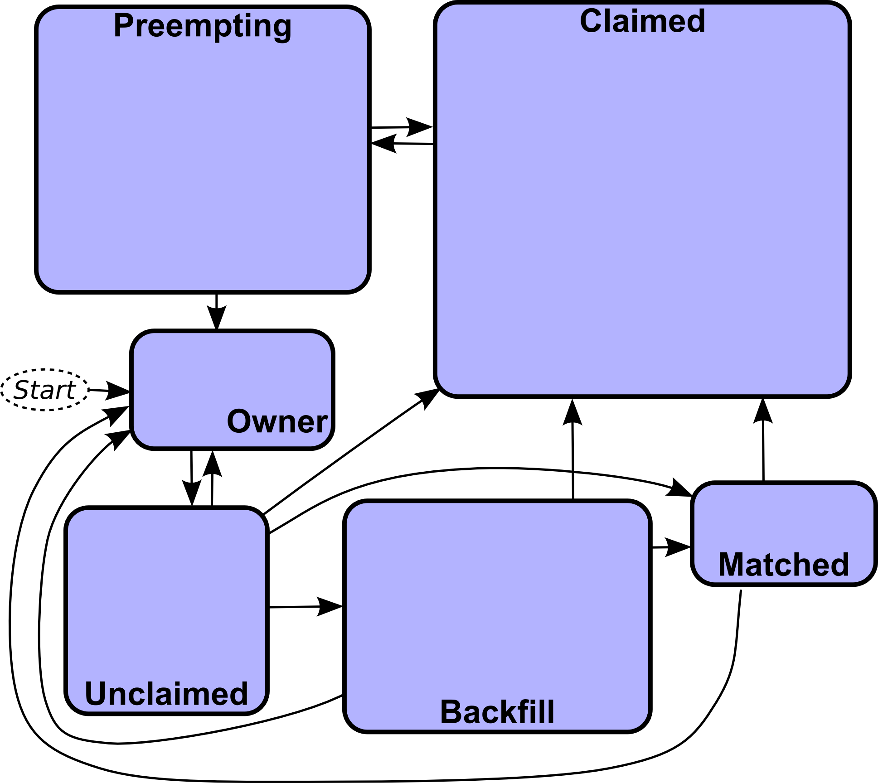
Machine States

Slide 73
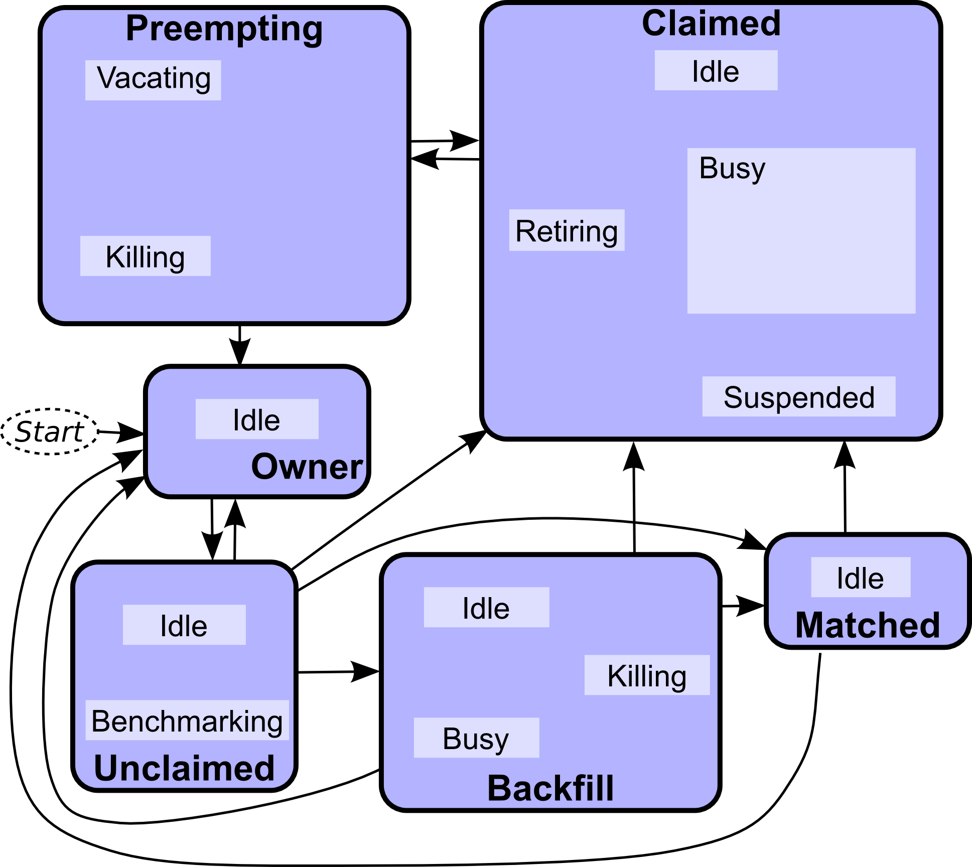
Machine Activities

Slide 74
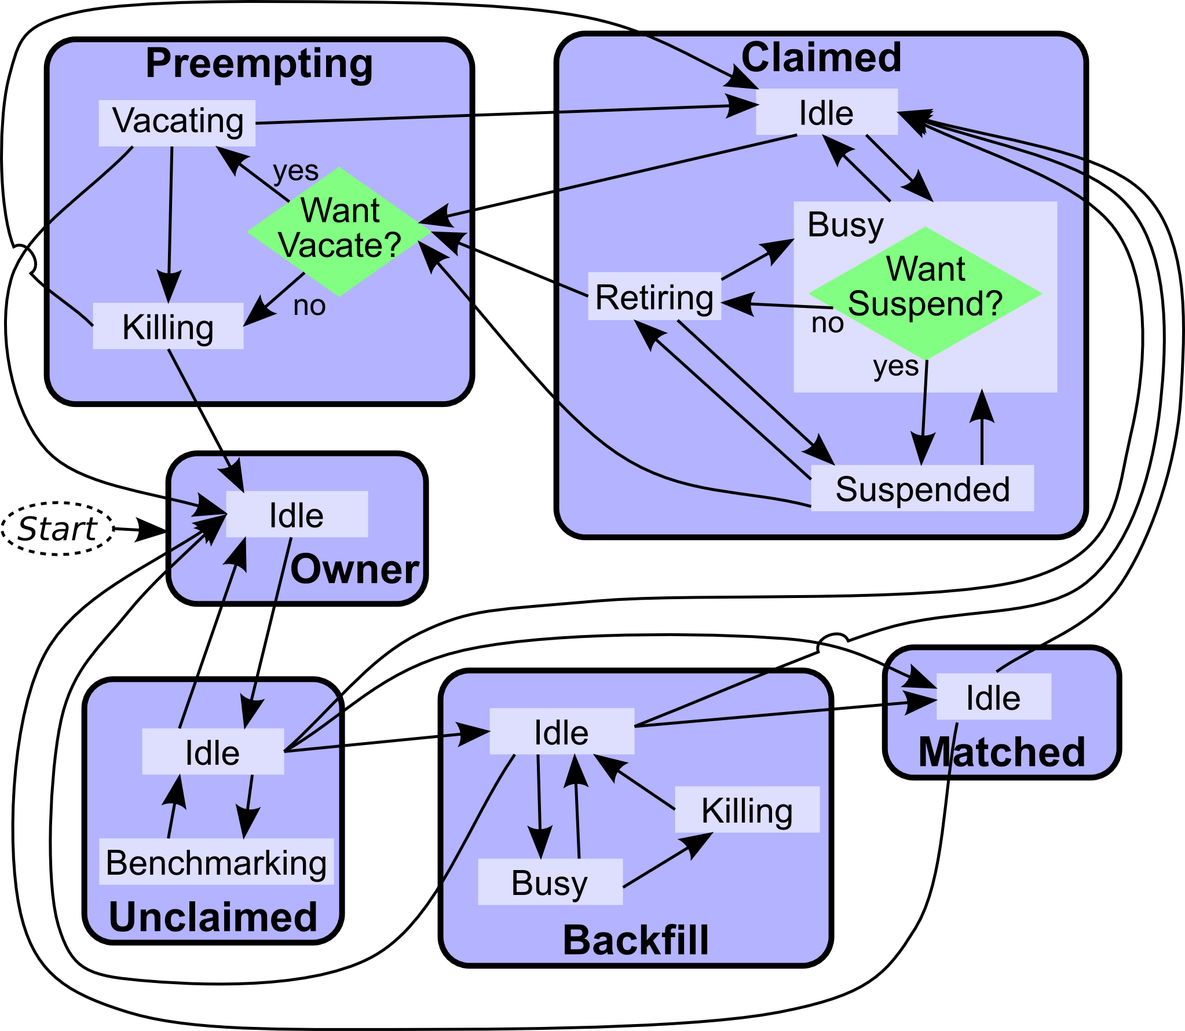
Machine Activities
See the manual for the gory details. (Section 3.5: Policy Configuration for the condor_startd)

Slide 75
Custom Machine Attributes
Can add attributes to a machine’s ClassAd, typically done in the local configuration file
  INSTRUCTIONAL=TRUE
  NETWORK_SPEED=1000
  STARTD_EXPRS=INSTRUCTIONAL, NETWORK_SPEED

Slide 76
Custom Machine Attributes
Jobs can now specify Rank and Requirements using new attributes:
  Requirements = (INSTRUCTIONAL=?=UNDEFINED || INSTRUCTIONAL==FALSE)
  Rank = NETWORK_SPEED
Dynamic attributes are available; see STARTD_CRON_* settings in the manual

Slide 77
Custom Machine Attributes
We can move some or all of our policy macros into the ClassAd:
IsOwner = (Owner == "adesmet"\
|| Owner == "roy")
STARTD_EXPRS = IsOwner
RANK = IsOwner
# Instead of RANK=$(IsOwner)

Slide 78
Further Machine
Policy Information
For further information, see section 3.5 “Policy Configuration for the condor_startd” in the Condor manual
condor-users mailing list
  http://www.cs.wisc.edu/condor/mail-lists/
condor-admin@cs.wisc.edu

Slide 79

Priorities
“IMG_2476” by “Joanne and Matt” © 2006 Licensed under the Creative Commons Attribution 2.0 license
http://www.flickr.com/photos/joanne_matt/97737986/ http://www.webcitation.org/5XIieCxq4

Slide 80
Job Priority
Set with condor_prio
Users can set priority of their own jobs
Integers, larger numbers are higher priority
Only impacts order between jobs for a single user on a single schedd
A tool for users to sort their own jobs

Slide 81
User Priority
Determines allocation of machines to waiting users
View with condor_userprio
Inversely related to machines allocated (lower is better priority)
  A user with priority of 10 will be able to claim twice as many machines as a user with priority 20

Slide 82
User Priority
Effective User Priority is determined by multiplying two components
  Real Priority
  Priority Factor

Slide 83
Real Priority
Based on actual usage
Defaults to 0.5
Approaches actual number of machines used over time
  Configuration setting PRIORITY_HALFLIFE

Slide 84
Priority Factor
Assigned by administrator
  Set with condor_userprio
Defaults to 1 (DEFAULT_PRIO_FACTOR)
Nice users default to 1,000,000 (NICE_USER_PRIO_FACTOR)
  Used for true bottom feeding jobs
  Add “nice_user=true” to your submit file

Slide 85
Negotiator Policy Expressions
PREEMPTION_REQUIREMENTS and PREEMPTION_RANK
Evaluated when condor_negotiator considers replacing a lower priority job with a higher priority job
Completely unrelated to the PREEMPT expression

Slide 86
PREEMPTION_REQUIREMENTS
If false will not preempt machine
  Typically used to avoid pool thrashing
  Typically use:
    RemoteUserPrio – Priority of user of currently running job (higher is worse)
    SubmittorPrio – Priority of user of higher priority idle job (higher is worse)

Slide 87
PREEMPTION_REQUIREMENTS
Only replace jobs running for at least one hour and 20% lower priority
StateTimer = \
CurrentTime – EnteredCurrentState
HOUR = (60*60)
PREEMPTION_REQUIREMENTS = \
$(StateTimer) > (1 * $(HOUR)) \
&& RemoteUserPrio > SubmittorPrio * 1.2

Slide 88
PREEMPTION_RANK
Picks which already claimed machine to reclaim
Strongly prefer preempting jobs with a large (bad) priority and a small image size
PREEMPTION_RANK = \
(RemoteUserPrio * 1000000)\
- ImageSize

Slide 89
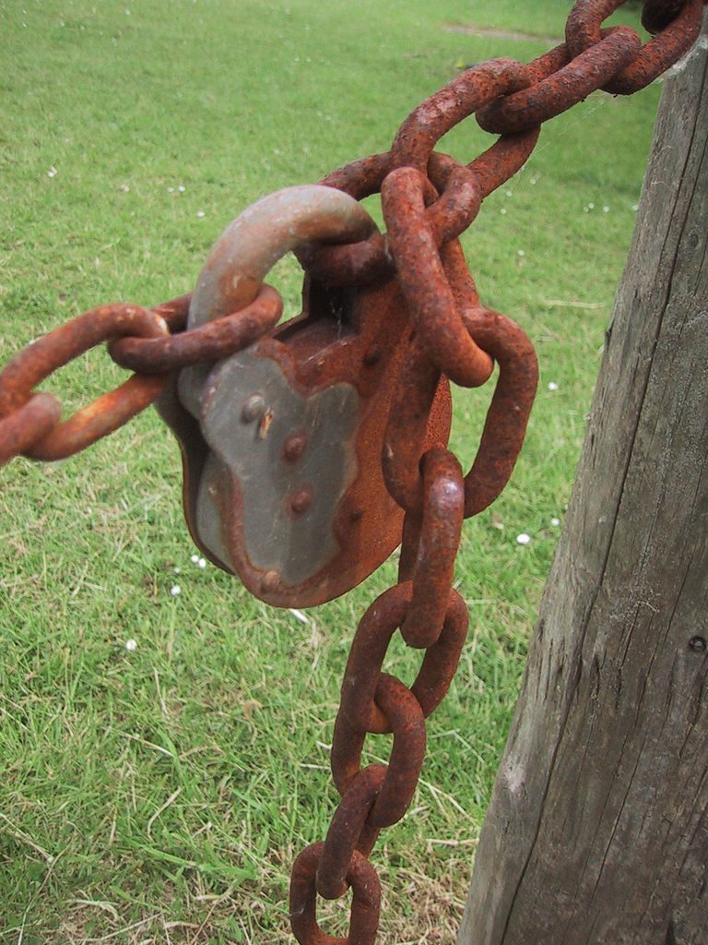
Security
“Padlock” by Peter Ford © 2005
Licensed under the Creative Commons Attribution 2.0 license
http://www.flickr.com/photos/peterf/72583027/
http://www.webcitation.org/5XIiBcsUg

Slide 90
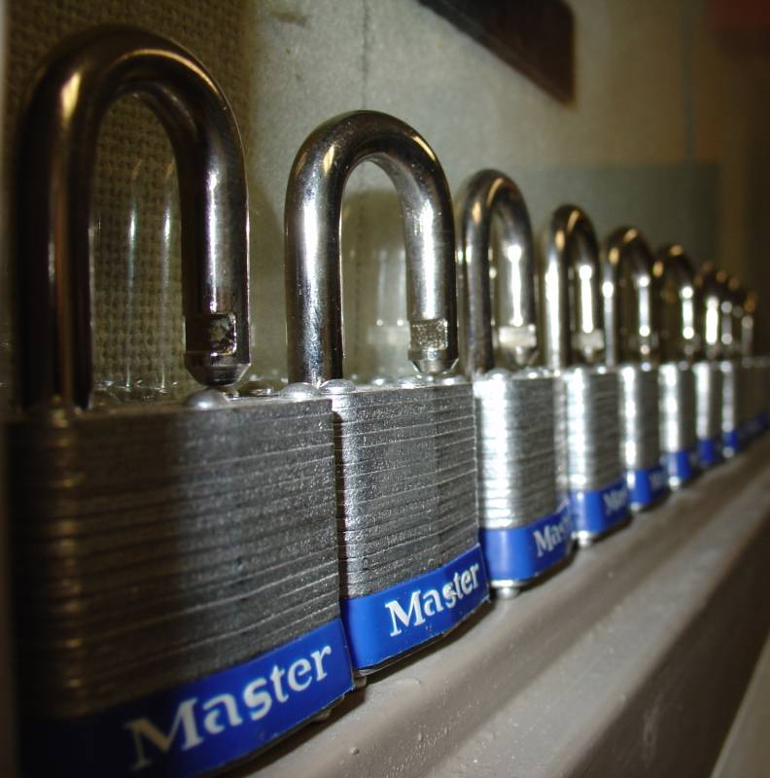
Condor Security
Strong authentication of users and daemons
Encryption over the network
Integrity checking over the network
“locks-masterlocks.jpg” by Brian De Smet, © 2005
Used with permission.
http://www.fief.org/sysadmin/blosxom.cgi/2005/07/21#locks

Slide 91

Minimal Security Settings
You must set ALLOW_WRITE, or nothing works
Simplest setting:
ALLOW_WRITE=*
  Extremely insecure!
A bit better:
ALLOW_WRITE=
*.cs.wisc.edu
“Bank Security Guard” by “Brad & Sabrina” © 2006
Licensed under the Creative Commons Attribution 2.0 license
http://www.flickr.com/photos/madaboutshanghai/184665954/ http://www.webcitation.org/5XIhUAfuY

Slide 92
Security Features
You need to turn the advanced security features on
SEC_DEFAULT_AUTHENTICATION=REQUIRED
SEC_DEFAULT_ENCRYPTION =REQUIRED
SEC_DEFAULT_INTEGRITY =REQUIRED
Can set on a per security level basis, see the manual.

Slide 93
Security Levels:
A Subset
READ
  querying information
  condor_status, condor_q, etc
WRITE
  updating information
  condor_submit, adding nodes to a pool, sending ClassAds to the collector, etc
  Includes READ

Slide 94
Security Levels:
A Subset
ADMINISTRATOR
  Administrative commands
  condor_on, condor_off, condor_reconfig, condor_restart, etc.
  Includes READ and WRITE

Slide 95
Security Levels:
A Subset
DAEMON
  Daemon to daemon communications
  Includes READ and WRITE
NEGOTIATOR
  condor_negotiator to other daemons
  Includes READ

Slide 96
Specifying User Identities
Canonical form (shortcuts exist): username@domain.com/hostname.com
adesmet@cs.wisc.edu/puffin.cs.wisc.edu
Can use * wildcard
Hostname can be hostname or IP address with optional netmask
  192.168.12.1/255.255.192.0
  192.168.12.1/18

Slide 97
Setting Up Security
List who you ALLOW access to
  ALLOW_WRITE=…
If not ALLOWed, then defaults to DENY access
Can also DENY people
  DENY_WRITE=…
  Warning: If you set DENY_* but not a matching ALLOW_* expression, access defaults to ALLOW.

Slide 98
Setting Up Security
Can define values that effect all daemons:
  ALLOW_WRITE, DENY_READ, ALLOW_ADMINISTRATOR, etc.
Can define daemon-specific settings:
  ALLOW_READ_SCHEDD, DENY_WRITE_COLLECTOR, etc.

Slide 99
Example Filters
Allow anyone from wisc.edu:
  ALLOW_READ=*@wisc.edu/*.wisc.edu
Allow any authenticated local user:
  ALLOW_READ=*/*.wisc.edu
Allow specific user/machine
  ALLOW_NEGOTIATOR= \ daemon@wisc.edu/condor.wisc.edu

Slide 100
AUTHENTICATION_METHODS
How to authenticate users and daemons?
  FS – Local file system
  SSL – Public key encryption
  PASSWORD – Shared secret
  ANONYMOUS
  NTSSPI – Microsoft Windows
  Kerberos
  GSI – Globus/Grid Security Infrastructure
  CLAIMTOBE - Insecure
  FS_REMOTE - Network file system

Slide 101
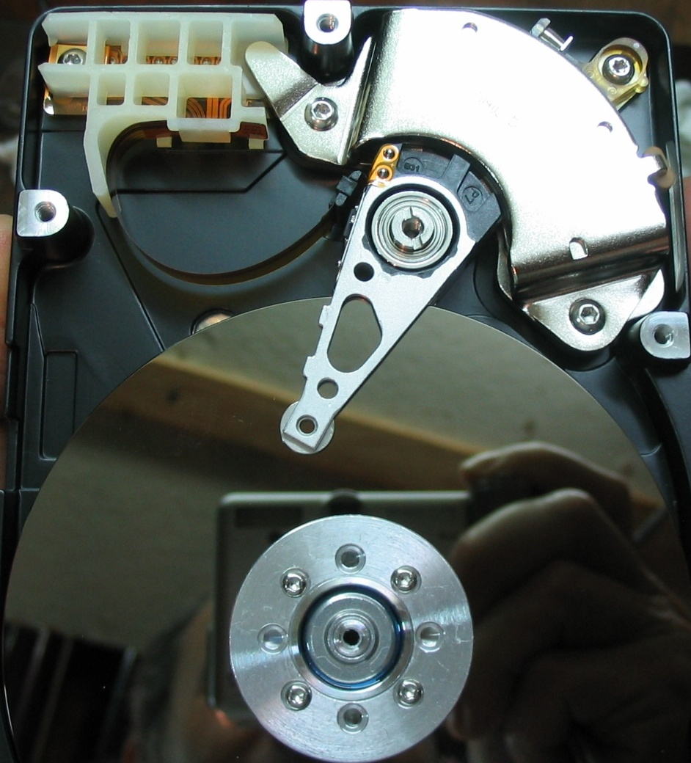
FS: File System
Checks that the user can create a directory owned by the user.
  Only works on
  local machine
  Assumes filesystem
  is trustworthy
Everyone should use
It just works!
“Hard drive” by Robbie Sproule © 2005
Licensed under the Creative Commons Attribution 2.0 license
http://www.flickr.com/photos/robbie1/73032053/ http://www.webcitation.org/5XQVcvsyYs

Slide 102
PASSWORD
Shared secret encryption file
Only suitable for daemon-to-daemon communications
Simple

Slide 103
SSL
Public key encryption system
Daemons and users have X.509 certificates
All Condor daemons in pool can share one certificate
Map file transforms X.509 distinguished name into an identity
  You’ll need to create this map file. See “3.6.4 The Unified Map File for Authentication” in the manual.

Slide 104
NTSSPI
Microsoft Windows
Only works on Windows
Insecure encryption and integrity checks

Slide 105
ANONYMOUS
ANONYMOUS - A sort of “guest” user
  CONDOR_ANONYMOUS_USER
  Insecure encryption and integrity checks

Slide 106
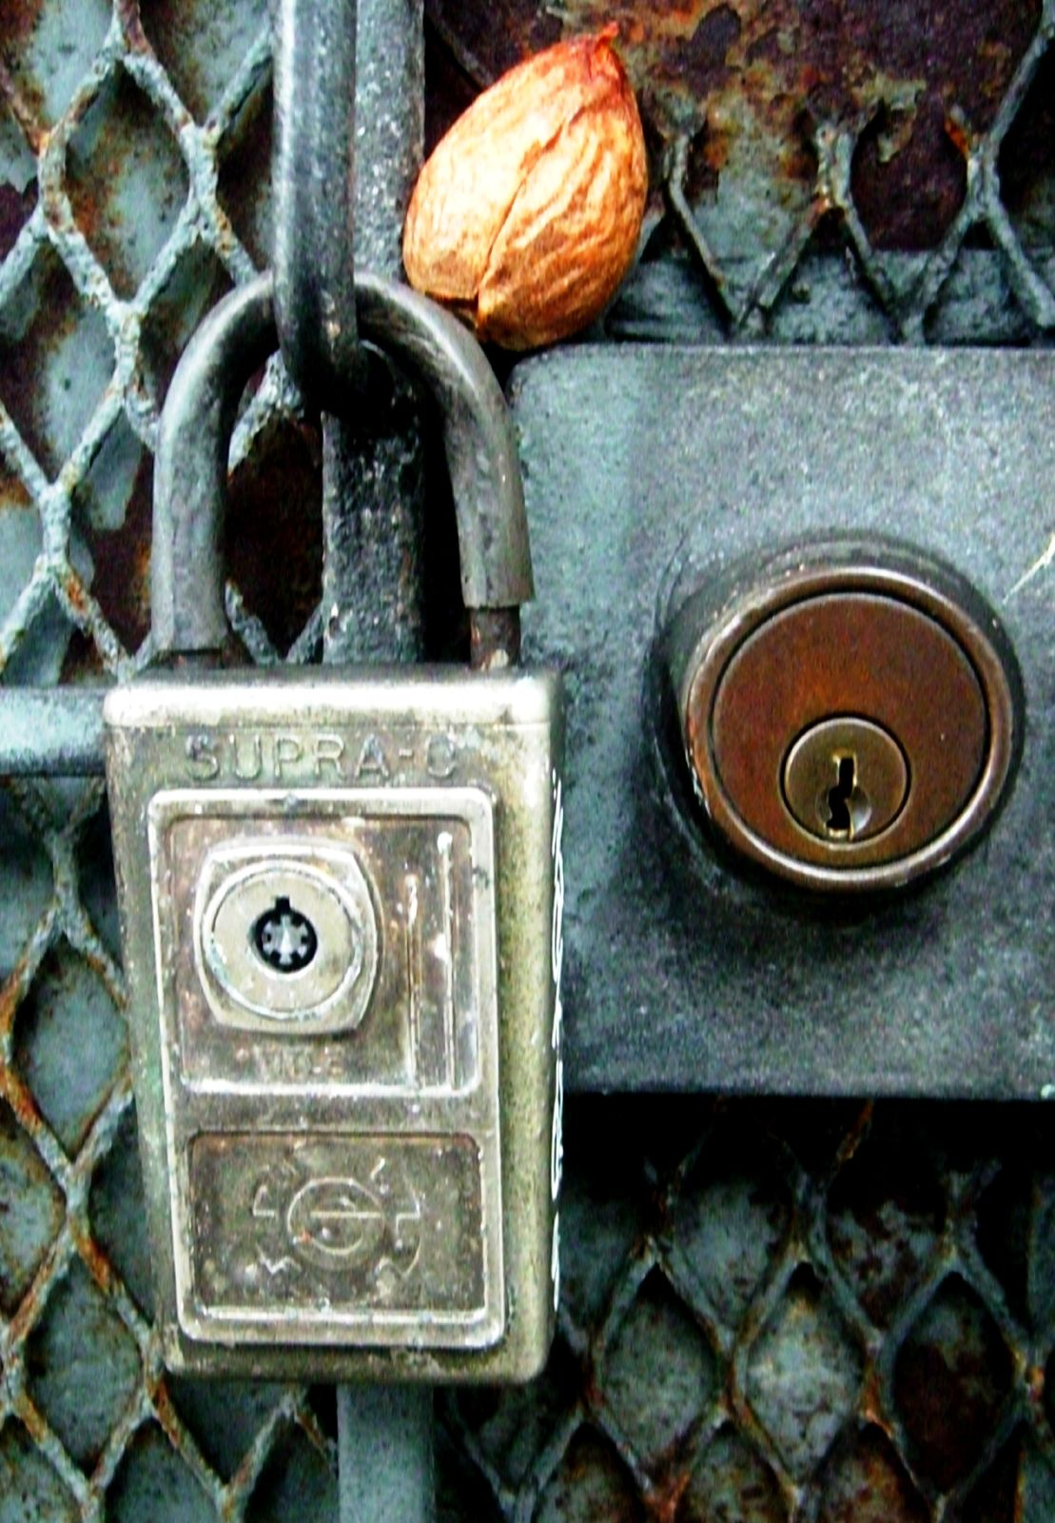
Kerberos and GSI
Complex to set up
Useful if you already use one of these systems
“two locks and a seed” by “Darwin Bell” © 2005
Licensed under the Creative Commons Attribution 2.0 license
http://www.flickr.com/photos/darwinbell/321434315/ http://www.webcitation.org/5XQW02h8V

Slide 107
Example Security Configuration
Use SSL authentication for between machine connections
Use SSL or FS authentication on a single machine

Slide 108
Example Security Configuration
# Turn on all security:
SEC_DEFAULT_AUTHENTICATION=REQUIRED
SEC_DEFAULT_ENCRYPTION=REQUIRED
SEC_DEFAULT_INTEGRITY=REQUIRED

Slide 109
Example Security Configuration
# Require authentication
SEC_DEFAULT_AUTHENTICATION_METHODS = FS, SSL
Requires giving your daemons an X.509 certificates
You will also need a map file

Slide 110
Example Security Configuration
ALLOW_READ = *
ALLOW_WRITE= *@wisc.edu/*.wisc.edu
DENY_WRITE = abuser@*.wisc.edu/*
ALLOW_ADMINISTRATOR = admin@wisc.edu/*.wisc.edu, *@wisc.edu/$(CONDOR_HOST)

Slide 111
Example Security Configuration
ALLOW_DAEMON = daemon@wisc.edu/*.wisc.edu
ALLOW_NEGOTIATOR = daemon@wisc.edu/$(CONDOR_HOST)

Slide 112
Users without Certificates
Using FS authentication users can submit jobs and check the local queue
condor_q –analyze and condor_status won’t work for normal users without an X.509 certificate
  Requires READ access to condor_collector
How to let anyone read any daemon? ANONYMOUS authentication

Slide 113
Allow Any User Read Access
SEC_READ_AUTHENTIATION_METHODS = FS, SSL, ANONYMOUS
The “ALLOW_READ = *” handles the rest. We could more explicitly match against “CONDOR_ANONYMOUS_USER/*” if we wanted.

Slide 114
Old Condor Security
HOSTALLOW_* and HOSTDENY_*
Deprecated
Security is entirely based on IP addresses and host names
No encryption or integrity checking

Slide 115

More on Security
Chapter 3.6, “Security,” in the Condor Manual
condor-admin@cs.wisc.edu
Capture the wily Zach Miller
“Zach Miller” by Alan De Smet

Slide 116

Tools
“Tools” by “batega” © 2007 Licensed under Creative Commons Attribution 2.0 license
http://www.flickr.com/photos/batega/1596898776/ http://www.webcitation.org/5XIj1E1Y1

Slide 117
condor_config_val
Find current configuration values
% condor_config_val MASTER_LOG
/var/condor/logs/MasterLog
% cd `condor_config_val LOG`

Slide 118
condor_config_val -v
Can identify source
% condor_config_val –v CONDOR_HOST
CONDOR_HOST: condor.cs.wisc.edu
Defined in ‘/etc/condor_config.hosts’, line 6

Slide 119
condor_config_val -config
What configuration files are being used?
% condor_config_val –config
Config source:
/var/home/condor/condor_config
Local config sources:
/unsup/condor/etc/condor_config.hosts
/unsup/condor/etc/condor_config.global
/unsup/condor/etc/condor_config.policy
/unsup/condor-test/etc/hosts/puffin.local

Slide 120
condor_fetchlog
Retrieve logs remotely
condor_fetchlog beak.cs.wisc.edu Master

Slide 121
Querying daemons condor_status
Queries the collector for information about daemons in your pool
Defaults to finding condor_startds
condor_status –schedd summarizes all job queues
condor_status –master returns list of all condor_masters

Slide 122
condor_status
-long displays the full ClassAd
Optionally specify a machine name to limit results to a single host
condor_status –l node4.cs.wisc.edu

Slide 123
condor_status -constraint
Only return ClassAds that match an expression you specify
Show me idle machines with 1GB or more memory
  condor_status -constraint 'Memory >= 1024 && Activity == "Idle"'

Slide 124

condor_status -format
Controls format of output
Useful for writing scripts
Uses C printf style formats
  One field per argument
“slanting” by Stefano Mortellaro (“fazen”) © 2005
Licensed under the Creative Commons Attribution 2.0 license http://www.flickr.com/photos/fazen/17200735/ http://www.webcitation.org/5XIhNWC7Y

Slide 125
condor_status -format
Census of systems in your pool:
% condor_status -format '%s ' Arch -format '%s\n' OpSys | sort | uniq –c
797 INTEL LINUX
118 INTEL WINNT50
108 SUN4u SOLARIS28
6 SUN4x SOLARIS28

Slide 126
Examining Queues condor_q
View the job queue
The “-long” option is useful to see the entire ClassAd for a given job
supports –constraint and -format
Can view job queues on remote machines with the “-name” option

Slide 127
condor_q -format
Census of jobs per user
% condor_q -format '%8s ' Owner -format '%s\n' Cmd | sort | uniq –c
  64 adesmet /scratch/submit/a.out
  2 adesmet /home/bin/run_events
  4 smith /nfs/sim1/em2d3d
  4 smith /nfs/sim2/em2d3d

Slide 128
condor_q -analyze
condor_q will try to figure out why the job isn’t running
Good at determining that no machine matches the job Requirements expressions

Slide 129
condor_q -analyze
Typical results:
% condor_q –analyze 471216
471216.000: Run analysis summary. Of 820 machines,
458 are rejected by your job's requirements
25 reject your job because of their own requirements
0 match, but are serving users with a better priority in the pool
4 match, but reject the job for unknown reasons
6 match, but will not currently preempt their existing job
327 are available to run your job
Last successful match: Sun Apr 27 14:32:07 2008

Slide 130
condor_q –better-analyze
Breaks down the job’s requirements and suggests modifications
Entirely replaces –analyze as of 7.5.1

Slide 131
condor_q –better-analyze
(Heavily truncated output)
The Requirements expression for your job is:
( ( target.Arch == "SUN4u" ) && ( target.OpSys == "WINNT50" ) && [snip]
Condition Machines Suggestion
1 (target.Disk > 100000000) 0 MODIFY TO 14223201
2 (target.Memory > 10000) 0 MODIFY TO 2047
3 (target.Arch == "SUN4u") 106
4 (target.OpSys == "WINNT50") 110 MOD TO "SOLARIS28"
Conflicts: conditions: 3, 4

Slide 132
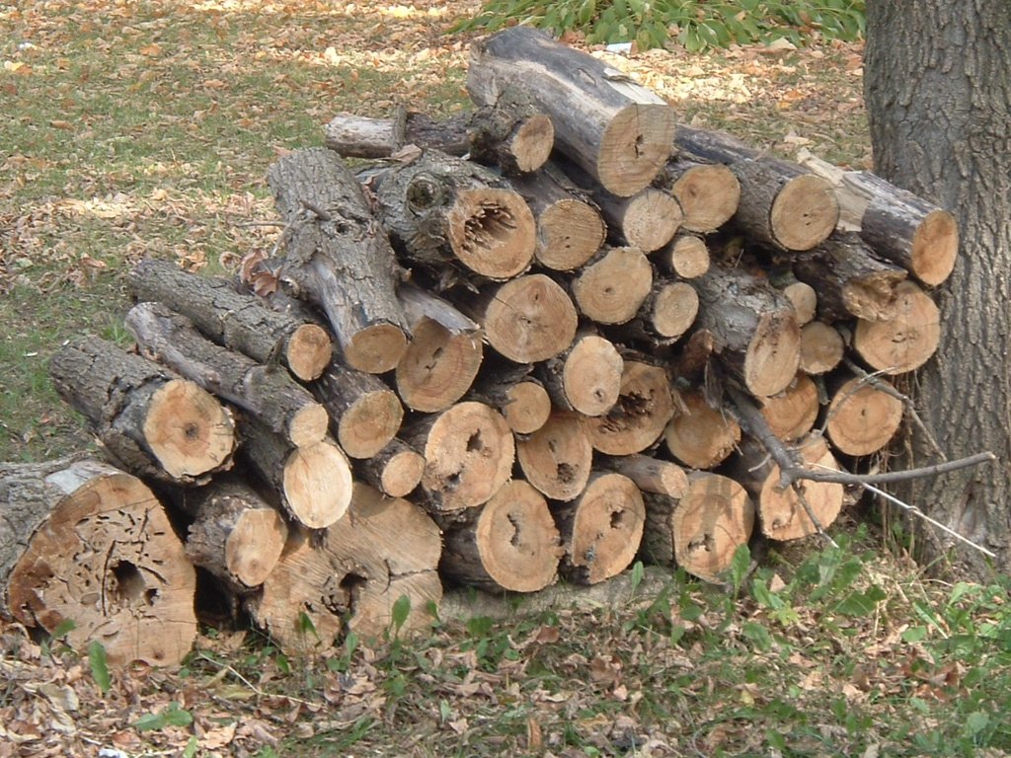
Log Files
“Ready for the Winter” by Anna “bcmom” © 2005 Licensed under the Creative Commons Attribution 2.0 license
http://www.flickr.com/photos/bcmom/59207805/ http://www.webcitation.org/5XIhRO8L8

Slide 133
Condor’s Log Files
Condor maintains one log file per daemon
Can increase verbosity of logs on a per daemon basis
  SHADOW_DEBUG, SCHEDD_DEBUG, and others
  Space separated list

Slide 134
Useful Debug Levels
D_FULLDEBUG dramatically increases information logged
  Does not include other debug levels!
D_COMMAND adds information about about commands received
  SHADOW_DEBUG = \
  D_FULLDEBUG D_COMMAND

Slide 135
Log Rotation
Log files are automatically rolled over when a size limit is reached
  Only one old version is kept
  Defaults to 1,000,000 bytes
  Rolls over quickly with D_FULLDEBUG
  MAX_*_LOG, one setting per daemon
    MAX_SHADOW_LOG, MAX_SCHEDD_LOG, and others

Slide 136
Condor’s Log Files
Many log files entries primarily useful to Condor developers
  Especially if D_FULLDEBUG is on
  Minor errors are often logged but corrected
  Take them with a grain of salt
  condor-admin@cs.wisc.edu

Slide 137
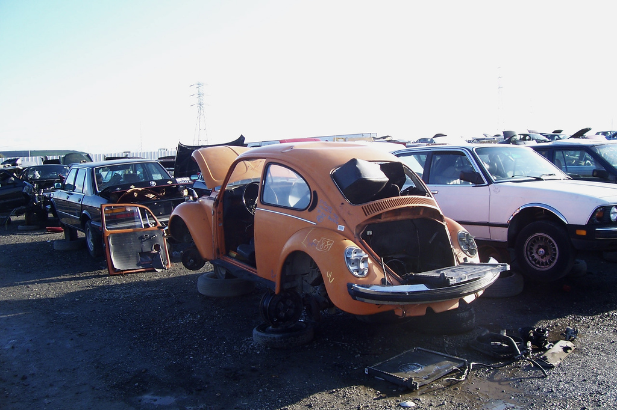
Debugging Jobs
“Wanna buy a Beetle?” by “Kevin” © 2006 Licensed under the Creative Commons Attribution 2.0 license
http://www.flickr.com/photos/kevincollins/89538633/ http://www.webcitation.org/5XIiMyhpp

Slide 138
Debugging Jobs: condor_q
Examine the job with condor_q
  especially -long and –analyze
  Compare with condor_status –long for a machine you expected to match

Slide 139
Debugging Jobs:
User Log
Examine the job’s user log
  Can find with:
condor_q -format '%s\n' UserLog 17.0
  Set with “log” in the submit file
  You can set EVENT_LOG to get a unified log for all jobs under a schedd
Contains the life history of the job
Often contains details on problems

Slide 140
Debugging Jobs:
ShadowLog
Examine ShadowLog on the submit machine
  Note any machines the job tried to execute on
  There is often an “ERROR” entry that can give a good indication of what failed

Slide 141
Debugging Jobs:
Matching Problems
No ShadowLog entries? Possible problem matching the job.
  Examine ScheddLog on the submit machine
  Examine NegotiatorLog on the central manager

Slide 142
Debugging Jobs:
Remote Problems
ShadowLog entries suggest an error but aren’t specific?
  Examine StartLog and StarterLog on the execute machine

Slide 143
Debugging Jobs:
Reading Log Files
Condor logs will note the job ID each entry is for
  Useful if multiple jobs are being processed simultaneously
  grepping for the job ID will make it easy to find relevant entries

Slide 144
Debugging Jobs:
What Next?
If necessary add “D_FULLDEBUG D_COMMAND” to DEBUG_DAEMONNAME setting for additional log information
Increase MAX_DAEMONNAME_LOG if logs are rolling over too quickly
If all else fails, email us
  condor-admin@cs.wisc.edu

Slide 145

More Information
“IMG 0915” by Eva Schiffer © 2008 Used with permission
http://www.digitalchangeling.com/pictures/ourCats2008/january2008/IMG_0915.html

Slide 146
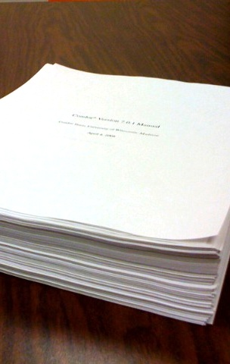
More Information
Condor staff here at Condor Week
Condor Manual
condor-users mailing list
  http://www.cs.wisc.edu/
  condor/mail-lists/
condor-admin
  condor-admin@cs.wisc.edu
“Condor Manual” by Alan De Smet
(Actual first page of the 7.0.1 manual on about 700 pages of other output. The actual 7.0.1 manual is about 860 pages.)

Slide 147
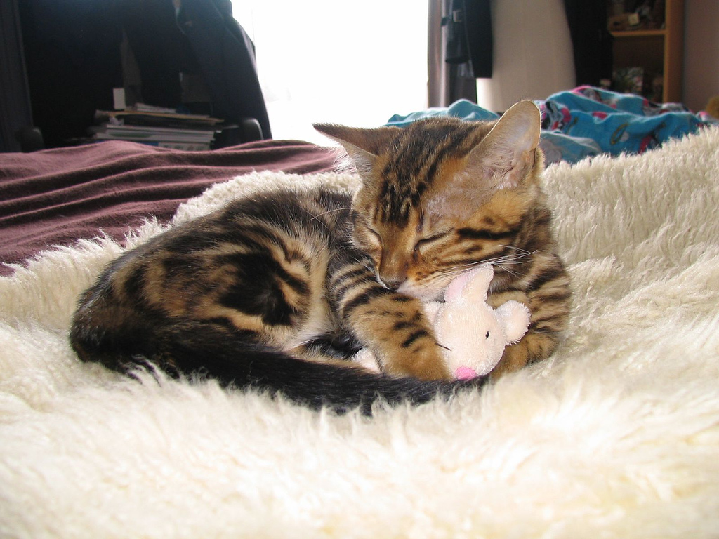
Thank You!
Any questions?
“My mouse” by “MysterFaery” © 2006 Licensed under the Creative Commons Attribution 2.0 license
http://www.flickr.com/photos/mysteryfaery/294253525/ http://www.webcitation.org/5XIi6HRCM

