Slide 1
Condor at UW

Slide 2
The Condor Project (Established ‘85)
Distributed Computing research performed by a team of ~40 faculty, full time staff and students who
  face software/middleware engineering challenges in a UNIX/Linux/Windows/OS X environment,
  involved in national and international collaborations,
  interact with users in academia and industry,
  maintain and support a distributed production environment (more than 2300 CPUs at UW),
  and educate and train students.
Funding – DoE, NASA, NIH, NSF, EU, INTEL,
Micron, Microsoft and the UW Graduate School

Slide 3
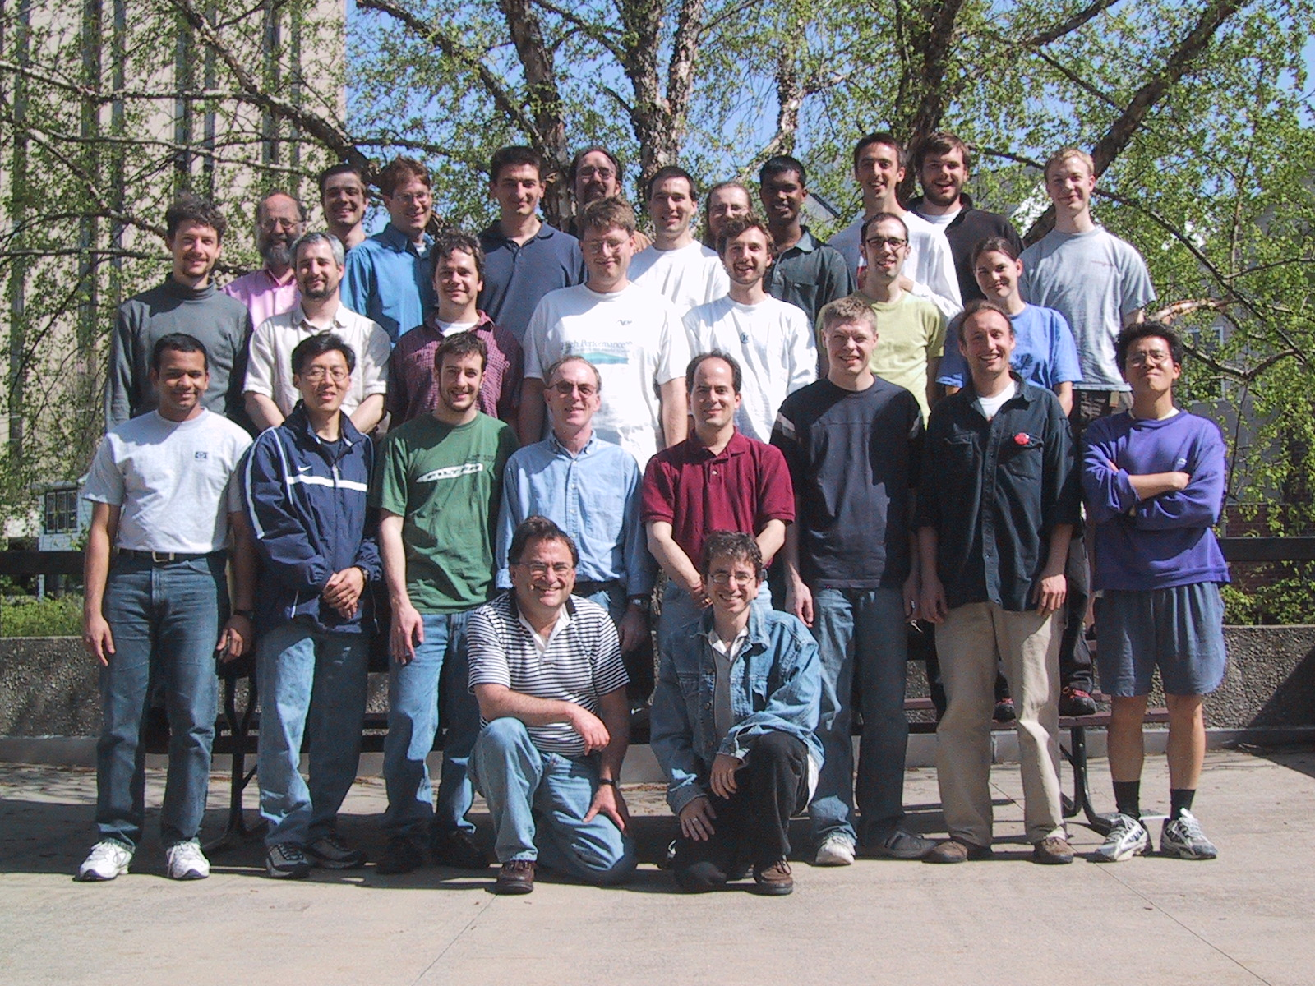

Slide 4
Excellence
S
u
p
p
o
r
t
Functionality
Research

Slide 5
“ … Since the early days of mankind the primary motivation for the establishment of communities has been the idea that by being part of an organized group the capabilities of an individual are improved. The great progress in the area of inter-computer communication led to the development of means by which stand-alone processing sub-systems can be integrated into multi-computer ‘communities’. … “
Miron Livny, “ Study of Load Balancing Algorithms for Decentralized Distributed Processing Systems.”,
Ph.D thesis, July 1983.

Slide 6
Claims for “benefits” provided by Distributed Processing Systems
  High Availability and Reliability
  High System Performance
  Ease of Modular and Incremental Growth
  Automatic Load and Resource Sharing
  Good Response to Temporary Overloads
  Easy Expansion in Capacity and/or Function
“What is a Distributed Data Processing System?” , P.H. Enslow, Computer, January 1978

Slide 7
The Ethernet Protocol
IEEE 802.3 CSMA/CD - A truly distributed (and very effective) access control protocol to a shared service.
  Client responsible for access control
  Client responsible for error detection
  Client responsible for fairness

Slide 8
Benefits to Science
Democratization of Computing – “you do not have to be a SUPER person to do SUPER computing.” (accessibility)
Speculative Science – “Since the resources are there, lets run it and see what we get.” (unbounded computing power)
Function shipping – “Find the image that has a red car in this 3 TB collection.” (computational mobility)

Slide 9

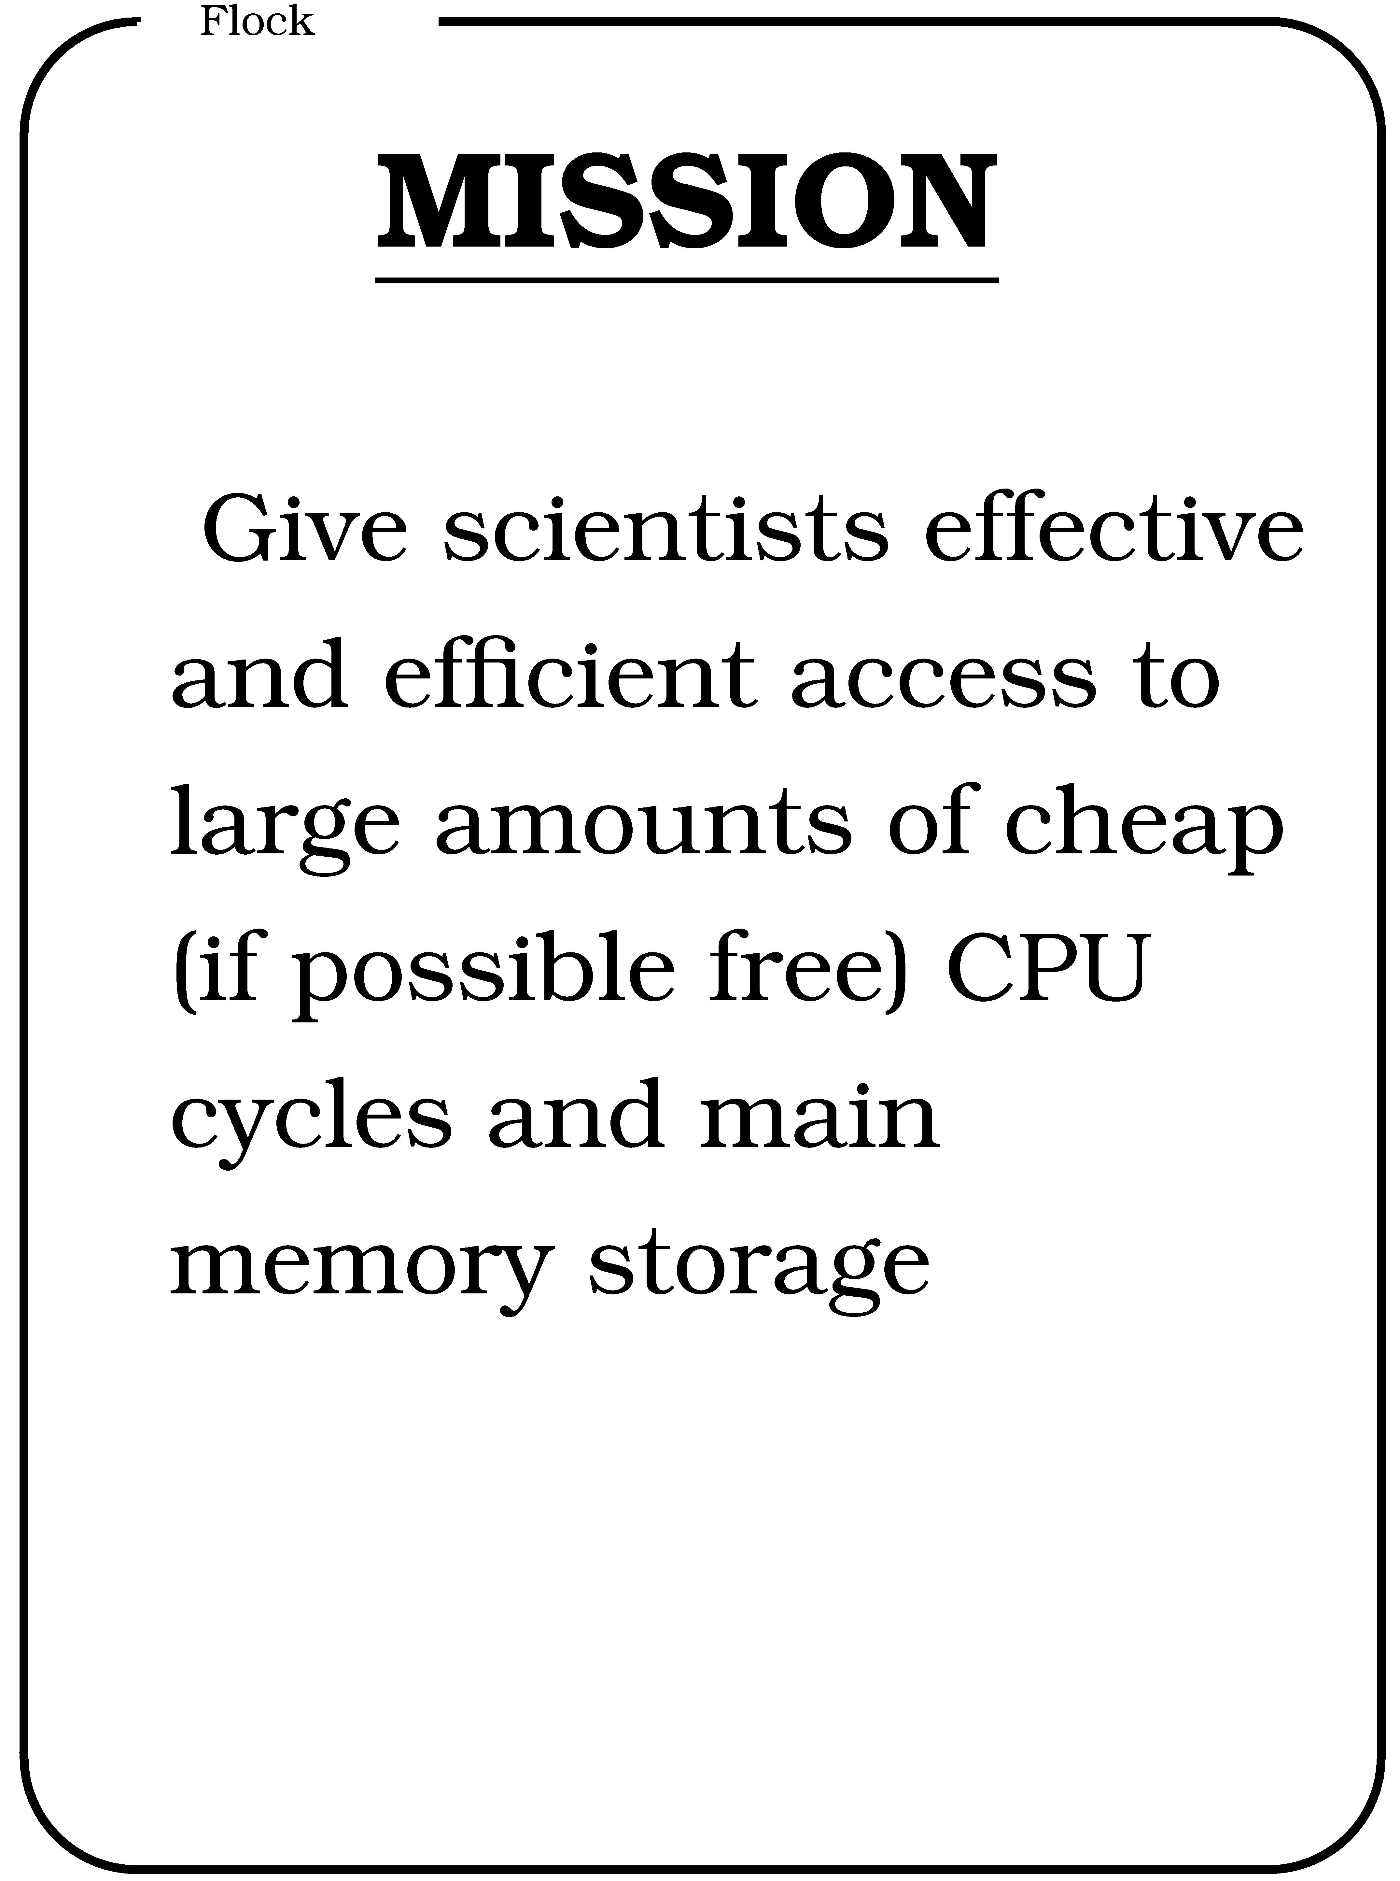
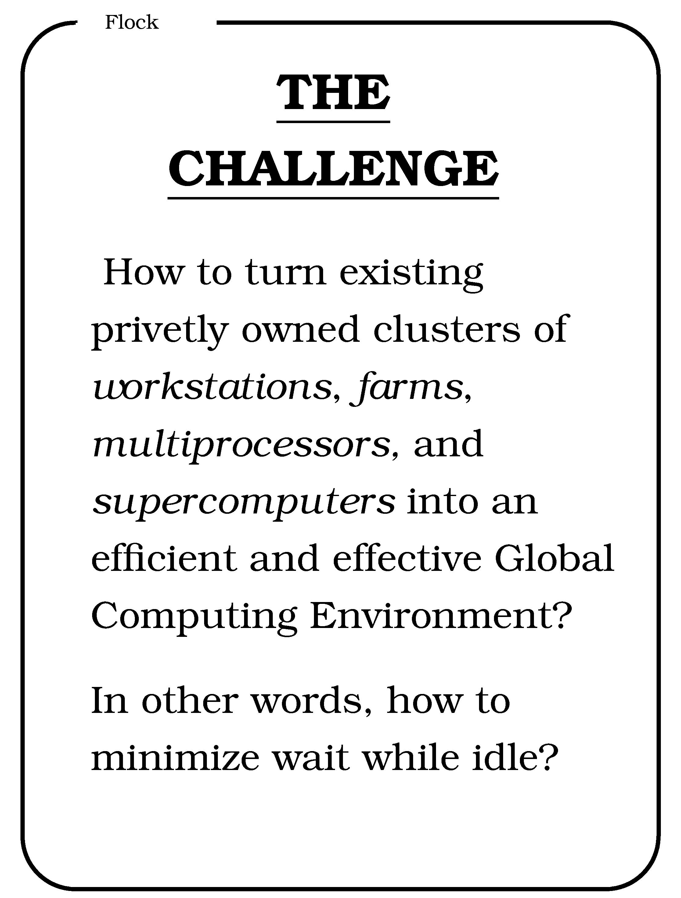
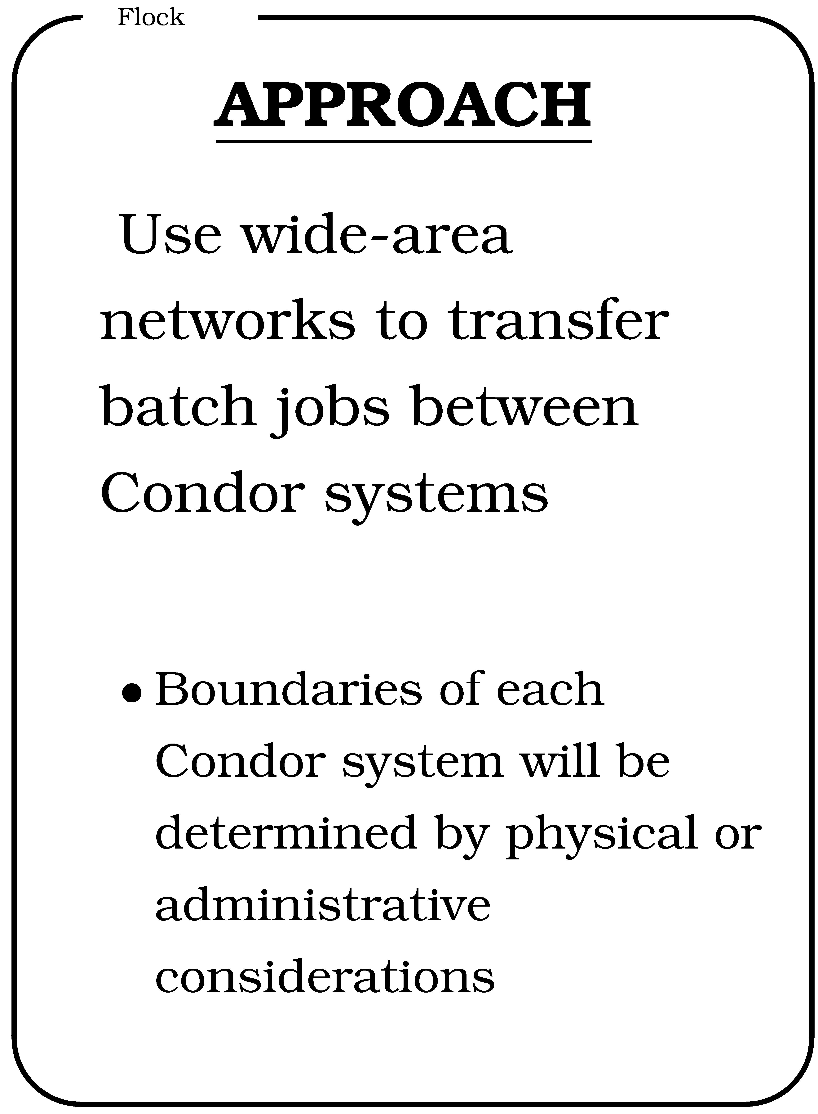
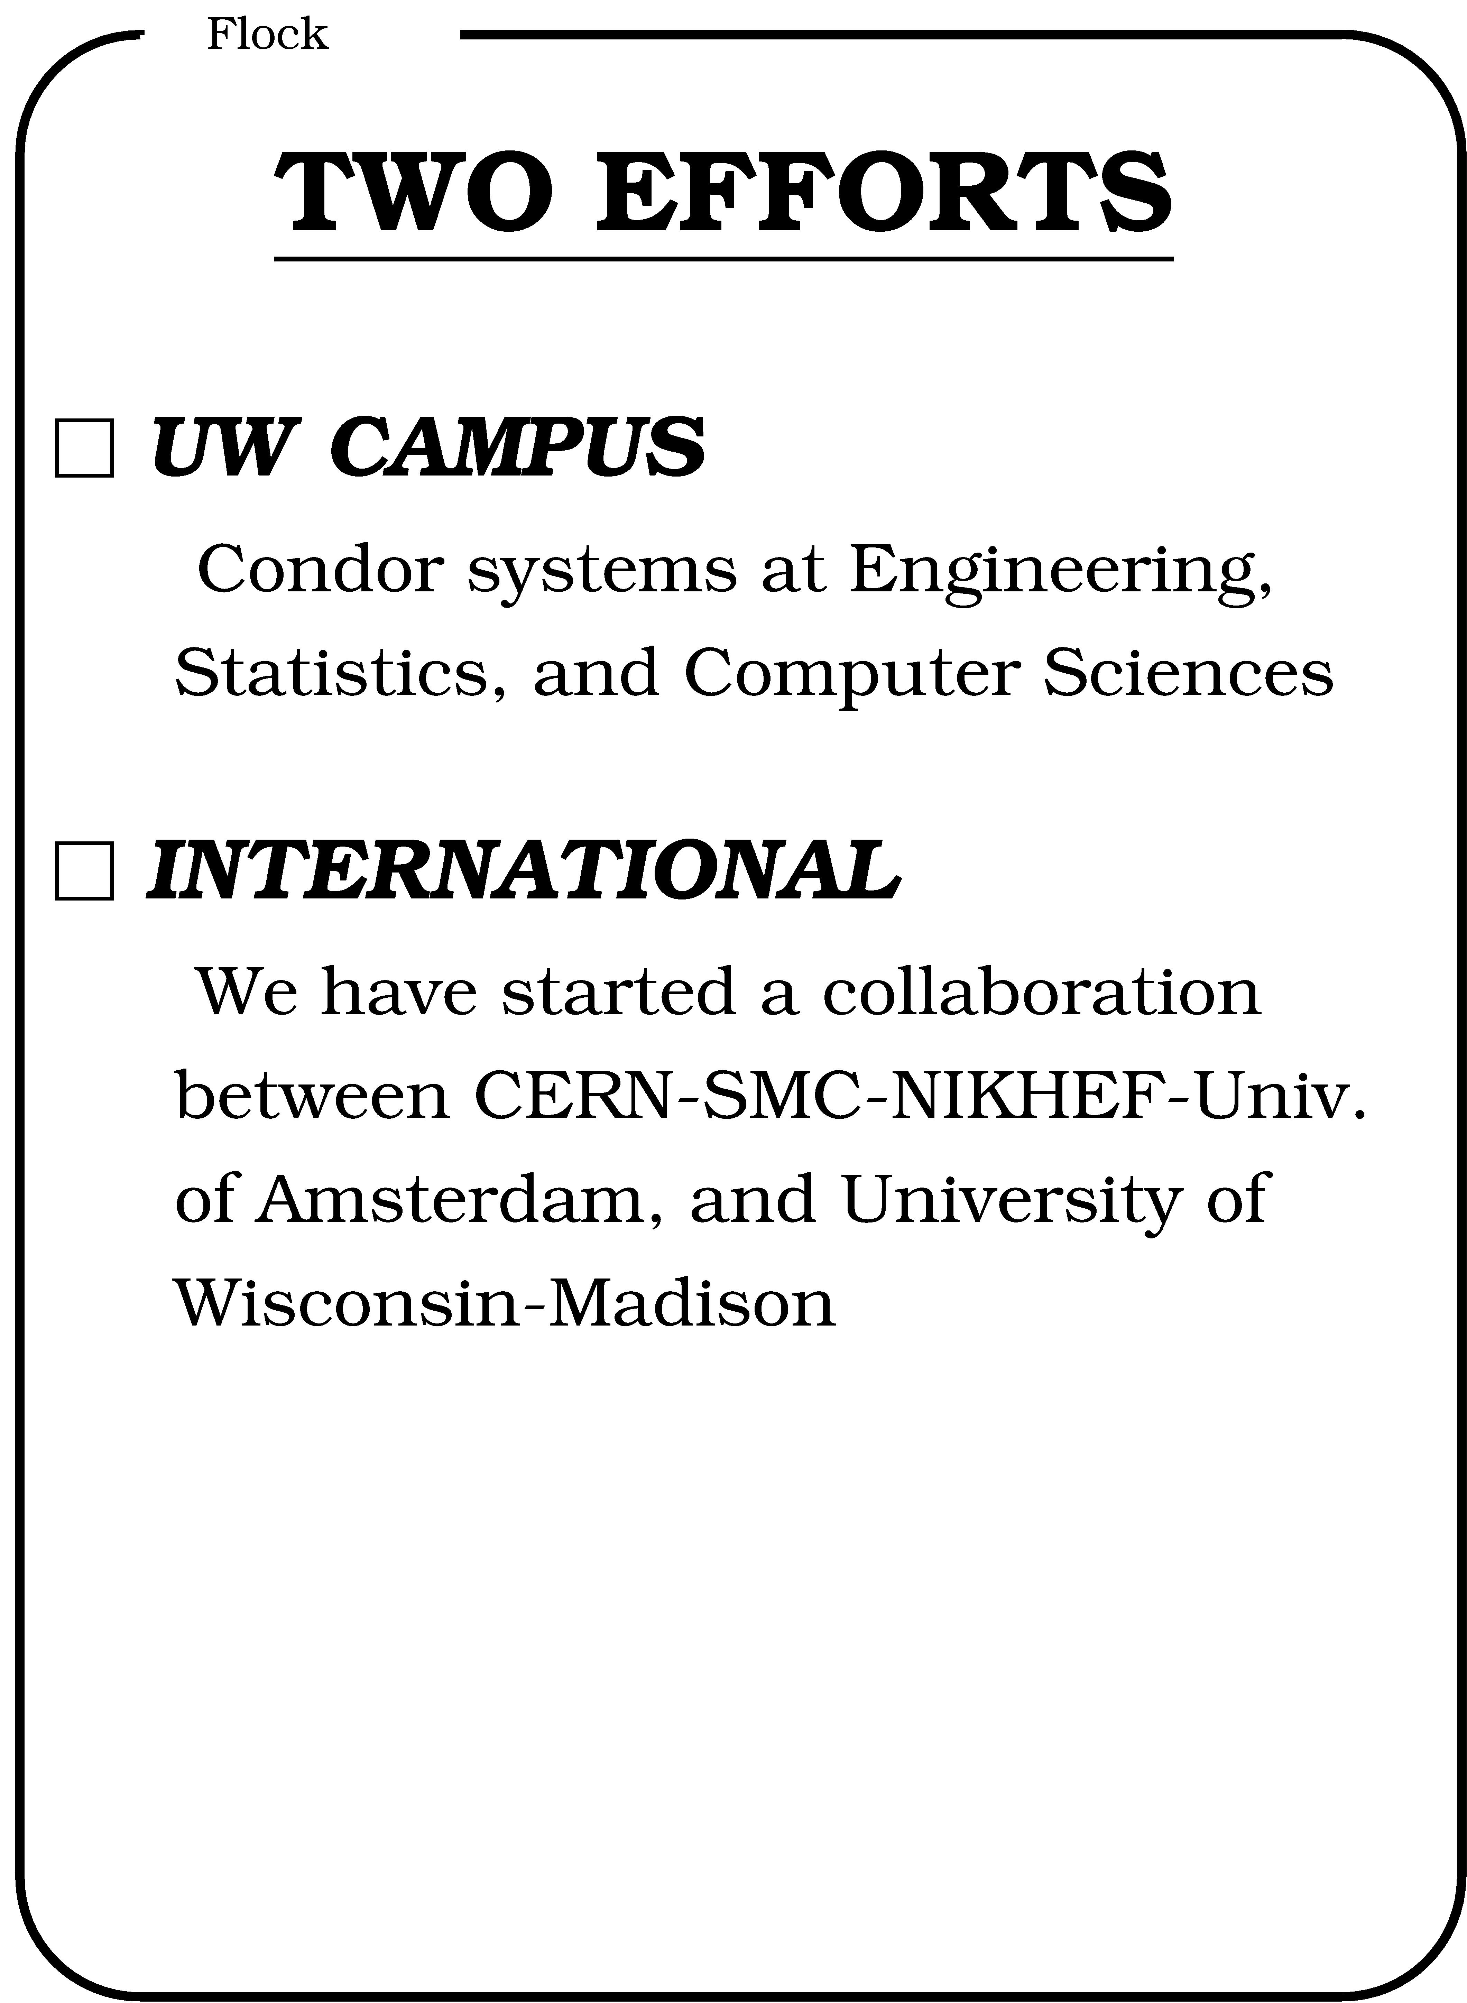
CERN 92

Slide 10
The ’94 Worldwide Condor Flock
Delft
Amsterdam
3
30
200
10
3
3
3
Madison
Warsaw
10
10
Geneva
Dubna/Berlin

Slide 11
The Grid: Blueprint for a New Computing Infrastructure
Edited by Ian Foster and Carl Kesselman
July 1998, 701 pages.
The grid promises to fundamentally change the way we think about and use computing. This infrastructure will connect multiple regional and national computational grids, creating a universal source of pervasive and dependable computing power that supports dramatically new classes of applications. The Grid provides a clear vision of what computational grids are, why we need them, who will use them, and how they will be programmed.

Slide 12
“ … We claim that these mechanisms, although originally developed in the context of a cluster of workstations, are also applicable to computational grids. In addition to the required flexibility of services in these grids, a very important concern is that the system be robust enough to run in “production mode” continuously even in the face of component failures. … “
Miron Livny & Rajesh Raman, "High Throughput Resource Management", in “The Grid: Blueprint for
a New Computing Infrastructure”.

Slide 13
“ … Grid computing is a partnership between clients and servers. Grid clients have more responsibilities than traditional clients, , and must be equipped with powerful mechanisms for dealing with and recovering from failures, whether they occur in the context of remote execution, work management, or data output. When clients are powerful, servers must accommodate them by using careful protocols.… “
Douglas Thain & Miron Livny, "Building Reliable Clients and Servers", in “The Grid: Blueprint for a New Computing
Infrastructure”,2nd edition

Slide 14
world
region
campus
building
floor
desktop

Slide 15
WWW
Grid
Client
Master
Server
Worker

Slide 16
Being a Master
Customer “deposits” task(s) with the master that is responsible for:
  Obtaining resources and/or workers
  Deploying and managing workers on obtained resources
  Assigning and delivering work unites to obtained/deployed workers
  Receiving and processing results
  Notify customer.

Slide 17
Application Responsibilities
Use algorithms that can generate very large numbers of independent tasks – “use pleasantly parallel algorithms”
Implement self-contained portable workers – “this code can run anywhere!”
Detect failures and react gracefully – “use exponential back off, please!”
Be well informed and opportunistic – “get your work done and out of the way !“

Slide 18
High Throughput Computing
For many experimental scientists, scientific progress and quality of research are strongly linked to computing throughput. In other words, they are less concerned about instantaneous computing power. Instead, what matters to them is the amount of computing they can harness over a month or a year --- they measure computing power in units of scenarios per day, wind patterns per week, instructions sets per month, or crystal configurations per year.

Slide 19
High Throughput Computing is a
24-7-365 activity
MB/y ≠ (60*60*24*7*52)*MB/s

Slide 20
Every community needs a
Matchmaker*!
* or a Classified section in the newspaper or an eBay.

Slide 21
We use Matchmakers to build
Computing Communities out of
Commodity Components

Slide 22
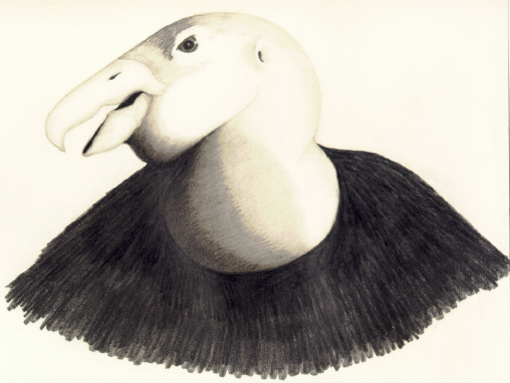
C
High Throughput Computing
ondor
our
answer to
High Throughput MW Computing
on commodity resources

Slide 23
The Layers of Condor
Application
Submit
(client)
Application Agent
Customer Agent (schedD)
Matchmaker
Owner Agent (startD)
Execute
(service)
Remote Execution Agent
Local Resource Manager
Resource

Slide 24
PSE or User
Condor
C-app
Local
Condor – G (schedD)
Flocking
Grid Tools
Flocking
PBS
LSF
Condor
Condor
(Glide-in)
Condor
(Glide-in)
Condor
(Glide-in)
Condor
Remote
C-app
G-app
C-app
G-app
C-app
G-app
C-app

Slide 25
The NUGn Quadratic Assignment Problem (QAP)
n
i=1
n
j=1
∑
∑
a_{ij}b_{p(i)p(j)}
min
p∈∏

Slide 26
NUG30 Personal Grid …
Managed by one Linux box at Wisconsin
Flocking: -- Condor pool at Wisconsin (500 processors)
-- Condor pool at Georgia Tech (284 Linux boxes)
-- Condor pool at UNM (40 processors)
-- Condor pool at Columbia (16 processors)
-- Condor pool at Northwestern (12 processors)
-- Condor pool at NCSA (65 processors)
-- Condor pool at INFN Italy (54 processors)
Glide-in: -- Origin 2000 (through LSF ) at NCSA. (512 processors)
-- Origin 2000 (through LSF) at Argonne (96 processors)
Hobble-in: -- Chiba City Linux cluster (through PBS) at Argonne
(414 processors).

Slide 27
Solution Characteristics (n=30)
Scientists | 4
Wall Clock Time | 6:22:04:31
Avg. # workers | 653
Max. # workers | 1007
CPU Time | Approx. 11 years
Nodes | 11,892,208,412
LAPs | 574,254,156,532
Parallel Efficiency | 92%

Slide 28
The World of Condors
Available for most Unix and Windows platforms at www.cs.wisc.edu/Condor
More than 1000 Condor pools at commercial and academia sites world wide
More than 40,000 CPUs world wide
“Best effort” and “for fee” support available

Slide 29
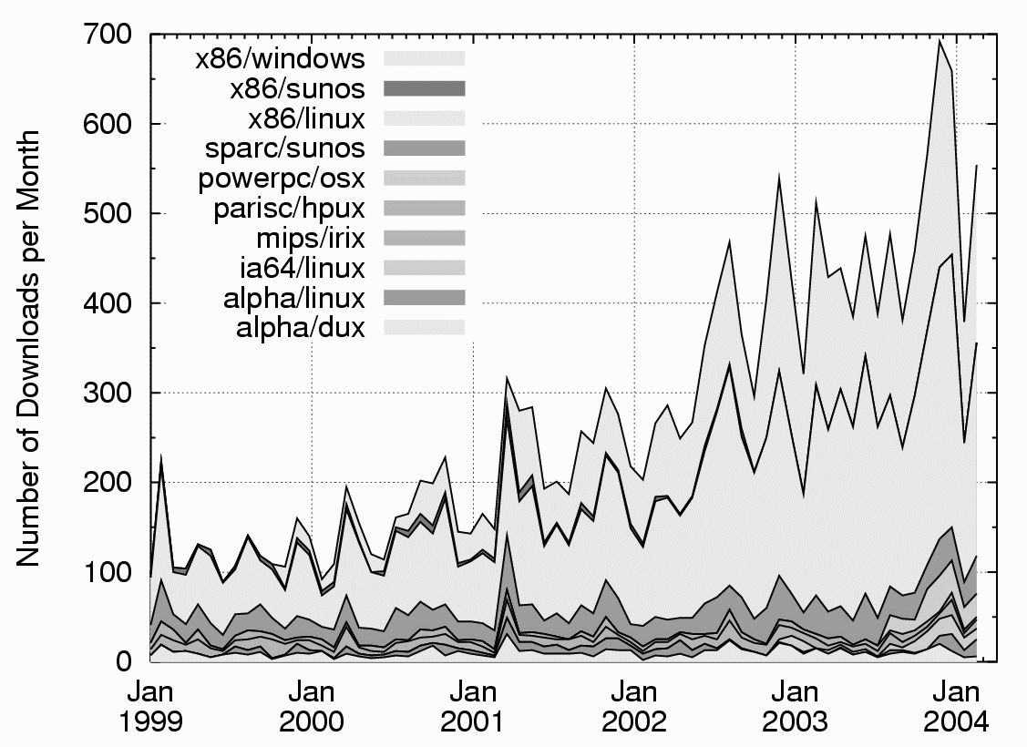
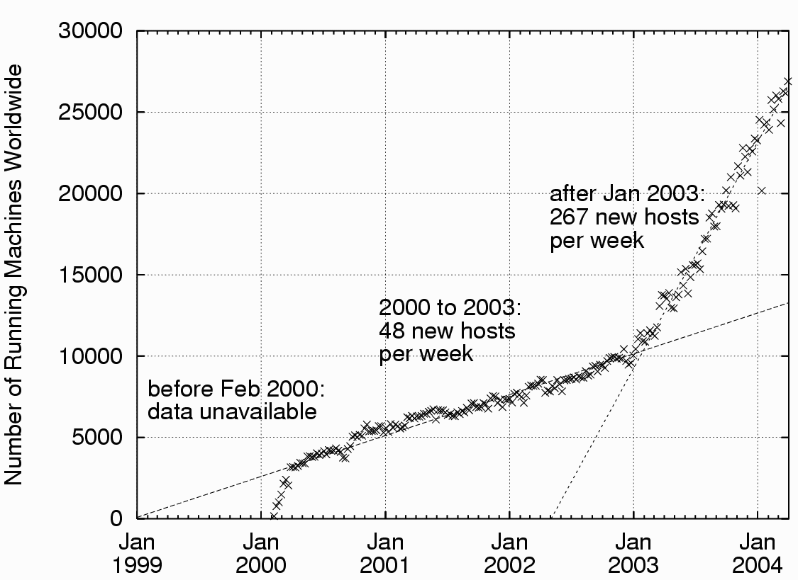
Downloads and Deployments

Slide 30
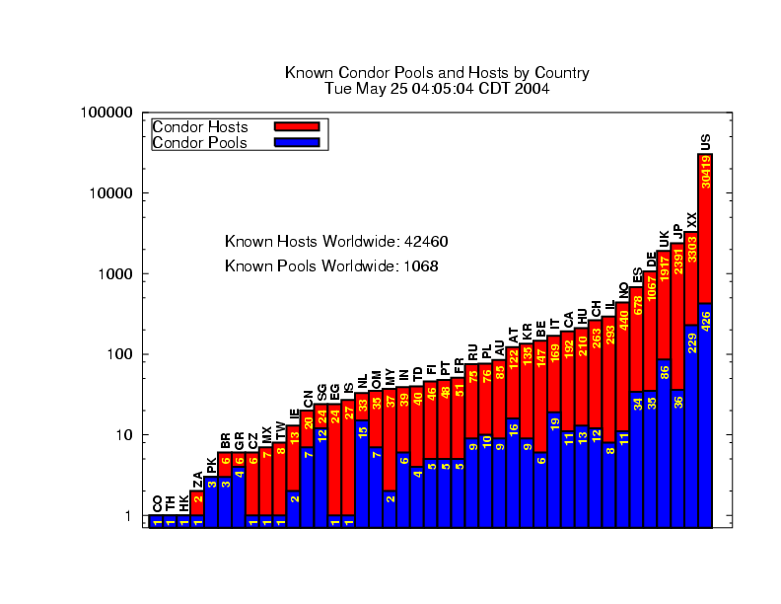

Slide 31
Condor on the UW Campus
The Grid Laboratory of Wisconsin (GLOW) ~700 CPUs at six sites on campus.
College of Engineering has 3 Condor pools with ~ 1.1K CPUs
Physics has 2 pools with ~120 CPUs
BioState has a pool with ~120 CPUs
BioTech has a pool ~50 CPUs
PopHealth has a pool of 4 CPUs
Others …
Most Flock with the 1K CPUs at CS

Slide 32
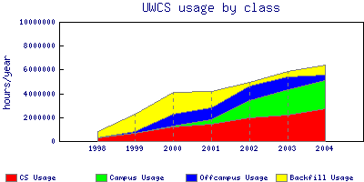

Slide 33
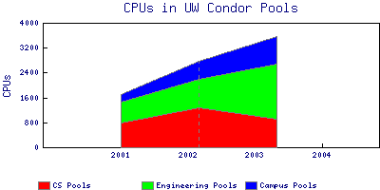

Slide 34
Joint Projects on Campus
Wesley Smith from Physics
John Markley from BioChem
Chris Horn from Education
More than six faculty at CS

Slide 35
(inter)National Grid Efforts
Open Science Grid (OSG)
NanoHab
TeraGrid
Enabling Grids for E-science in Europe (EGEE)

Slide 36
Data Placement
Management of storage space and bulk data transfers play a key role in the end-to-end performance of an application.
  Data Placement (DaP) operations must be treated as “first class” jobs and explicitly expressed in the job flow
  Fabric must provide services to manage storage space
  Data Placement schedulers are needed.
  Data Placement and computing must be coordinated
  Smooth transition of CPU-I/O interleaving across software layers
  Error handling and garbage collection

Slide 37
A simple DAG for y=F(x)L
Allocate (size(x)+size(y)+size(F)) at SE(i)
Move x from SE(j) to SE(i)
Place F on CE(k)
Compute F(x) at CE(k)
Move y to L
Release allocated space
Storage Element (SE); Compute Element (CE)

Slide 38



WCER Pipeline
Need to convert DV videos to MPEG-1, MPEG-2 and MPEG-4
Each 1 hour video is 13 GB
Videos accessible through ‘transana’ software
Need to stage the original and processed videos to SDSC

Slide 39
WCER Pipeline
First attempt at such large scale distributed video processing
Decoder problems with large 13 GB files
Uses bleeding edge technology
Encoding | Resolution | Average Time
MPEG-1 | Half (320 x 240) | 2 hours
MPEG-2 | Full (720x480) | 8 hours
MPEG-4 | Half (320 x 480) | 4 hours

Slide 40

WCER Pipeline
Staging Site @UW
Condor Pool @UW
WCER
Input Data flow
Output Data flow
SRB Server @SDSC
Processing

Slide 41
C
High Throughput Computing
ondor
Don’t
ask “what can
grids do for
me?”ask “what can
I do with grids?”

