Slide 1
The Principals and Power of
Distributed Computing

Slide 2
14 years ago we had
“The Grid”

Slide 3
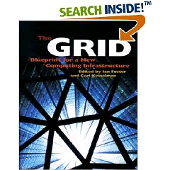
The Grid: Blueprint for a New Computing Infrastructure
Edited by Ian Foster and Carl Kesselman
July 1998, 701 pages.
The grid promises to fundamentally change the way we think about and use computing. This infrastructure will connect multiple regional and national computational grids, creating a universal source of pervasive and dependable computing power that supports dramatically new classes of applications. The Grid provides a clear vision of what computational grids are, why we need them, who will use them, and how they will be programmed.

Slide 4
“ … We claim that these mechanisms, although originally developed in the context of a cluster of workstations, are also applicable to computational grids. In addition to the required flexibility of services in these grids, a very important concern is that the system be robust enough to run in “production mode” continuously even in the face of component failures. … “
Miron Livny & Rajesh Raman, "High Throughput Resource Management", in “The Grid: Blueprint for
a New Computing Infrastructure”.

Slide 5
In the words of the
CIO of Hartford Life
Resource: What do you expect to gain from grid computing? What are your main goals?
Severino: Well number one was scalability. …
Second, we obviously wanted scalability with stability. As we brought more servers and desktops onto the grid we didn’t make it any less stable by having a bigger environment.
The third goal was cost savings. One of the most …

Slide 6
2,000 years ago we had the words of
Koheleth son of David king in Jerusalem

Slide 7
The words of Koheleth son of David, king in Jerusalem ….
  Only that shall happen
  Which has happened,
  Only that occur
  Which has occurred;
  There is nothing new
  Beneath the sun!
Ecclesiastes Chapter 1 verse 9

Slide 8
35 years ago we had
The ALOHA network

Slide 9
One of the early computer networking designs, the ALOHA network was created at the University of Hawaii in 1970 under the leadership of Norman Abramson. Like the ARPANET group, the ALOHA network was built with DARPA funding. Similar to the ARPANET group, the ALOHA network was built to allow people in different locations to access the main computer systems. But while the ARPANET used leased phone lines, the ALOHA network used packet radio.
ALOHA was important because it used a shared medium for transmission. This revealed the need for more modern contention management schemes such as CSMA/CD, used by Ethernet. Unlike the ARPANET where each node could only talk to a node on the other end, in ALOHA everyone was using the same frequency. This meant that some sort of system was needed to control who could talk at what time. ALOHA's situation was similar to issues faced by modern Ethernet (non-switched) and Wi-Fi networks.
This shared transmission medium system generated interest by others. ALOHA's scheme was very simple. Because data was sent via a teletype the data rate usually did not go beyond 80 characters per second. When two stations tried to talk at the same time, both transmissions were garbled. Then data had to be manually resent. ALOHA did not solve this problem, but it sparked interest in others, most significantly Bob Metcalfe and other researchers working at Xerox PARC. This team went on to create the Ethernet protocol.

Slide 10
35 years ago we had
Distributed
Processing
Systems

Slide 11
Claims for “benefits” provided by Distributed Processing Systems
P.H. Enslow, “What is a Distributed Data Processing System?” Computer, January 1978
  High Availability and Reliability
  High System Performance
  Ease of Modular and Incremental Growth
  Automatic Load and Resource Sharing
  Good Response to Temporary Overloads
  Easy Expansion in Capacity and/or Function

Slide 12
Definitional Criteria for a Distributed Processing System
P.H. Enslow and T. G. Saponas “”Distributed and Decentralized Control in Fully Distributed Processing Systems” Technical Report, 1981
  Multiplicity of resources
  Component interconnection
  Unity of control
  System transparency
  Component autonomy

Slide 13
Multiplicity of resources
The system should provide a number of assignable resources for any type of service demand. The greater the degree of replication of resources, the better the ability of the system to maintain high reliability and performance

Slide 14
Component interconnection
A Distributed System should include a communication subnet which interconnects the elements of the system. The transfer of information via the subnet should be controlled by a two-party, cooperative protocol (loose coupling).

Slide 15
Unity of Control
All the component of the system should be unified in their desire to achieve a common goal. This goal will determine the rules according to which each of these elements will be controlled.

Slide 16
System transparency
From the users point of view the set of resources that constitutes the Distributed Processing System acts like a “single virtual machine”. When requesting a service the user should not require to be aware of the physical location or the instantaneous load of the various resources

Slide 17
Component autonomy
The components of the system, both the logical and physical, should be autonomous and are thus afforded the ability to refuse a request of service made by another element. However, in order to achieve the system’s goals they have to interact in a cooperative manner and thus adhere to a common set of policies. These policies should be carried out by the control schemes of each element.

Slide 18
Challenges
Race Conditions…
Name spaces …
Distributed ownership …
Heterogeneity …
Object addressing …
Data caching …
Object Identity …
Trouble shooting …
Circuit breakers …

Slide 19
27 years ago I wrote a Ph.D. thesis –
“Study of Load Balancing Algorithms for Decentralized Distributed Processing Systems”
http://www.cs.wisc.edu/condor/doc/livny-dissertation.pdf

Slide 20
BASICS OF A M/M/1 SYSTEM
Expected # of customers is 1/(1-ρ), where (ρ = λ/μ) is the utilization
λ
When utilization is 80%,
you wait on the average 4 units
for every unit of service
μ

Slide 21
BASICS OF TWO M/M/1 SYSTEMS
When utilization is 80%,
you wait on the average 4 units
for every unit of service
λ
λ
When utilization is 80%,
25% of the time a customer is
waiting for service while
a server is idle
μ
μ

Slide 22
Wait while Idle (WwI) in m*M/M/1
1
m = 20
m = 10
Prob
(WwI)
m = 5
m = 2
0
0
Utilization
1

Slide 23
“ … Since the early days of mankind the primary motivation for the establishment of communities has been the idea that by being part of an organized group the capabilities of an individual are improved. The great progress in the area of inter-computer communication led to the development of means by which stand-alone processing sub-systems can be integrated into multi-computer ‘communities’. … “
Miron Livny, “ Study of Load Balancing Algorithms for Decentralized Distributed Processing Systems.”,
Ph.D thesis, July 1983.

Slide 24
25 years ago we had
“Condor”

Slide 25
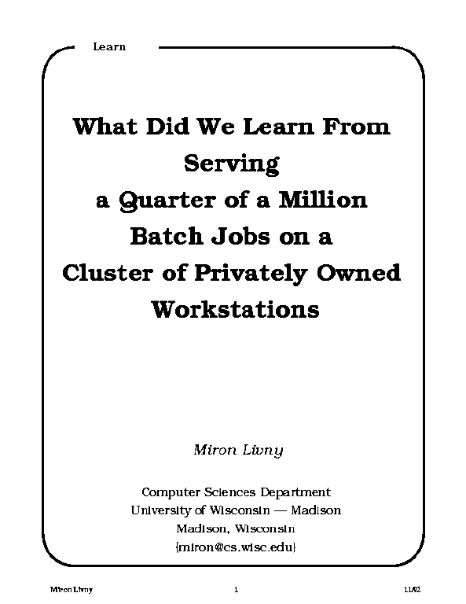
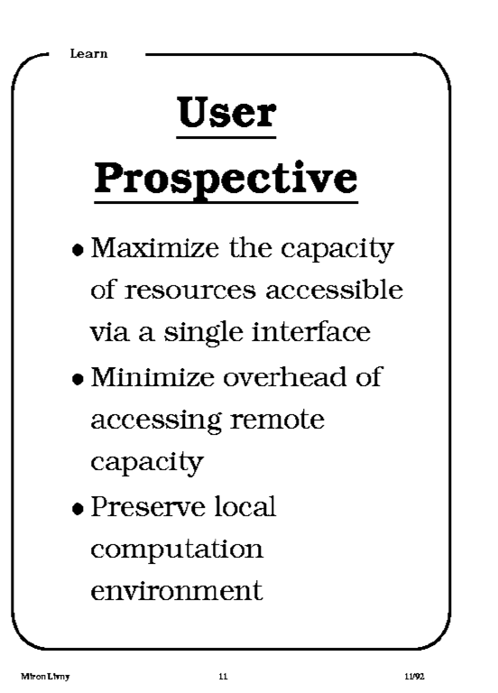
1992

Slide 26
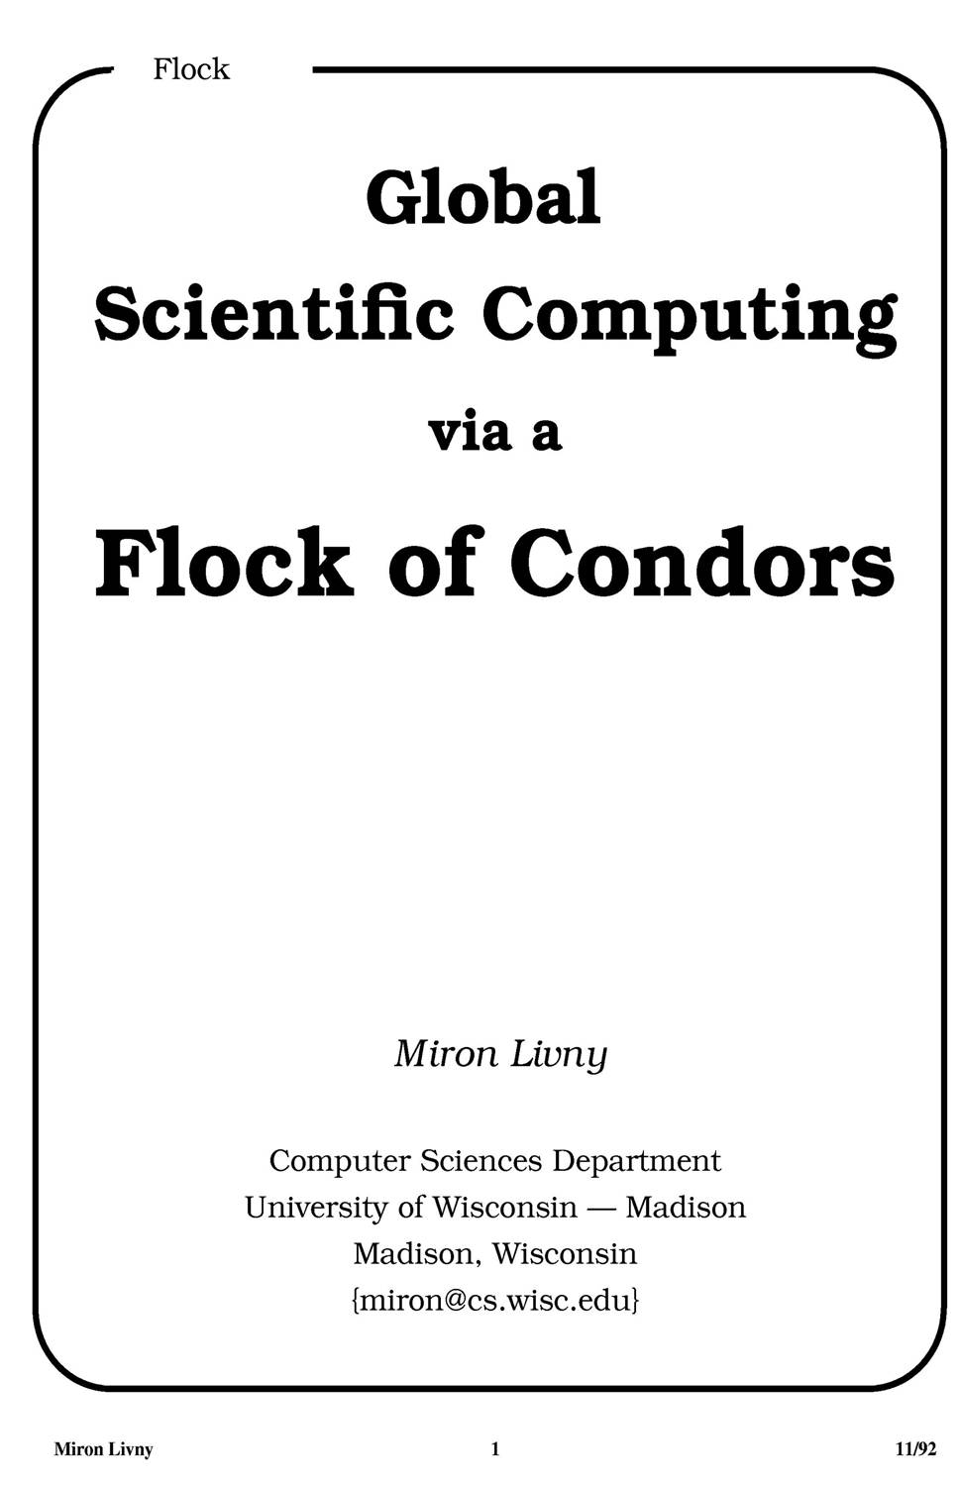
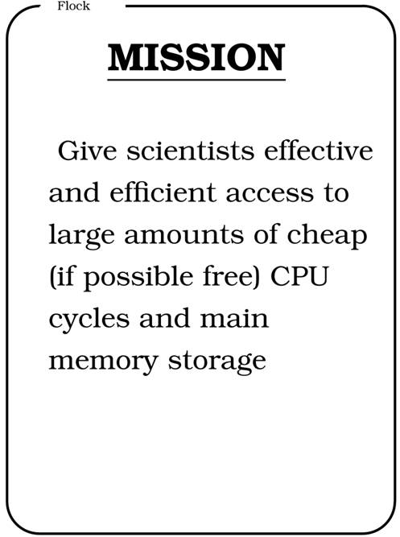
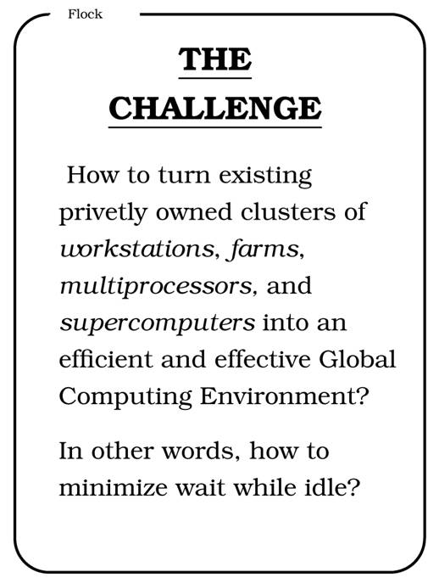
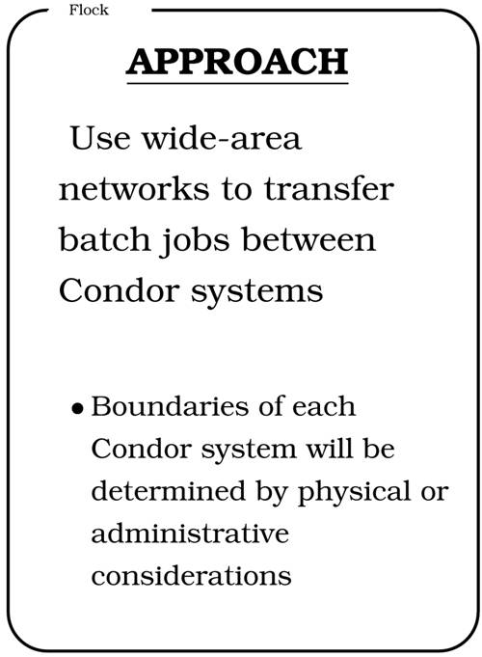
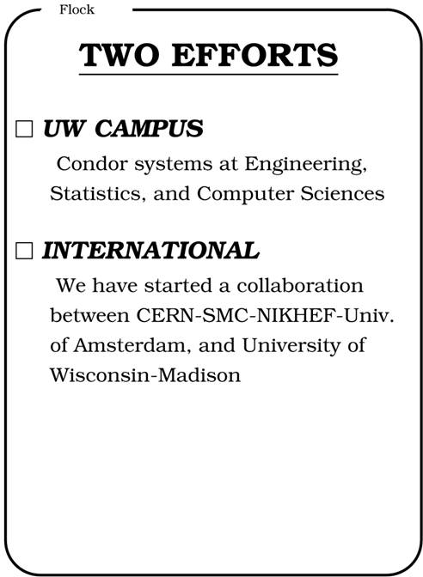
CERN 92

Slide 27
High Throughput Computing
We first introduced the distinction between High Performance Computing (HPC) and High Throughput Computing (HTC) in a seminar at the NASA Goddard Flight Center in July of 1996 and a month later at the European Laboratory for Particle Physics (CERN). In June of 1997 HPCWire published an interview on High Throughput Computing.

Slide 28
Why HTC?
For many experimental scientists, scientific progress and quality of research are strongly linked to computing throughput. In other words, they are less concerned about instantaneous computing power. Instead, what matters to them is the amount of computing they can harness over a month or a year --- they measure computing power in units of scenarios per day, wind patterns per week, instructions sets per month, or crystal configurations per year.

Slide 29
High Throughput Computing is a
24-7-365 activity
FLOPY ≠ (60*60*24*7*52)*FLOPS

Slide 30
Obstacles to HTC
(Sociology)
(Education)
(Robustness)
(Portability)
(Technology)
Ownership Distribution
Customer Awareness
Size and Uncertainties
Technology Evolution
Physical Distribution

Slide 31
Focus on the problems that are unique to HTC not the latest/greatest technology

Slide 32
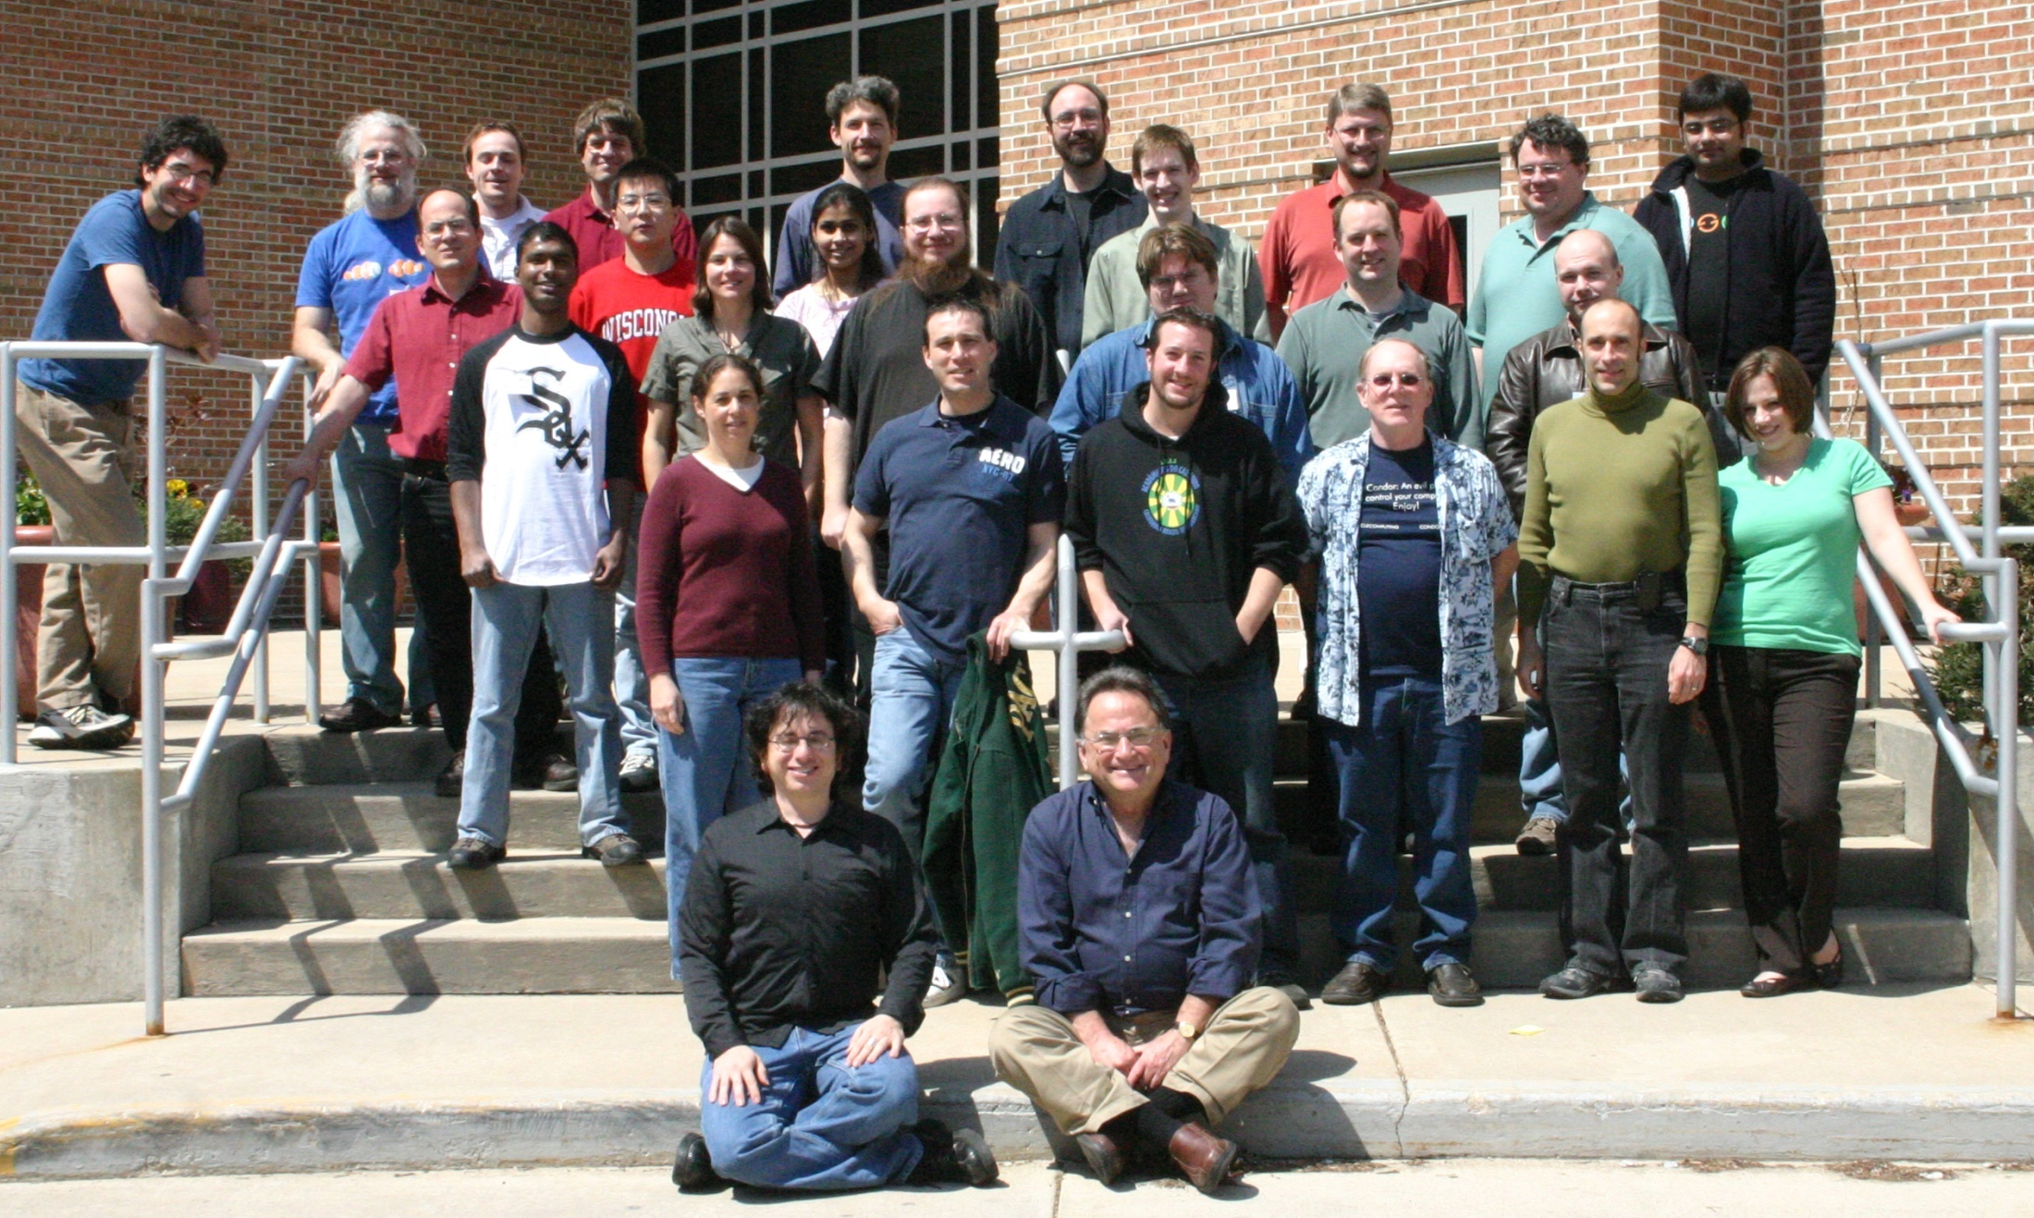
Condor Team 2009

Slide 33
Main Threads of Activities
Distributed Computing Research – develop and evaluate new concepts, frameworks and technologies
Keep the Condor system “flight worthy” and support our users
The Grid Laboratory Of Wisconsin (GLOW) – build, maintain and operate a distributed computing and storage infrastructure on the UW campus
The Open Science Grid (OSG) – build and operate a national distributed computing and storage infrastructure
The NSF Middleware Initiative (NMI) – develop, build and operate a national Build and Test facility

Slide 34
Open Source Code
Large open source code base mostly in C and C++
  680,000+ lines of code (LOC) written by the Condor Team.
  Including “externals”, building Condor as we ship it will compile over 9 million lines.
  Interesting comparisons:
  Apache Web Server: ~60,000 LOC
  Linux TCP/IP network stack: ~80,000 LOC
  Entire Linux Kernel v2.6.0 : ~5.2 million LOC
  Windows XP (complete) : ~40 million LOC

Slide 35
A very dynamic code base
A typical month sees
  A new release of Condor to the public
  Over 200 commits to the codebase
  Modifications to over 350 source code files
  ~20,000 lines of code changing
  ~2,000 builds of the code…
  …running of 1.2 million regression tests
Many tools required to make a quality release, and expertise in using tools effectively
  Git, Coverity, Metronome, Gittrac, MySQL to store build/test results, Microsoft Developer Network, Compuware DevPartner, valgrind, perfgrind, CVS, Rational Purify, many more…

Slide 36
13 years ago we had
“The Grid”

Slide 37
Introduction
“The term “the Grid” was coined in the mid 1990s to denote a proposed distributed computing infrastructure for advanced science and engineering [27]. Considerable progress has since been made on the construction of such an infrastructure (e.g., [10, 14, 36, 47]) but the term “Grid” has also been conflated, at least in popular perception, to embrace everything from advanced networking to artificial intelligence. One might wonder if the term has any real substance and meaning. Is there really a distinct “Grid problem” and hence a need for new “Grid technologies”? If so, what is the nature of these technologies and what is their domain of applicability? While numerous groups have interest in Grid concepts and share, to a significant extent, a common vision of Grid architecture, we do not see consensus on the answers to these questions.”
“The Anatomy of the Grid - Enabling Scalable Virtual Organizations” Ian Foster, Carl Kesselman and Steven Tuecke 2001.

Slide 38
Global Grid Forum (March 2001)
The Global Grid Forum (Global GF) is a community-initiated forum of individual researchers and practitioners working on distributed computing, or "grid" technologies. Global GF focuses on the promotion and development of Grid technologies and applications via the development and documentation of "best practices," implementation guidelines, and standards with an emphasis on rough consensus and running code.
Global GF efforts are also aimed at the development of a broadly based Integrated Grid Architecture that can serve to guide the research, development, and deployment activities of the emerging Grid communities. Defining such an architecture will advance the Grid agenda through the broad deployment and adoption of fundamental basic services and by sharing code among different applications with common requirements.
Wide-area distributed computing, or "grid" technologies, provide the foundation to a number of large scale efforts utilizing the global Internet to build distributed computing and communications infrastructures..

Slide 39
Summary
“We have provided in this article a concise statement of the “Grid problem,” which we define as controlled resource sharing and coordinated resource use in dynamic, scalable virtual organizations. We have also presented both requirements and a framework for a Grid architecture, identifying the principal functions required to enable sharing within VOs and defining key relationships among these different functions.”
“The Anatomy of the Grid - Enabling Scalable Virtual Organizations” Ian Foster, Carl Kesselman and Steven Tuecke 2001.

Slide 40
What makes an
“O” a
“VO”?

Slide 41
The NUG30 Quadratic Assignment Problem (QAP)
Solved!
(4 Scientists +
1 Linux Box)
30
i=1
30
j=1
∑
∑
a_{ij}b_{p(i)p(j)}
min
p∈∏

Slide 42
NUG30 Personal Grid …
Managed by one Linux box at Wisconsin
Flocking: -- the main Condor pool at Wisconsin (500 processors)
-- the Condor pool at Georgia Tech (284 Linux boxes)
-- the Condor pool at UNM (40 processors)
-- the Condor pool at Columbia (16 processors)
-- the Condor pool at Northwestern (12 processors)
-- the Condor pool at NCSA (65 processors)
-- the Condor pool at INFN Italy (54 processors)
Glide-in: -- Origin 2000 (through LSF ) at NCSA. (512 processors)
-- Origin 2000 (through LSF) at Argonne (96 processors)
Hobble-in: -- Chiba City Linux cluster (through PBS) at Argonne
(414 processors).

Slide 43
Solution Characteristics.
Scientists | 4
Workstations | 1
Wall Clock Time | 6:22:04:31
Avg. # CPUs | 653
Max. # CPUs | 1007
Total CPU Time | Approx. 11 years
Nodes | 11,892,208,412
LAPs | 574,254,156,532
Parallel Efficiency | 92%

Slide 44
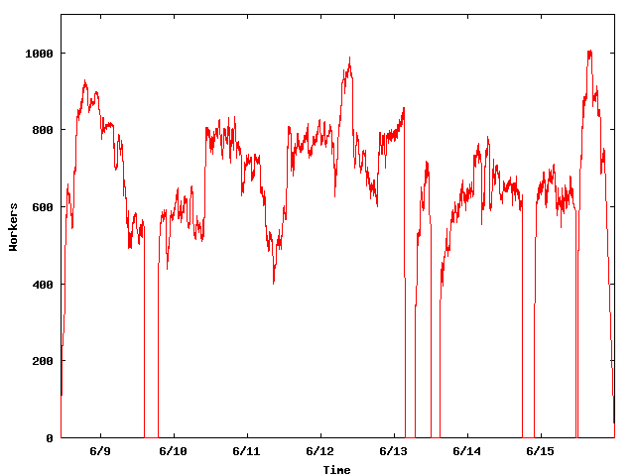
The NUG30 Workforce
System
Upgrade
Condor crash
Workers
Application
Upgrade

Slide 45
WWW
Grid
Client
Master
Server
Worker

Slide 46
“ … Grid computing is a partnership between clients and servers. Grid clients have more responsibilities than traditional clients, and must be equipped with powerful mechanisms for dealing with and recovering from failures, whether they occur in the context of remote execution, work management, or data output. When clients are powerful, servers must accommodate them by using careful protocols.… “
Douglas Thain & Miron Livny, "Building Reliable Clients and Servers", in “The Grid: Blueprint for a New Computing
Infrastructure”,2nd edition

Slide 47
Being a Master
Customer “delegates” task(s) to the master who is responsible for:
  Obtaining allocation of resources
  Deploying and managing workers on allocated resources
  Delegating work unites to deployed workers
  Receiving and processing results
  Delivering results to customer

Slide 48
Master must be …
Persistent – work and results must be safely recorded on non-volatile media
Resourceful – delegates “DAGs” of work to other masters
Speculative – takes chances and knows how to recover from failure
Self aware – knows its own capabilities and limitations
Obedience – manages work according to plan
Reliable – can mange “large” numbers of work items and resource providers
Portable – can be deployed “on the fly” to act as a “sub master”

Slide 49
The Ethernet Protocol
IEEE 802.3 CSMA/CD - A truly distributed (and very effective) access control protocol to a shared service.
  Client responsible for access control
  Client responsible for error detection
  Client responsible for fairness

Slide 50
Never assume that what you know is still true and that what you ordered did actually happen.

Slide 51
4 years ago we had
“A Cloud”

Slide 52
Focus of the grid “movement” has been remote job delegation
(Gate Keepers), commercial clouds are all about remote resource allocation
(Provisioning)

Slide 53
If you want to do real work in a distributed heterogeneous dynamic environment you need both!

Slide 54
The line was echoed by Andrew Kaczorek, associate information consultant with Eli Lilly ….
Kaczorek reported that Lilly was running clinical trial optimization in Amazon’s EC2 and proteomics workflows—the company’s heaviest compute consumer—with the help of Cycle Computing’s CycleCloud and hoping to take advantage of Condor’s scheduling capabilities. ( “Since then,” Kaczorek told Bio•IT World, “we’ve gone after ten other internal applications.

Slide 55
AMAZON WEB SERVICES ANNOUNCES SPOT INSTANCES FOR AMAZON EC2
Allows customers to bid on unused capacity, enabling lower costs and access to significant short-term capacity for those with flexibility in when their applications can run
SEATTLE--(BUSINESS WIRE)--Dec. 14, 2009-- Amazon Web Services LLC, an Amazon.com company (NASDAQ: AMZN), today announced Spot Instances, a new option for purchasing and consuming Amazon EC2 compute resources. With Spot Instances, customers bid on unused Amazon EC2 capacity and run those instances for as long as their bid exceeds the current Spot Price.

Slide 56
"Spot Instances and the Condor scheduler will enable a 'no compute cycle left behind' policy for running scientific and financial calculations on Amazon EC2," said Jason Stowe, CEO of Cycle Computing. "Our CycleCloud service provides secure, elastic compute clusters on Amazon EC2, helping our customers, including Eli Lilly, Varian Inc. and Pfizer, run molecular modeling, next-generation sequencing and risk-analysis calculations. With Spot Instances, CycleCloud can execute calculations when the price is right, resulting in real cost management for our clients."

Slide 57
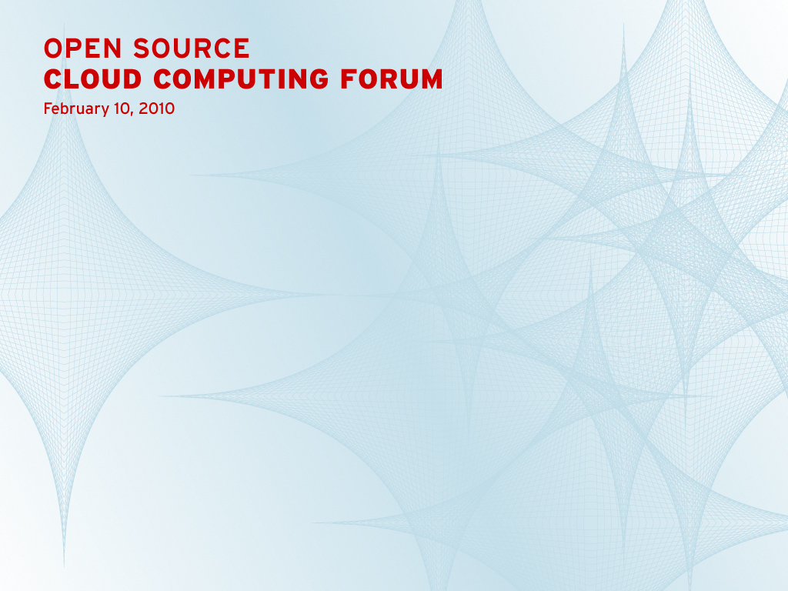
Condor: Cloud Scheduler
Matthew Farrellee
Senior Software Engineer, Red Hat

Slide 58
What is Condor
Open source project out of the University of Wisconsin-Madison
  http://www.cs.wisc.edu/condor
Distributed computing research project in Computer Sciences, est. 1985
To many – a batch system managing millions of machines worldwide, running many more jobs – for individuals, enterprises, governments and research organizations
Under active development by multiple organizations
Maintaining an active user community
Multi-platform code base
  RHEL, HPUX, AIX, SLES, YDL, Solaris, Debian, FreeBSD, OS X, Windows – IA64, x86, X86_64, HPPA, PPC64, Cell, UltraSPARC
Distributed by multiple organizations, e.g. UW and Red Hat in Fedora and RHEL (MRG)
A fundamental building block for creating clouds

Slide 59
Introducing DeltaCloud September 3rd, 2009
by Brian Stevens, CTO and VP, Engineering at Red Hat
The initiation of a new open source project within Red Hat is certainly not news. It’s an established expectation within our engineering ranks. It’s how we advance and develop software.
Every once in a while, though, a new project breaks through the norm of business as usual. Something special. Creating a buzz.
Today that project is http://deltacloud.org.
The goal is simple. To enable an ecosystem of developers, tools, scripts, and applications which can interoperate across the public and private clouds.
Today each infrastructure-as-a-service cloud presents a unique API that developers and ISVs need to write to in order to consume the cloud service. The deltacloud effort is creating a common, REST-based API, such that developers can write once and manage anywhere.
A cloud broker if you will, with drivers that map the API to both public clouds like EC2, and private virtualized clouds based on VMWare and Red Hat Enterprise Linux with integrated KVM.
The API can be test driven with the self-service web console, which is also a part of the deltacloud effort.
While it is a young project, the potential impact on users, developers, and IT to consume cloud services via a common set of tools is epic.

Slide 60
Resource Allocation
(resource -> customer) vs.
Work Delegation
(job -> resource)

Slide 61
Delegate work
Delegate work
Delegate work
W
R
W
R
Allocate Resource
Allocate Resource
Allocate Resource

Slide 62
Resource Allocation
A limited assignment of temporary “ownership” of a resource offered by a provider to a requestor
  Requestor is charged for allocation regardless of actual consumption
  Requestor may be given the right to allocate resource to others
  Provider has the right and means to revoke the allocation
  Allocation is governed by an “agreement” between the provider and the requestor
  Allocation is a “lease” that expires if not renewed by the requestor
  Tree of allocations

Slide 63
Work Delegation
An assignment of a responsibility to perform a task
  Delegation involved a definition of these “responsibilities”
  Responsibilities my be further delegated
  Delegation consumes resources
  Delegation is a “lease” that expires if not renewed by the assigner
  Can form a tree of delegations

Slide 64
In Condor we use a two phase matchmaking process to first allocate a resource to a requestor and then to select a task to be delegated to this resource

Slide 65

MatchMaker
Match!
Match!
Wi
Wi
Wi
Wi
I am S and am looking for a resource
I am D and I am willing to offer you a resource
MM
S
Claim Resource
D
W3
Delegate Work

Slide 66
Overlay Resource Managers
Ten years ago we introduced the concept of Condor glide-ins as a tool to support ‘just in time scheduling’ in a distributed computing infrastructure that consists of recourses that are managed by (heterogeneous) autonomous resource managers. By dynamically deploying a distributed resource manager on resources allocated (provisioned) by the local resource managers, the overlay resource manager can implement a unified resource allocation policy.
In other words, we use remote job invocation to get resources allocated.

Slide 67
Application/Portal
Condor
MM
C-app
Local
SchedD (Condor G)
MM
Cloud/Grid Interfaces
MM
MM
MM
SchedD
(Condor C)
SchedD
(Condor C)
SchedD
(Condor C)
MM
MM
LSF
EC2
Condor
Condor
StartD
(Glide-in)
StartD
(Glide-in)
StartD
(Glide-in)
Remote
C-app
C-app
G-app
C-app
G-app
C-app
G-app

Slide 68
Managing Job Dependencies
15 years ago we introduced a simple language and a scheduler that use Directed Acyclic Graphs (DAGs) to capture and execute interdependent jobs. The scheduler (DAGMan) is a Condor job and interacts with the Condor job scheduler (SchedD) to run the jobs.
DAGMan has been adopted by the Laser Interferometer Gravitational Wave Observatory (LIGO) Scientific Collaboration (LSC).

Slide 69

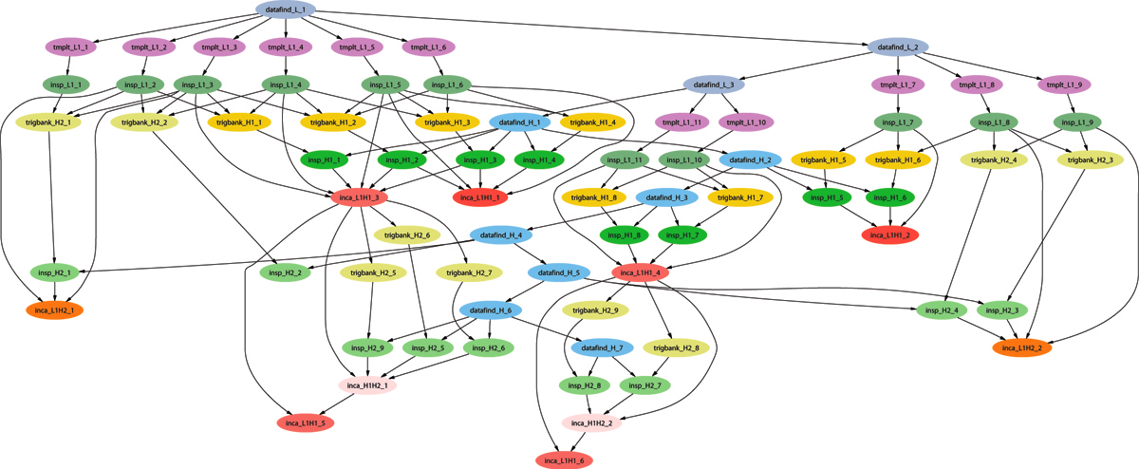
Example of a LIGO Inspiral DAG

Slide 70
From: Stuart Anderson <anderson@ligo.caltech.edu>
Date: February 28, 2010 11:51:32 PM EST
To: Condor-LIGO mailing list <condorligo@aei.mpg.de>
Subject: [CondorLIGO] Largest LIGO workflow
Pete,
Here are some numbers you ask about for LIGO's use of DAGs to manage large data analysis tasks broken down by the largest number of jobs managed in different categories:
1) DAG Instance--one condor_dagman process: 196,862.
2) DAG Workflow--launched from a single condor_submit_dag but may include multiple automatic sub- or spliced DAGs: 1,120,659.
3) DAG Analysis--multiple instances of condor_submit_dag to analyze a common dataset with results combined into a single coherent scientific result: 6,200,000.
4) DAG Total--sum over all instances of condor dagman run: O(100M).
P.S. These are lower bounds as I did not perform an exhaustive survey/search, but they are probably close.
Thanks.

Slide 71
A proven computational protocol for genome-wide predictions and annotations of intergenic bacterial sRNA-encoding genes
NCBI FTP
ORFs
t/rRNAs
IGRExtract3
genomes
RNAMotif
FindTerm
TransTerm
ROI IGRs
All other IGRs
BLAST
Terminators
Conservation
Known sRNAs,
riboswitches
sRNAPredict
BLAST
sRNA candidates
FFN parse
TFBS
matrices
BLAST
BLAST
ORFs flanking
candidates
ORFs flanking
known sRNAs
Homology
to known
Paralogues
QRNA
Patser
BLAST
2º conservation
TFBSs
sRNA Annotate
Synteny
Annotated candidate sRNA-encoding genes

Slide 72


Using SIPHT, searches for sRNA-encoding genes were conducted in 556 bacterial genomes (936 replicons)
This kingdom-wide search:
was launched with a single command line and required no further user intervention
consumed >1600 computation hours and was completed in < 12 hours
involved 12,710 separate program executions
yielded 125,969 predicted loci, inlcluding ~75% of the 146 previously confirmed sRNAs and 124,925 previously unannotated candidate genes
The speed and ease of running SIPHT allow kingdom-wide searches to be repeated often incorporating updated databases; the modular design of the SIPHT protocol allow it to be easily modified to incorporate new programs and to execute improved algorithms

Slide 73
Clouds/VMs/Hadoop
Turn VMs into “first class citizens” in the Condor framework
Interact with users in academia and industry who express interest in using computing resources offered by clouds
Add EC2+S3 to the (long) list of remote resources Condor can harness (or delegate work to)
Explore possible enhancements to our matchmaking and workflow technologies to support provisioning of cloud resources (including inter-cloud migration)
Understand the semantics of the EC2+S3 services, protocols and infrastructure so that we can provide a Condor “overlay” that expend local capabilities to include these resources
Interface with Hdoop Distribute File System (HDFS) and support MapReduce applications
Monitor new cloud “formations”

Slide 74
Manage the resources of my Cloud and/or
Provision resources from a Cloud and/or
Manage my resources in a Cloud

Slide 75
How can we accommodate an unbounded need for computing and an unbounded amount of data with an unbounded amount of resources?

