Slide 1

Hunter of Idle Workstations
Miron Livny
Marvin Solomon
University of Wisconsin-Madison
Email: condor-admin@cs.wisc.edu
URL: http://www.cs.wisc.edu/condor

Slide 2
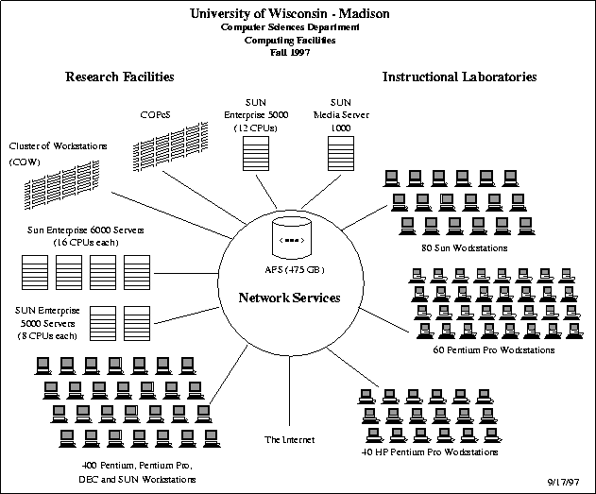

Slide 3
Outline
Condor overview
Potential uses of Java in Condor
Current use of Java in Condor:
  Classified Advertisements

Slide 4
What is Condor?
Resource finder
Batch queue manager
Scheduler
Checkpoint/Restart
Process migration
Remote system calls
All jobs
Jobs linked
with the Condor
library

Slide 5
Condor is Real
In production use at dozens (hundreds?) of sites
In production use for over a decade
Basis of commercial products
  Load leveler
  LCF
Evolving

Slide 6
Condor System Structure
Central Manager
Negotiator
Collector
N
C
Submit Machine
Execution Machine
[...A]
CA
RA
[...C]
[...B]
Customer Agent
Resource Agent

Slide 7
Customer Agent
Maintains queue of submitted jobs
Advertises status
Selects jobs to run

Slide 8
Resource Agent
Monitors system status
  Load average
  Keyboard and mouse idle time
  Memory, disk space, ...
Advertises status
Listens for requests to run jobs

Slide 9
Central Manager
Collector
  Accepts ads from resource agents and customer agents
Negotiator
  Matches customers with resources
Accountant
  Records resource usage by customers

Slide 10
Condor System Structure
Central Manager
Negotiator
Collector
N
C
Submit Machine
Execution Machine
[...A]
CA
RA
[...C]
[...B]
Customer Agent
Resource Agent

Slide 11
Advertising Protocol
[...N]
[...M]
N
C
[...M]
[...A]
CA
RA
[...C]
[...B]

Slide 12
Advertising Protocol
[...N]
[...M]
N
C
[...A]
CA
RA
[...C]
[...B]

Slide 13
Matching Protocol
[...N]
N
C
[...M]
[...B]
[...A]
CA
RA
[...C]

Slide 14
Claiming Protocol
[...S]
N
C
[...A]
CA
RA
[...C]

Slide 15
Claiming Protocol
[...S]
N
C
RA
[...A]
CA
[...C]
Job

Slide 16
Remote System Calls
[...S]
N
C
CA
RA
[...A]
[...C]
Shadow
Job

Slide 17
Condor Meets Java
Java jobs
Java for Condor implementation

Slide 18
Running Java Jobs
Run JVM as “vanilla” job
  Class files are treated as ordinary jobs
  Requires uniform environment (same CLASSPATH everywhere)
  No checkpointing
Re-link JVM as “standard” job
  Remote system calls for class loader
Checkpoint/restart of “vanilla” jobs

Slide 19
Java-Aware Condor
Class file as “job”
  Requires “pre-installed” JVM, class libraries and/or job “package” (code + files)
  Also useful for remote compilation
Checkpoint JVM state
Platform-independent checkpoint

Slide 20
Java for Implementing Condor

Slide 21
Classified Advertisements
Simple yet powerful
Extensible
Active matching
Symmetric matching

Slide 22
Symmetric Active Matching
Job requires a workstation
  X86 architecture
  Solaris 2.6
  1 GB memory
Resource is only avialable
  Between 6pm and 6am
  If the keyboard is idle at least 15 mintues
  To DOE Contractors
Owner
is
King

Slide 23
The ClassAd Language
Set of bindings of Attribute Names to Expressions
Self-describing (no separate schema)
Combine query and data
Arbitrarily composed and nested

Slide 24
Examples
[ Type = "Job";
Owner = "raman";
Cmd = "run_sim";
Args = "-Q 17 3200";
Cwd = "/u/raman";
Memory = 31;
Qdate = 886799469;
...
Rank = other.Kflops...
Constraint =
other.Type = ...
]
[ Type = "Machine";
Name = "xxy.cs. ...";
Arch = "iX86";
OpSys = "Solaris";
Mips = 104;
Kflops = 21893;
State = "Unclaimed";
LoadAvg = 0.042969;
...
Rank = ...;
Constraint = ...;
]

Slide 25
Attribute Expressions
Constants 104, 0.042969, "iX86"
References attr, self.attr, other.attr, expr.attr
Operators +, *, >>, <, >=, &&, ...
Functions strcat, substr, floor, member, ...
Lists { expr, expr, ... }
ClassAds [ name=expr; name=expr; ... ]

Slide 26
Example Attributes
Descriptive attributes
  Type = "Job";
  Owner = "raman";
  Arch = "iX86";
  OpSys = "Solaris";
  Memory = 64; // megabytes
  Disk = 323496; // k bytes

Slide 27
Example Attributes
Current state
  Daytime = 36017; // secs past midnight
  KeyboardIdle = 1432; // seconds
  State = "Unclaimed";
  LoadAvg = 0.042969;

Slide 28
Example Attributes
Parameters
  ResearchGrp = { "raman", "miron", "solomon", "jbasney" };
  Friends = { "tannenba", "wright" };
  Untrusted = { "rival", "riffraff" };
  WantCheckpoint = 1;

Slide 29
Complex Attributes
Derived data
  Rank = // machine's rank for job
  10 * member(other.Owner,ResearchGrp)
  + member(other.Owner, Friends);
  Rank = // job's rank for machine
  Kflops/1E3 + other.Memory/32;

Slide 30
Constraints
Job constraint
Constraint =
other.Type = "Machine"
&& Arch = "iX86"
&& OpsSys = "Solaris"
&& Disk > 10000
&& other.Memory >= self.Memory;

Slide 31
Constraints
Machine constraint
Constraint =
! member(other.Owner, Untrusted) && Rank >= 10
? true
: Rank > 0
? (LoadAvg < 0.3 && KeyboardIdle > 15*60)
: DayTime < 6*60*60 || DayTime > 18*60*60;

Slide 32
Matching Algorithm
To match two ads A and B
  Set up enironment such that in A
    self evaluates to A
    other evaluates to B
    other attributes are searched for first in A and then in B
    and vice versa (with A and B interchanged)
  Check if A.Constraint and B.Constraint both evaluate to true
  A.Rank and B.Rank for preferences

Slide 33
Three-valued Logic
other.Memory > 32 all
other.Memory == 32 UNDEFINED
other.Memory != 32 if other has no
!(other.Memory == 32) "Memory" attribute
other.Mips >= 10 || other.Kflps >= 1000
TRUE if either attribute exists and
satisfies the given condition

Slide 34
Summary
Distributed resource allocation
  Distributed clients, servers
  Heterogeneous resources
  Distributed ownership
Classified advertisements
  Semi-structured data model
  Schema, data, and query in one language
  Separation of matching from claiming

Slide 35
Summary
ClassAds are currently in use throughout Condor
  Flexible
  Robust
C++ and Java implementations
Freely available as part of Condor and as stand-alone libraries

Slide 36
Future Work
Get “Java” customers
Support “Java” customers
  Vanilla jobs
  Standard jobs
  Java-aware Condor execution engine

Slide 37
Future Work
Application of ClassAds to other distributed resource-allocation and discovery problems
Bulk operations and aggregation
  Structural regularity
  Value regularity
User interfaces
Tools

Slide 38
Information About Condor
WWW
  http://www.cs.wisc.edu/condor
Email
  condor-admin@cs.wisc.edu
  solomon@cs.wisc.edu

