Slide 1


Condor
A New PACI Partner Opportunity
Miron Livny
Computer Sciences Dept.
University of Wisconsin-Madison
miron@cs.wisc.edu
NCSA NINTH ANNUAL INDUSTRIAL PARTNER EXECUTIVE MEETING
APRIL 28, 1997 - MAY 1, 1997

Slide 2
KEY CONCEPTS
High Throughput Computing
&
Distributed Ownership

Slide 3
High Throughput Computing
Large amounts of processing capacity over a very large period of time (FLOPY = Floating Point Operations per Year).
Higher Throughput enables better research, better designs, and better products.
Cycles as a fertilizer

Slide 4
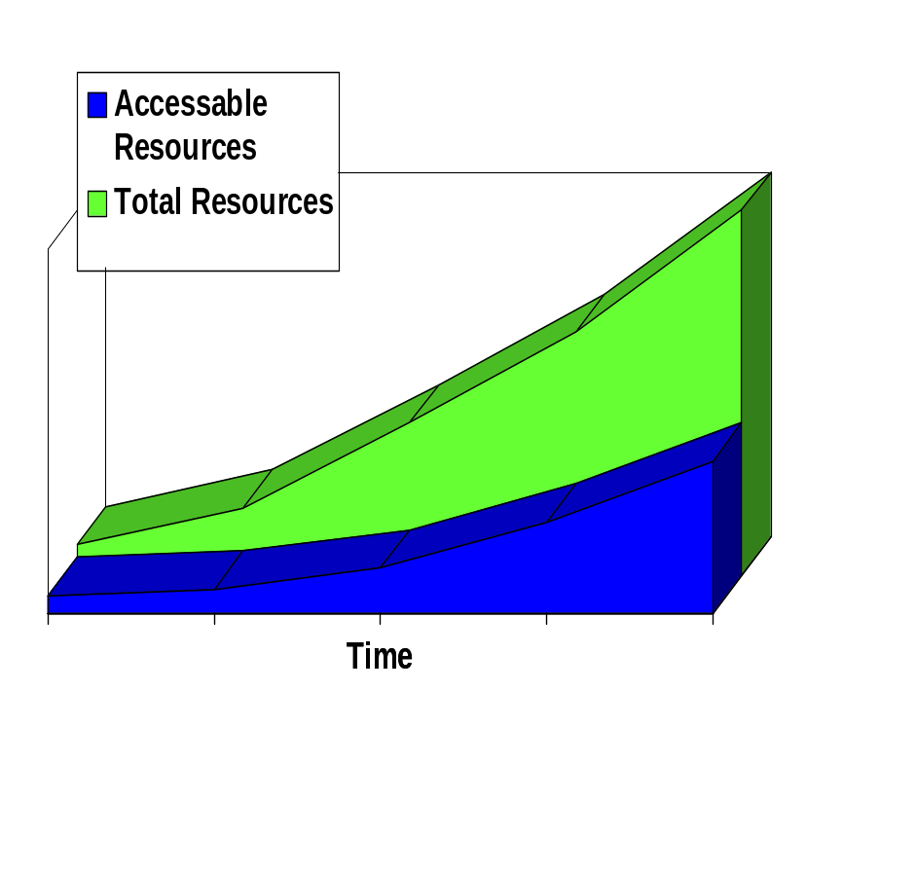
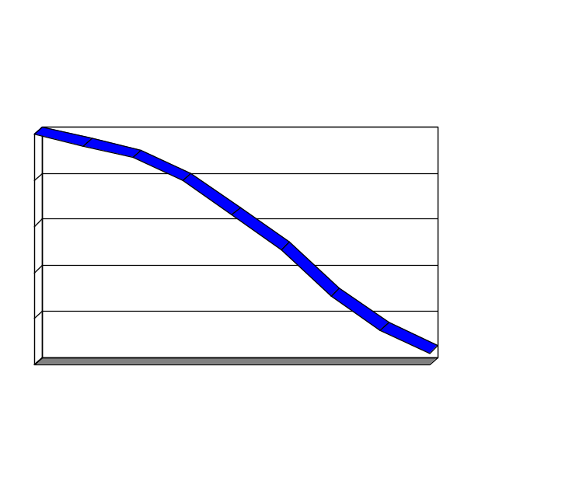
Resource Fragmentation
(due to distributed ownership)
My resource
is my
castle
As an organization’s aggregate distributed compute power increases, the percentage accessible to any given individual decreases.
100
% Accessible
0
Time

Slide 5
The Condor System
Supporting High-Throughput Computing in large, distributively owned environments.
  Harnesses the power of existing non-dedicated resources.
  Does not require (in most cases) changes to the application.
  Adapts to local requirements and policies.
  Supports sequential and parallel (PVM) applications.
A culture, not just a technology

Slide 6


Novel Layered Design
Resource
Access Control
Resource Owner
Match-Making
Condor
System Administrator
Request Agent
Customer/User
Application RM
Distributed
Scaleable
Adaptable
Customizable
Application

Slide 7
Unique Mechanisms
Checkpointing
  Enables Preemptive Resume Resource Allocation (essential in an opportunistic environment)
Remote I/O
  Enables computation across administrative domains (essential for HTC)
ClassAds
  Enables flexible resource matchmaking (essential in a distributively owned environment)

Slide 8
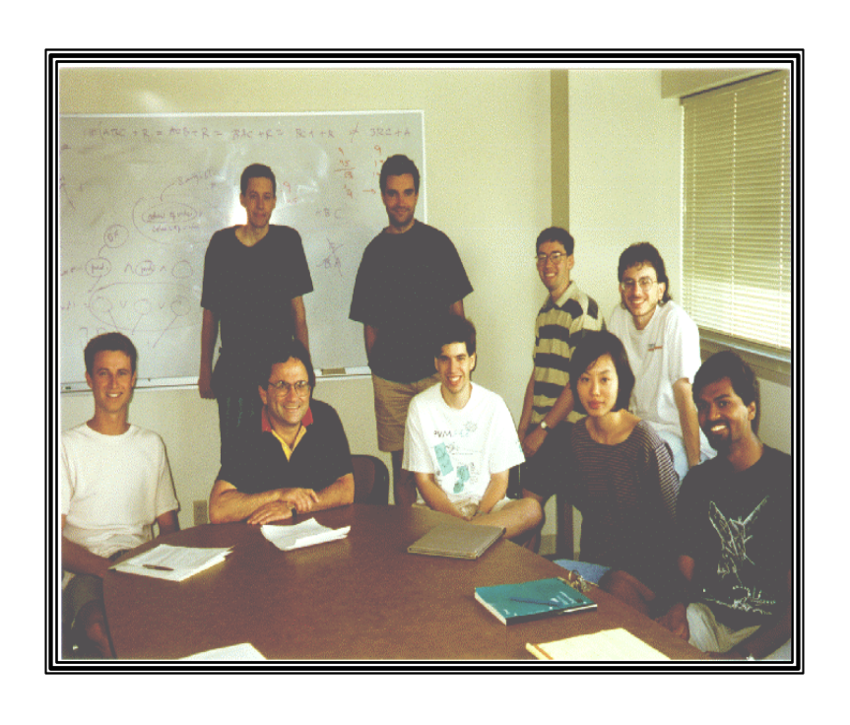
The Condor Team
More than 10 years of Experience with a production HTC Environment.
Close interaction with owners, customers, and system administrators worldwide.
Maintain a large HTC environment.
Ongoing Research

Slide 9
The Condor UW-Flock
>500 Desktop Workstations
Multiple Administrative Domains
Supported by the UW Graduate School
Architectures/Operating Systems
  Sun SPARC/Solaris
  HP-RISC/HPUX
  SGI/IRIX
  DEC Alpha/Digital UNIX
  Intel/LINUX
  Intel/Solaris
  Soon… Windows NT!
No dedicated resources,
maximizing the utility of
our investment

Slide 10
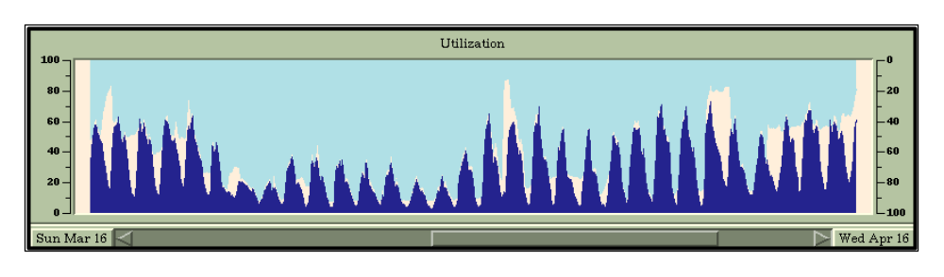
UW-Flock Engineering Pool
(3/16/97 - 4/16/97)
Pool Profile
  190 HP Workstations
  35 active users
  120 CPU-days per day
  90 jobs completed per day
Average Job Profile
  Consumed 26 CPU-hours
  44 hours response time

Slide 11
Customer Example: KIVA
KIVA: a state-of-the-art computational fluid dynamics code
for modeling two-phase, turbulent, reacting flows within
the combustion chambers of diesel engines.
“Condor enabled us to push the futility-point farther away enabling KIVA to be used as a design tool.”
-Dan Mather, UW Engine Research Center
  futility-point: when the time for multiple computations to complete far exceeds the available time to the point where they are not even worth considering

Slide 12
Customer Example: KIVA
In 2 weeks, the Engineering Condor Pool delivered to the KIVA customer:
  420 completed KIVA runs
  Average run consumed 25 CPU-hours
  Average run response time: 36 hours
  Overall: ~30 CPU-days/day
Other customer experiences: http://www.cs.wisc.edu/condor/stories.html

Slide 13
Joint Projects/Opportunities
Establish and support Condor Pools at Industrial Partners.
Identify Industrial HTC applications and adapt them to the Condor environment.
Develop and Implement customized HTC layers to meet special Industrial requirements.

Slide 14


