Slide 1
MW – A Framework to Support Master-Worker Style Applications

Slide 2
Outline
MW Overview
Current Status
Future Directions

Slide 3
MW = Master-Worker
Master-Worker Style Parallel Applications
  Large problem partitioned into small pieces (tasks);
  The master manages tasks and resources (worker pool);
  Each worker gets a task, execute it, sends the result back, and repeat until all tasks are done;
  Examples: ray-tracing, optimization problems, etc.
On Condor (PVM, Globus, … … )
  Many opportunities!
  Issues (in a Distributed Opportunistic Environment):
    Resource management, communication, portability;
    Fault-tolerance, dealing with runtime pool changes.

Slide 4
MW to Simplify the Work!
An OO framework with simple interfaces
  3 classes to extend, a few virtual functions to fill;
  Scientists can focus on their algorithms.
Lots of Functionality
  Handles all the issues in a meta-computing environment;
  Provides sufficient info. to make smart decisions.
Many Choices without Changing User Code
  Multiple resource managers: Condor, PVM, …
  Multiple communication interfaces: PVM, File, Socket, …

Slide 5
MW’s Layered Architecture
Application classes
API
MW abstract classes
MW
App.
IPI
M
W
Infrastructure Provider’s Interface
Resource Mgr
Communication Layer
Underlying infrastructure

Slide 6
MW’s Runtime Structure
Master Process
Worker
Process
ToDo
tasks
Running
tasks
Workers
Worker
Process
……
Worker
Process
User code adds tasks to the master’s Todo list;
Each task is sent to a worker (Todo -> Running);
The task is executed by the worker;
The result is sent back to the master;
User code processes the result (can add/remove tasks).

Slide 7
MW Programming
class Your_Driver: for your master behavior
    get_userinfo()
    setup_initial_tasks()
    act_on_completed_task()
class Your_Worker: for your worker behavior
    unpack_init_data()
    benchmark(MWTask *t)
    execute_task( MWTask *t)
class Your_Task: to store and parse task info
    pack_work() / unpack_work()
    pack_results() / unpack_results()
Setup
Mainloop
Setup
Mainloop
Pack/unpack

Slide 8
More MW Features
Checkpointing/restarting
IPI and multiple Resource Manager and Communication (RMComm) ports
RMComm | Resource Mgr | Communication
MW-PVM | Condor-PVM | PVM
MW-File | Condor | Files
MW-Socket | Condor | Socket
MW-Indp | Single Host | memcpy()
More RMComm Ports?
MW-Java | Condor | Files
MW-MPI | Condor-MPI | MPI

Slide 9
MW Summary
It’s simple:
  simple API, minimal user code.
It’s powerful:
  works on meta-computing platforms.
It’s inexpensive:
  On top of Condor, it can exploits 100s of machines.
It solves hard problems!
  Nug30, STORM, … …

Slide 10
MW Success Stories
Nug30 solved in 7 days by MW-QAP
  Quadratic assignment problem outstanding for 30 years
  Utilized 2500 machines from 10 sites
    NCSA, ANL, UWisc, Gatech, INFN@Italy, … …
    1009 workers at peak, 11 CPU years
  http://www-unix.mcs.anl.gov/metaneos/nug30/
STORM (flight scheduling)
  Stochastic programming problem (1000M row X 13000M col)
  2K times larger than the best sequential program can do
  556 workers at peak, 1 CPU year
  http://www.cs.wisc.edu/~swright/stochastic/atr/

Slide 11
MW Users/Collaborators
Institute | For What | Project Name
ANL & UWisc | Optimization | FATCOP and ATR
UCSD | Comp. Architecture Research and others
JPL | Image Processing
UIUC | Optimization
UPC@Spain | Linear Algebra; Comp. Arch. Research
Inst. at Pakistan | Generics Algorithm
UAB@Spain | Grid Middleware Scheduling
UWisc | Grid Middleware Scheduling | POEMS
Hungary | Performance Visualization | P-GRADE
Sandia NL | Optimization and MPI
We expect more to come!

Slide 12
Status Update (since 07/2001)
Better config/build system, new app. skeleton
MW-Indp back to work, “insured” the code
Performance measurement and debugging
Support millions of tasks by indexing & swapping
Robustness enhancements
  Better handling of host suspension/resume
  Better handling of task reassignments
Bug fixes – download from website
Mailing list – mw@cs.wisc.edu

Slide 13
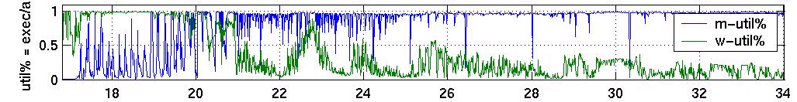
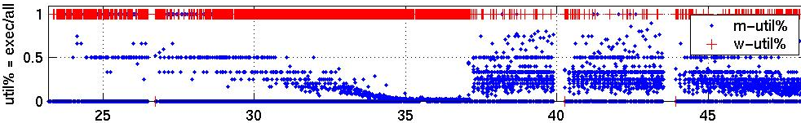
Challenges and Future Work (1)
Scalability
  The master bottleneck: only keeps 30% workers busy
  Improved worker utilization shown below:
  But, how about 1000+ workers?
Time (hr)

Slide 14
Challenges and Future Work (2)
Enhancing Scalability
  Worker hierarchy to remove bottleneck
  Runtime adaptive throttling of workers
  Group tasks to schedule at larger granularity
  Need more involvement of application designers
Understanding Performance and Scheduling
  To collect data and predict performance
  To collect information at runtime
  Several groups are studying scheduling for grid middleware (UAB & POEMS)

Slide 15
Challenges and Future Work (3)
Improving Usability
  More debugging support
  Redesign the current MW API
  Support more communication interfaces
  Create test suite (and better doc/examples)
  Improve logging/error handling.
Solve more and harder computational problems!

Slide 16
Thank You!
Further Information:
  Homepage: www.cs.wisc.edu/condor/mw
  Papers: www.cs.wisc.edu/condor/publications.html#mw
  Email: mw@cs.wisc.edu
  Bug-report: condor-admin@cs.wisc.edu
BOF session:
  Wednesday Morning at 3369, come talk to Jichuan Chang.

Slide 17
MW Backup Slides

Slide 18
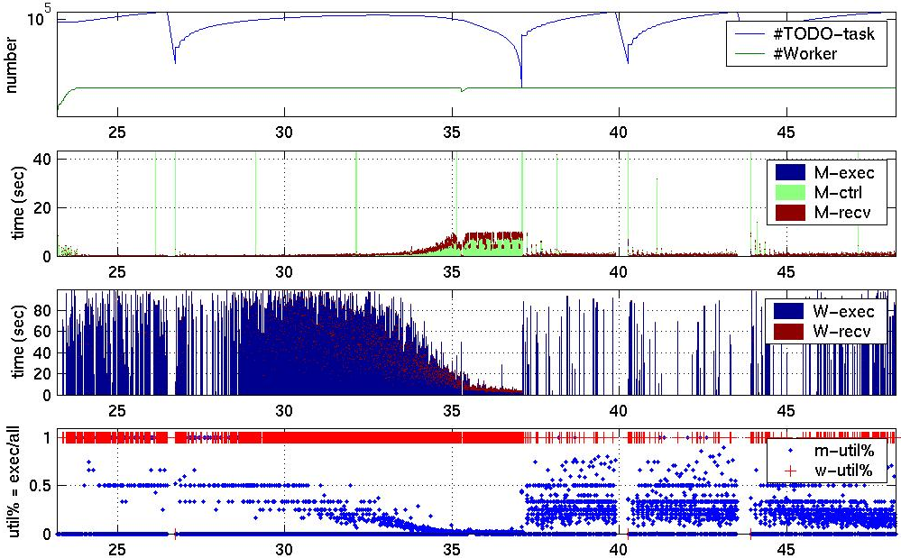
Fatcop Recent Run

Slide 19
MW API
Must extend three classes
  MWDriver: to define your master behavior;
  MWWorker: to define your worker behavior;
  MWTask: to store/parse task information.
Might use other MW utilities
  MWprintf: to print progress, result, debug info, etc;
  MWDriver: to get information, set control policies, etc;
  RMC: to specify resource requirements,
  prepare for communication, etc.
Resource
Manager &
Communicator

Slide 20
MW Programming (1)
class Your_Driver: public MWDriver
  Setup
    get_userinfo(): to parse args and do the initial setup;
    setup_initial_tasks(): to create initial tasks;
  Main loop (event driven)
    act_on_completed_task(): let user process the result;
  Optional:
    set_task_key_func(), set_***_policy(), set_***_mode();
    add_task() / delete_tasks_worse_than()
    write_master_state() / read_master_state()
    pack_worker_init_data() / unpack_worker_initinfo()

Slide 21
MW Programming (2)
class Your_Worker: public MWWorker
  Setup:
    unpack_init_data()
    benchmark(MWTask *t)
  Main loop (event driven):
    execute_task( MWTask *t)
class Your_Task: public MWTask
  Pack/Unpack:
    pack_work() / unpack_work()
    pack_results() / unpack_results();
  Checkpoint/restore
    write_ckpt_info() / read_ckpt_info()

Slide 22
MW Submit File
Universe
  PVM (for MW-CondorPVM)
  Scheduler (for MW-File and MW-Socket)
Executable – the master executable
Input (or Arguments)
  worker executable name(s);
  configuration, input data.
Output – the master’s stdout
Error – the workers’ stdout (and stderr)
Requirements – more requirements

Slide 23
MW Contributors
Jeff Linderoth
Jean-Pierre Goux
Mike Yoder
Sanjeev Kulkarni
Peter Keller
Jichuan Chang
Elisa Heymann
… …

