Slide 1
Logistic Regression
& R Programming

Slide 2
Simple Linear Regression
Model the mean of a numeric response Y as a function of a single predictor X, i.e.
E(Y|X)=μ(x) = β_{o} + β₁f(x)
(This link of the mean is called the identity link)
Here f(x) is any function of X, e.g.
f(x) = X ➔ E(Y|X) = β_{o} + β₁X (line)
f(x) = ln(X) ➔ E(Y|X) = β_{o} + β₁ln(X) (curved)
The key is that E(Y|X) is a linear in the
parameters β_{o} and β₁ but not necessarily in X.

Slide 3
Simple Linear Regression
^
β₀ = Estimated Intercept
= -value at x = 0
^
Interpretable only if x = 0 is a
value of particular interest.
β₁ w units
^
β₀
^
w units
β₁ = Estimated Slope
= Change in for every
unit increase in x
0
x
= estimated change in the mean of Y for a unit change in X.
Always interpretable!

Slide 4
Multiple Linear Regression
We model the mean of a numeric response as linear combination of the predictors themselves or some functions based on the predictors, i.e.
E(Y|X) = β_{o} + β₁X₁+ β₂X₂ +…+ β_{p}X_{p}
Here the terms in the model are the predictors
E(Y|X) = β_{o} + β₁ f₁(X)+ β₂ f₂(X)+…+ β_{k} f_{k}(X)
Here the terms in the model are k different functions of the p predictors

Slide 5
Multiple Linear Regression
For the classic multiple regression model
E(Y|X) = β_{o} + β₁X₁+ β₂X₂ +…+ β_{p}X_{p}
the regression coefficients (β_{i}) represent the estimated change in the mean of the response Y associated with a unit change in X_{i} while the other predictors are held constant.
They measure the association between Y and X_{i} adjusted for the other predictors in the model.

Slide 6
Generalized Linear Models
Family of regression models
Response (Y) Model Type
  Continuous General Linear Model
  Counts Poisson regression
  Survival times Cox model
  Binary (or more categories) Logistic regression
Uses
  Control for potentially confounding factors
  Model building , risk prediction

Slide 7
Logistic Regression
Models relationship between set of variables X_{i}
  dichotomous (yes/no, smoker/nonsmoker,…)
  categorical (social class, race, ... )
  continuous (age, weight, gestational age, ...)
and
  dichotomous categorical response variable Y
  e.g. Success/Failure, Remission/No Remission Survived/Died, CHD/No CHD, Low Birth Weight/Normal Birth Weight, etc…

Slide 8
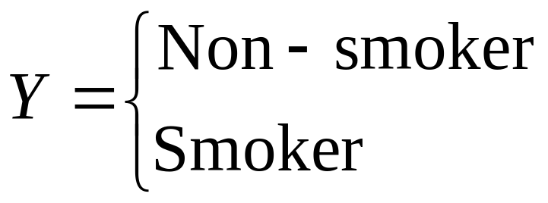
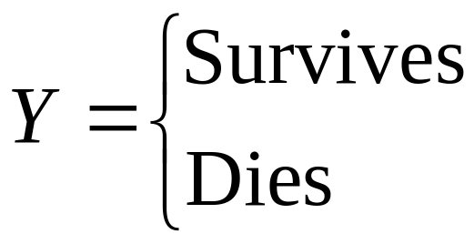
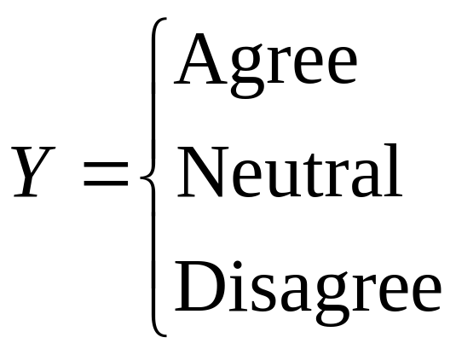
Categorical Response Variables
Examples:
Whether or not a person smokes
Binary Response
Success of a medical treatment
Opinion poll responses
Ordinal Response

Slide 9
Example: Height predicts Gender
Y = Gender (0=Male 1=Female)
X = Height (inches)
Try an ordinary linear regression
> regmodel=lm(Gender~Hgt,data=Pulse)
> summary(regmodel)
Coefficients:
Estimate Std. Error t value Pr(>|t|)
(Intercept) 7.343647 0.397563 18.47 <2e-16 ***
Hgt -0.100658 0.005817 -17.30 <2e-16 ***
Notes:
Pulse.csv datafile

Slide 10
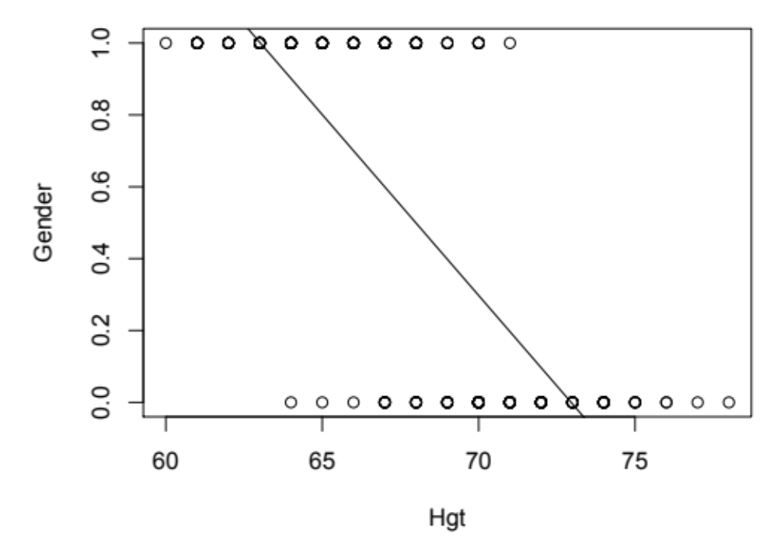
Notes:
> plot(Pulse$Gender~Pulse$Hgt)
> abline(regmodel)

Slide 11
Ordinary linear regression is used a lot, and is taught in every intro stat class. Logistic regression is rarely taught or even mentioned in intro stats, but mostly because of inertia.
We now have the computing power and software to implement logistic regression.
Notes:
> plot(Pulse$Gender~Pulse$Hgt)
> abline(regmodel)

Slide 12
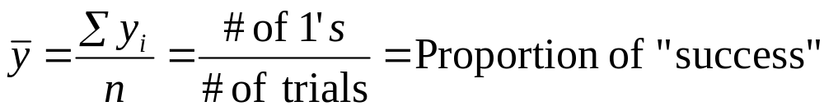

π = the Population Proportion of “Success”
In ordinary regression the model predicts the mean Y for any combination of predictors.
What’s the “mean” of a 0/1 indicator variable?
= Sample Proportion: π_hat ( )
* Goal of logistic regression: Predict the “true” proportion of success, π (sometimes we use p), at any value of the predictor x.
* For a binary response Y (0,1 valued),
P(Y=1) = π; E(Y) = μ =1*π+0*(1-π) = π

Slide 13
Binary Logistic Regression Model
Y = Binary response
X = Quantitative predictor
π = proportion of 1’s (yes,success) at any X
Equivalent forms of the logistic regression model:
Regular multiple linear regression (use the identity link):
π(x) = μ(x) = β₀ + β₁*x
This is not reasonable
Because the left-side is in (0,1) and the right
can be as much as (-∞, +∞): different scales!

Slide 14
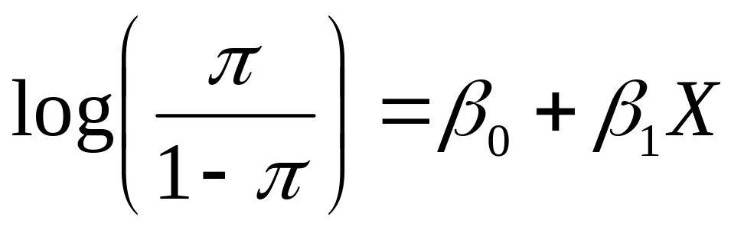
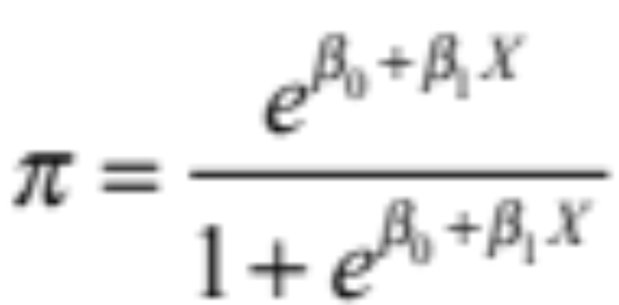
Binary Logistic Regression Model
Y = Binary response
X = Quantitative predictor
π = proportion of 1’s (yes,success) at any X
Equivalent forms of the logistic regression model:
Logit form
Probability form
This is the natural log with base e (aka “ln”)
Ln[π/(1-π)] has the range of (-∞, +∞):
The same scales on both sides of the equation!

Slide 15
How to fit the model?
OLS (ordinary least squares)? – questionable
Maximum likelihood estimators (MLE) – this is what we use to fit the model because each Y|x ~ Bernoulli(π)
PDF of Y|x: f(y|x) = (π^y)*[(1-π)^(1-y)]
You can check: when y=1, f(y|x) = P(Y=1|x) = π
when y=0, f(y|x) = P(Y=0|x) = 1-π
The likelihood function: L = f(y1, y2, ..yn) = Πf(yi |x) =g(β₀, β₁, x)
The MLE’s of β₀ and β₁ are the values that will maximize the likelihood L (or equivalently, the log likelihood: ln(L)).
Once we estimated the model parameters, we can plug them into the logistic regression model to estimate the π(x)
To make prediction (of Y), we threshold the estimated π with 0.5
If π_hat >=0.5, then y_hat =1; If π_hat < 0.5, then y_hat = 0
Then you can generate the confusion matrix comparing y to y_hat

Slide 16
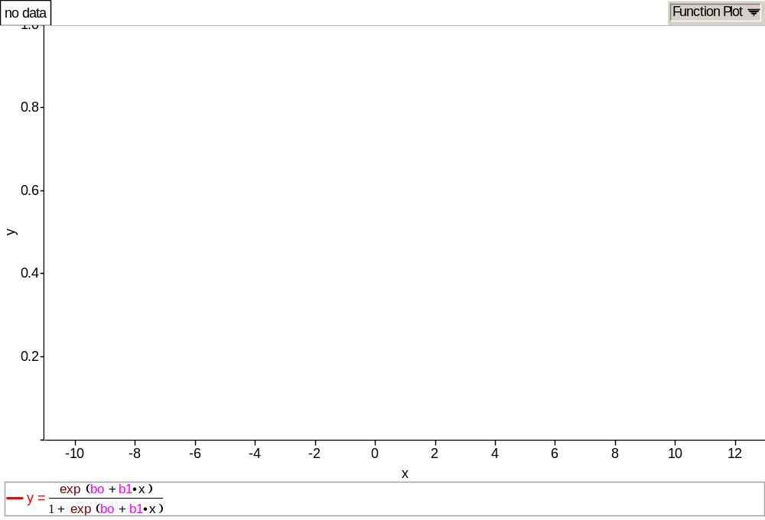
Logit Function

Slide 17
Binary Logistic Regression via R
> logitmodel=glm(Gender~Hgt,family=binomial, data=Pulse)
> summary(logitmodel)
Call:
glm(formula = Gender ~ Hgt, family = binomial)
Deviance Residuals:
Min 1Q Median 3Q Max
-2.77443 -0.34870 -0.05375 0.32973 2.37928
Coefficients:
Estimate Std. Error z value Pr(>|z|)
(Intercept) 64.1416 8.3694 7.664 1.81e-14 ***
Hgt -0.9424 0.1227 -7.680 1.60e-14***
---

Slide 18
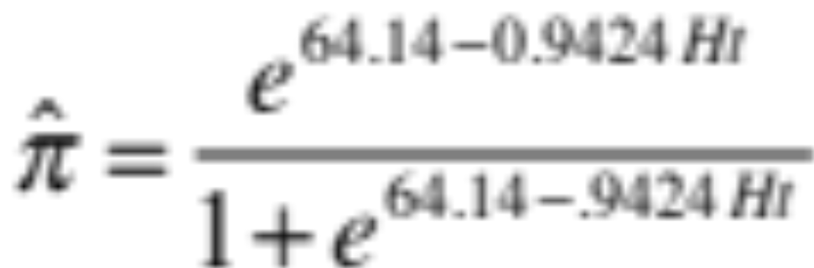
Call:
glm(formula = Gender ~ Hgt, family = binomial, data = Pulse)
Coefficients:
Estimate Std. Error z value Pr(>|z|)
(Intercept) 64.1416 8.3694 7.664 1.81e-14 ***
Hgt -0.9424 0.1227 -7.680 1.60e-14***
---
proportion of females at that Hgt

Slide 19
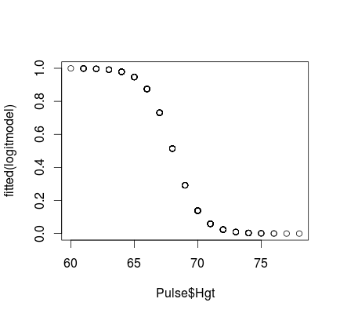
> plot(fitted(logitmodel)~Pulse$Hgt)

Slide 20
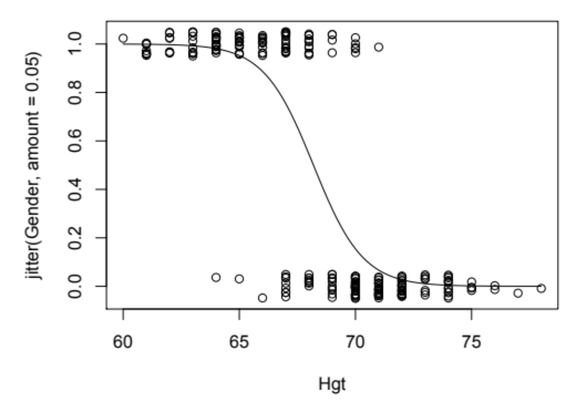
> with(Pulse,plot(Hgt,jitter(Gender,amount=0.05)))
> curve(exp(64.1-0.94*x)/(1+exp(64.1-0.94*x)), add=TRUE)

Slide 21
Example: Golf Putts
Length (x) | 3 | 4 | 5 | 6 | 7
Made (y=1) | 84 | 88 | 61 | 61 | 44
Missed (y=0) | 17 | 31 | 47 | 64 | 90
Total | 101 | 119 | 108 | 125 | 134
Build a model to predict the proportion of putts made (success) based on length (in feet).
Notes:
> table(Made,Length)

Slide 22
Logistic Regression for Putting
Call:
glm(formula = Made ~ Length, family = binomial, data = Putts1)
Deviance Residuals:
Min 1Q Median 3Q Max
-1.8705 -1.1186 0.6181 1.0026 1.4882
Coefficients:
Estimate Std. Error z value Pr(>|z|)
(Intercept) 3.25684 0.36893 8.828 <2e-16 ***
Length -0.56614 0.06747 -8.391 <2e-16 ***
---
Notes:
> lmod=glm(Made ~ Length, family = binomial, data=Putts1)
> summary(lmod)

Slide 23
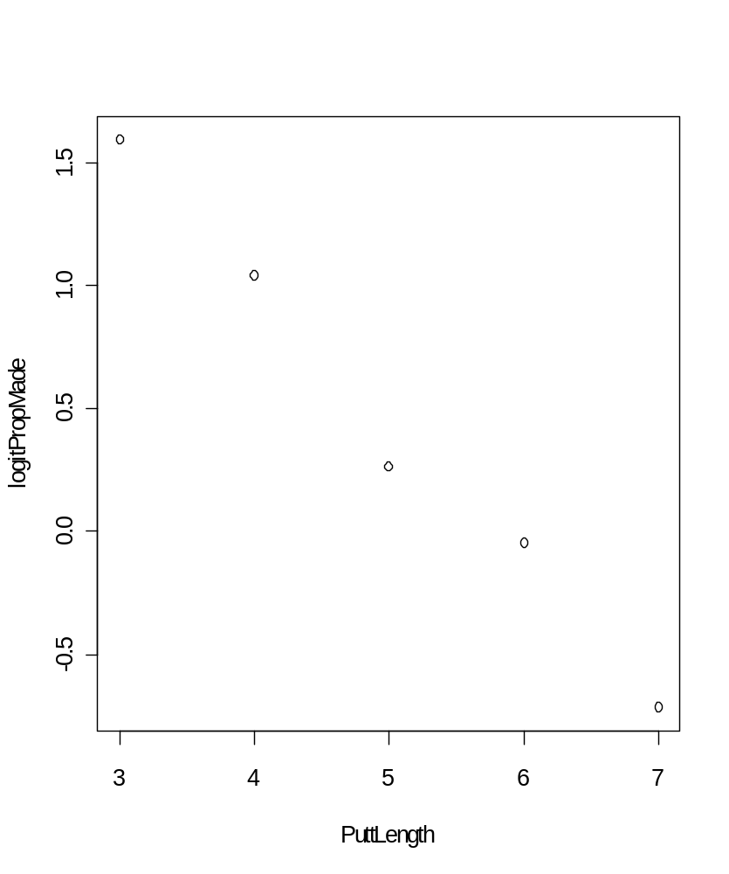
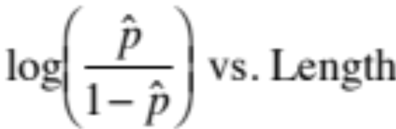
Linear part of logistic fit
Notes:
>PropMade=c(84/101,88/119,61/108,61/125,44/134)
>PuttLength=c(3,4,5,6,7)
>logitPropMade=log(PropMade/(1-PropMade))
>model=glm(Made~Length,family=binomial,data=Putts1)
>plot(logitPropMade~PuttLength)
>abline(reg=model)

Slide 24
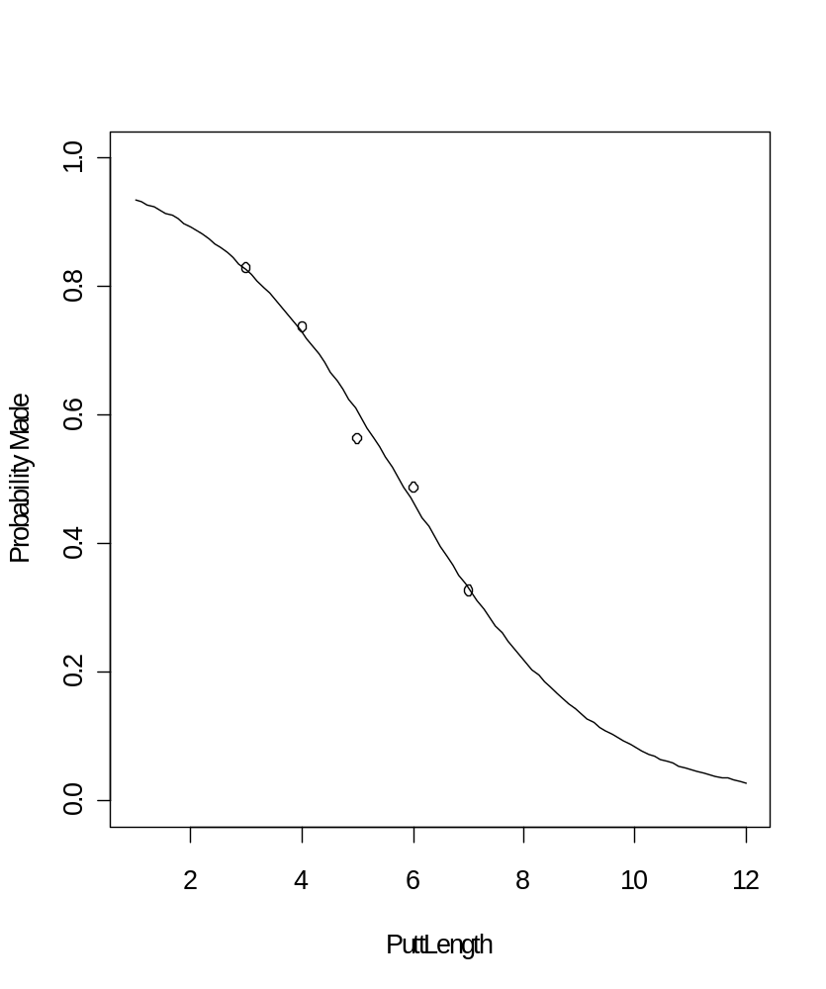
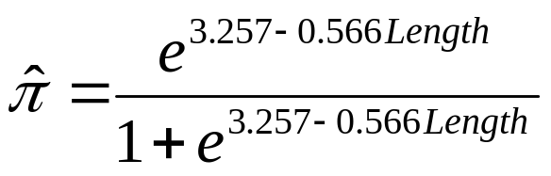
Probability Form of Putting Model
Notes:
>plot(PropMade~PuttLength,xlim=c(1,12),ylim=c(0,1))
>curve(exp(3.2568-.5661*x)/(1+exp(3.2568-.5661*x)),add=TRUE)

Slide 25
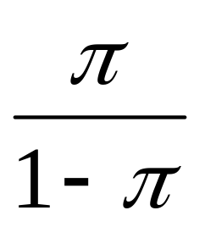
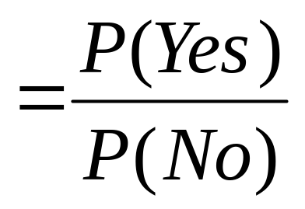
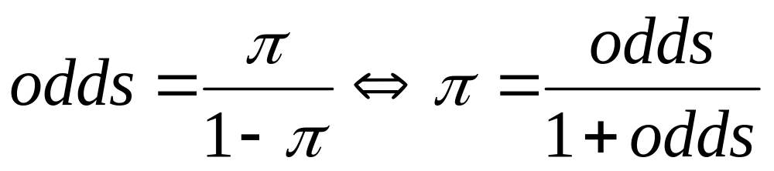
Odds
Definition:
is the odds of Yes.

Slide 26
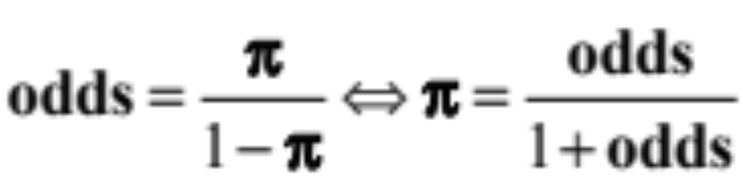
Fair die
Event
Prob
Odds
even #
1/2
1 [or 1:1]
X > 2
2/3
2 [or 2:1]
roll a 2
1/6
1/5 [or 1/5:1 or 1:5]

Slide 27
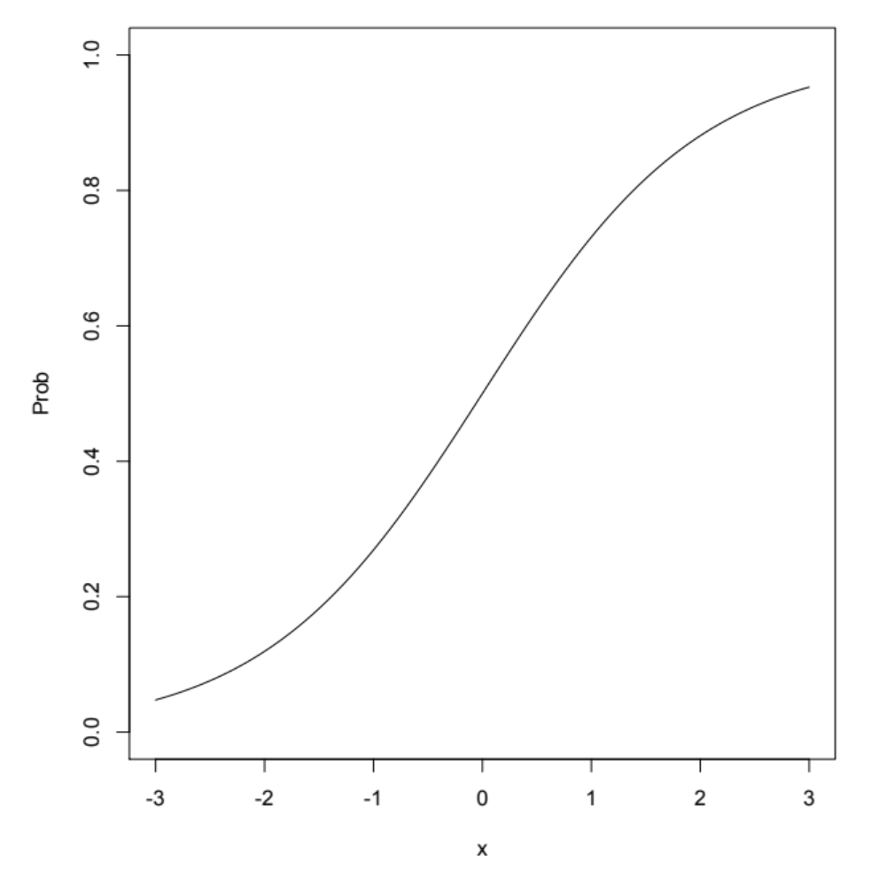
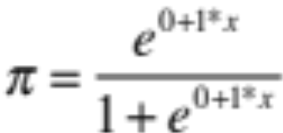
π increases by .231
x increases by 1
x increases by 1
the odds increase by a factor of 2.718
π increases by .072
Notes:
Pi(-3)=.0474, Pi(-2)=.1192, Pi(0)=.5, Pi(1)=.7311
Odds(-3)=.0498, Odds(2)=.1353, Odds(0)=1, Odds(1)=2.718

Slide 28
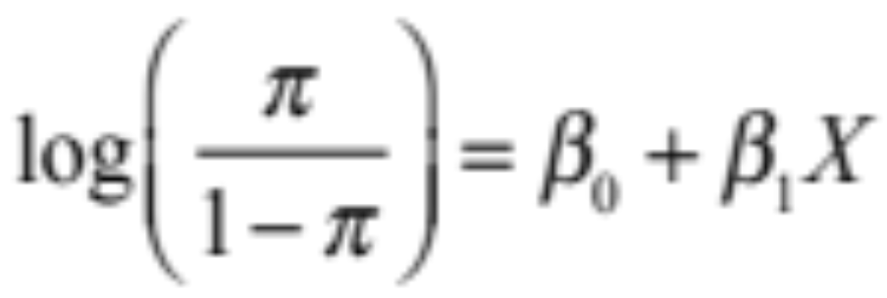
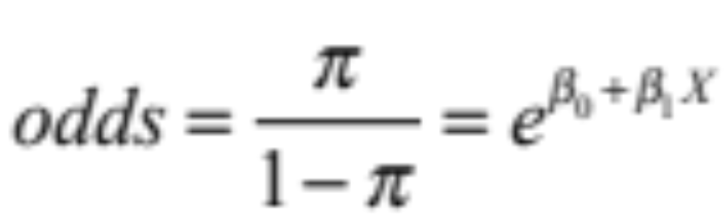
Odds
Logit form of the model:
⇒
The logistic model assumes a linear relationship between the predictors and log(odds).

Slide 29
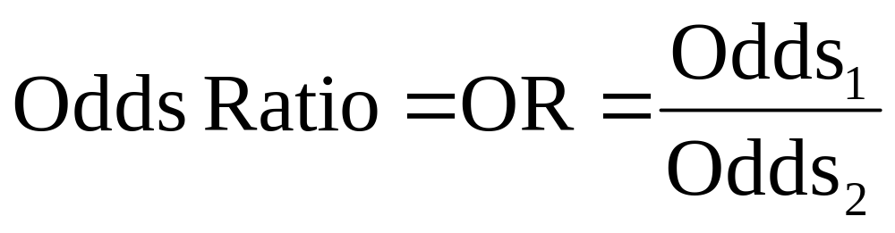
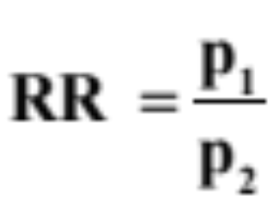
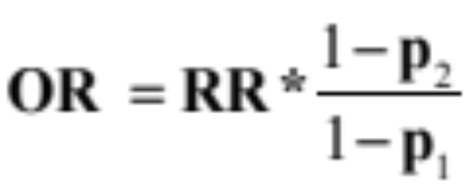
Odds Ratio
A common way to compare two groups is to look at the ratio of their odds
Note: Odds ratio (OR) is similar to relative risk (RR).
So when p is small, OR ≈ RR.
Notes:
Sometimes a study fixes the number of cases and controls, e.g., 500 lung cancer patients and 500 persons without lung cancer. We can then estimate Pr{smoker|lung cancer} but we cannot estimate Pr{lung cancer|smoker} which is what a RR wants as input. But we can find the OR.

Slide 30
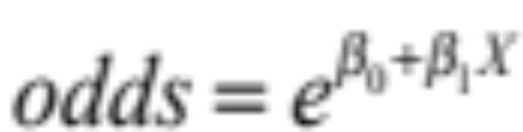
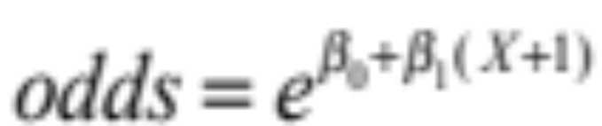
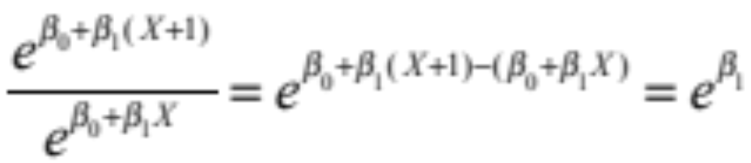
X is replaced by X + 1:
is replaced by
So the ratio is

Slide 31

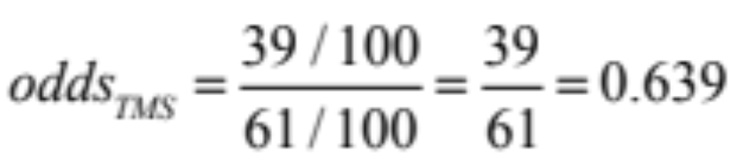
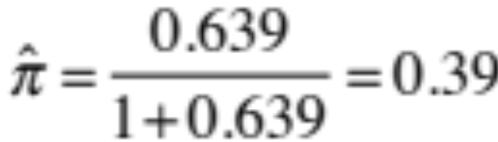

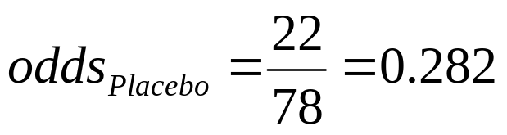
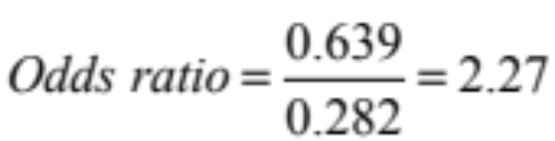
Example: TMS for Migraines
Transcranial Magnetic Stimulation vs. Placebo
Pain Free? | TMS | Placebo
YES | 39 | 22
NO | 61 | 78
Total | 100 | 100
Odds are 2.27 times higher of getting relief using TMS than placebo

Slide 32
Logistic Regression for TMS data
> lmod=glm(cbind(Yes,No)~Group,family=binomial,data=TMS)
> summary(lmod)
Coefficients:
Estimate Std. Error z value Pr(>|z|)
(Intercept) -1.2657 0.2414 -5.243 1.58e-07 ***
GroupTMS 0.8184 0.3167 2.584 0.00977 **
---
Signif. codes: 0 ‘***’ 0.001 ‘**’ 0.01 ‘*’ 0.05 ‘.’ 0.1 ‘ ’ 1
(Dispersion parameter for binomial family taken to be 1)
Null deviance: 6.8854 on 1 degrees of freedom
Residual deviance: 0.0000 on 0 degrees of freedom
AIC: 13.701
Note: e^{0.8184} = 2.27 = odds ratio

Slide 33
> datatable=rbind(c(39,22),c(61,78))
> datatable
[,1] [,2]
[1,] 39 22
[2,] 61 78
> chisq.test(datatable,correct=FALSE)
Pearson's Chi-squared test
data: datatable
X-squared = 6.8168, df = 1, p-value = 0.00903
Chi-Square Test for 2-way table
> lmod=glm(cbind(Yes,No)~Group,family=binomial,data=TMS)
> summary(lmod)
Call:
glm(formula = cbind(Yes, No) ~ Group, family = binomial)Coefficients:
Estimate Std. Error z value Pr(>|z|)
(Intercept) -1.2657 0.2414 -5.243 1.58e-07 ***
GroupTMS 0.8184 0.3167 2.584 0.00977 **
Binary Logistic Regression

Slide 34
A Single Binary Predictor for a Binary Response
Response variable: Y = Success/Failure
Predictor variable: X = Group #1 / Group #2
Method #1: Binary logistic regression
Method #2: Z- test, compare two proportions
Method #3: Chi-square test for 2-way table
All three “tests” are essentially equivalent, but the logistic regression approach allows us to mix other categorical and quantitative predictors in the model.

Slide 35
Putting Data
Odds using data from 6 feet = 0.953
Odds using data from 5 feet = 1.298
➔ Odds ratio (6 ft to 5 ft) = 0.953/1.298 = 0.73
The odds of making a putt from 6 feet are 73% of the odds of making from 5 feet.
Notes:
>PropMade=c(84/101,88/119,61/108,61/125,44/134)
>odds=PropMade/(1-PropMade)
>odds

Slide 36

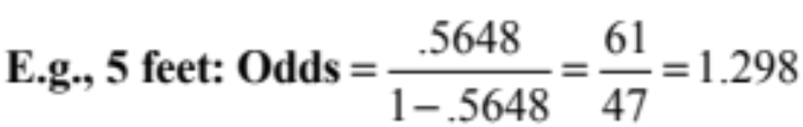
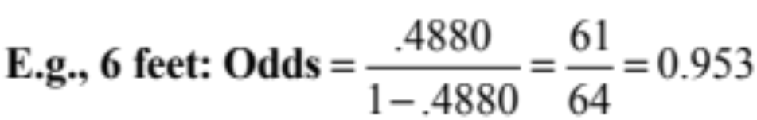
Golf Putts Data
Length | 3 | 4 | 5 | 6 | 7
Made | 84 | 88 | 61 | 61 | 44
Missed | 17 | 31 | 47 | 64 | 90
Total | 101 | 119 | 108 | 125 | 134
 | .8317 | .7394 | .5648 | .4880 | .3284
Odds | 4.941 | 2.839 | 1.298 | 0.953 | 0.489

Slide 37
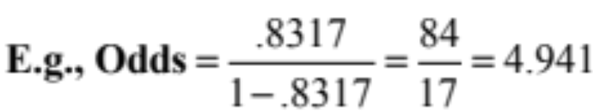
Golf Putts Data
Length | 3 | 4 | 5 | 6 | 7
Made | 84 | 88 | 61 | 61 | 44
Missed | 17 | 31 | 47 | 64 | 90
Total | 101 | 119 | 108 | 125 | 134
 | .8317 | .7394 | .5648 | .4880 | .3284
Odds | 4.941 | 2.839 | 1.298 | .953 | .489
OR | .575 | .457 | .734 | .513

Slide 38
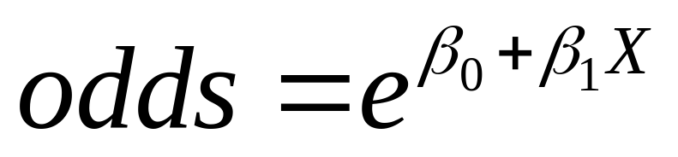
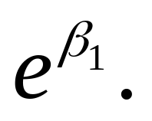
Interpreting “Slope” using Odds Ratio
⇒
When we increase X by 1, the ratio of the new odds to the old odds is
i.e. odds are multiplied by

Slide 39
Odds Ratios for Putts
From samples at each distance:
4 to 3 feet | 5 to 4 feet | 6 to 5 feet | 7 to 6 feet
0.575 | 0.457 | 0.734 | 0.513
From fitted logistic:
4 to 3 feet | 5 to 4 feet | 6 to 5 feet | 7 to 6 feet
0.568 | 0.568 | 0.568 | 0.568
In a logistic model, the odds ratio is constant when changing the predictor by one.

Slide 40
Example: 2012 vs 2014 congressional elections
How does %vote won by Obama relate to a Democrat winning a House seat?
See the script elections 12, 14.R
Notes:
See the script elections 12, 14.R

Slide 41
Example: 2012 vs 2014 congressional elections
How does %vote won by Obama relate to a Democrat winning a House seat?
In 2012 a Democrat had a decent chance even if Obama got only 50% of the vote in the district. In 2014 that was less true.

Slide 42
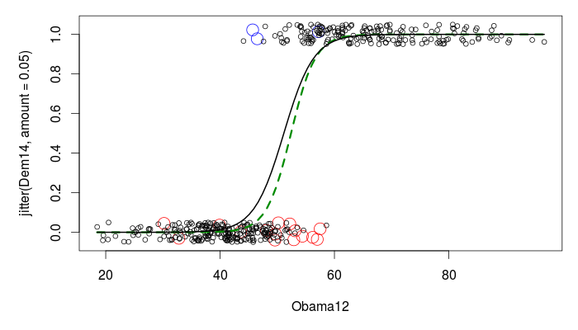
In 2012 a Democrat had a decent chance even if Obama got only 50% of the vote in the district. In 2014 that was less true.

Slide 43
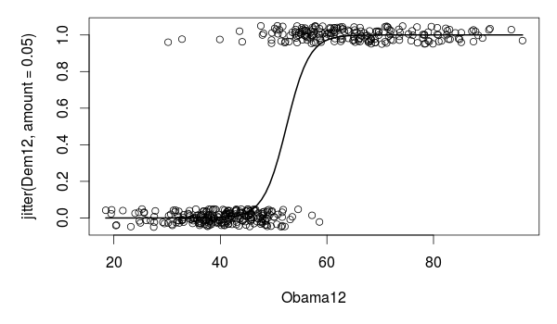
There is an easy way to graph logistic curves in R.
> library(TeachingDemos)
> with(elect, plot(Obama12,jitter(Dem12,amount=.05)))
> logitmod14=glm(Dem14~Obama12,family=binomial,data=elect)
> Predict.Plot(logitmod14, pred.var="Obama12”,add=TRUE, plot.args = list(lwd=3,col="black"))

Slide 44
R Logistic Output
> PuttModel=glm(Made~Length, family=binomial,data=Putts1)
> anova(PuttModel)
Analysis of Deviance Table
Df Deviance Resid. Df Resid. Dev
NULL 586 800.21
Length 1 80.317 585 719.89
> summary(PuttModel)
Call:
glm(formula = Made ~ Length, family = binomial)
Coefficients:
Estimate Std. Error z value Pr(>|z|)
(Intercept) 3.25684 0.36893 8.828 <2e-16 ***
Length -0.56614 0.06747 -8.391 <2e-16 ***
---
Null deviance: 800.21 on 586 degrees of freedom
Residual deviance: 719.89 on 585 degrees of freedom

Slide 45
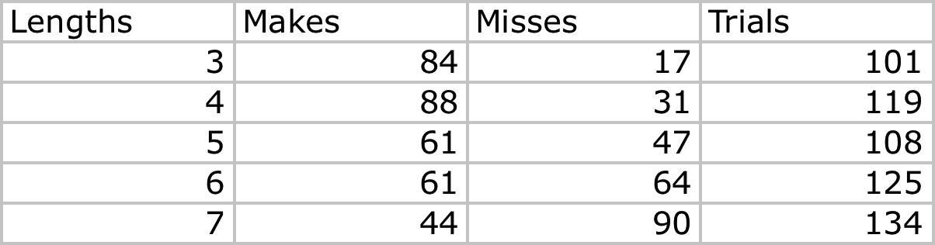
Two forms of logistic data
Response variable Y = Success/Failure or 1/0: “long form” in which each case is a row in a spreadsheet (e.g., Putts1 has 587 cases). This is often called “binary response” or “Bernoulli” logistic regression.
Response variable Y = Number of Successes for a group of data with a common X value: “short form” (e.g., Putts2 has 5 cases – putts of 3 ft, 4 ft, … 7 ft). This is often called “Binomial counts” logistic regression.

Slide 46
> str(Putts1)
'data.frame': 587 obs. of 2 variables:
$ Length: int 3 3 3 3 3 3 3 3 3 3 ...
$ Made : int 1 1 1 1 1 1 1 1 1 1 ...
> longmodel=glm(Made~Length,family=binomial,data=Putts1)
> summary(longmodel)
Coefficients:
Estimate Std. Error z value Pr(>|z|)
(Intercept) 3.25684 0.36893 8.828 <2e-16 ***
Length -0.56614 0.06747 -8.391 <2e-16 ***
---
Null deviance: 800.21 on 586 degrees of freedom
Residual deviance: 719.89 on 585 degrees of freedom

Slide 47
> str(Putts2)
'data.frame': 5 obs. of 4 variables:
$ Length: int 3 4 5 6 7
$ Made : int 84 88 61 61 44
$ Missed: int 17 31 47 64 90
$ Trials: int 101 119 108 125 134
> shortmodel=glm(cbind(Made,Missed)~Length,family=binomial,data=Putts2)
> summary(shortmodel)
Coefficients:
Estimate Std. Error z value Pr(>|z|)
(Intercept) 3.25684 0.36893 8.828 <2e-16 ***
Lengths -0.56614 0.06747 -8.391 <2e-16 ***
---
Null deviance: 81.3865 on 4 degrees of freedom
Residual deviance: 1.0692 on 3 degrees of freedom

Slide 48
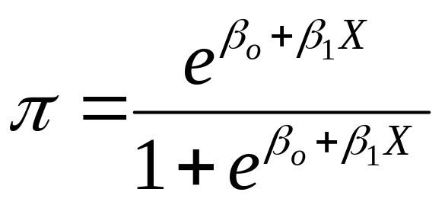
Binary Logistic Regression Model
Y = Binary response
X = Single predictor
π = proportion of 1’s (yes, success) at any x
Equivalent forms of the logistic regression model:
Logit form
Probability form

Slide 49
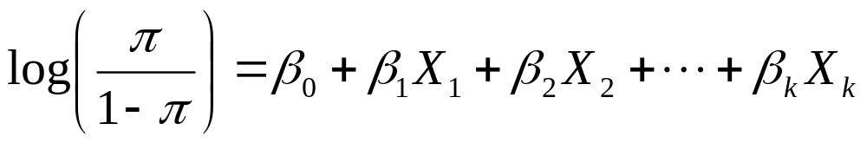
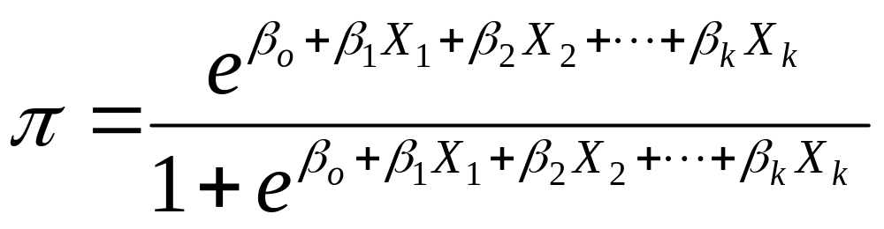
Binary Logistic Regression Model
Y = Binary response
X₁,X₂,…,X_{k} = Multiple predictors
X = Single predictor
π = proportion of 1’s (yes, success) at any x
π = proportion of 1’s at any x₁, x₂, …, x_{k}
Equivalent forms of the logistic regression model:
Logit form
Probability form

Slide 50
Interactions in logistic regression
Consider Survival in an ICU as a function of SysBP -- BP for short – and Sex
> intermodel=glm(Survive~BP*Sex, family=binomial, data=ICU)
> summary(intermodel)
Coefficients:
Estimate Std. Error z value Pr(>|z|)
(Intercept) -1.439304 1.021042 -1.410 0.15865
BP 0.022994 0.008325 2.762 0.00575 **
Sex 1.455166 1.525558 0.954 0.34016
BP:Sex -0.013020 0.011965 -1.088 0.27653
Null deviance: 200.16 on 199 degrees of freedom
Residual deviance: 189.99 on 196 degrees of freedom

Slide 51
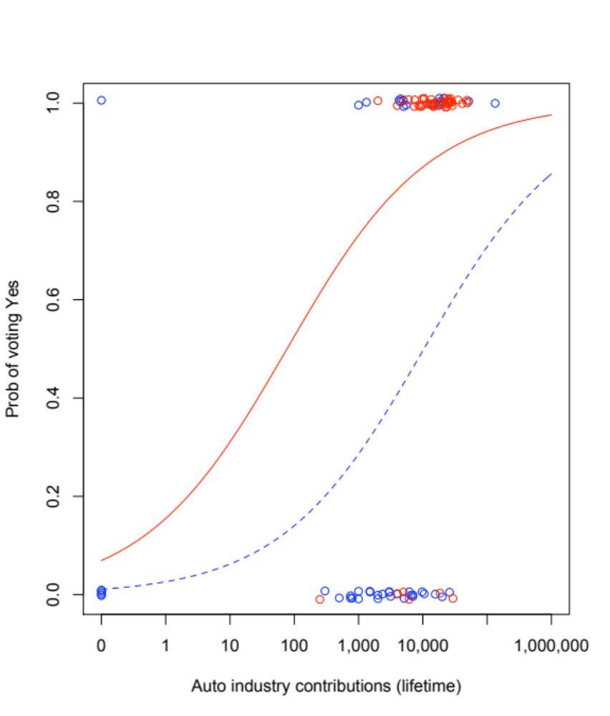
Rep = red, Dem = blue
Lines are very close to parallel; not a significant interaction

Slide 52
Generalized Linear Model
(1) What is the link between Y and β₀ + β₁X?
(a) General linear model: identity
(b) Logistic reg: logit
(c) Poisson reg: log
(2) What is the distribution of Y given X?
(a) Regular reg: Normal (Gaussian)
(b) Logistic reg: Bernoulli
(c) Poisson reg: Poisson

Slide 53
C-index, a measure of concordance
Med school acceptance: predicted by MCAT and GPA?
Med school acceptance: predicted by coin toss??

Slide 54
> library(Stat2Data)
> data(MedGPA)
> str(MedGPA)
> GPA10=MedGPA$GPA*10
> Med.glm3=glm(Acceptance~MCAT+GPA10, family=binomial, data=MedGPA)
> summary(Med.glm3)
> Accept.hat <- Med.glm3$fitted > .5
> with(MedGPA, table(Acceptance,Accept.hat))
Accept.hat
Acceptance FALSE TRUE
0 18 7
1 7 23
18 + 23 = 41 correct out of 55

Slide 55
> with(MedGPA, table(Acceptance,Accept.hat))
Accept.hat
Acceptance FALSE TRUE
0 18 7
1 7 23
Now consider that there were 30 successes and 25 failures. There are 30*25=750 possible pairs.
We hope that the predicted Pr(success) is greater for the success than for the failure in a pair! If yes then the pair is “concordant”.
C-index = % concordant pairs

Slide 56
The R package rms has a command, lrm, that does logistic regression and gives the C-index.
> #C-index work using the MedGPA data
> library(rms) #after installing the rms package
> m3=lrm(Acceptance~MCAT+GPA10, data=MedGPA)
> m3
lrm(formula = Acceptance~ MCAT + GPA10)
Model Likelihood Discrimination Rank Discrim.
Ratio Test Indexes Indexes
Obs 55 LR chi2 21.78 R2 0.437 C 0.834
0 25 d.f. 2 g 2.081 Dxy 0.668
1 30 Pr(> chi2) <0.0001 gr 8.015 gamma 0.669
max |deriv| 2e-07 gp 0.342 tau-a 0.337
Brier 0. 167
Coef S.E. Wald Z Pr(>|Z|)
Intercept -22.373 6.454 -3.47 0.0005
MCAT 0.1645 0.1032 1.59 0.1108
GPA10 0.4678 0.1642 2.85 0.0044

Slide 57
Suppose we scramble the cases..
Then the C-index should be ½, like coin tossing
> newAccept=sample(MedGPA$Acceptance) #scramble the acceptances
> m1new=lrm(newAccept~MCAT+GPA10,data=MedGPA)
> m1new
lrm(formula = newAccept ~ MCAT + GPA10)
Model Likelihood Discrimination Rank Discrim.
Ratio Test Indexes Indexes
Obs 55 LR chi2 0.24 R2 0.006 C 0.520
0 25 d.f. 2 g 0.150 Dxy 0.040
1 30 Pr(> chi2) 0.8876 gr 1.162 gamma 0.041
max |deriv| 1e-13 gp 0.037 tau-a 0.020
Brier 0.247
Coef S.E. Wald Z Pr(>|Z|)
Intercept -1.4763 3.4196 -0.43 0.6659
MCAT 0.0007 0.0677 0.01 0.9912
GPA10 0.0459 0.1137 0.40 0.6862

Slide 58
Important R Websites
Logistic regression procedures, and how to split data into training and testing, and make predictions:
http://www.sthda.com/english/articles/36-classification-methods-essentials/151-logistic-regression-essentials-in-r/
Stepwise and Best-subset variable selection methods using the information criteria (AIC or BIC):
http://atm.amegroups.com/article/view/9706/pdf
I know they look tiny, but copy, paste and go, you will find them
very helpful in your homework and exams, as always.

Slide 59
Acknowledgement
We thank Dr. Jeff Witmer for his wonderful notes!
We also thank colleagues who posted their notes on the internet.
Thank you!

