Slide 1
Programming Basic
Week #1

Slide 2
Computer Fundamentals
Operating Systems
Basic elements of a computer
Processor
Main Memory
Secondary Memory
Cache Memory
System Bus
I/O Modules

Slide 3
Operating Systems
The operating system is the most important program that runs on a computer.
Operating system is an interface between computer and user.
It is responsible for the management and coordination of activities and the sharing of the resources of the computer.
User
Application
Operating System
Hardware

Slide 4
Major functions of Operating Systems
Resource management
Data management
Job management
Standard means of communication between User and Computer

Slide 5
Basic components of Computer System
Input Unit
It accepts (or reads) the list of instructions and data from the outside word.
It converts these instructions and data in computer acceptable format
It supplies the converted instructions and data to the computer system for further processing.
Output Unit
It accepts the results produced by the computer which are in coded form and hence cannot be easily understood by us.
It converts these coded results to human acceptable (readable) form.
It supplies the converted results to the outside world.

Slide 6
Basic components of Computer System
Storage Unit
Store all the data to be processed and the instruction required for processing,
intermediate results of processing
final results of processing before these results are released to an output device.

Slide 7
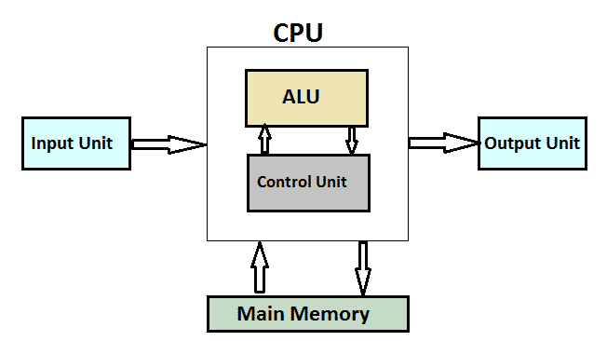
Central Processing Unit (CPU)
CPU is considered as the brain of the computer.
CPU performs all types of data processing operations.
It stores data, intermediate results, and instructions (program).
It controls the operation of all parts of the computer.

Slide 8
Control Unit
This unit controls the operations of all parts of the computer but does not carry out any actual data processing operations.
Functions of this unit are −
It is responsible for controlling the transfer of data and instructions among other units of a computer.
It manages and coordinates all the units of the computer.
It obtains the instructions from the memory, interprets them, and directs the operation of the computer.
It communicates with Input/Output devices for transfer of data or results from storage.
It does not process or store data.

Slide 9
Arithmetic Logic Unit (ALU)
This unit consists of two subsections namely,
Arithmetic Section
Logic Section
Arithmetic Section
Function of arithmetic section is to perform arithmetic operations like addition, subtraction, multiplication, and division. All complex operations are done by making repetitive use of the above operations.
Logic Section
Function of logic section is to perform logic operations such as comparing, selecting, matching, and merging of data.

Slide 10
Primary Memory (Main Memory)
It is the working memory of the computer.
It holds only those data and instructions on which the computer is currently working.
It has a limited capacity ,usually volatile memory and data is lost when power is switched off.
Faster than secondary memories.
A computer cannot run without the primary memory.
It is divided into two subcategories RAM and ROM.
RAM (Random Access Memory) is the internal memory of the CPU for storing data, program, and program result. It is a read/write memory which stores data until the machine is working. As soon as the machine is switched off, data is erased.
ROM stands for Read Only Memory. The memory from which we can only read but cannot write on it. This type of memory is non-volatile. The information is stored permanently in such memories during manufacture. A ROM stores such instructions that are required to start a computer.

Slide 11
Secondary Memory
This type of memory is also known as external memory or non-volatile.
It is known as the backup memory.
Data is permanently stored even if power is switched off.
It is slower than the main memory.
Computer may run without the secondary memory.
For example, disk, CD-ROM, DVD, etc.

Slide 12
Cache Memory
Cache memory is a very high speed semiconductor memory which can speed up the CPU.
It acts as a buffer between the CPU and the main memory.
It is used to hold those parts of data and program which are most frequently used by the CPU.
The parts of data and programs are transferred from the disk to cache memory by the operating system, from where the CPU can access them.
Advantages
Cache memory is faster than main memory.
It consumes less access time as compared to main memory.
It stores the program that can be executed within a short period of time.
It stores data for temporary use.
Disadvantages
Cache memory has limited capacity.
It is very expensive.

Slide 13
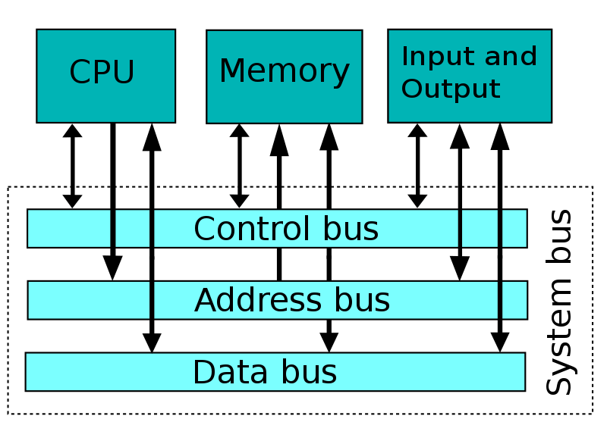
System Bus
A system bus is a single computer bus that connects the major components of a computer system, combining the functions of a data bus to carry information, an address bus to determine where it should be sent, and a control bus to determine its operation.
While the address bus carries the information about the device with which the CPU is communicating and the data bus carries the actual data being processed, the control bus carries commands from the CPU and returns status signals from the devices

Slide 14
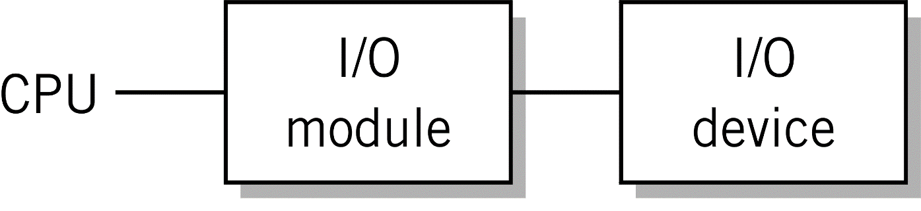
I/O Module
External devices are not generally connected directly into the bus system of the computer.
I/O module is an interface for the external devices (peripherals) of CPU and Memory.
Recognizes messages from device(s) addressed to it and accepts commands from the CPU
Provides a buffer where the data from memory can be held until it can be transferred to the disk
Provides the necessary registers and controls to perform a direct memory transfer
Physically controls the device
Copies data from its buffer to the device/from the CPU to its buffer
Notifies with interrupts

