Slide 1
GitHub Learning

Slide 2
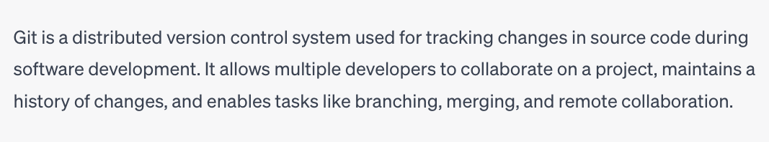
Git

Slide 3
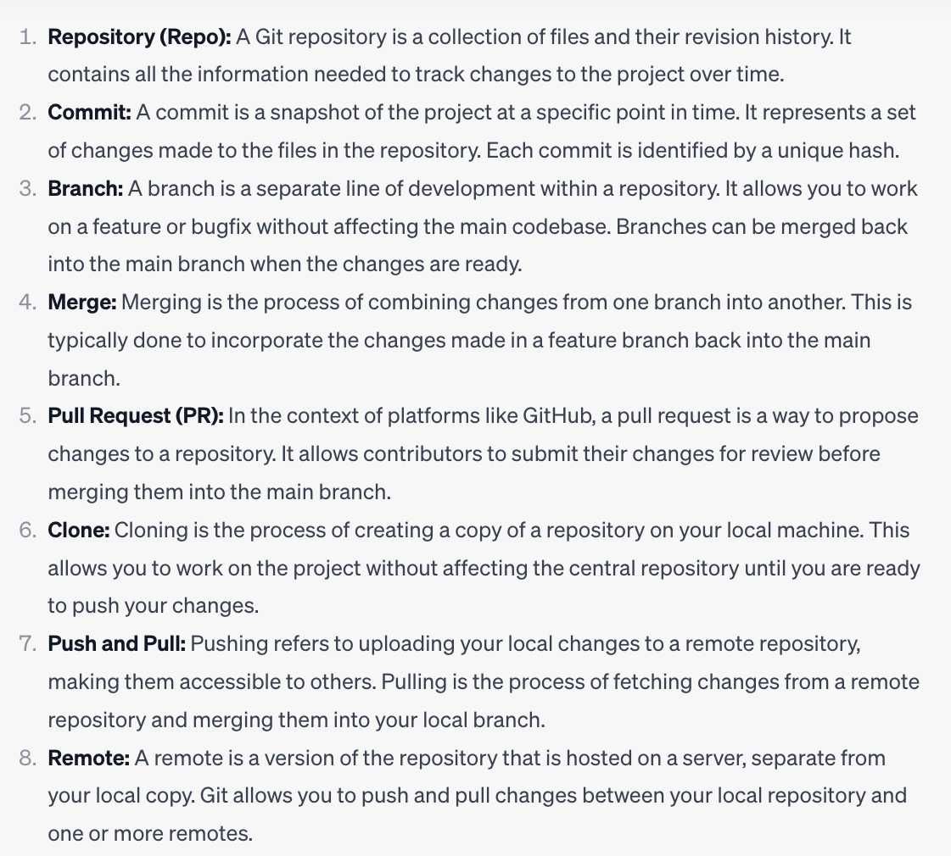
Git

Slide 4
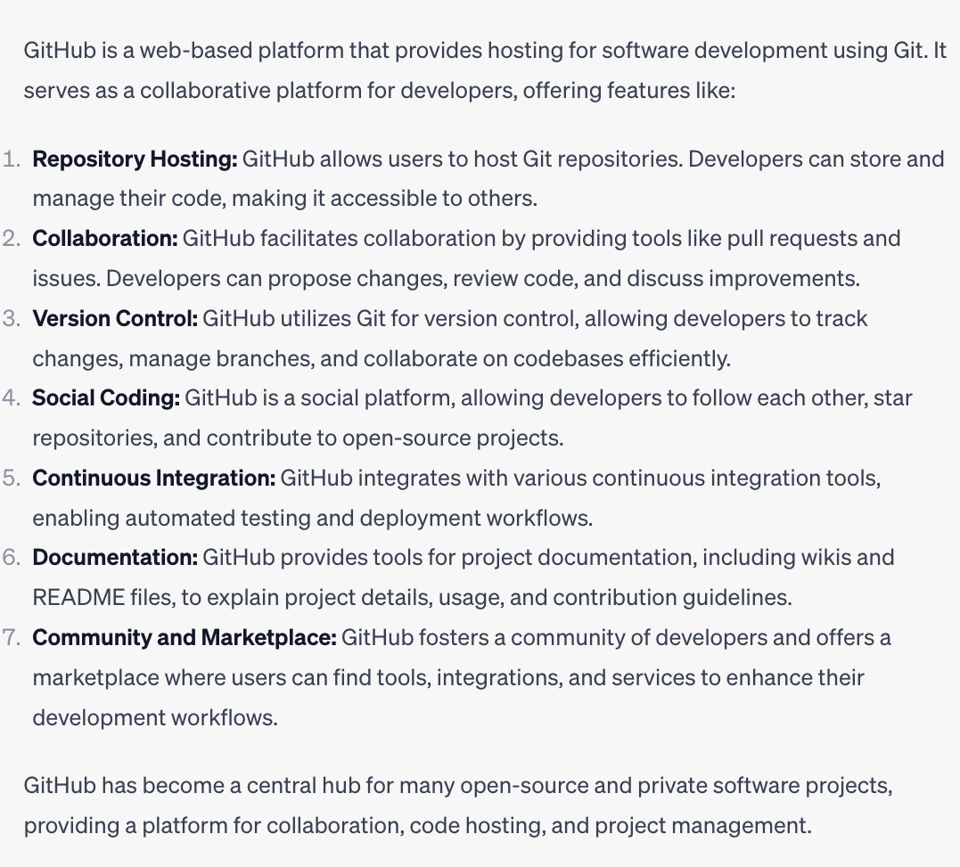
GitHub

Slide 5
GitHub
Create Reponsitory -- > One Reponsitory can assume that one Project
  Public or Private
Create ReadMe (To understand what is your project)
Click on Code -> HTTP > copy “URL”

Slide 6
Creating New Repository
Create Repository -- > One Repository can assume that one Project
  Public or Private
Create ReadMe (To understand what is your project)
How to get token
  Setting -> Dev Setting -> Personal Access Token -> Classic
Click on Code -> HTTP > copy “URL”

Slide 7
How to Clone, Push and Pull in Command Line to GitHub
git clone “type url of your repository”
Copy → Paste in your local file
To push in github each file
  git add ”file name” (You must enter the correct path)
  git commit –m “ ‘reason’ ”
  git push origin “branch name”
To push in github all file
  git add . (You must enter the correct path)
  git commit –m “ ‘reason’ ”
  git push origin “branch name”
To pull in github each file
  git pull ”file name”
To push in github all file
  git pull . (You must enter the correct path)

Slide 8
Command in Terminal
How to edit in command line
  nano “filename”
How to delete the file in command
  sudo rm –rf “filename”

