Slide 1


Team Details
a. Team name: Hounds of Singularity
b. Team leader name: Harshwardhan Tripathi
c. Problem Statement: Media, Content & Digital Experiences
Team member: Chennika
Notes:
ProofMesh / Hounds of Singularity. Sources: repository docs/EVALUATION.md, docs/DEPLOYMENT.md, docs/PRODUCT_QA.md; official AI Builder Cup template preserved. Historical reference: https://science.nasa.gov/resource/apollo-8s-iconic-earthrise/. No claim of NASA endorsement. Working build and measurements verified October 17, 2026.

Slide 2
Brief about the idea
ProofMesh separates the identity of an image from the claims made about it.
The Chrome extension checks visible X posts against a shared investigation registry. A familiar image with a different caption stays unverified.
On demand, Gemini researches the exact claim, assesses fetched source passages and critiques its conclusion. Media origin remains unknown.
Notes:
ProofMesh / Hounds of Singularity. Sources: repository docs/EVALUATION.md, docs/DEPLOYMENT.md, docs/PRODUCT_QA.md; official AI Builder Cup template preserved. Historical reference: https://science.nasa.gov/resource/apollo-8s-iconic-earthrise/. No claim of NASA endorsement. Working build and measurements verified October 17, 2026.

Slide 3
Opportunities
Difference: completed investigations become reusable context in the browsing feed, rather than a one-off chat response.
Problem addressed: authentic media can be assigned a misleading date, location or event. Each caption needs its own evidence.
USP: exact-context reuse makes zero model calls. Similar images retrieve leads, never an inherited verdict.
Notes:
ProofMesh / Hounds of Singularity. Sources: repository docs/EVALUATION.md, docs/DEPLOYMENT.md, docs/PRODUCT_QA.md; official AI Builder Cup template preserved. Historical reference: https://science.nasa.gov/resource/apollo-8s-iconic-earthrise/. No claim of NASA endorsement. Working build and measurements verified October 17, 2026.

Slide 4
List of features offered by the solution
Visible-post extraction and opt-in registry lookups on X
Image fingerprints and separate caption identity
Source-linked supported, contradicted or unresolved findings
Persistent jobs with polling, deduplication and bounded retry
Public recorded cases and downloadable evidence reports
Notes:
ProofMesh / Hounds of Singularity. Sources: repository docs/EVALUATION.md, docs/DEPLOYMENT.md, docs/PRODUCT_QA.md; official AI Builder Cup template preserved. Historical reference: https://science.nasa.gov/resource/apollo-8s-iconic-earthrise/. No claim of NASA endorsement. Working build and measurements verified October 17, 2026.

Slide 5
Process flow diagram or Use-case diagram
Visible post
or submission
→
Exact context
lookup
→
Fresh report
exists?
→
Reuse report
0 model calls
No match: stay unverified
→
User requests investigation
A matching image does not answer a new caption.
Notes:
ProofMesh / Hounds of Singularity. Sources: repository docs/EVALUATION.md, docs/DEPLOYMENT.md, docs/PRODUCT_QA.md; official AI Builder Cup template preserved. Historical reference: https://science.nasa.gov/resource/apollo-8s-iconic-earthrise/. No claim of NASA endorsement. Working build and measurements verified October 17, 2026.

Slide 6
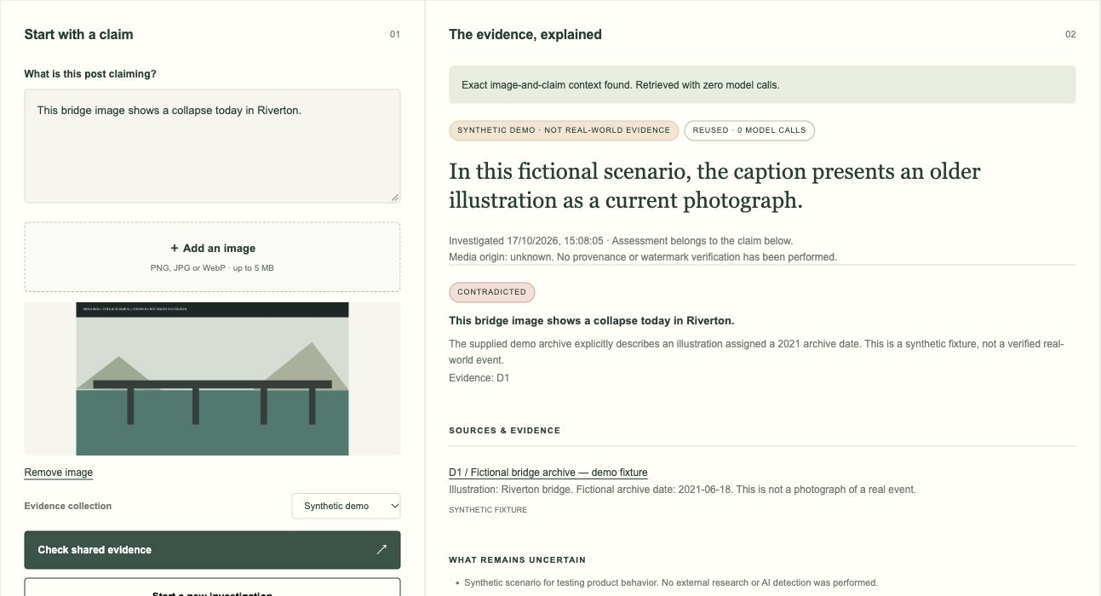
Wireframes/Mock diagrams of the proposed solution (optional)
Notes:
ProofMesh / Hounds of Singularity. Sources: repository docs/EVALUATION.md, docs/DEPLOYMENT.md, docs/PRODUCT_QA.md; official AI Builder Cup template preserved. Historical reference: https://science.nasa.gov/resource/apollo-8s-iconic-earthrise/. No claim of NASA endorsement. Working build and measurements verified October 17, 2026.

Slide 7
Architecture diagram of the proposed solution
Chrome extension / portal
→
Cloud Run API
→
Firestore
↓
Cloud Tasks
↓
Vision matching-page leads
Gemini + fetched sources
Cloud Run worker
Private image bucket
Secret Manager
←
→
Mumbai resources; Gemini global endpoint. Attached service identities.
Notes:
ProofMesh / Hounds of Singularity. Sources: repository docs/EVALUATION.md, docs/DEPLOYMENT.md, docs/PRODUCT_QA.md; official AI Builder Cup template preserved. Historical reference: https://science.nasa.gov/resource/apollo-8s-iconic-earthrise/. No claim of NASA endorsement. Working build and measurements verified October 17, 2026.

Slide 8
Technologies to be used in the solution
Gemini on Vertex AI: search research, structured assessment and critique
Cloud Vision Web Detection: image matching-page leads
Cloud Firestore: reports, jobs and transactional admission limits
Cloud Run + Cloud Tasks: application and durable work delivery
Cloud Storage + Secret Manager: temporary images and credentials
FastAPI, Python, Chrome Manifest V3, HTML/CSS/JavaScript
Notes:
ProofMesh / Hounds of Singularity. Sources: repository docs/EVALUATION.md, docs/DEPLOYMENT.md, docs/PRODUCT_QA.md; official AI Builder Cup template preserved. Historical reference: https://science.nasa.gov/resource/apollo-8s-iconic-earthrise/. No claim of NASA endorsement. Working build and measurements verified October 17, 2026.

Slide 9
Estimated implementation cost (optional)
Approved trial-credit budget: US$5 total for bounded work
Four selected completed local runs: estimated model-token cost US$0.0711, before search, Vision, infrastructure and failed attempts. This is not a billing receipt.
Controls: zero minimum / one maximum instance; four new attempts per day and twelve across the live window.
No billing upgrade. Alerts and workload limits are not an absolute dollar cap.
Notes:
ProofMesh / Hounds of Singularity. Sources: repository docs/EVALUATION.md, docs/DEPLOYMENT.md, docs/PRODUCT_QA.md; official AI Builder Cup template preserved. Historical reference: https://science.nasa.gov/resource/apollo-8s-iconic-earthrise/. No claim of NASA endorsement. Working build and measurements verified October 17, 2026.

Slide 10
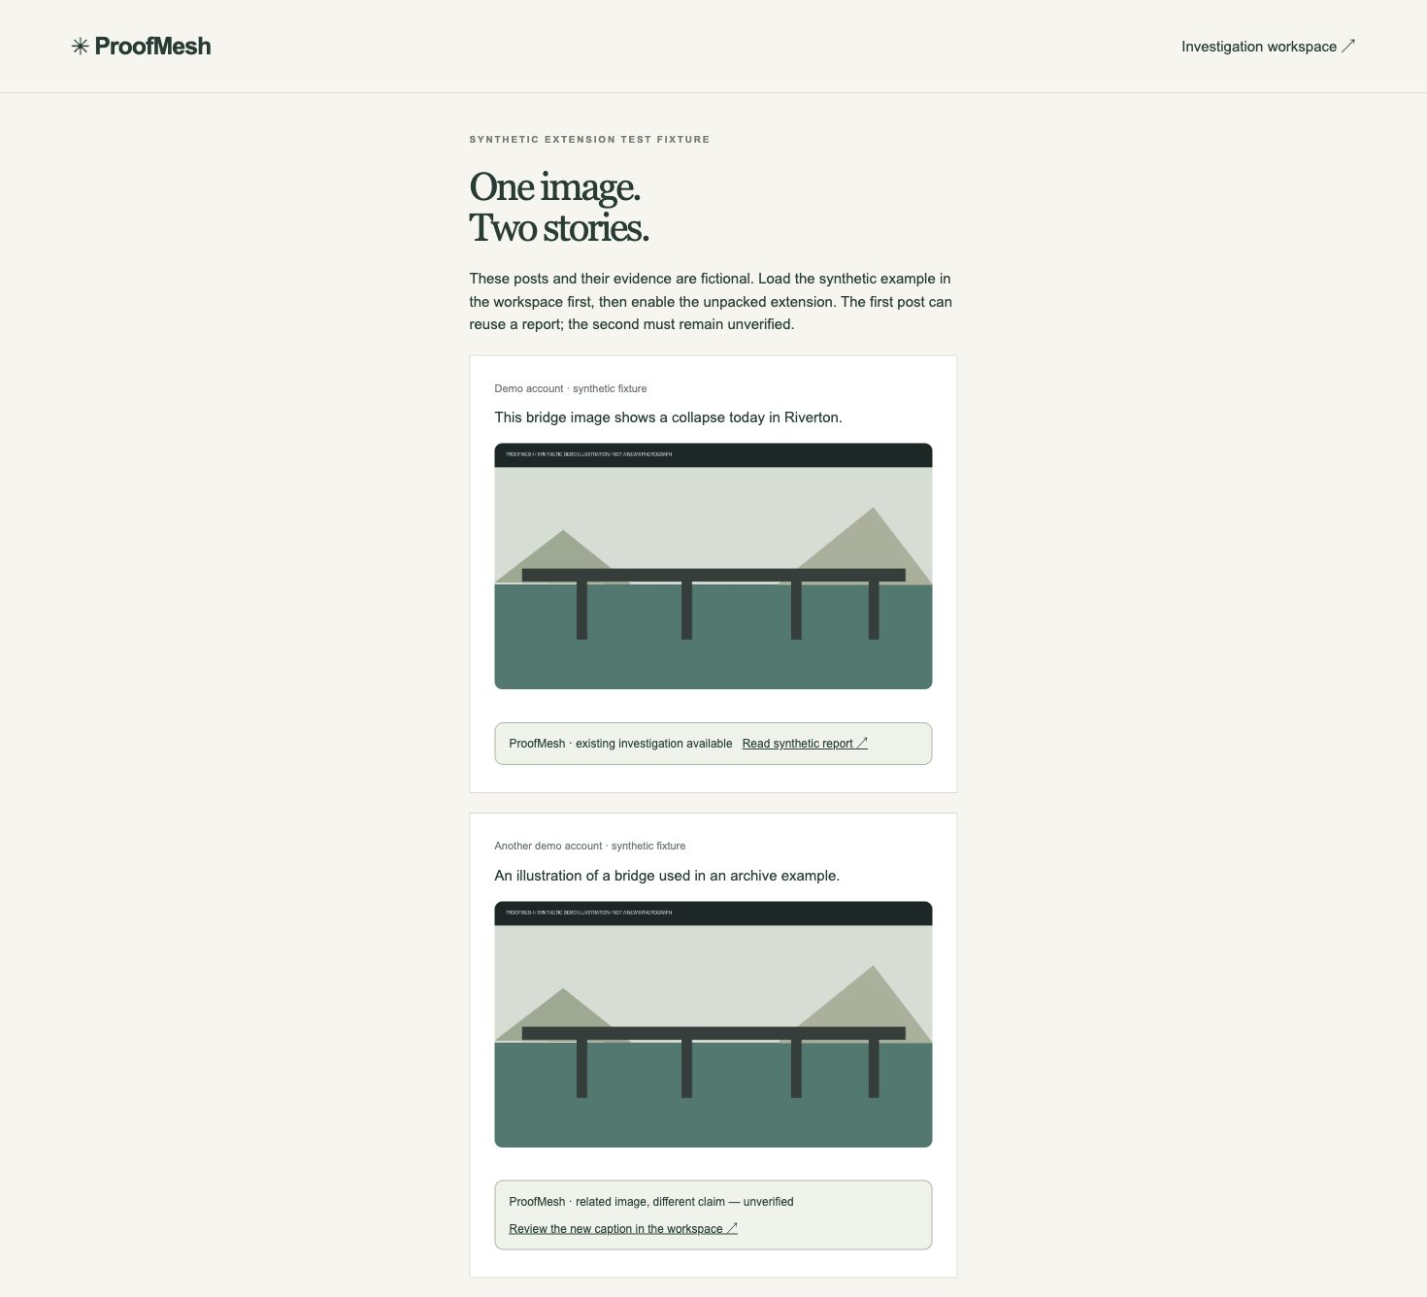
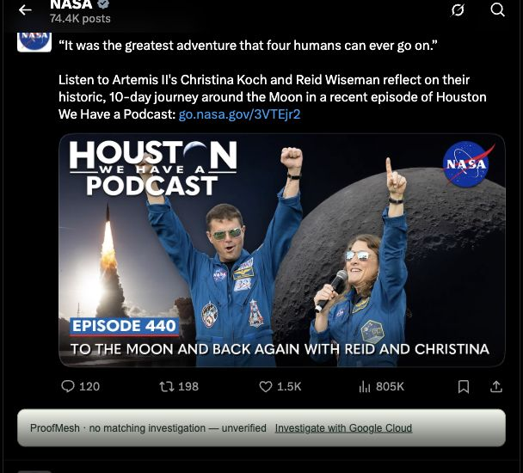
Snapshots of the prototype
Notes:
ProofMesh / Hounds of Singularity. Sources: repository docs/EVALUATION.md, docs/DEPLOYMENT.md, docs/PRODUCT_QA.md; official AI Builder Cup template preserved. Historical reference: https://science.nasa.gov/resource/apollo-8s-iconic-earthrise/. No claim of NASA endorsement. Working build and measurements verified October 17, 2026.

Slide 11
Prototype Performance report/Benchmarking
Selected live cases: supported historical caption; contradicted caption on the same image; unresolved assertion with no evidence; source-injection attempt.
Four exact repeats: zero additional model calls.
Local fresh runs: 3.3–25.9 s; local reuse: 1.0–21.0 ms.
Hosted queued run: 10.531 s; Firestore reuse: 104.5 ms.
36 Python + 23 JavaScript tests. Provider failures and one incidental temporal wording error are documented. No accuracy percentage is claimed.
Notes:
ProofMesh / Hounds of Singularity. Sources: repository docs/EVALUATION.md, docs/DEPLOYMENT.md, docs/PRODUCT_QA.md; official AI Builder Cup template preserved. Historical reference: https://science.nasa.gov/resource/apollo-8s-iconic-earthrise/. No claim of NASA endorsement. Working build and measurements verified October 17, 2026.

Slide 12
Additional Details/Future Development (if any)
Current limits: X and single-image posts only. No watermark detector, C2PA validation, video analysis or semantic claim reuse.
Same-model critique can miss mistakes; report links and explicit uncertainty remain essential.
Next work: larger labeled evaluation with independent reviewers, broader logged-in X coverage, fingerprint-only lookup and an Instagram-specific adapter.
Notes:
ProofMesh / Hounds of Singularity. Sources: repository docs/EVALUATION.md, docs/DEPLOYMENT.md, docs/PRODUCT_QA.md; official AI Builder Cup template preserved. Historical reference: https://science.nasa.gov/resource/apollo-8s-iconic-earthrise/. No claim of NASA endorsement. Working build and measurements verified October 17, 2026.

Slide 13
Project links
Public repository
https://github.com/htg2704/proofmesh
Demo video (3 minutes 20 seconds)
https://proofmesh-2god3tua3a-el.a.run.app/assets/demo.mp4
Working prototype
https://proofmesh-2god3tua3a-el.a.run.app/
Notes:
ProofMesh / Hounds of Singularity. Sources: repository docs/EVALUATION.md, docs/DEPLOYMENT.md, docs/PRODUCT_QA.md; official AI Builder Cup template preserved. Historical reference: https://science.nasa.gov/resource/apollo-8s-iconic-earthrise/. No claim of NASA endorsement. Working build and measurements verified October 17, 2026.

Slide 14
Evidence and evaluation notes
Primary historical reference
science.nasa.gov/resource/apollo-8s-iconic-earthrise/
Image credit: NASA/Bill Anders; educational example, no endorsement.
AI assessments are ProofMesh outputs. The misleading-caption recorded case includes a QA note identifying an incidental mission-date wording error.
Full methodology and limits: docs/EVALUATION.md in the repository.
Public cases are recorded runs; viewing them makes no inference calls.
Notes:
ProofMesh / Hounds of Singularity. Sources: repository docs/EVALUATION.md, docs/DEPLOYMENT.md, docs/PRODUCT_QA.md; official AI Builder Cup template preserved. Historical reference: https://science.nasa.gov/resource/apollo-8s-iconic-earthrise/. No claim of NASA endorsement. Working build and measurements verified October 17, 2026.

Slide 15

Notes:
ProofMesh / Hounds of Singularity. Sources: repository docs/EVALUATION.md, docs/DEPLOYMENT.md, docs/PRODUCT_QA.md; official AI Builder Cup template preserved. Historical reference: https://science.nasa.gov/resource/apollo-8s-iconic-earthrise/. No claim of NASA endorsement. Working build and measurements verified October 17, 2026.

