Slide 1
Stem Cell Engineering Informatics in 2015
Status of LIMS2, HTGT and WGE systems

Slide 2
Talk Outline
What are we trying to achieve with our systems?
Overall landscape of systems
HTGT – legacy but still used
LIMS2 – the current LIMS still actively developed
WGE – a research tool for CRISPR genome editing
People

Slide 3
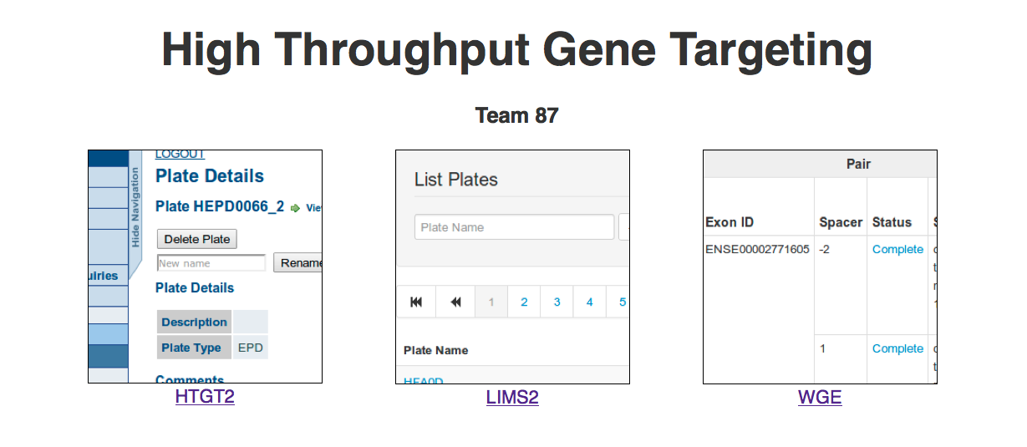
The Landscape
URL: www.sanger.ac.uk/htgt

Slide 4
HTGT
HTGT – High-Throughput Gene Targeting
The ‘original’ LIMS for Team87
Perl/Catalyst/DBI/DBIx::Class/Oracle
Was running on Etch (aka ancient version of Debian)
A ‘legacy’ system supporting Mouse (only)
Essentially relational ‘one well -> one parent’ model
A kind of tree

Slide 5
HTGT2 – The migration
Removal of support for Etch
drives effort to migrate to Ubuntu Precise (VMs)
The painstaking task of gathering all Perl modules required:
Local – multiple subversion repositories re-organised into handful of GIT repositories (using GIT submodules)
htgt-root
htgt-batch
htgt-app
CPAN modules for Perl 5.14.4

Slide 6
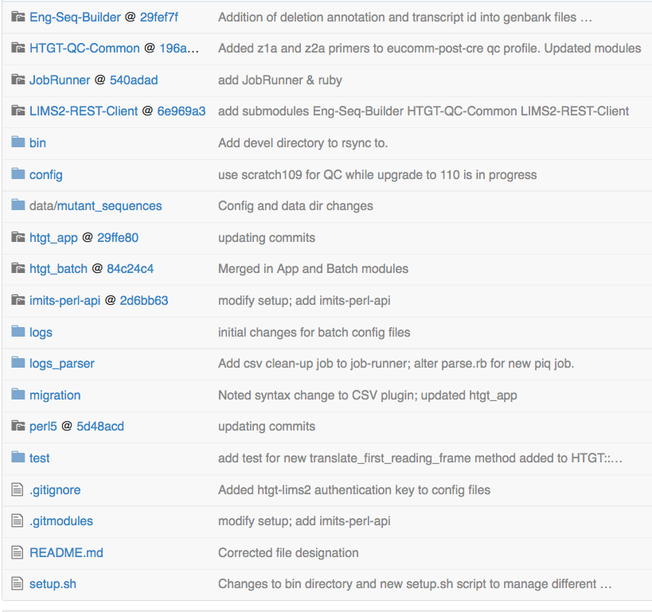
HTGT2 code repo

Slide 7
LIMS2
Supports:
both Human and Mouse species
Gibson Designs
CRISPR/Cas9 support
Runs on Ubuntu 10.04 (Lucid lynx)
Perl 5.10.1 (…old!)
Catalyst/DBIx::Class/PostgreSQL
More use of JavaScript
ExtJS for flexible table widget
Genoverse genome browser

Slide 8
LIMS2 - architecture
A well can have … multiple parent wells!
Re-arrays, extensive parameter validation
Access the DB through the model.
Thin controller/fat model.
Shares QC system with HTGT2
For Farm3 submission
Directed Acyclic Graph
Graph Support is limited in DBIx::Class and ANSI SQL
‘WITH RECURSIVE’ required in PostgreSQL to permit searching across the graph
No support in DBIx::Class … yet
Required for fast reporting

Slide 9
Recent features
Automatic genotyping/PCR/sequencing primer generation
JavaScript trace viewer for Sequencing QC review
CRISPR QC
Bar coding check-in/check-out and tracking
Plate versioning required as a result

Slide 10
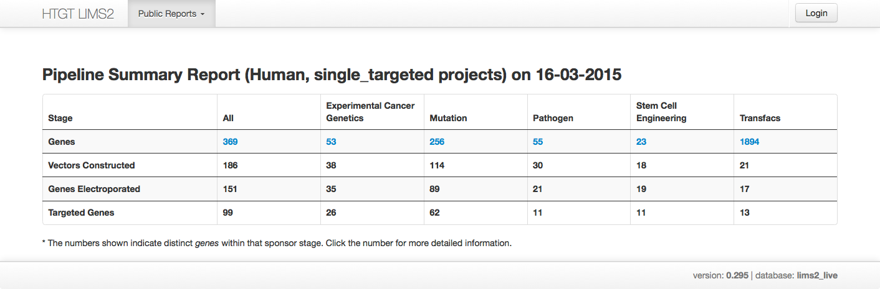
LIMS2 Public Access

Slide 11
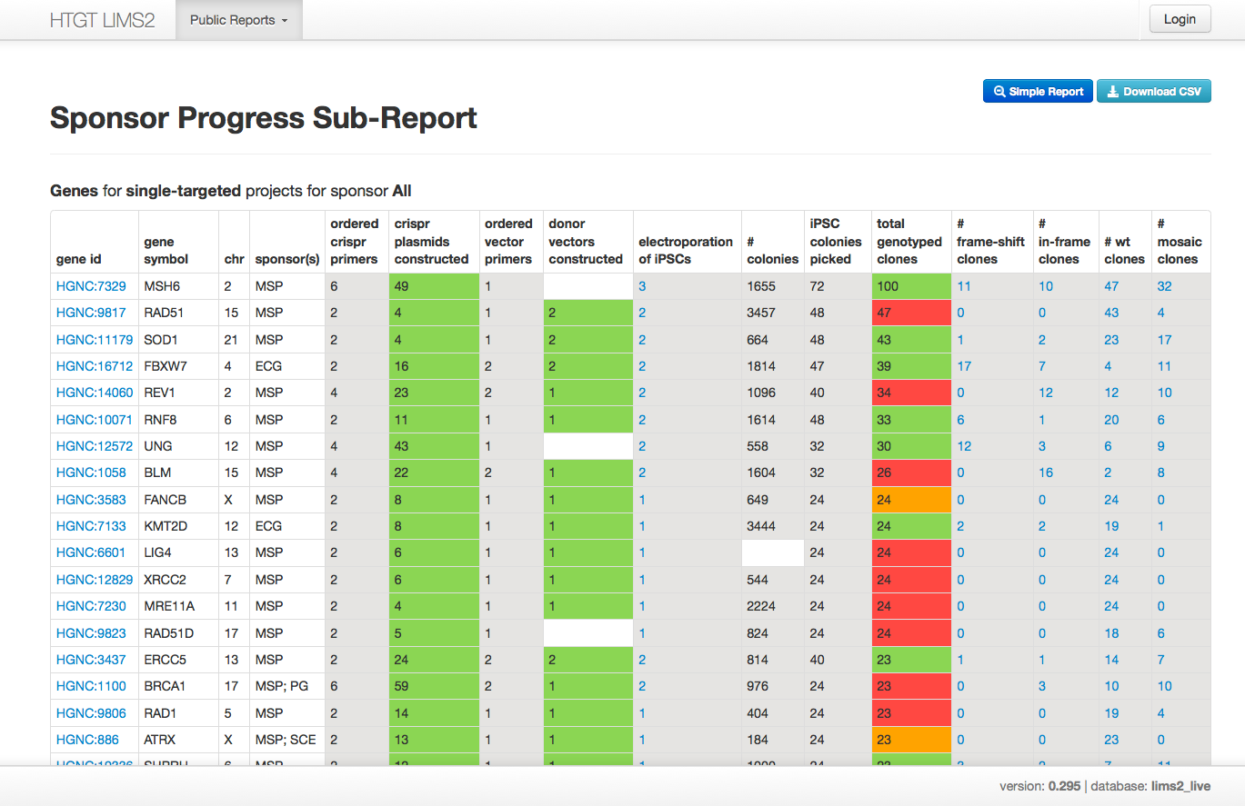
Drill down …

Slide 12
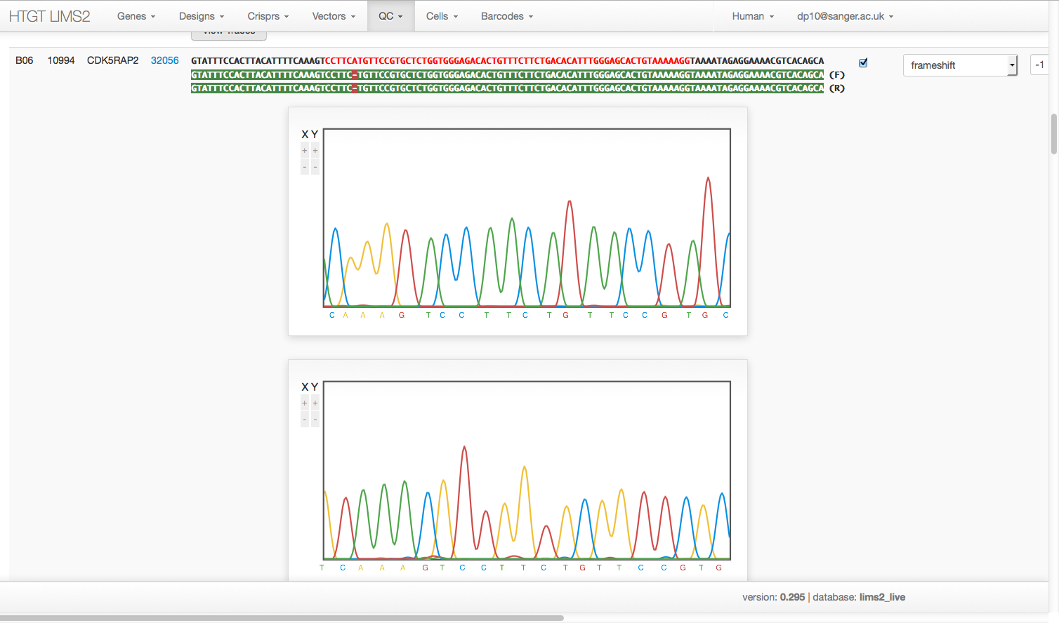
CRISPR QC Trace Viewer

Slide 13
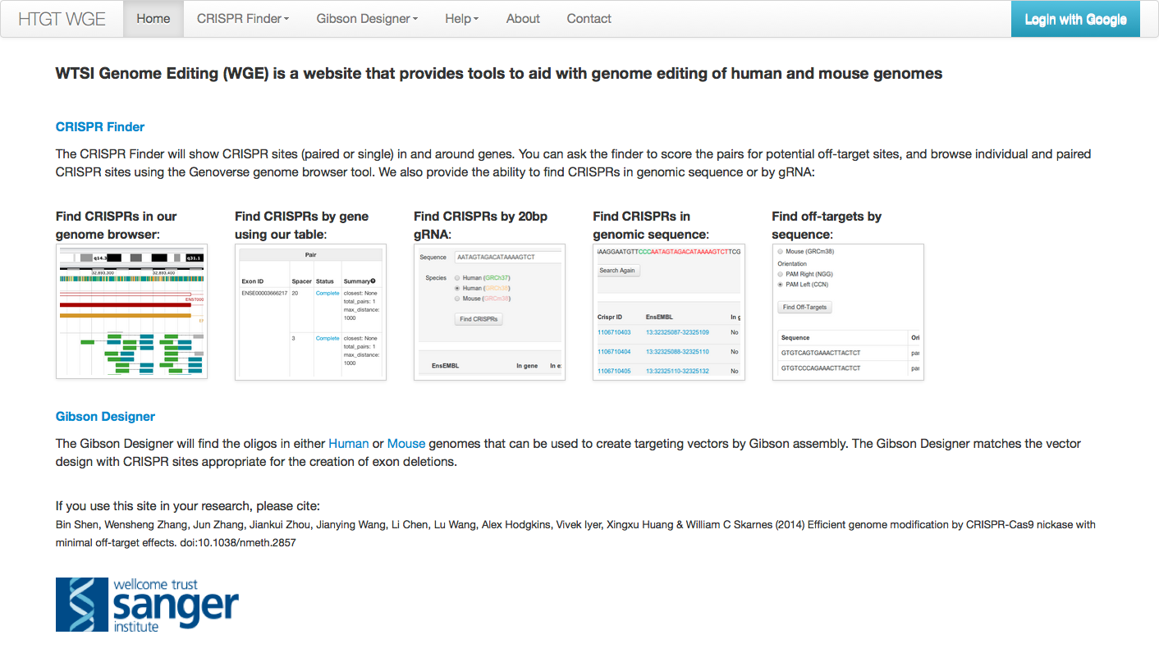
WGE

Slide 14
WGE - Implementation
Originally a Dancer app
Now a Perl/Catalyst/DBIx::Class/PostgreSQL app
Genome browser interface to a database of CRISPR sites in the Human and Mouse genomes
Uses an in memory index served by separate server
Off-targets are calculated and stored
batch mode or via genome browser interface

Slide 15
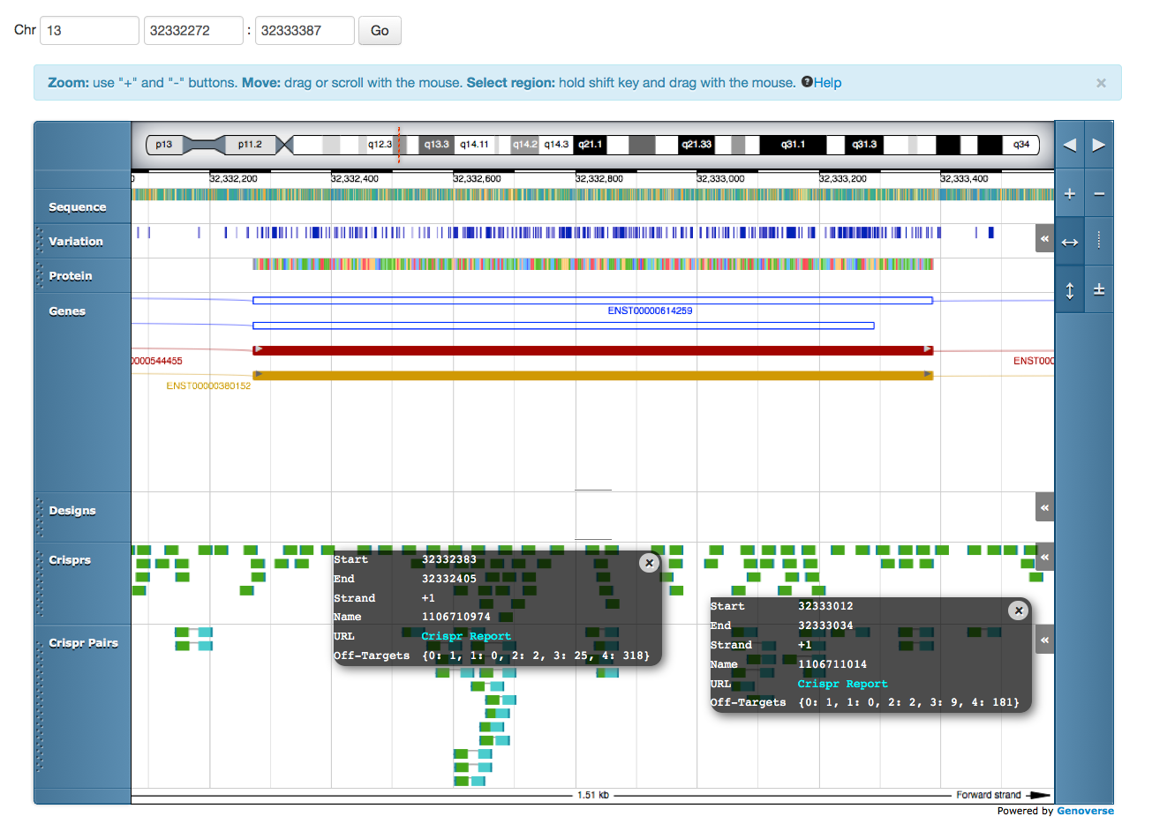
WGE Genoverse Genome Browser

Slide 16
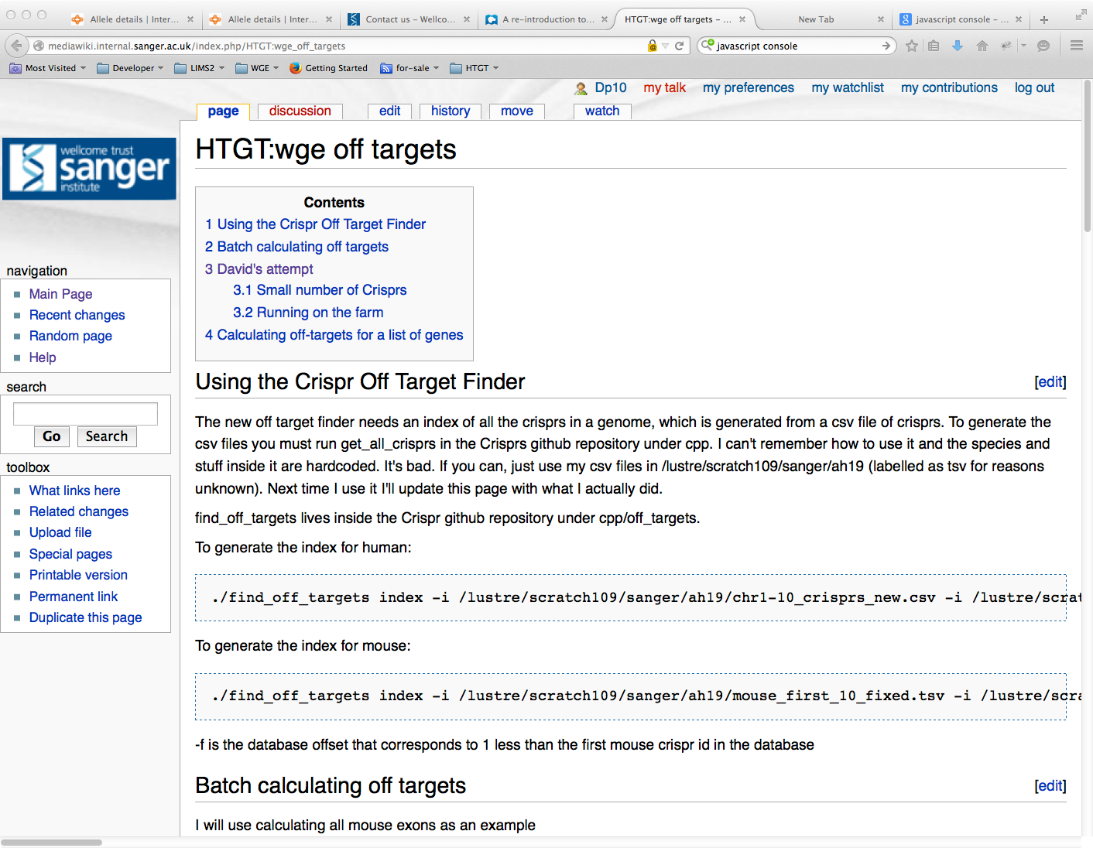
Wiki Documentation

Slide 17
People
Informatics Group
Anna Farne
Tiago Grego
Saj Pereira
Andrew Sparkes
Alex Hodgkins
Vivek Iyer
Peter Matthews
Richard Easty
Scientists
Wendy Bushell
Barry Rosen
Mark Thomas
Bill Skarnes

