Slide 1
Stem Cell Engineering Informatics in 2015
Status of LIMS2, HTGT and WGE systems

Slide 2
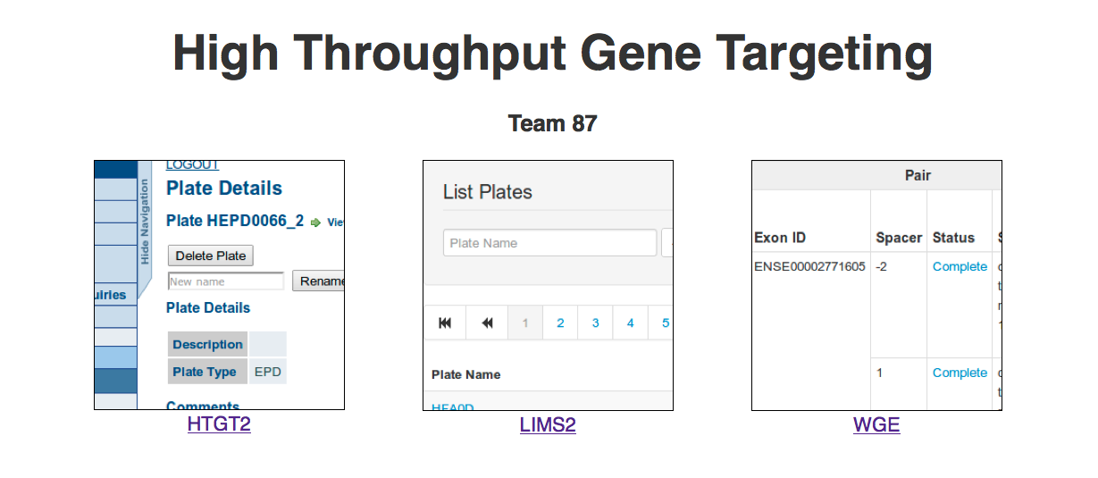
The Landscape
URL: www.sanger.ac.uk/htgt

Slide 3
HTGT
HTGT – High-Throughput Gene Targeting
The ‘original’ LIMS for Team87
Perl/Catalyst/DBI/DBIx::Class/Oracle
Was running on Etch (aka ancient version of Debian)
A ‘legacy’ system supporting Mouse (only)
Essentially relational ‘one well -> one parent’ model
A kind of tree

Slide 4
HTGT2 – The migration
Removal of support for Etch
drives effort to migrate to Ubuntu Precise (VMs)
The painstaking task of gathering all Perl modules required:
Local – multiple subversion repositories re-organised into handful of GIT repositories (using GIT submodules)
htgt-root
htgt-batch
htgt-app

Slide 5
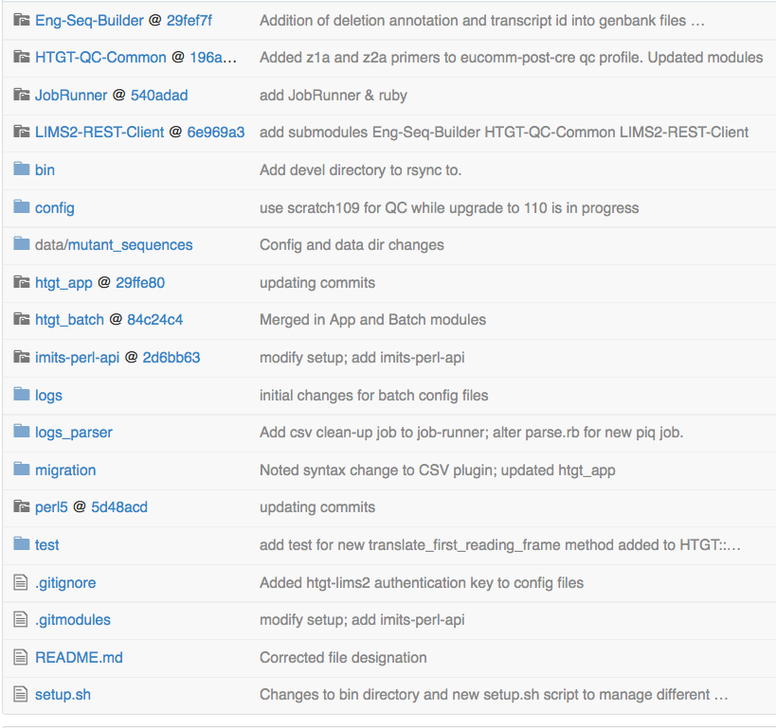
HTGT2 code repo

Slide 6
LIMS2
Supports:
both Human and Mouse species
Gibson Designs
CRISPR/Cas9 support
Runs on Ubuntu 10.04 (Lucid lynx)
Perl 5.10.1 (…old!)
Catalyst/DBIx::Class/PostgreSQL
More use of JavaScript
ExtJS for flexible table widget

Slide 7
LIMS2 - architecture
A well can have … multiple parent wells!
Re-arrays, parameter validation
Shares QC system with HTGT2
For Farm3 submission
Directed Cyclic Graph
Support is limited in DBIx::Class
‘WITH RECURSIVE’ required in PostgreSQL to permit searching across the graph
No support in DBIx::Class … yet
Required for fast reporting

Slide 8
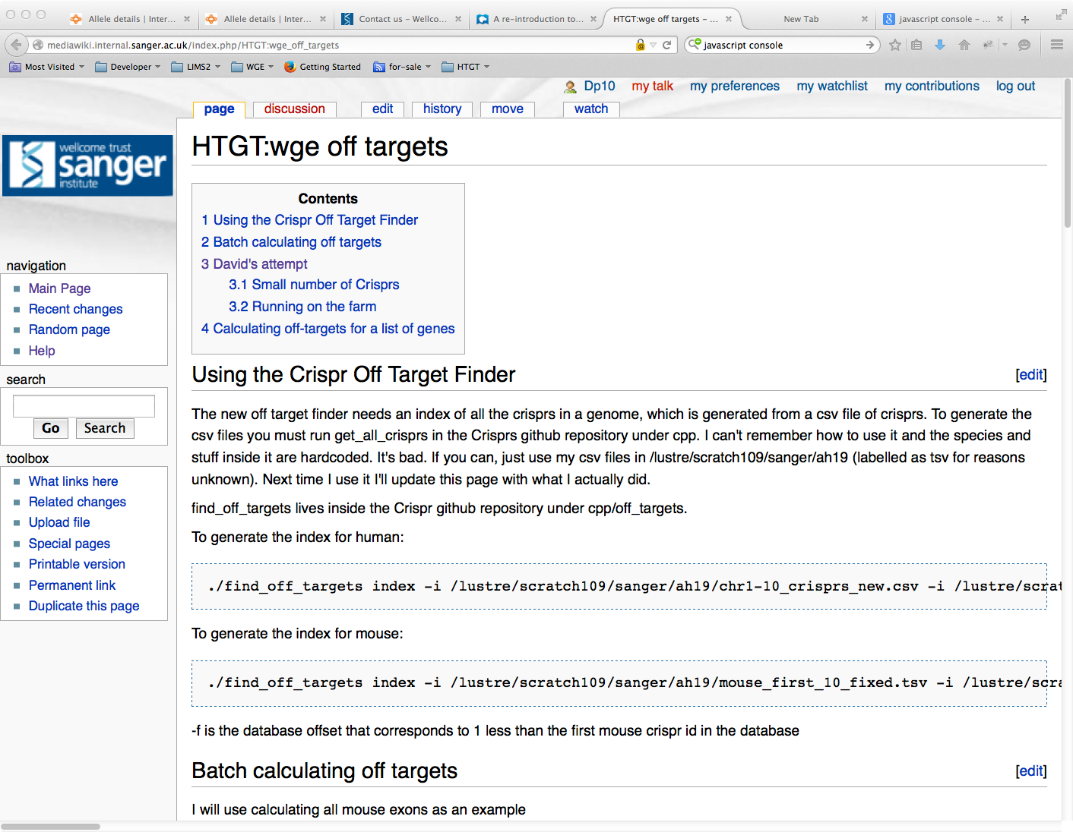
Wiki Documentation

Slide 9
Acknowledgements
Informatics Group
Anna Farne
Tiago Grego
Saj Pereira
Andrew Sparkes
Alex Hodges
Vivek Iyer
Peter Matthews
Richard Easty
Scientists
Wendy Bushell
Barry Rosen
Mark Thomas
Bill Skarnes

