Slide 1
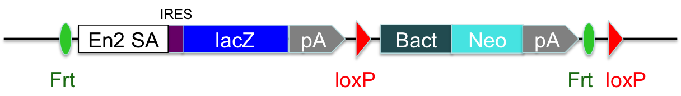
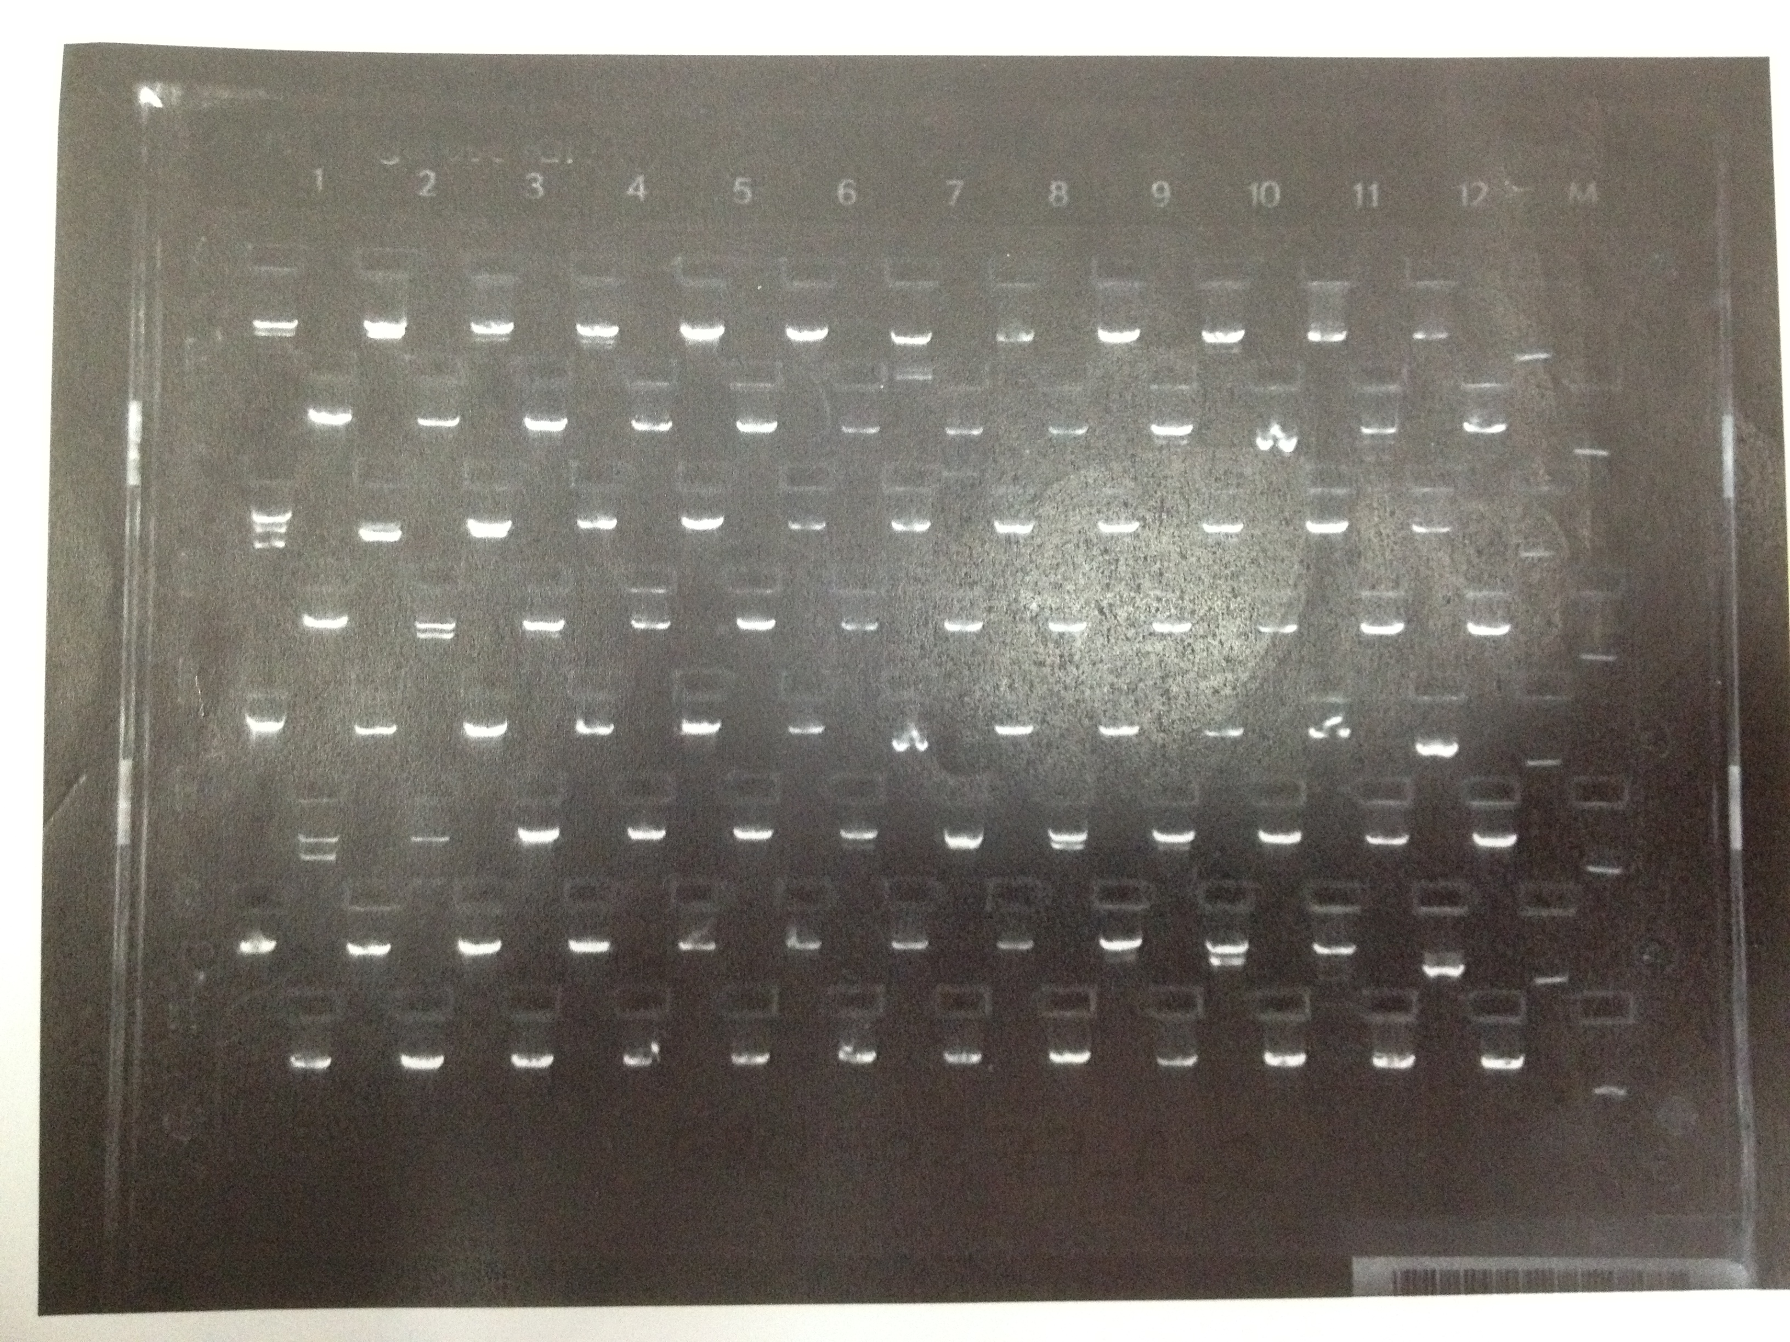

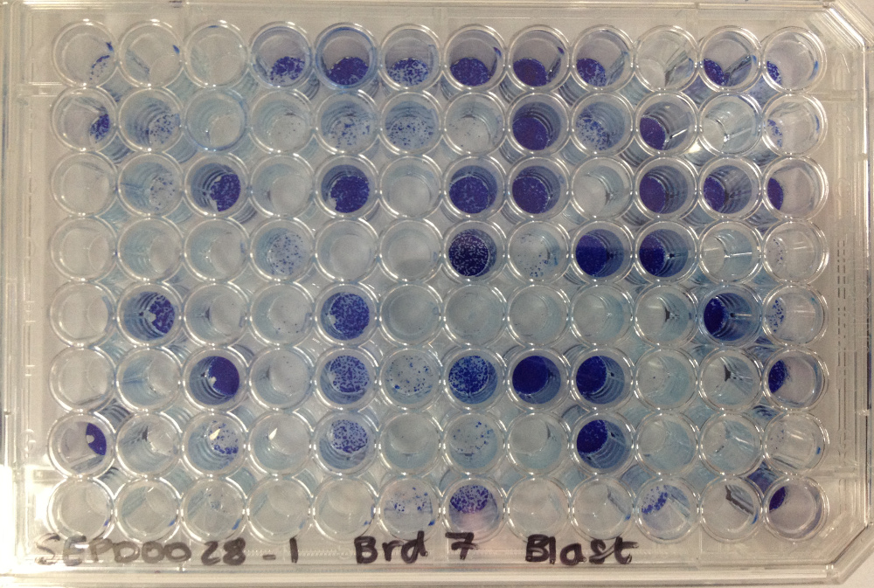
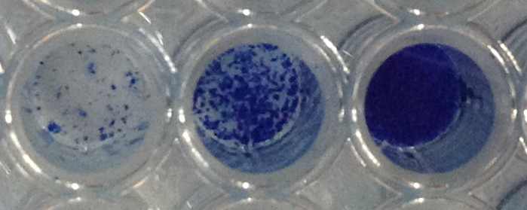
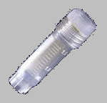
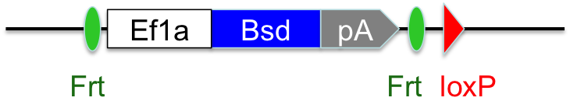
Standard Workflow – Non-essential genes
iCre; iFlp ES cells
‘DNA’
(Neo)
QC: 5μL
E-gel
fail weak pass
Cherry-pick QC passes (1-2μg DNA)
One DNA well per gene per one FEP well.
WT cells (approx. 1x10⁷)
‘FEP_A01’
FIRST ELECTROPORATION:
Target 1st allele. One 10cm dish per gene (i.e. per cuvette well). ‘A01’ is the well id in cuvette (‘A01’-’E05’).
‘FEP’
Genotype (+/- 4-OHT)
5 x 5 cuvette
x96
24hrs no drugs, then 7-10 days selective growth (G418 at 200μg/ml, Neomycin confers resistance).
Neo
Pick 96 colonies into trypsin (round-bottomed wells)
Add media and transfer to flat-bottomed wells plate.
First allele conditional knockout
(Archive ’A’ and QC: Control)
‘FEPD_A01’
grow for 3-4 days then split 1:4 and keep all 4 copies (3 no drugs, 1 Tamoxifen)
QC: Tamoxifen induces Cre expression which excises between loxP sites.
Tamoxifen: CR = 1 DR = 1
Control: CR = 2 DR = 1
(CR = critical region, DR = deleted region)
Archive: To matrix tubes
(no drugs)
QC:
Tamoxifen
QC: Control
(no drugs)
Stain: methylene blue
(no drugs)
low med high
Thaw and expand: QC passes pooled (~4 tubes : 1 well) into one 12-well plate well and then later expanded into two 6-well plate wells (no drugs).
x2
‘XEP_A01’
Archive one well:
1ml Cryo-vial(s)
(no drugs)
one well to 10cm dish (no drugs)
‘DNA’
(Bsd)
A
QC: 5μL
Cherry-pick QC passes
(1-2μg DNA).
E-gel
fail weak pass
Bsd
‘SEP’
SECOND ELECTROPORATION:
Target 2nd allele. One 10cm dish per gene (i.e. per one cuvette well). ‘A01’ is the well id in cuvette (‘A01’ to ‘E05’) i.e. not related to FEP/XEP numbers.
Neo
5 x 5 cuvette
Second allele deletion knockout
24hrs no drugs, then dual drug selection (Neomycin at 150μg/ml and Blasticidin at 15μg/ml) for 7-10 days. Once colonies appear transfer back to one 6-well plate well (no drugs, 24hrs to clear antibiotics before Dox).
Then expand to two 6-well plate wells and treat 3-4 days with Doxycyclin (induces Flp to excise between Frt sites to remove resistance markers).
Archive contents of one well and plate one well at ~1000 cells per dish on two 10cm dishes (no drugs) and grow 7-10 days.
Pick the best 96 colonies in total from both dishes into one trypsin plate (round-bottomed wells). Incubate 20mins then add media and transfer to flat-bottomed wells plate. Grow 2 days then split 1:4 and keep 2 copies (no drugs).
Grow for 2 days then split each 1:4 and keep 6 copies (2 Tamoxifen, 4 no drugs)
Genotype (+/- 4-OHT)
‘SEP_A01’
Archive one well:
Post-Dox in
1ml Cryo-vial(s)
(no drugs)
x2
Heterozygous conditional knockout
(Archive ‘B’ and QC: Control plate)
B
x2
x2
x96
‘SEPD_A01’
x2
x2
x2
Archive:
96 x matrix tubes (no drugs)
QC:
Tamoxifen
QC: Control
(no drugs)

Slide 2
Variation 1– Essential genes
iCre; iFlp ES cells
‘DNA’
(Neo)
QC: 5μL
E-gel
fail weak pass
Cherry-pick QC passes (1-2μg DNA)
One DNA well per gene per one FEP well.
FIRST ELECTROPORATION:
Target 1st allele. One 10cm dish per gene (i.e. per cuvette well). FEP_‘A01’ is the well id in the cuvette (‘A01’ to ‘E05’).
WT cells (approx. 1x10⁷)
‘FEP’
Genotype (+/- 4-OHT)
5 x 5 cuvette
24hrs no drugs, then 7-10 days selective growth (G418 at 200μg/ml, Neomycin confers resistance). Once colonies appear move back to one plate well (12-well or 6-well depending on cell concentration) and treat with Doxycyclin for 2 days.
Then expand to two 6-well plate wells and treat 2 days with Doxycyclin (induces Flp to excise between Frt sites to remove Neo resistance marker).
Then archive one well and plate out one well to two 10cm dishes at ~1000 cells per dish (no drugs).
Neo
First allele conditional knockout
‘FEP_A01’
Archive one well:
Post-Dox in
1ml Cryo-vial(s)
x2
Genotype (+/- 4-OHT)
C
x2
Post-Dox: NeoR gone, both alleles active.
(Archive ‘C’ and QC: Control plate)
x96
Pick 96 colonies into trypsin (round-bottomed wells)
Add media (no drugs) and transfer to flat-bottomed wells plate.
‘FEPD_A01’
Archive: To matrix tubes
(no drugs)
grow for 3-4 days (no drugs) then split 1:4 and keep all 4 copies (3 no drugs, 1 Tamoxifen)
QC:
Tamoxifen
QC: Control (no drugs)
Stain: methylene blue
(no drugs)
low med high
‘XEP_A01’
x2
Archive one well:
1ml Cryo-vial(s)
(no drugs)
one well to 10cm dish (no drugs)
‘DNA’
(Bsd)
D
QC: 5μL
Genotype (+/- 4-OHT)
E-gel
fail weak pass
‘SEP_A01’
SECOND ELECTROPORATION:
Target 2nd allele. One 10cm dish per gene (i.e. per one cuvette well). ‘A01’ is the well id in the cuvette (‘A01’ to ‘E05’) i.e. not related to FEP/XEP numbers.
Bsd
‘SEP’
Second allele deletion knockout
(Archive ‘D’ and QC: Control plate)
5 x 5 cuvette
x96
24hrs no drugs, then Blasticidin at 15μg/ml for 7-10 days.
Pick 96 colonies into trypsin (round-bottomed wells)
Add media (Blasticidin) and transfer to flat-bottomed wells plate.
Grow for 2 days (Blasticidin) then split each 1:4 and keep 6 copies (4 no drugs, 2 Tamoxifen)
‘SEPD_A01’
x2
x2
x2
Archive:
96 x matrix tubes (no drugs)
QC:
Tamoxifen
QC: Control (no drugs)

Slide 3
Variation 2 – Non-essential genes
iCre; iFlp ES cells
‘DNA’
(Bsd)
QC: 5μL
E-gel
fail weak pass
Cherry-pick QC passes (1-2μg DNA)
One DNA well per gene per one FEP well.
WT cells (approx. 1x10⁷)
‘FEP’
‘FEP_A01’
FIRST ELECTROPORATION:
Target 1st allele. One 10cm dish per gene (i.e. per cuvette well). ‘A01’ is the well id in the cuvette (‘A01’ to ‘E05’).
Genotype (+/- 4-OHT)
5 x 5 cuvette
Bsd
x96
24hrs no drugs, then 7-10 days selective growth (Blasticidin, Bsd confers resistance).
First allele deletion knockout
(Archive plate, Archive ‘E’ and QC: Control)
Pick 96 colonies into trypsin (round-bottomed wells)
Add media and transfer to flat-bottomed wells plate.
‘FEPD_A01’
grow for 3-4 days then split 1:3 and keep all 3 copies (3 no drugs)
Archive: To matrix tubes
(no drugs)
QC: Control (no drugs)
Stain: methylene blue
(no drugs)
low med high
Thaw and expand: QC passes pooled (~4 tubes : 1 well) into one 12-well plate well (no drugs) and then later expanded into two 6-well plate wells (no drugs).
‘XEP_A01’
x2
Archive one well:
1ml Cryo-vial(s)
(no drugs)
one well to 10cm dish (no drugs)
‘DNA’
(Neo)
QC: 5μL
E
Cherry-pick QC passes
(1-2μg DNA).
E-gel
fail weak pass
Bsd
‘SEP’
SECOND ELECTROPORATION:
Target 2nd allele. One 10cm dish per gene (i.e. per one cuvette well). ‘A01’ is the well id in the cuvette (‘A01’ to ‘E05’) i.e. not related to FEP/XEP numbers.
Neo
5 x 5 cuvette
Second allele deletion knockout
(Post-electroporation, pre-Doxycylin)
24hrs no drugs, then dual drug selection (Neomycin at 200μg/ml and Blasticidin at 10μg/ml). Once colonies appear transfer back to one well on one 6-well plate.
Grow 2 days and expand into two 6-well plate wells with Doxycyclin (induces Flp to excise between Frt sites to remove both resistance markers).
Archive contents of one well and plate one well at ~1000 cells per dish on two 10cm dishes (no drugs) and grow 7-10 days. Pick 96 best colonies (in total) from both dishes.
Genotype (+/- 4-OHT)
‘SEP_A01’
Archive one well:
Post-Dox in
1ml Cryo-vial(s)
x2
Heterozygous conditional knockout
(Archive ‘F’ and QC: Control plate)
F
x2
x2
x96
Pick 96 colonies into trypsin (round-bottomed wells)
Add media (no drugs) and transfer to flat-bottomed wells plate. Grow for 2 days then split 1:4 and keep 2 copies (no drugs).
Grow for 2 days then split each 1:4 and keep 6 copies (4 no drugs, 2 Tamoxifen) and grow for 2 days.
‘SEPD_A01’
x2
x2
x2
Archive:
96 x matrix tubes (no drugs)
QC:
Tamoxifen
QC: Control
(no drugs)

