Slide 1
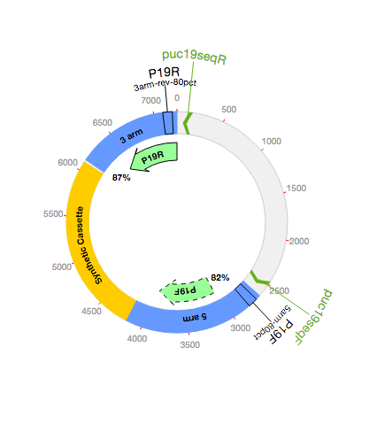
This example QC plasmid map shows:
The synthetic vector with cassette and homology arms shown in colour
Location of the primer target sequence puc19seqR
The region where the P19R read aligns to the synthetic vector
The overall percentage of target bases matched in the P19R alignment
The region where the P19F read must align to the synthetic vector in order to pass QC. The exact criteria are set in the rule ‘5arm-80pct’ in the QC profile
The region where the P19F read aligns to the synthetic vector. In this case a dashed outline shows the alignment has failed QC (it does not satisfy the requirements in the QC profile)
Notes:
Edit this and save as plasmid_map_help.png if the plasmid map view changes

