Slide 1
Website Analytics
Hetal Thakkar

Slide 2
Topic
Project focuses on website analytics identifying below key parameters.
Number of visitors grouping them by weekdays
Number of blog posts grouping them by weekdays
Total pageviews grouping them by weekdays
Identify webpages with total pageviews
Total visitors by country
Visitors by geography location on a map
This project also area of different countries having less number of visitors.

Slide 3
Datasource
Datasource contains statistics of website, usage and their users geography.
Datasource contains below fields,
Landing page (group)
Landing page
Users
Number of Records
Pageviews
Date
Latitude
Longitude
City
Country
Avg. Session Duration

Slide 4
Challenges
Had some challenges to adjust dashboard size with screen size, had to customize from default settings.
Had faced difficulties aligning different tableau sheets in the dashboard, used containers to align them to display in proper order.
Blog posts had to be identified and filtered out with landing page as ‘/Tabitha.html?hootPostID’ from all info given in the website datasource.

Slide 5
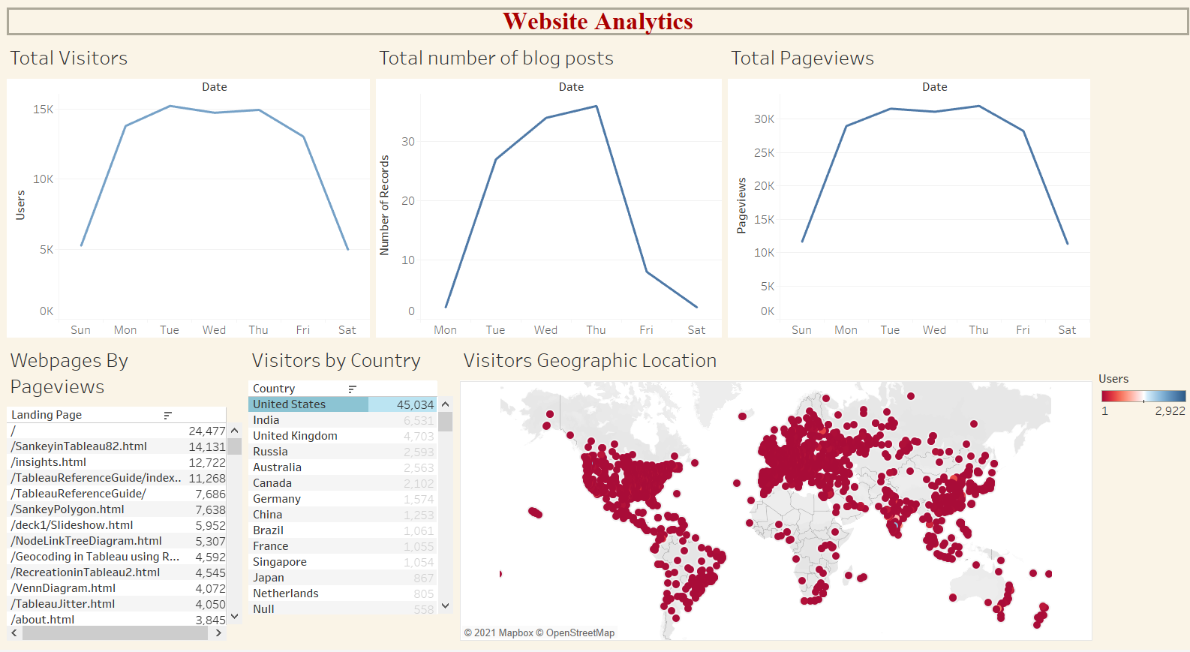
Overall Visualization

Slide 6
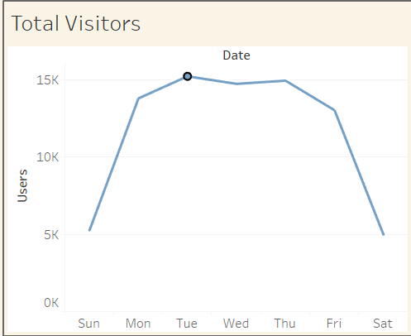
Conclusion
Which weekday the maximum number of visitors has visited the website?
Tuesday the maximum number of 15,225 visitors has visited the website.

Slide 7
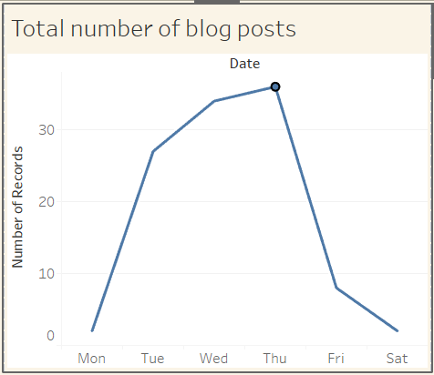
Conclusion (cont.)
Which weekday the maximum post has been posted to the website?
Thursday the maximum post with 36 has been posted to the website.

Slide 8
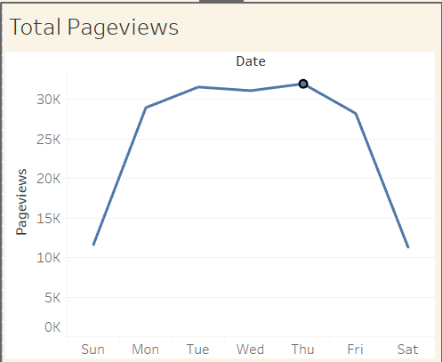
Conclusion (cont.)
Which weekday has the maximum pageviews?
Thursday has the maximum pageviews of 31,996.

Slide 9
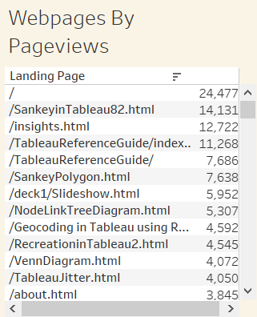
Conclusion (cont.)
Which webpage has the maximum pageviews?
/SankeyinTableau82.html has the maximum pageviews 14,131.

Slide 10
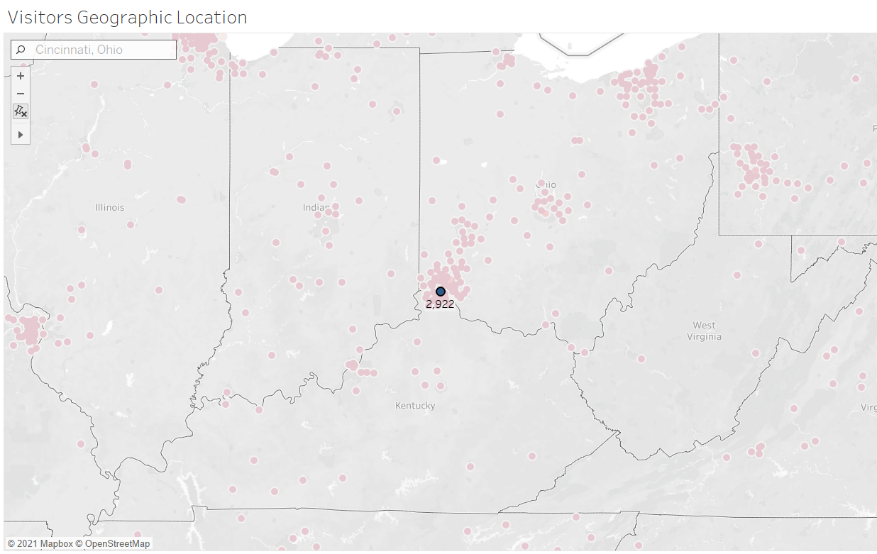
Conclusion (cont.)
Which city, country has maximum visitors who visited the webpages?
Cincinnati, US has the maximum visitors of 2922, who visited the webpages.

Slide 11
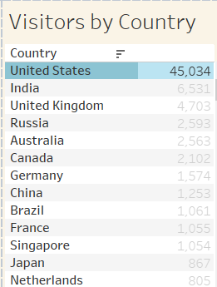
Conclusion (cont.)
Maximum number of visitors are from United States.

