Slide 1
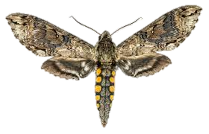
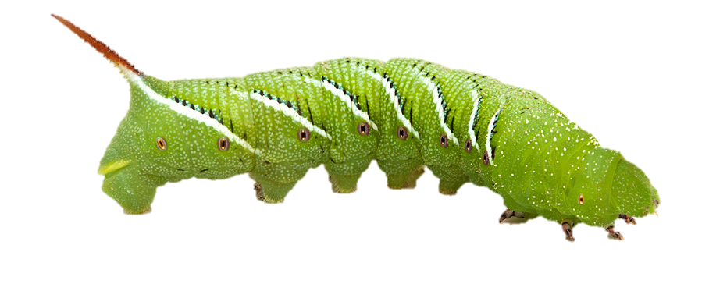
Adulting 101: Exploring developmental gene expression profiles in Tobacco Hornworm (Manduca sexta)
Regan Cross, Marco Lee, Hana Thompson, and Hayden Wainwright
Background
Holometabolous insects (e.g. moths) have morphologically distinct larvae, pupae, and adults
These life history stages often have different ecological niches and specializations^{1,2} (e.g. larvae specialized for feeding, adults for reproduction)
Each stage should have physiological adaptations to maximize fitness, reflected in differential gene expression across life stages (e.g. reproductive genes only expressed in adults³)
Goals
Explore how tobacco hornworm Manduca sexta regulates its physiology through gene expression at different life stages
Examine which genes change most in expression between larvae and adult using transcriptomic data from different tissues of M. sexta at different life stages
Determine which physiological functions undergo most change during transition to adulthood
Significance
Holometabolous insects have existed for 315 million years, so this is an evolutionarily stable trait⁵
By identifying genes that are differentially expressed between life stages and may play a role during metamorphosis, we can better understand genetic mechanisms behind metamorphosis
M. sexta larvae are important agricultural pests, feeding on solanaceous plants (e.g. tobacco, tomato), so studying M. sexta genetics could aid in development of specific pesticides to mitigate agricultural impacts
Data
Data sourced from study examining 67 RNA-seq datasets of 15 544 genes from 8 tissues across 9 life stages of Manduca sexta⁴
Each transcript represents a different tissue-life stage combination
For each transcript we have the FPKM (fragments per kilobase per million mapped reads) for each gene, which represents the level of gene expression
References
[1] Chapman, R. F. 2013. The insects: Structure and function. Simpson SJ, Douglas AE, editors. Cambridge University Press.
[2] Truman JW. 2019. The evolution of insect metamorphosis. Curr Biol. 29(23): R1252–R1268.
[3] Zhao J, Sun Y, Xiao LB, Tan YA, Bai LX. 2016. Molecular characterization and expression of vitellogenin gene from Spodoptera exigua exposed to cadmium stress. Gene. 593(1): 179–184.
[4] Cao, X., & H. Jiang. 2017. An analysis of 67 RNA-seq datasets from various tissues at different stages of a model insect, Manduca sexta. BMC Genomics 18: 796.
[5] Nel, A., P. Roques, P. Nel, A. A. Prokin, T. Bourgoin, K. Prokop, J. Szwedo, D. Azar, L. Desutter-Grandcolas, T. Wappler, R. Garrouste, D. Coty, D. Huang, M. S. Engel, & A. G. Kirejtshuk. 2013. The earliest known holometabolous insects. Nature 503:257–261.

