Slide 1
Introduction
Thread-Level parallelism
Have multiple program counters
Uses MIMD model
Targeted for tightly-coupled shared-memory multiprocessors
For n processors, need n threads
Amount of computation assigned to each thread = grain size
Threads can be used for data-level parallelism, but the overheads may outweigh the benefit
Slides adapted from Comp. Arch A Quantitative Approach Hennessy and Patterson

Slide 2
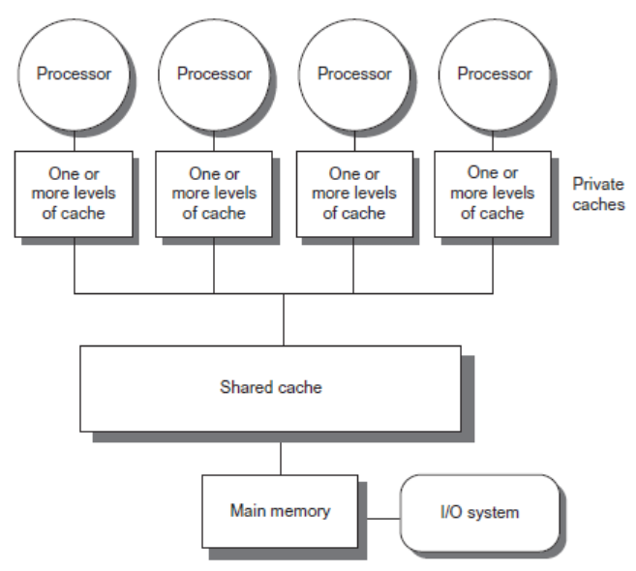
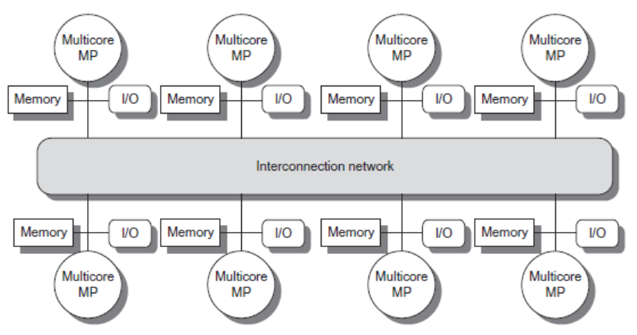
Architectures
Symmetric multiprocessors (SMP)
Small number of cores
Share single memory with uniform memory latency
Uses Snoopy Cache Protocols
Distributed shared memory (DSM)
Memory distributed among processors
Non-uniform memory access/latency (NUMA)
Processors connected via direct (switched) and non-direct (multi-hop) interconnection networks
Uses Directory Cache Protocol
Slides adapted from Comp. Arch A Quantitative Approach Hennessy and Patterson

Slide 3
Cache Coherence
Coherence
All reads by any processor must return the most recently written value
Writes to the same location by any two processors are seen in the same order by all processors
Consistency
When a written value will be returned by a read
If a processor writes location A followed by location B, any processor that sees the new value of B must also see the new value of A
Slides adapted from Comp. Arch A Quantitative Approach Hennessy and Patterson

Slide 4
Enforcing Coherence
Coherent caches provide:
Migration: movement of data
Replication: multiple copies of data
Cache coherence protocols
Directory based
Sharing status of each block kept in one location
Snooping
Each core tracks sharing status of each block
Slides adapted from Comp. Arch A Quantitative Approach Hennessy and Patterson

Slide 5
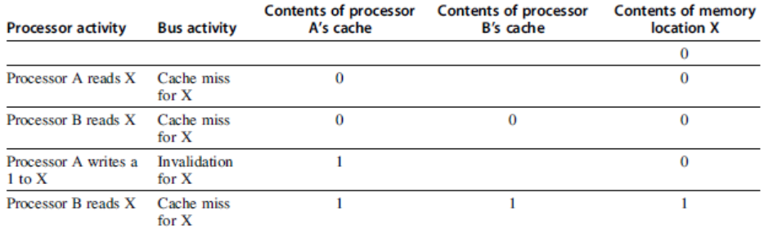
Snoopy Cache Protocols
Write invalidate
On write, invalidate all other copies
Use bus itself to serialize
Write cannot complete until bus access is obtained
Write update
On write, update all copies
Slides adapted from Comp. Arch A Quantitative Approach Hennessy and Patterson

Slide 6
Snoopy Coherence Protocols
Locating an item when a read miss occurs
In write-back cache, the updated value must be sent to the requesting processor
Cache lines marked as shared or exclusive/modified <- Caution: “modified” takes on different meanings for different protocols
Only writes to shared lines need an invalidate broadcast
After this, the line is marked as exclusive
Common Snoopy Protocols
MSI: Modified, Shared, Invalid
MESI: Modified, +(Exclusive), Shared, Invalid
MOESI: Mod, +(Owned), Exc. Shared, Invalid
Slides adapted from Comp. Arch A Quantitative Approach Hennessy and Patterson

Slide 7
Coherence Protocols
Every multicore with >8 processors uses an interconnect other than bus
Makes it difficult to serialize events
Write and upgrade misses are not atomic
How can the processor know when all invalidates are complete?
How can we resolve races when two processors write at the same time?
Solution: associate each block with a single bus
Slides adapted from Comp. Arch A Quantitative Approach Hennessy and Patterson

Slide 8
Directory Based Protocols
Snooping schemes require communication among all caches on every cache miss
Limits scalability
Another approach: Use centralized directory to keep track of every block
Which caches have each block
Dirty status of each block
Implement in shared L3 cache
Keep bit vector of size = # cores for each block in L3
Not scalable beyond shared L3
Slides adapted from Comp. Arch A Quantitative Approach Hennessy and Patterson

