Slide 1
Processor-In-Memory (PIM) Architectures
Domain Specific Architectures
Guest Lecturer
MD Arafat Kabir
Summer Graduate, PhD
Advisor: Dr. David Andrews
Dissertation: Deep-learning FPGA accelerator using PIM architecture

Slide 2
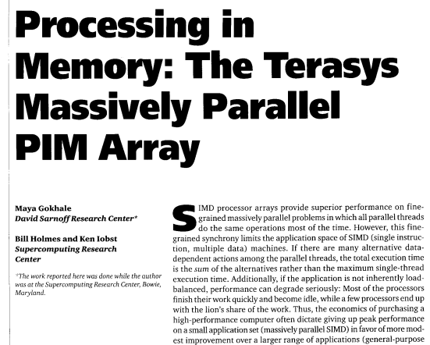
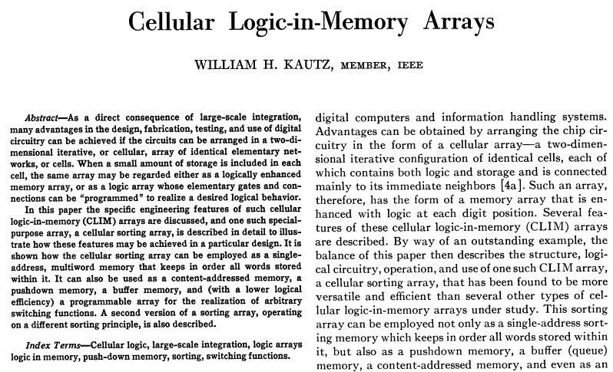
Earliest Publications
Computer, 1995
IEEE Transactions on Computers, 1969

Slide 3
What is Processor-in-Memory (PIM)
Main idea: Put memory and processor together (same chip)
PIM
SRAM
SRAM
CPU
RAM
ALU
ALU
Address
Regfile
SRAM
SRAM
SRAM
SRAM
Data
SRAM
SRAM
ALU
ALU
ALU
Classic von Neumann Architecture
PIM Architecture

Slide 4
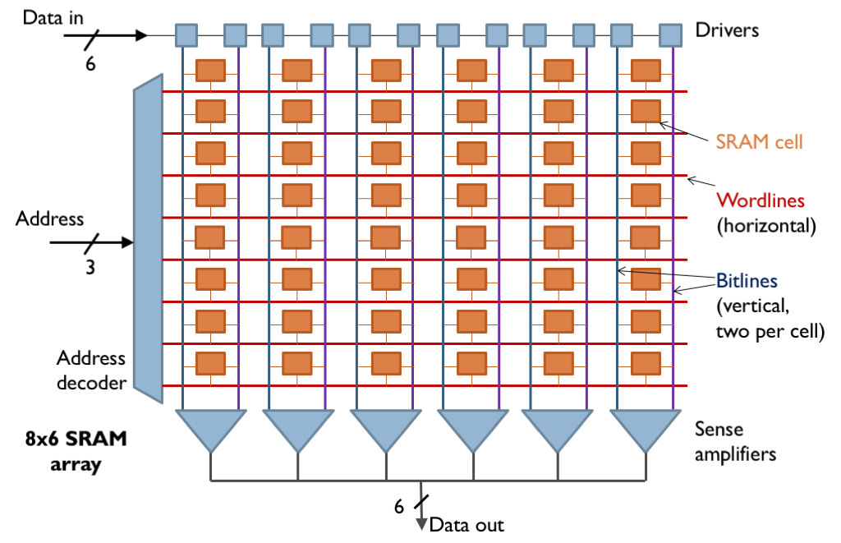
SRAM Array
Image source: Google search

Slide 5
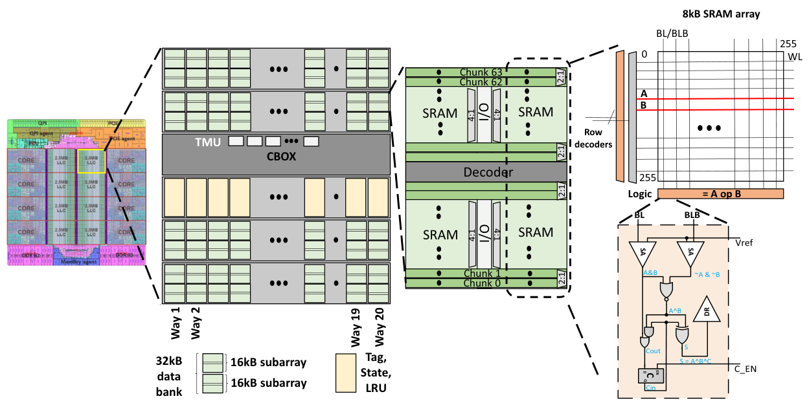
A Practical PIM Design: Cache-based
C. Eckert, X. Wang, J. Wang, A. Subramaniyan, R. Iyer, D. Sylvester, D. Blaauw, and R. Das, “Neural Cache: Bit-Serial in-Cache Acceleration of Deep Neural Networks,” in 2018 ACM/IEEE 45Th annual international symposium on computer architecture (ISCA), 2018, pp. 383–396.

Slide 6
Why Do We Need PIM Architectures?
What happens in the CPU when you add two vectors?
C = A+B; A,B,C are vectors of 1000 elements
result[i] = array1[i] + array2[i];
read array1[i] to register R1
read array2[i] to register R2
add R1, R2 and save to R3
Write R3 to result[i]
for (int i = 0; i < size; i++)
increment i (R4)
read size to register R5
compare R4, R5
make a conditional jump
Most of the instructions (90%) are spent on control sequence!
void add_vector(int array1[], int array2[], int result[], int size)
{
for (int i = 0; i < size; i++) {
result[i] = array1[i] + array2[i];
}
}

Slide 7
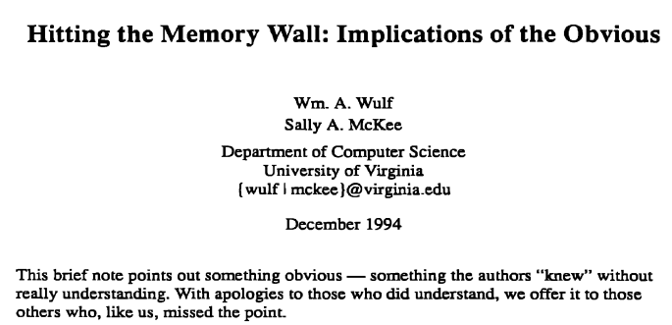
Why Do We Need PIM Architectures?
“The Memory Wall”
Memory operations (read/write) are significantly slower than CPU operations.
Cycle latency from Wikipedia
Corei9: 0.16 ns
DDR5: 14 ns

Slide 8
Why Do We Need PIM Architectures?
Memory access cost
100x slower
100x more energy
Narrow bus connection
Limited bus frequency
Limited number of pins
One word at a time
Application requirements
Different access patterns
Domain-specific PIMs,
Smaller arrays can be faster
PIM can minimize energy cost
Not limited by bus frequency or pin count
Match application access pattern
Massive parallelism

Slide 9
Key Takeaway
PIM architectures can help with
memory-intensive applications.

