Slide 1
Terrible Presentations (…and how to not give one)
Katherine Compton
Dept. of ECE
UW-Madison
Mark L. Chang
Dept. of ECE
Olin College of Eng.
http://www.ece.wisc.edu/%7Ekati/PresentationGuide.ppt
Modifications by Kia Bazargan, Univ. of Minnesota

Slide 2
Tips For Presenting
Part I: You!
Attitude, habits, do’s and don’ts
Practice, practice, practice
Part II: flow of the presentation
Logical ordering of material
Audience, audience, audience
Revise, revise, revise
Part III: Slide formats
Best format for each topic
Graphs, text, animation

Slide 3
Part I: YOU!

Slide 4
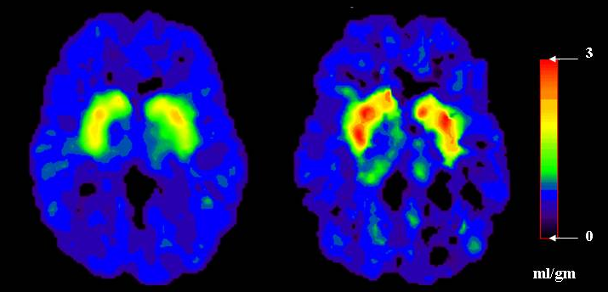
Powerpoint Addiction
YOU are the presentation, not the slides!
Don’t just read off your slides
Engage the audience
Look at them
Point at things
Modulate your voice

Slide 5
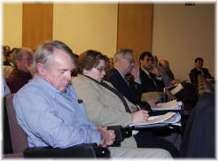
Dead Man Talking
Are you staring…
at your advisor/boss?
at your laptop?
at the screen?
Are you hiding behind the podium?
Are your hands/face motionless?
IF SO… you’re probably BORING!

Slide 6

Is This Thing On <tap tap>?
Feedback kills people!
Microphone: middle of your chest
Not 2mm from your mouth
Modulate your voice evenly

Slide 7
Your “Moves”
You have a set of “moves” that repeat during your talk
Do a practice for friends
Make sure they’re not too nice
What are your hand gestures?
Make sure they aren’t silly looking
Don’t point with you middle finger
From the movie“Hitch”

Slide 8
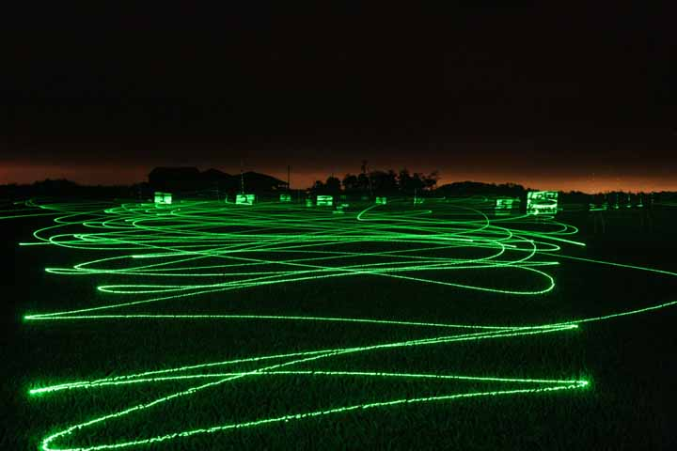
Common Laser Pointer Moves
The circle, the underline
DO NOT POINT AT EVERYTHING
DO NOT POINT AT AUDIENCE!!!
Don’t point at your laptop screen
They can’t see it

Slide 9
Ummmm… The… Uh… Yeah.
Practice makes perfect
Do not read your slides like a script
Most people lose 20 IQ points in front of an audience

Slide 10
How to Handle Questions…
If you don’t understand the question, don’t be shy: ask for clarification
If the question is too long/complex, simplify and repeat for the audience
Short answer is the key: get to the point
Handling questions needs practice

Slide 11
Part II: Flow of the Presentation

Slide 12
Slide Design
Goals:
Convey the necessary information
Understandable for THEM
Take-away message
Avoid:
Stuffing their heads with EVERY DETAIL of your work

Slide 13
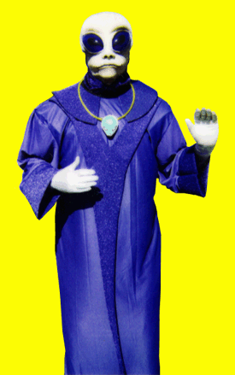
Know Your Audience
Their background?
How much motivation for your work?
How detailed should you get?
Go over your material: do they know where this part fits in the big picture?

Slide 14
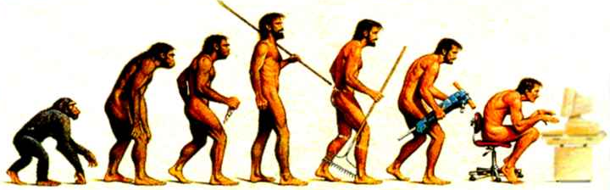
Revise, Revise, Revise
When preparing slides: multiple iterations
Logical flow of material
Ask “why did I add this slide?”
Trim down material
Ask “what might be ambiguous in this slide?”
Ask a friend to listen to your talk

Slide 15
Anatomy of a Presentation
Intro / motivation
Why they should listen to this talk
WHAT you are trying to solve
Outline
Main work
Results
Conclusion / summary
Bring people back if they zoned out
Remind them why you’re great
Give “selling” points here: 30x performance increase with only 10% area penalty

Slide 16
Part III: Slide Format

Slide 17
README.TXT
Do not attempt to put all the text, code, or explanation of what you are talking about directly onto the slide, especially if it consists of full, long sentences. Or paragraphs. There’s no place for paragraphs on slides. If you have complete sentences, you can probably take something out.
If you do that, you will have too much stuff to read on the slide, which isn’t always a good thing.
Like the previous slide, people do not really read all the stuff on the slides.
That’s why it’s called a “presentation” and not “a reading” of your work
Practice makes perfect, which is what gets you away from having to have all of you “notes” in textual form on the screen in front of you.
Utilize the Notes function of PowerPoint, have them printed out for your reference.
The audience doesn’t need to hear the exact same thing that you are reading to them.
The bullet points are simply talking points and should attempt to summarize the big ideas that you are trying to convey
If you’ve reached anything less than 18 point font, for God’s sake, please:
Remove some of the text
Split up the text and put it on separate slides
Perhaps you are trying to do much in this one slide?
Reading a slide is annoying.
You should not simply be a text-to-speech converter.

Slide 18
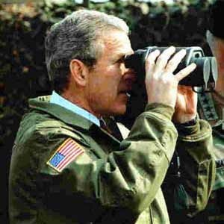
“you probably can’t see this, but…”
Your audience is far from the screen
Lucida Sans
32 pt
28 pt
24 pt
20 pt
18 pt
16 pt
14 pt
12 pt
10 pt
Tahoma
32 pt
28 pt
24 pt
20 pt
18 pt
16 pt
14 pt
12 pt
10 pt
TNR
32 pt
28 pt
24 pt
20 pt
18 pt
16 pt
14 pt
12 pt
10 pt
Courier
32 pt
28 pt
24 pt
20 pt
18 pt
16 pt
14 pt
12 pt
10 pt

Slide 19
“you probably can’t see this, but…”
10
6
Energy
Virtex
2
HARP
alu4
apex2
apex4
des
ex1010
ex5p
misex3
pdc
seq
spla

Slide 20
Picture This
System Architecture
There’s a CPU, a RAM and an FPGA and they’re all connected
- The FPGA connects to the
CPU’s data cache
- The bus is 32 bits wide
- Blah blah blah blah
You have to visualize it yourself
System Architecture
CPU
data cache
main
memory
32
32
FPGA

Slide 21
Example Animation
Compute-intensive sections on hardware
Hardware reconfigured for each
wwwwwwwwwww
wwwwwwwwwww
wwwwwwwww
wwwwwwwwwwwwwww
wwwwwwwwww
wwwwwwwwwwwwww
w
wwwwwwwwwwwwwww
wwwwwwwwww
wwwwwwwwwwwww
wwwwwwwwwwwwww
wwwwwwwwww
wwwwww
wwwwwwwwwwwww
w
w
Source code
FPGA

Slide 22
Example Animation
Compute-intensive sections on hardware
Hardware reconfigured for each
wwwwwwwwwww
wwwwwwwwwww
wwwwwwwww
wwwwwwwwwwwwwww
wwwwwwwwww
wwwwwwwwwwwwww
w
wwwwwwwwwwwwwww
wwwwwwwwww
wwwwwwwwwwwww
wwwwwwwwwwwwww
wwwwwwwwww
wwwwww
wwwwwwwwwwwww
w
w
Source code
FPGA

Slide 23
You are not Pixar Studios
Previous slide(s) used “animation”…
Use only where it is USEFUL
Know if presentation system will handle
Different versions of PowerPoint, Macs, etc.
Or use multiple slides to safely animate
Flip-book style
Animation
Use it sparingly
Can
(it can be annoying)
Be Very
Distracting

Slide 24
And Sometimes You Are Pixar!
Size | 16 | 8192 | Δ
Pins | 448 | 229K
Fly | 32 | 53K
Mult | 96 | 159K
Add | 288 | 480K
Shift | 0 | 0
1
1
1
1
2
2
2
2
3
3
3
3
4
4
4
4
5
5
5
5
6
6
6
6
7
7
7
7
A pipelined version
IO Bound
100% Efficient
8
8
8
8
9
9
9
9
10
10
10
10
11
11
11
11
12
12
12
12
13
13
13
13
14
14
14
14
15
15
15
15
16
16
16
16
Slide from: “A Systolic FFT Architecture for Real Time FPGA Systems”, P. Jackson, C. Chan, C. Rader, J. Scalera, and M. Vai, HPEC’04
Notes:
The parallel implementation is easily pipelined. This architecture would be 100% efficient if it could be supplied with enough data. However, the number of input pins needed to keep an 8192-point FFT would be 65606, with only 8-bit inputs. Also, A/D converters cannot keep up with this rate of data generation. Thus, a serial design is often used to match with the serial input.

Slide 25
Mommy, my eyes are burning!
Can you look at this for 45 minutes?
Colors look different on every LCD projector
Colors look different between transparencies and projector
Side note: if printing slides, may want to choose white background to save ink!

Slide 26
I See A Ghost
More contrast on monitor than projector
Different projectors == different results
Colors to avoid with white are:
Light Green
Light Blue
Pale Yellow
Your slides should have good contrast
Usually can’t read this…

Slide 27
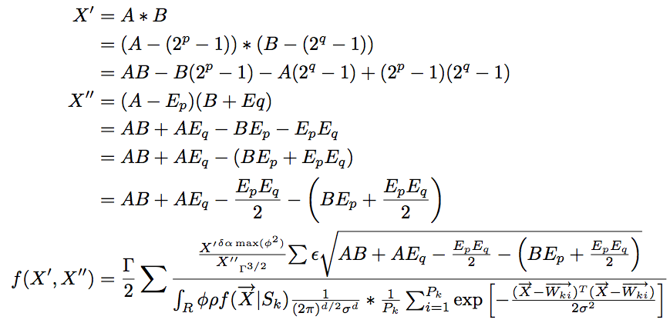
Equations
Ummm… okay…

Slide 28
Use Simple Examples
This isn’t one. It doesn’t help.
BB
D
N
l
g
h
B
A
a
FF
EE
HH
q
V
o
c
GG
F
E
H
n
DD
VV
YY
R
p
II
m
NN
h
K
KK
JJ
Y
OO
k
CC
L
I
t
J
O
TT
QQ
C
X
LL
f
Q
PP
ZZ
M
MM
P
Z
RR
XX
x
r
y
T
u
SS
d
z
G
WW
w
UU
S
W
s
v
b
AA
U
e
j

Slide 29
Sure you want to use a table?
Circuit | PPFF | VPR
 | Delay | Delay
ex5p | 7.69 | 8.02
apex4 | 7.51 | 6.69
misex3 | 7.25 | 7.48
alu4 | 6.72 | 6.84
des | 9.51 | 9.52
seq | 8.12 | 8.10
apex2 | 8.33 | 8.91
spla | 12.3 | 13.6
pdc | 14.4 | 15.4
ex1010 | 13.8 | 15.1
Avg. | 0.97 | 1
8 out of 10 circuits yield better delay.
3% better delay on average, max 9.5%
This slide not that easy to digest
Graphs are your friends!

Slide 30
Graphs Can Also Be The Enemy

Slide 31
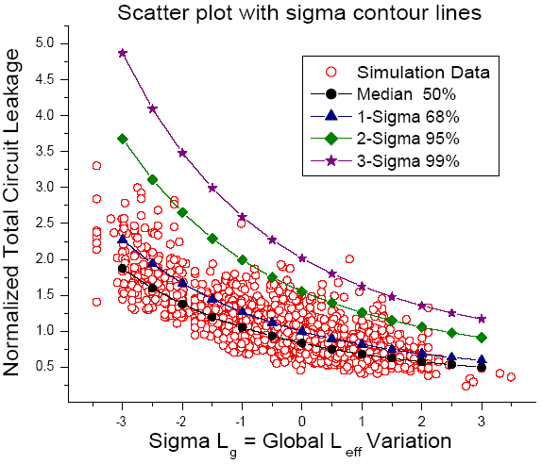
Graphs
What type of graph?
Scatter plot?
Bar chart?
Labels/axis visible?
Define what the axis are showing
Larger values good or bad? (e.g., speedup vs. runtime)
Don’t just show the graph, talk about trends, meaning
Scatter plot from: Rajeev R. Rao, Anirudh Devgan, David Blaauw, Dennis Sylvester, “Parametric Yield Estimation Considering Leakage Variability”, DAC 2004.

Slide 32
Bad Presentations
Audience won’t see your work as great
But will make fun of you from the back row
Those are some NASTY colors…
What does that slide say?
Dunno, I’m playing minesweeper
Hey – it matches my tie.
Please let it be OVER…
zzz

Slide 33
Good Presentations
Interesting topic, explained at audience’s level
Slides are understandable and easy to see
Good presentations reflect well on speaker!
I wonder if this technique would work for my problem
I understood this one!
You should with a PhD…
Let’s talk to them at the break
But it’s outside my main area
I never thought of that!
Interesting

