Slide 1
The Decline of GPT’s and Feasibility of Specialization
CSCE 4013/5012 Domain Specific Architectures
Professor David Andrews
Lecture materials drawn from the following two papers:
N. Thompson, S, Spanuth “The Decline of Computers as a General Purpose Technology” Communications of the ACM, March 2021
A. Fuchs, D. Wentzlaff, “The Accelerator Wall: Limits of Chip Specialization”, HPCA 2019

Slide 2

The Decline of GPT’s and Feasibility of Specialization
Recap:
1. Moore’s Law is slowing and Dennard Scaling ended.
2. Manycores: Moore’s Law applied to increasing GP processor cores.
3. Heterogeneous Manycores: Mix of cores to increase energy efficiency and exploit types of parallelism within an application.
3. Domain Specific Architectures: A new era of specialization.
Machine Learning Thundering Hurd

Slide 3
N. Thompson, S, Spanuth “The Decline of Computers as a General Purpose Technology” Communications of the ACM, March 2021
Key Insights
1. Moore’s Law was driven by technical achievements and a “general purpose technology” (GPT) economic cycle where market growth and investments in technical progress reinforced each other. These created strong economic incentives for users to standardize to fast-improving CPUs, rather than designing their own specialized processors.
2. Today, the GPT cycle is unwinding, resulting in less market growth and
slower technical progress.
3. As CPU improvement slows, economic incentives will push users toward specialized processors, which threatens to fragment computing. In such a computing landscape, some users will be in the ‘fast lane,’ benefiting from customized hardware, and others will be left in the ‘slow lane,’ stuck on CPUs whose progress fades

Slide 4
The end of GPT’s
General Purpose Technologies (GPTs): Products with broad applicability. Programmable CPU’s.
Lifecycle of GPTs
-Use case will grow (Expansion and growing Economics)
-Eventually progress slows
-Will be displaced in some niches
-Displacement will undermine economic model. When this
happens applications will move to specialized processors.
Has this already happened ?

Slide 5
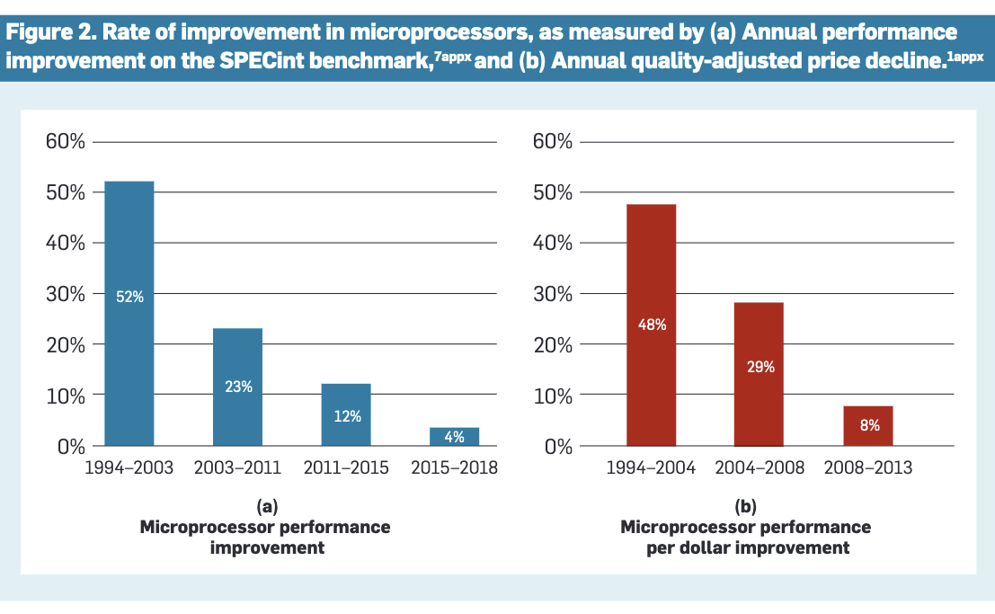
Rate of Improvements slowed

Slide 6
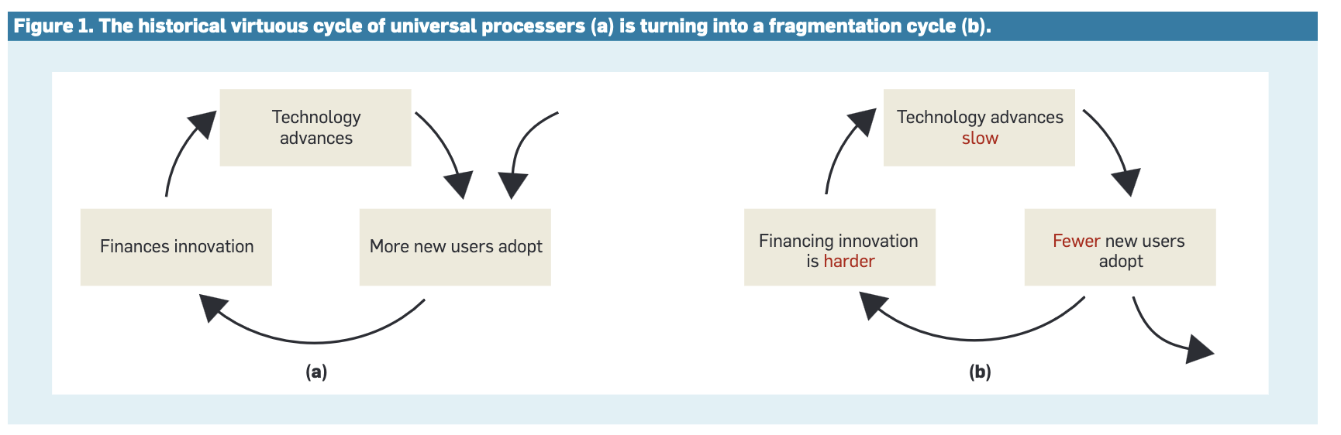
From Virtuous to Fragmentation
PC replacement 4 -> 5-6 years
Smartphones 23 months -> 31 months
Some may skip generational replacements

Slide 7

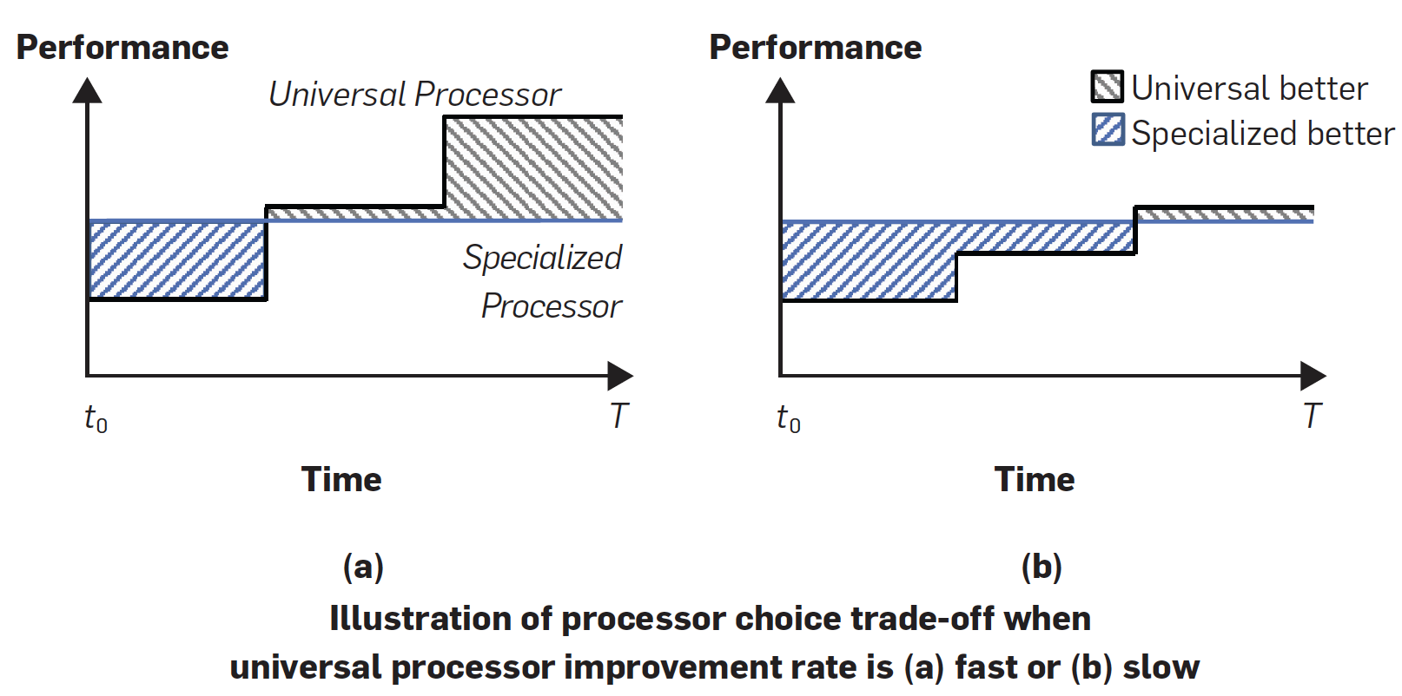
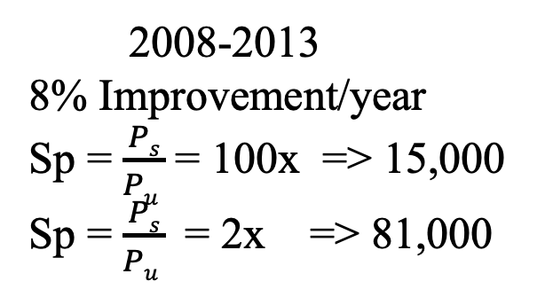
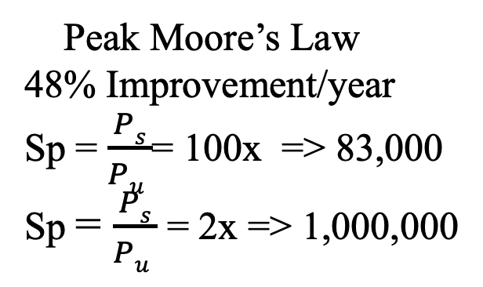
“That’s mathematics son! You can argue with me but you cant argue with figures”
Peak Moore’s Law
48% Improvement/year
Sp = $\frac{Ps}{Pu }$= 100x => 83,000
Sp = $\frac{Ps}{Pu }$= 2x => 1,000,000
2008-2013
8% Improvement/year
Sp = $\frac{Ps}{Pu }$= 100x => 15,000
Sp = $\frac{Ps}{Pu }$= 2x => 81,000
N. Thompson, S. Spanuth, Decline of Computers as a General Purpose Technology, Comm of the ACM March 2021

Slide 8
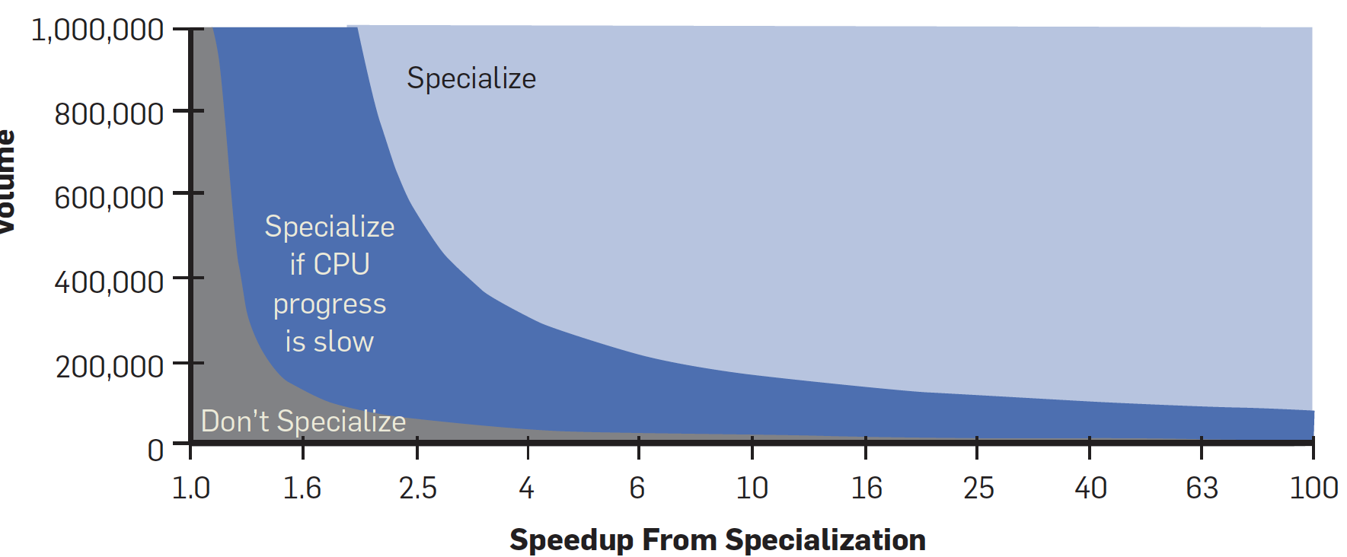
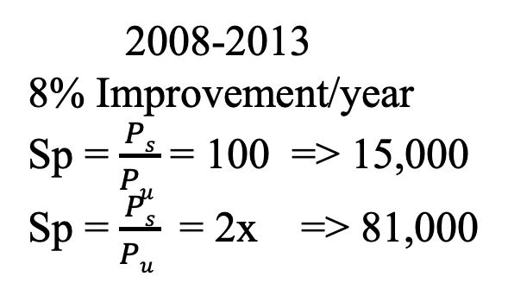
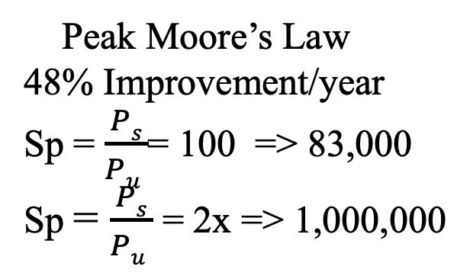
“That’s mathematics son! You can argue with me but you cant argue with figures”
Peak Moore’s Law
48% Improvement/year
Sp = $\frac{Ps}{Pu }$= 100 => 83,000
Sp = $\frac{Ps}{Pu }$= 2x => 1,000,000
2008-2013
8% Improvement/year
Sp = $\frac{Ps}{Pu }$= 100 => 15,000
Sp = $\frac{Ps}{Pu }$= 2x => 81,000
N. Thompson, S. Spanuth, Decline of Computers as a General Purpose Technology, Comm of the ACM March 2021

Slide 9
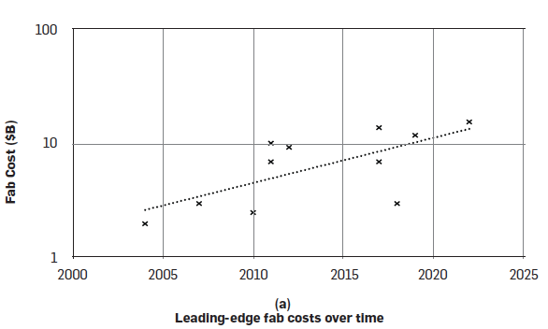
Its Economics
Fab Costs 13%/year.
Moore’s ”Second Law” Cost of a chip fab doubles every four years
CAGR 5% 1996-2016
Less competitive players left the Market and remaining players amortized fixed cost over larger numbers of chips
N. Thompson, S. Spanuth, Decline of Computers as a General Purpose Technology, Comm of the ACM March 2021

Slide 10
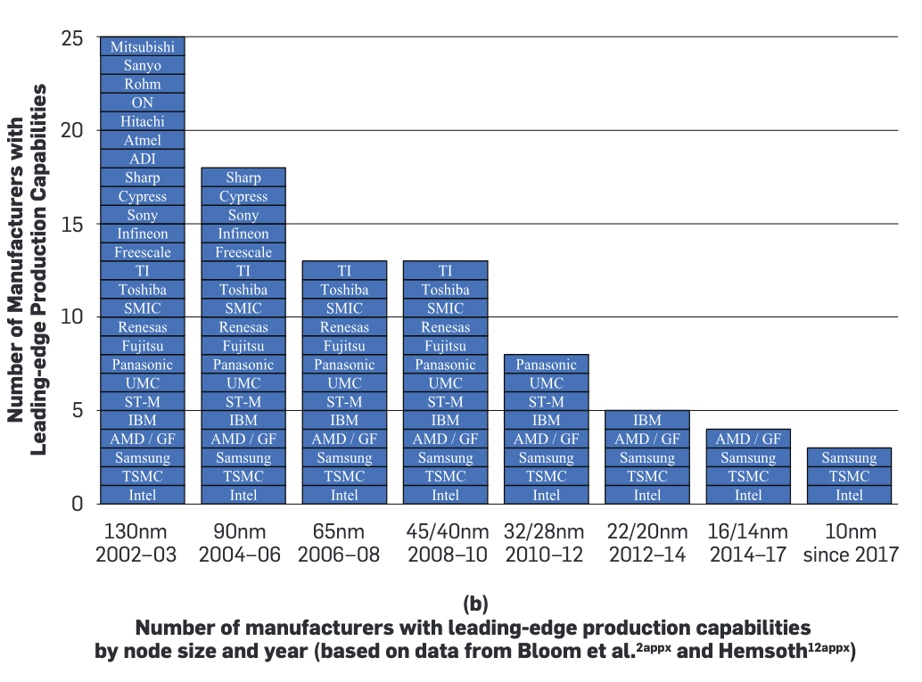
The shrinking number of fabs

Slide 11
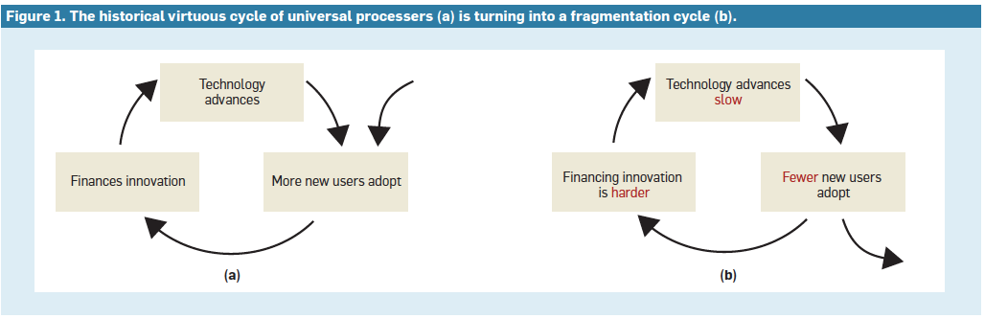
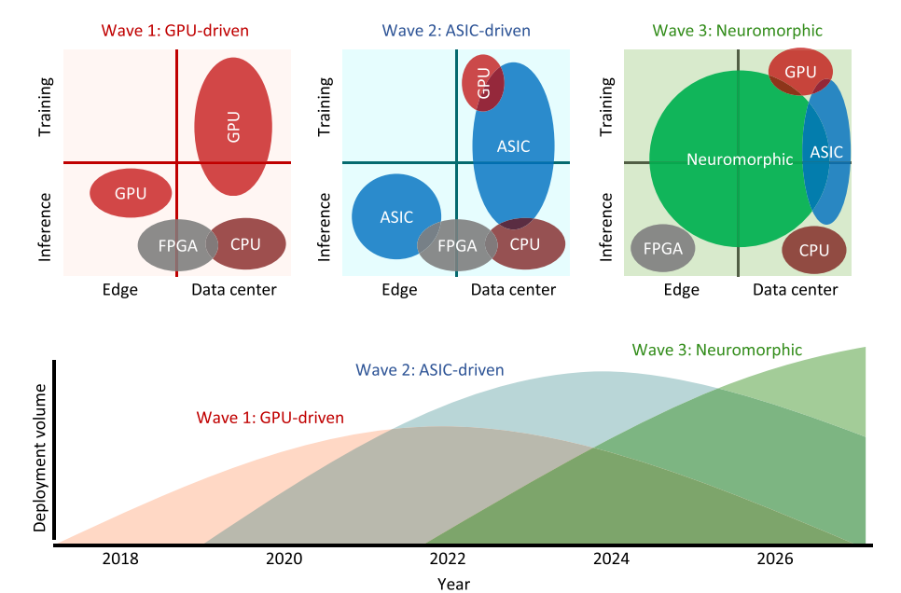
Dennard Scaling Ends and Moore’s Law Slows Specialization Gains Market Share
N. Thompson, S. Spanuth, Decline of Computers as a General Purpose Technology, Comm of the ACM March 2021
J. Kendall, S. Kumar, “The building Blocks of a Brain Inspired-Computer” Applied Physics Reviews 2020

Slide 12

So no big deal right ? Specialization can fill the gap……..
Buzz Lightyear, Disney-Pixar

Slide 13


Gain = CMOS-Driven Gains x Chip Specialization Gains
DSA’s are Silicon thus Dependent on Transistor Scaling
CSR: Chip Specialization Return:
Take transistor scaling out
Evaluate gain only due to specialization
When Moore’s Law ends CSR is all we are left with !
Fuchs, D. Wentzlaff “The Accelerator Wall: Limits of Chip Specialization” HPCA 2019

Slide 14
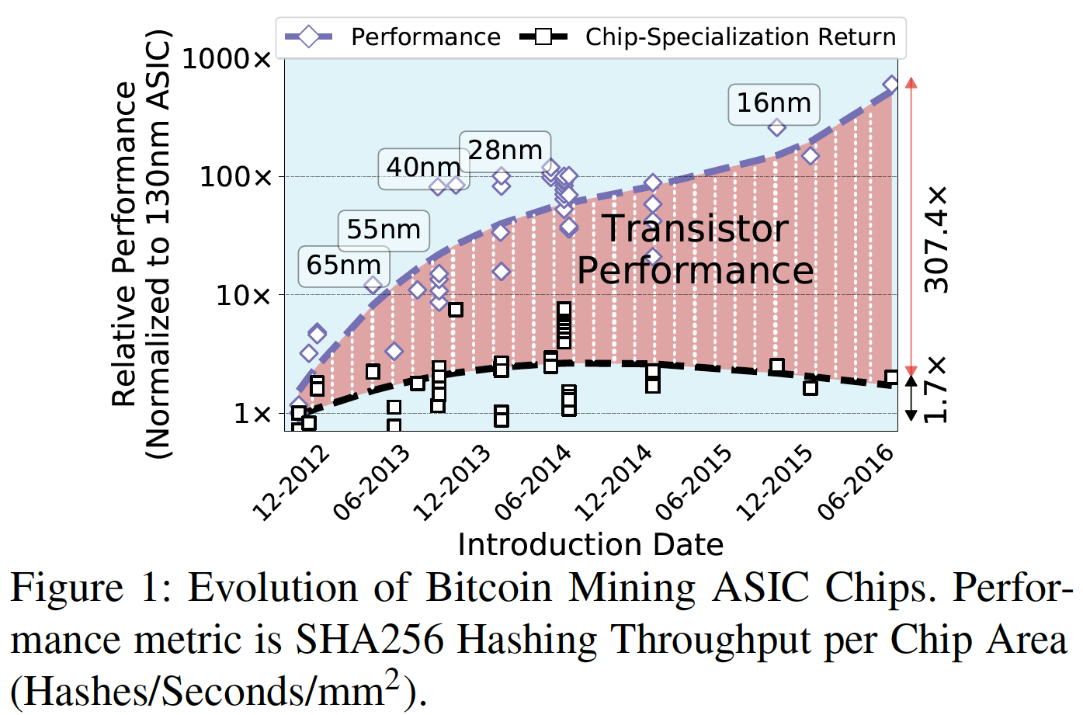
Nex Time: The Accelerator Wall
Fuchs, D. Wentzlaff “The Accelerator Wall: Limits of Chip Specialization” HPCA 2019

Slide 15
Fuchs, D. Wentzlaff “The Accelerator Wall: Limits of
Chip Specialization” HPCA 2019
Key Insights:
Specialization gives nice initial boost but further increases
from additional specialization tails off. 1st generation new
Parallel architecture matching parallelism of new domain can
Give impressive speedup. Once exploited performance boosts
Of each iteration of “new hardware tricks” diminishes. Can also
get increasingly expensive.
2. Majority of observed generational improvements are derived
From device scaling (aka Moore’s Law). Reinforces the importance
of finding some new form of device scaling.
Cost and time for hardware customization may become critical

Slide 16
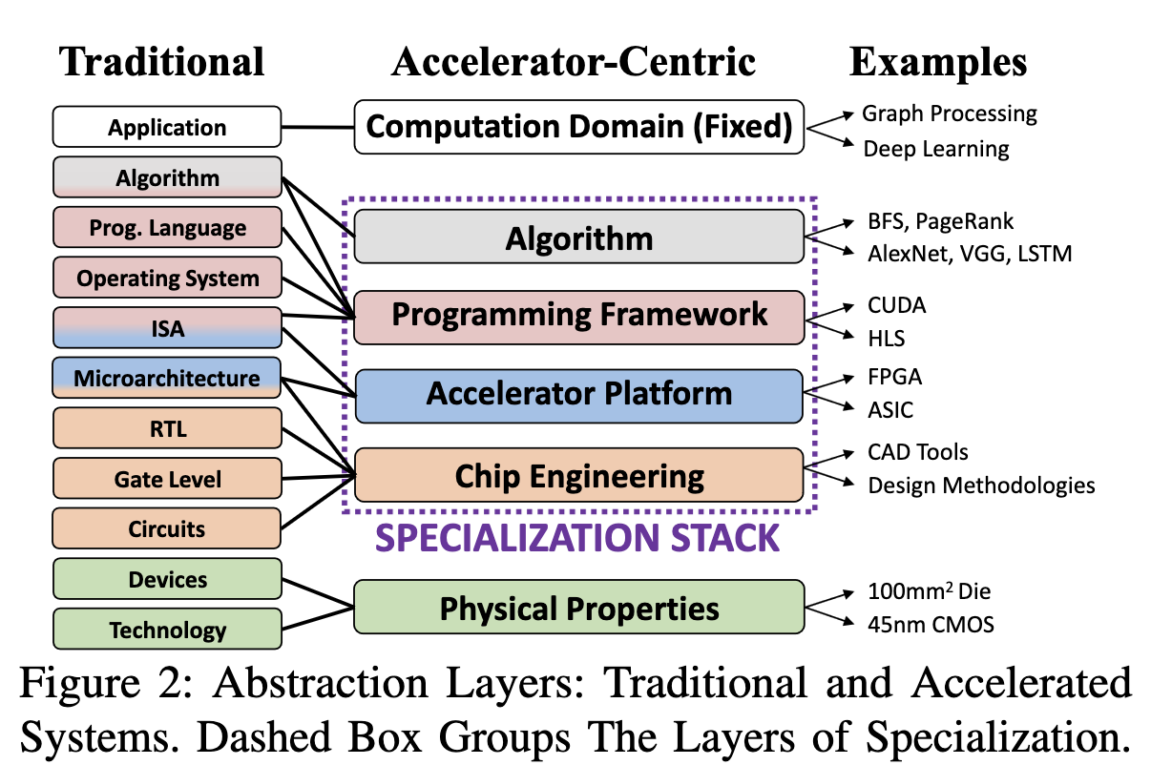
The Specialization Stack

Slide 17
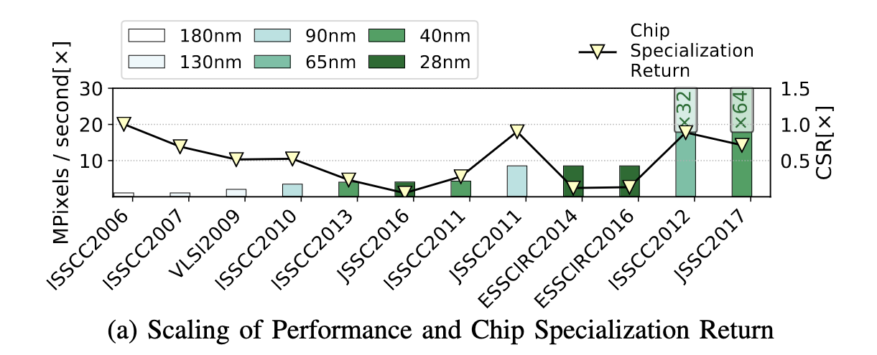
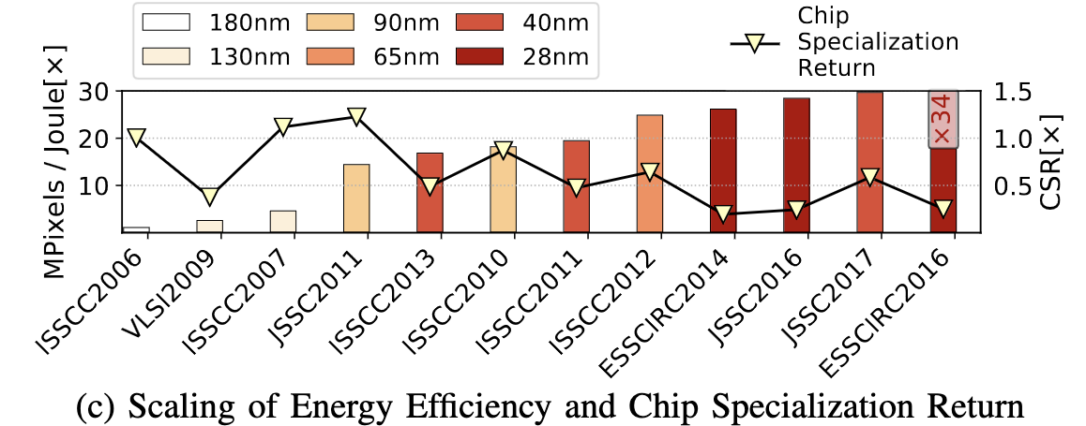
Throughput due to scaling increases with technology node
Throughput due to specialization < 1.0

Slide 18
The Law of Diminishing Returns
Computational Confinement: Domains with fixed hardware implementation have limited future specialization returns
Massive Parallelism: Domains like GPU graphics processing enabled via higher transistor counts: Relies on Moore’s Law and limited by dark silicon
Domain Maturity: Only so many ways to skin a cat !
An Impending Accelerator Wall !
Fuchs, D. Wentzlaff “The Accelerator Wall: Limits of Chip Specialization” HPCA 2019

Slide 19
An Impending Accelerator Wall !
We will hit the Accelerator Wall after Moore’s law finally dies, and transistor budgets plateau.
Chip Specialization is not a long-term remedy for the ending of Moore’s Law
Yes, this applies to CPUs, GPUs, DSA’s and FPGAs !
Can we re-establish Virtuous Cycle in a Post Moore’s Law era ?
A “New” General Purpose Technology
Exponential Scaling of New Technologies
Save discussions are for a different class. ☺
Fuchs, D. Wentzlaff “The Accelerator Wall: Limits of Chip Specialization” HPCA 2019

Slide 20
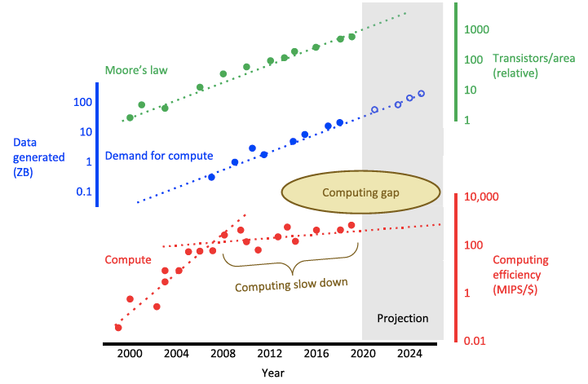
Whats the big deal ?
J. Kendall, S. Kumar, The Building Blocks of a Brain-Inspired Computer, Applied Physics Reviews, Sept. 2019

