Slide 2

Motivation for TPU
•
2006: “Just run DNNs on our CPU datacenter. It’s basically free.”
•
2013: “3 minutes of DNN-based voice search == 2x more datacenter compute.”

Slide 3
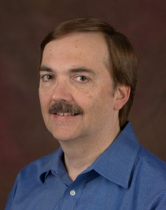
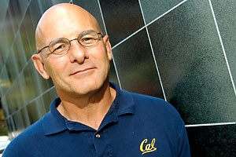


The Players
70+ other Google engineers
David Patterson
Norman P. Jouppi and his two musketeers.

Slide 4
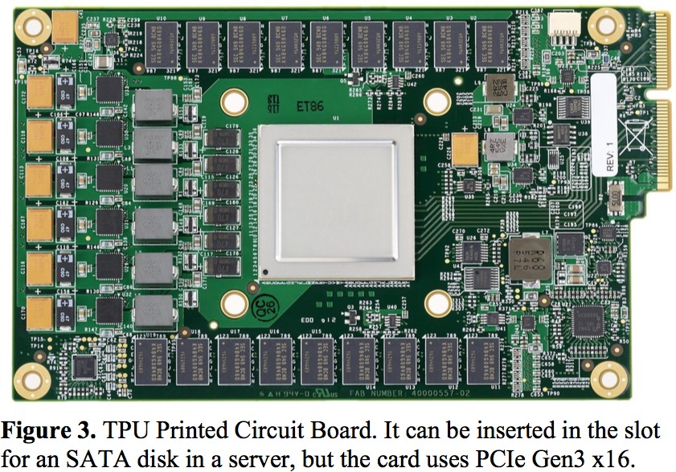
Tensor Processing Unit (TPU)
•
30-80x TOPS/watt vs. 2015 CPUs and GPUs.
•
8 GiB DRAM.
•
8-bit ﬁxed point.
•
256x256 MAC unit.
•
Support for data reordering, matrix multiply, activation, pooling, and normalization.

Slide 5
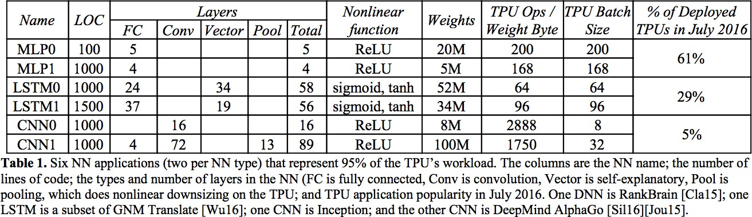
Application Testbed
“The unexpected desire for TPUs by many Google services combined with the preference for low response time changed the equation, with application writers often opting for reduced latency over waiting for bigger batches to accumulate.”

Slide 6
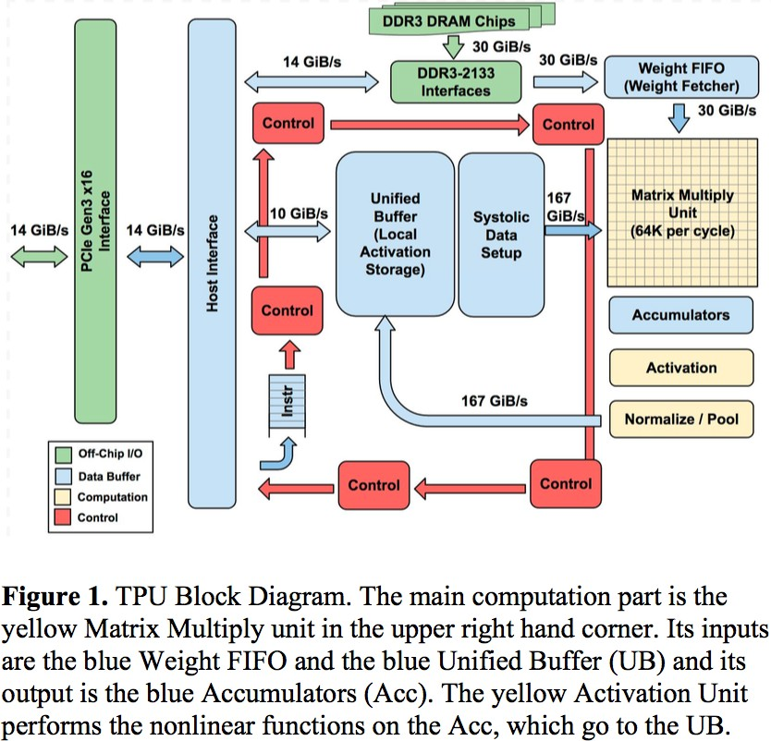
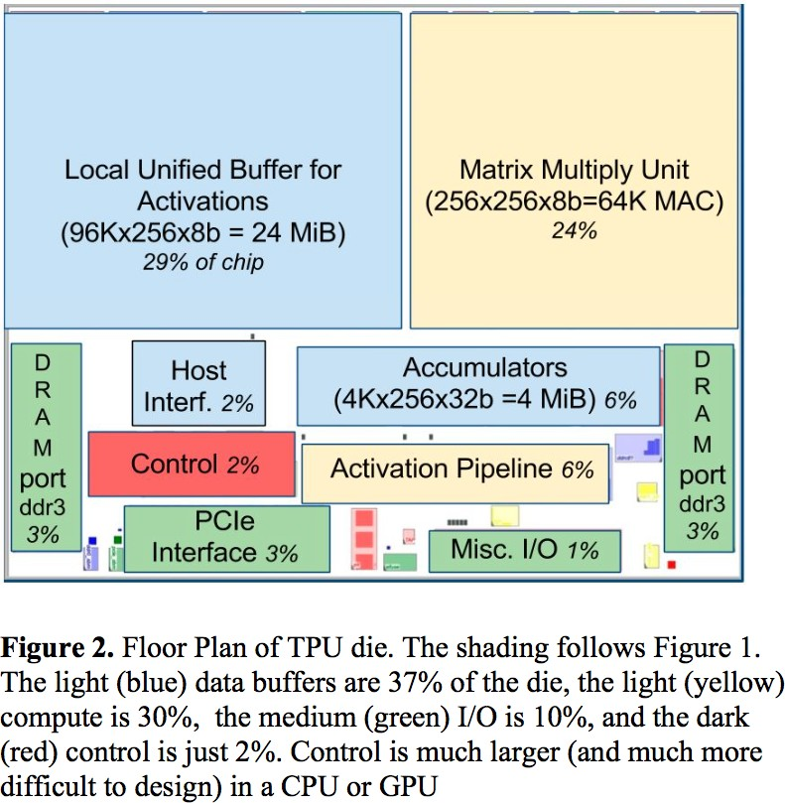
TPU Block Diagram & Floor Plan

Slide 7
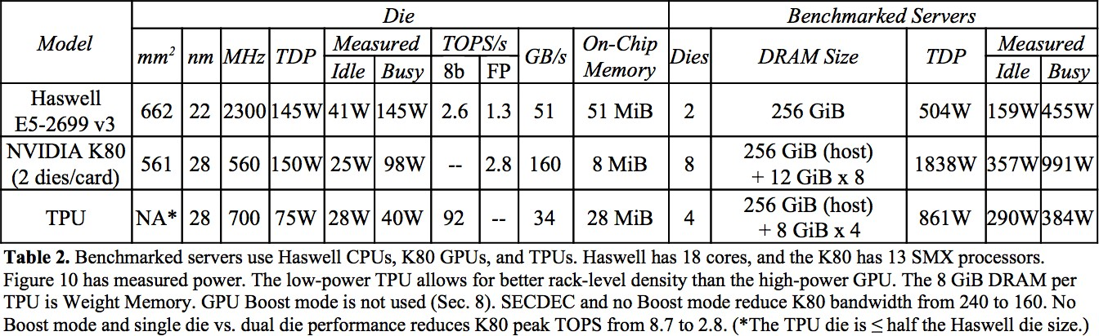
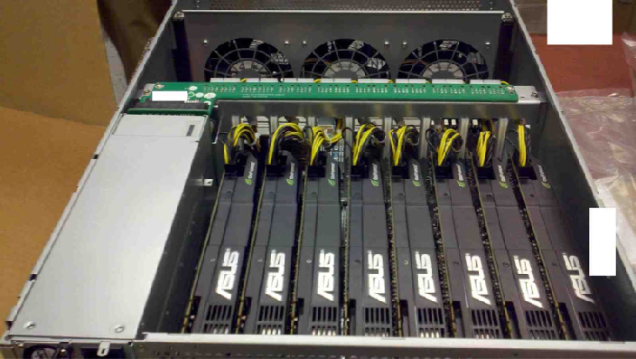
Experimental Testbed
8x K80 GPUs

Slide 8

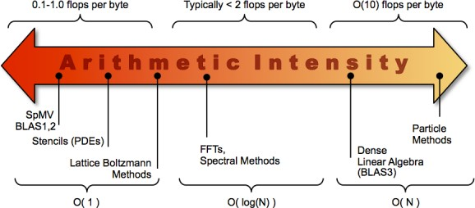
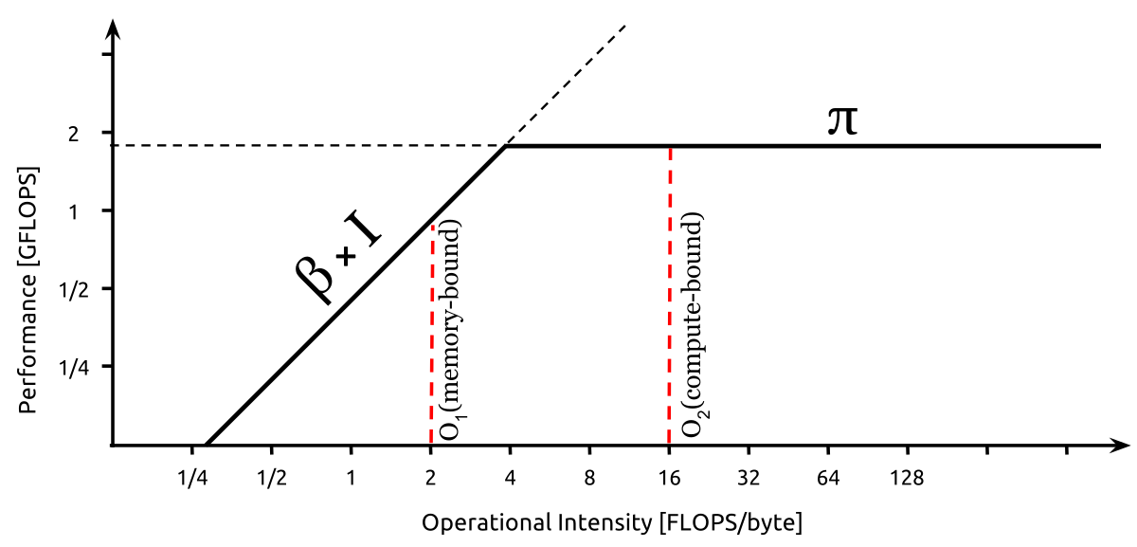
The Rooﬂine Model

Slide 9
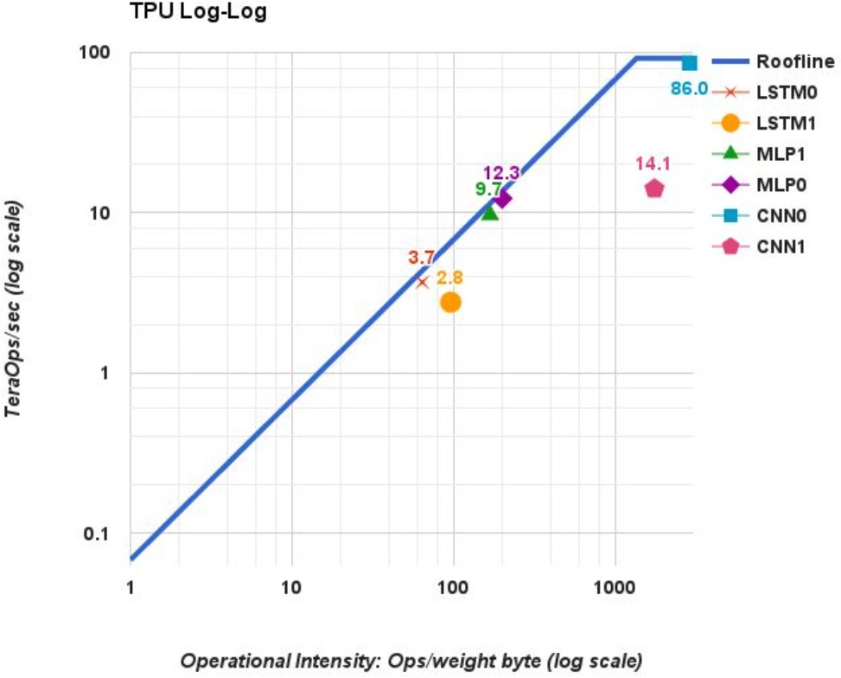
Rooﬂines of TPU with DNN Apps

Slide 10
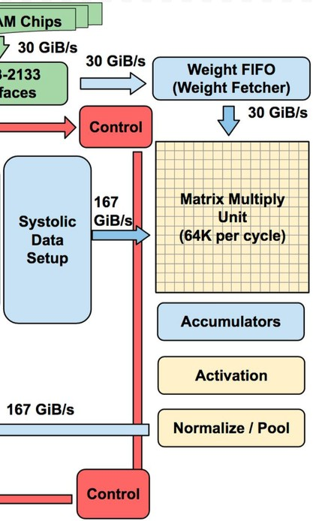
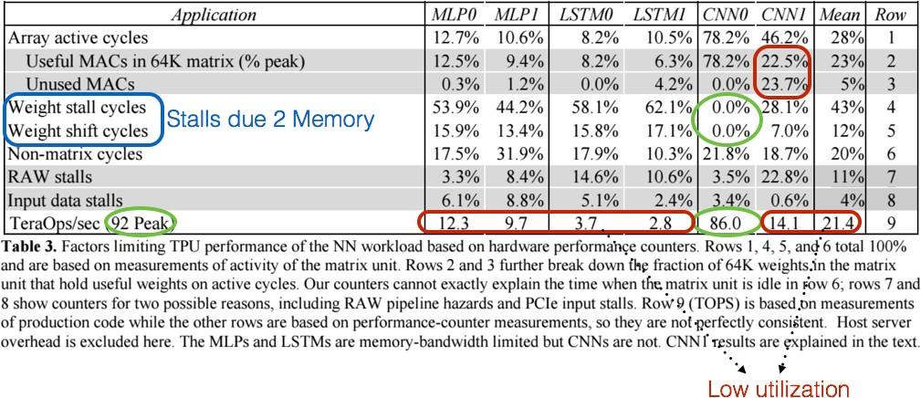
App breakdown by Performance Counters

Slide 11
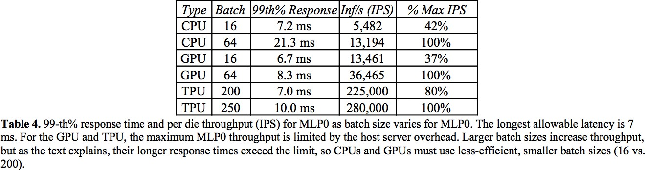
Latency Results (99%ile)

Slide 12
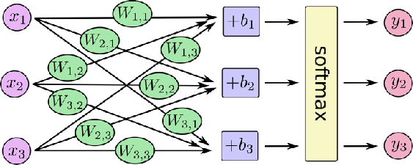
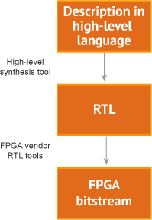


Programming the TPU
Programming FPGAs
TensorFlow graph
TPU
bitstream
TPU host instructions

Slide 13
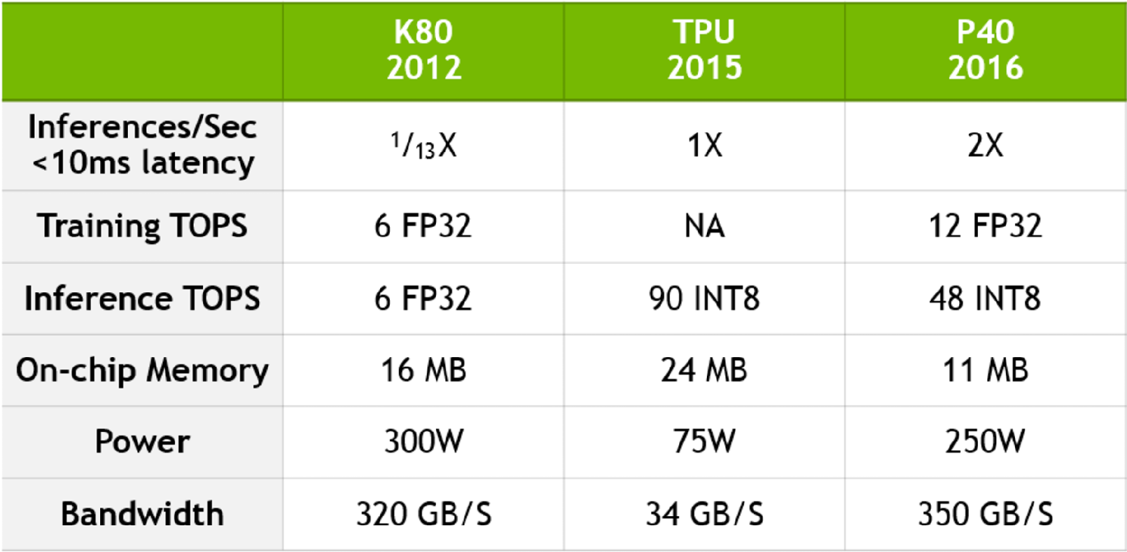
NVIDIA’s Rebuttal to the TPU
https://blogs.nvidia.com/blog/2017/04/10/ai-drives-rise-accelerated-computing-datacenter/

Slide 14
“Patterson” Discussion
Fallacy: NN inference applications in data centers value throughput as much as response time.
Fallacy: The K80 GPU architecture is a good match to NN inference.
Pitfall: Architects have neglected important NN tasks.
Pitfall: For NN hardware, Inferences Per Second (IPS) is an inaccurate summary performance metric.
Fallacy: The K80 GPU results would be much better if Boost mode were enabled.
Fallacy: CPU and GPU results would be comparable to the TPU if we used them more eﬃciently or compared to newer versions.
Pitfall: Performance counters added as an afterthought for NN hardware.
Fallacy: After two years of software tuning, the only path left to increase TPU performance is hardware upgrades.

Slide 15
Interesting quote
“CNNs constitute only about 5% of the representative NN workload for Google. More attention should be paid to MLPs and LSTMs. Repeating history, it’s similar to when many architects concentrated on ﬂoating- point performance when most mainstream workloads turned out to be dominated by integer operations.”

