Slide 1
Mini Project 2
Nhóm 7
Hà Văn Hiển
Phạm Duy Nam
Nguyễn Thị Hoài Thương

Slide 2
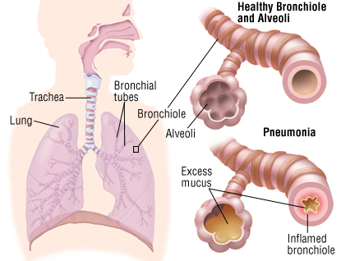
Chest X-Ray Images (Pneumonia)
Dataset: is organized into 3 folders (train, test, val) and contains subfolders for each image category (Pneumonia/Normal). There are 5,863 X-Ray images (JPEG) and 2 categories (Pneumonia/Normal).
(https://www.kaggle.com/paultimothymooney/chest-xray-pneumonia)
Train Set: PNEMONIA (3875), NORMAL (1341)
Test Set : PNEMONIA (390), NORMAL (234)

Slide 3
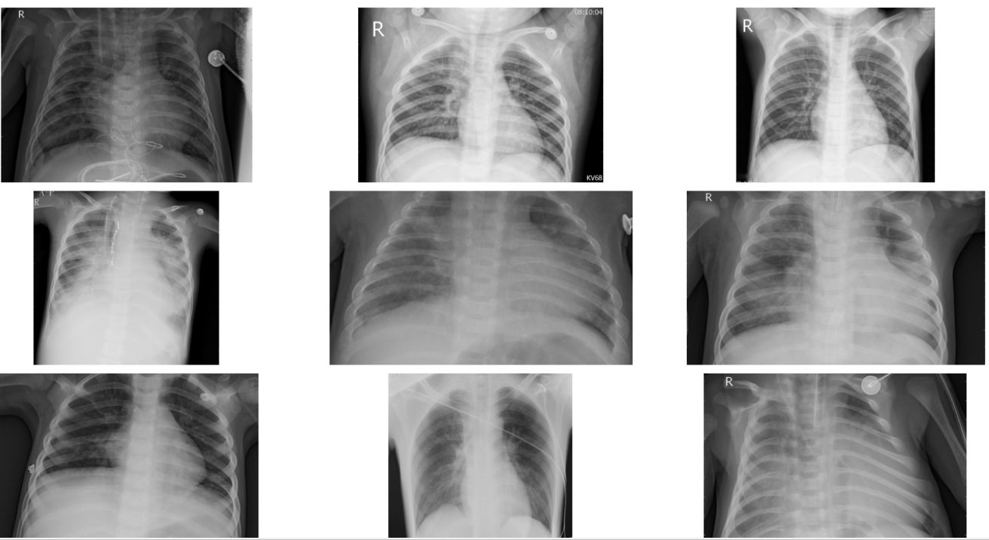
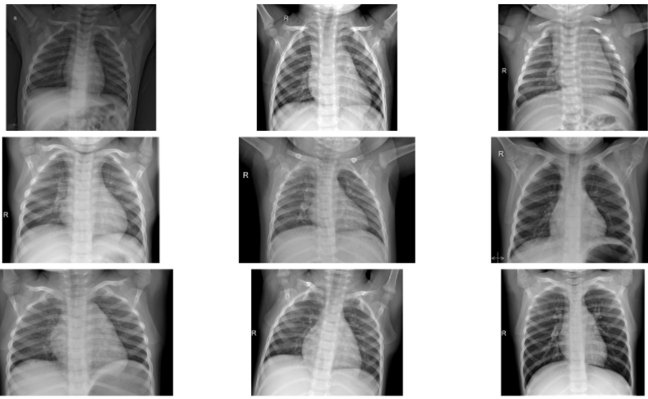
Data Visualization
Train: Pneumonia
Train: Normal

Slide 4
Model
SVM
CNN

Slide 5
You can also split your content
White
Is the color of milk and fresh snow, the color produced by the combination of all the colors of the visible spectrum.
Black
Is the color of ebony and of outer space. It has been the symbolic color of elegance, solemnity and authority.

Slide 6
CNN(Convolutional neural network)

Slide 7
Evaluation

