Slide 1
Online Threats vs. Mitigation Efforts: Keeping Children Safe in the Era of Online Learning
T. O’Dell, A. K. Ghosh
Jacksonville State University, Jacksonville, Alabama

Slide 2
Introduction
Problem Description
Research Objectives
K-12 children spent more time online during COVID-19 school closures
more exposure to cyberthreats
RQs:
What are the online threats as children learn online?
How aware are children of online safety and cybersecurity?
What are the government policies and recommendations to protect children online?
What efforts are being made to teach children cybersecurity principles?
To provide the cybersecurity community, policymakers, K-12 administrators, and educators with an overview of the latest research, policies, practices, and open issues, including both existing and proposed efforts to keep K-12 kids safe while learning online.

Slide 3
Background
COVID-19 lockdowns affected 50.8M US public school students and 1.5 billion children worldwide
FBI in 2020 reported 69% increase in complaints to ICCC (3,202 crimes against children)
FBI and CISA warned the public of cyberattacks on virtual environments
Ransomware, videoconferencing invasions and espionage, data leaks, etc.
HRW Study (May 2022)
145/163 (89%) EdTech platforms collected and shared student data with 196 third party companies (mostly AdTech)
US FTC issued a policy statement asserting that EdTech
cannot require students to surrender privacy to learn online
must comply with COPPA rules
Definition of “child”
Person below 18 years (Article I, UN CRC)

Slide 4
Methods
Academic literature review, web search, policy review
Google Scholar, Google Search
Most sources from year 2020 or later
Research based on answering the four RQs
Example search terms:
distributed systems, children, teenager, online safety, online safety threats, cyber- security, e-learning, online learning, remote learning, distance learning, cyberattacks on children, cybersecurity awareness, cybersecurity education, cybersecurity knowledge, cybersecurity awareness, gamification, and game-based-learning, and cybersecurity policies

Slide 5
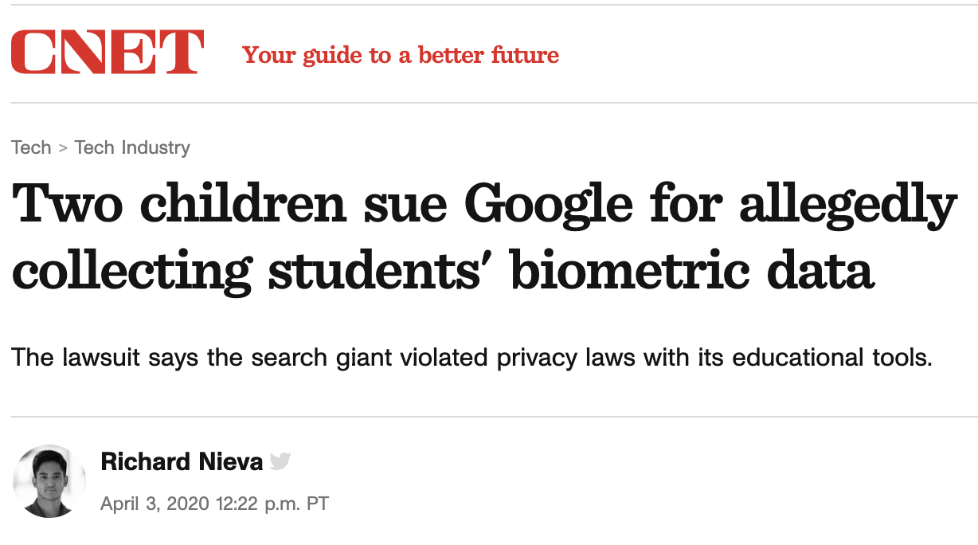
Results
RQ1: Online Privacy & Security Risks to K-12 Children
Schools have larger attack surface
Methods of attack include ransomware, DoS, Doxing, etc.
Data breaches include academic records, PII, login credentials, etc.
Online classroom invasions (“digital hijacking”) in which students are harassed and harmful content is broadcast in videoconferencing classrooms
Data surveillance
RQ2: Awareness of Online Safety & Cybersecurity
Survey Study | Key Finding
EdWeek Research Center (U.S.) | Most U.S. educators reported that they and their students know little or nothing about cybersecurity education
New Zealand | 19% ages 8-12 and 32% ages 13-17 had cybersecurity awareness based on questions about cybersecurity terms, software, data protection, and sources of breaches
Netherlands | Students showed both cybersecure and reckless behavior
United States | 13% of 189 children in grades 3-8 created “very strong” passwords
Scotland | A child’s cybersecurity knowledge and skills may be influenced by socio-economic status (financially deprived students performed worse in password knowledge and recall)
Source: CNET
Source: CNET

Slide 6
Results
RQ3: Policies
RQ3: Recommendations
Policy | Purpose | Open Issues
FERPA (U.S.) | Federally funded schools protect PII in student records | Does not directly address use of EdTech or third-party technologies
COPPA (U.S.) | Protects data privacy and security of children < 13 | Fails to cover nonprofits, government, data brokers ”teacher approved” Google app store apps violated COPPA
California’s SOPIPA | Prohibits online vendors from using or selling student data for targeted ads | EdTech companies (e.g., Google) signed a Student Privacy Pledge to uphold the principles of SOPIPA in other states; lack of federal oversight
U.S. K-12 Cybersecurity Act of 2021 | Requires CISA to study K-12 cybersecurity issues and provide a set of guidelines and online training for school leaders | Recommendations, not legal requirements
GDPR (E.U.) | Children < 13 must have permission from parents to consent to data collection | Children are not required to give joint consent
Organization | Recommendations
U.S. GAO | Set up a coordination plan between agencies (Department of Education, Department of Homeland Security, and CISA) and school districts
U.S. CISA | Reduce the school’s attack surface by minimizing the number of collaboration tools Extend the school’s security policies to distance learning platforms
K12 Security Information Exchange (U.S.) | Schools should offer greater transparency by disclosing cyber incidents EdTech software vendors should improve security practices School districts should collaborate
5Rights Foundation (U.K.) | Government should require EdTech’s data collection practices and privacy policies be open and transparent Government should facilitate standardize contracts between EdTech and schools

Slide 7
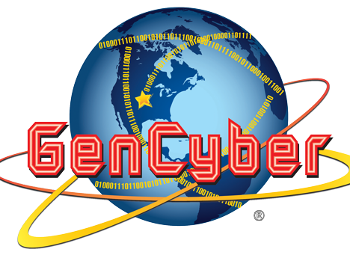



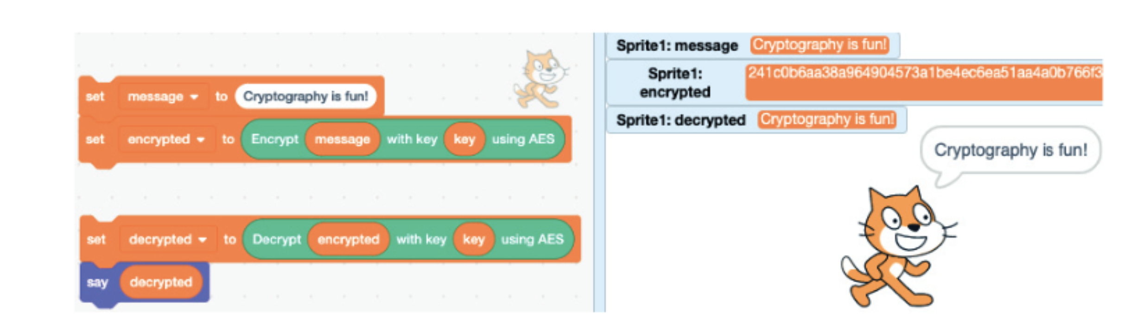
Results
RQ4: Efforts to teach children online safety and cybersecurity
GenCyber summer camp (NSA, NSF)
Get middle and high school students interested cybersecurity careers through lessons and activities
Google’s Be Internet Awesome campaign
Provides lesson plans, slides, games, certificates, etc.
Stop.Think.Connect.
Online safety information for the general public
Tip sheets, videos, posters, etc.
U.K. Safer Internet Centre
Provide awareness and support to children, parents, schools
CryptoScratch block-based programming tool
Teaches cryptographic algorithms and schemes

Slide 8
Conclusions
Core Contributions
Summary
Increased reliance on EdTech/videoconferencing tools leads to greater vulnerability of cyberattacks and data breaches
Many children lack the knowledge of cybersecurity principles
Government policies are put in place to help protect children, although there are still open issues
Following recommendations from government and organizations can help protect children and schools from data breaches
There are many initiatives and areas of research aiming to teach children cybersecurity principles
Children are more vulnerable as they spend time online for schoolwork
Protect
Educate
Promote behavioral change
Recommended future studies:
Assess EdTech privacy policy compliance with state and federal laws
Assess K-12 cybersecurity policies
Evaluate the cybersecurity tools employed by K-12 school systems to safeguard student privacy and security
Quantify the number of K-12 school districts that teach cybersecurity and their effectiveness
Survey U.S. children’s cybersecurity knowledge on national scale

Slide 9
Acknowledgements
Dr. Arup Kumar Ghosh, Advisor
Department of Mathematical, Computing, & Information Sciences, JSU
College of Science and Mathematics, JSU

