Slide 1
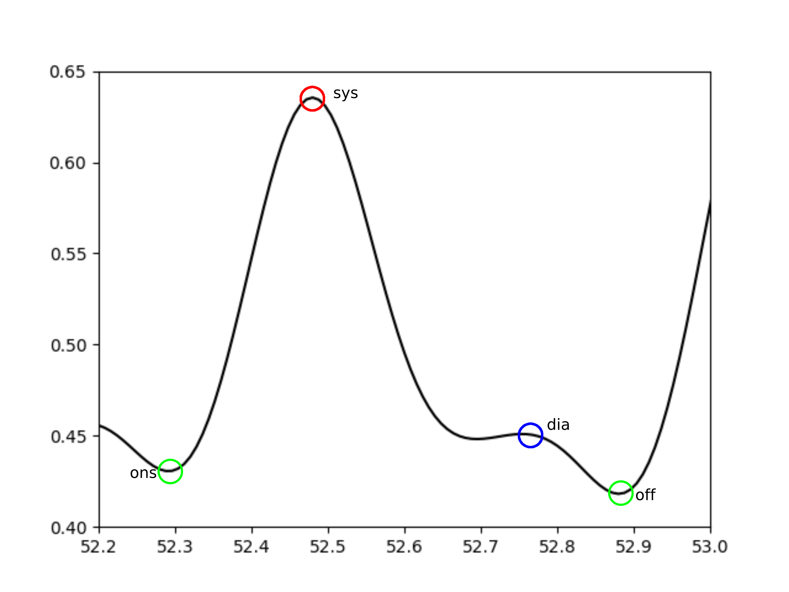
res_index = h1 / h2
dia_sys_area_ratio = dia_area / sys_area
sw75
dw75
pulse_area = sys_area + dia_area
sw50
dw50
vvi_sys = sys / max(all_sys)
vvi_dia = min(all_off) / off
delta_area
sw25
dw25
sys_area
h2
delta_t
h1
sys_t
dia_area
dia_t
dia = off

Slide 2
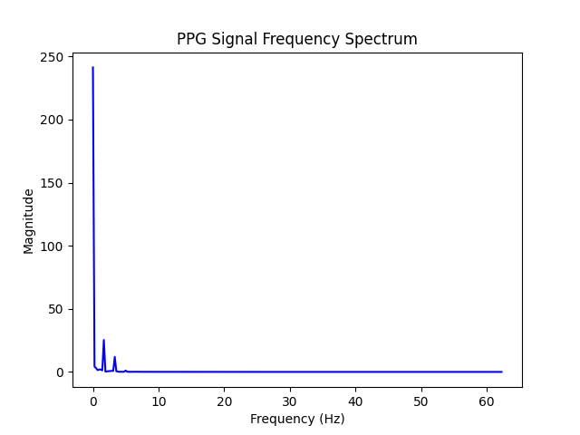
total_power = sum(magnitudes)
normalized_power_at_peak = max(magnitude) / total_power
mean_frequency = avg(frequencies)

