Slide 1

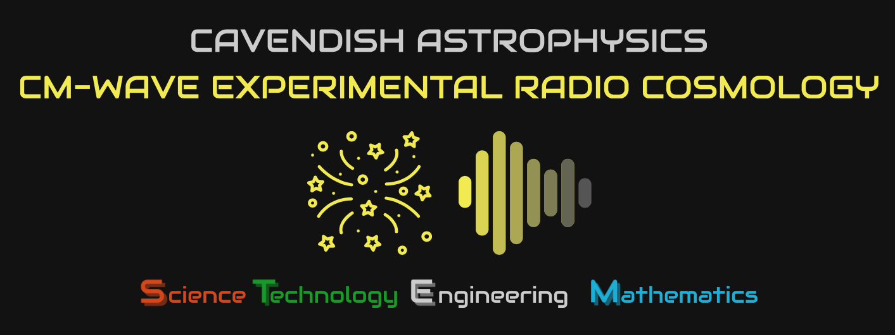
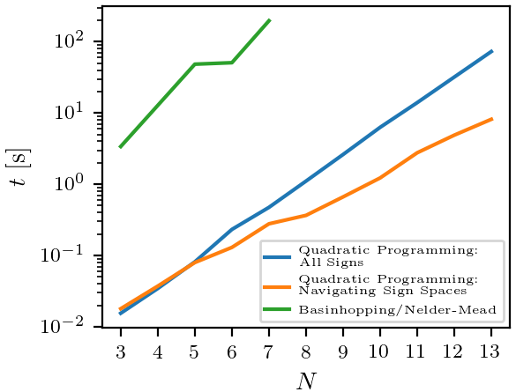
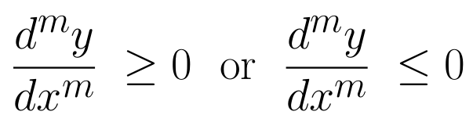
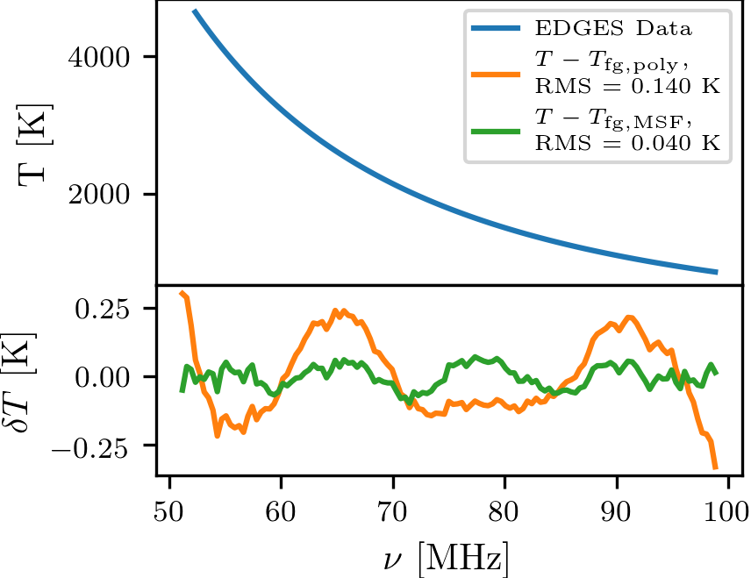
maxsmooth
Bevins, Handley, Fialkov, de Lera Acedo, Greenhill, Price (2020)
maxsmooth is a fast and robust algorithm for fitting Maximally Smooth Functions (MSFs) and related functions.
Github: https://github.com/htjb/maxsmooth
MSFs are constrained to have derivatives of order 2 or greater constrained such that,
The details of the algorithm can be found in the paper: https://arxiv.org/abs/2007.14970
2 Orders of magnitude faster than historically used algorithms
Designed for use in Global 21-cm cosmology
SALF VII 2020 Lightening Talk – Harry Bevins (htjb2@cam.ac.uk)
Slide 1

Slide 2
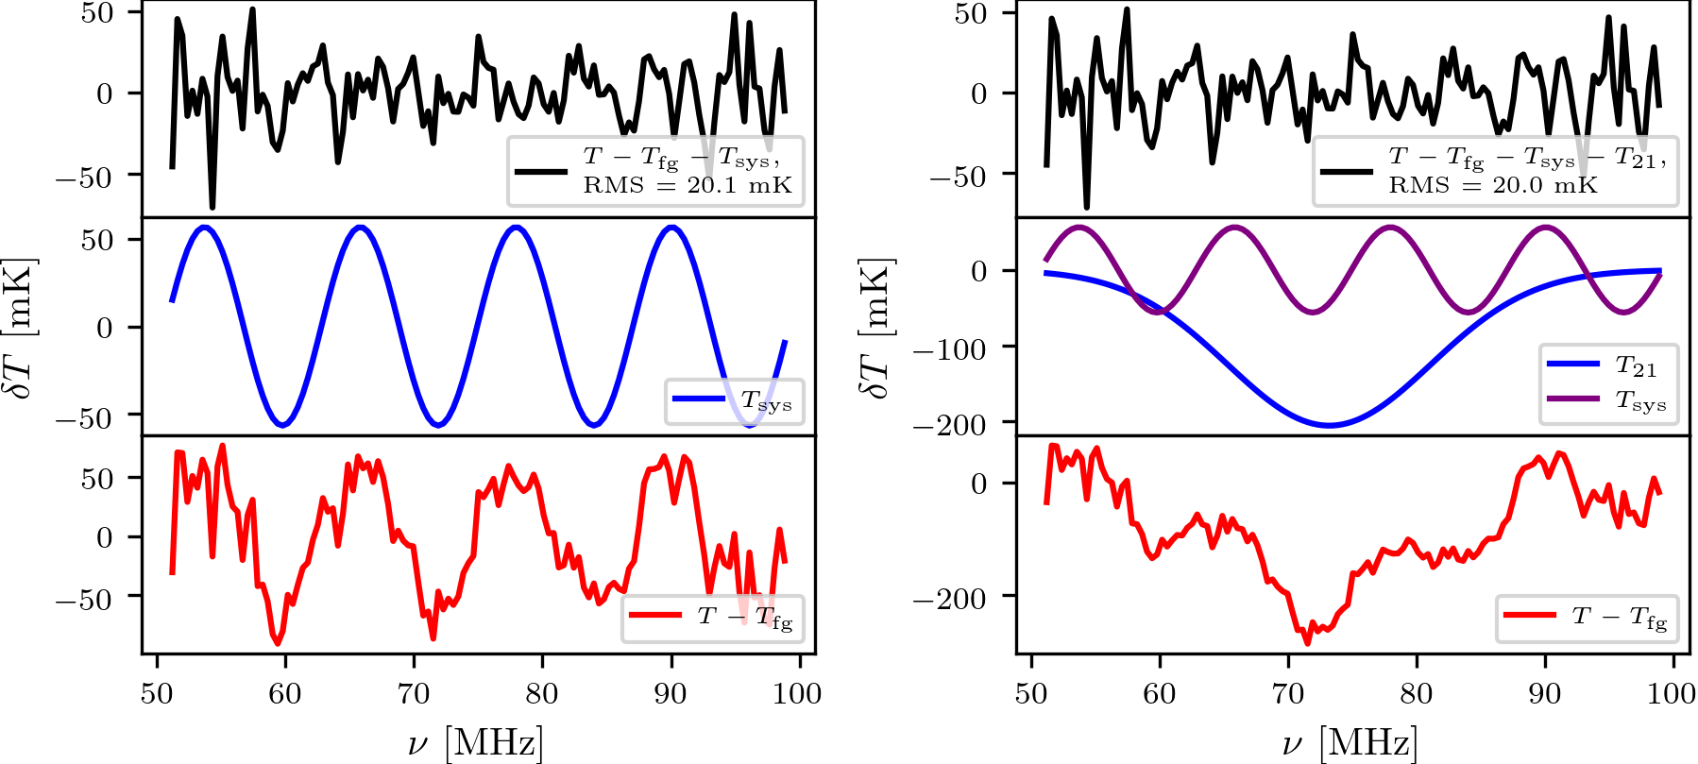
Applications in
Science At Low Frequencies
maxsmooth can be applied to any field where signals of interest are hidden in smooth continuum emission such as:
Global 21-cm cosmology: Modelling foregrounds with smooth MSFs can lead to a better identification of signal structure and systematics. (Tried and tested)
Exoplanet Transit Detection: Modelling the continuum emission of a planets star with MSFs may lead to an increased sensitivity to small amplitude transits. (Not tested yet… )
Spectral Line Identification: Similarly MSFs my help identify low amplitude spectral lines in continuum emission. (Not tested yet… )
Many more fields…?
SALF VII 2020 Lightening Talk – Harry Bevins (htjb2@cam.ac.uk)
Slide 2

