Slide 1

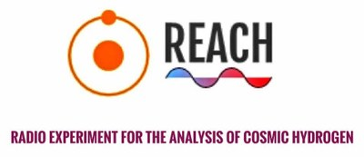
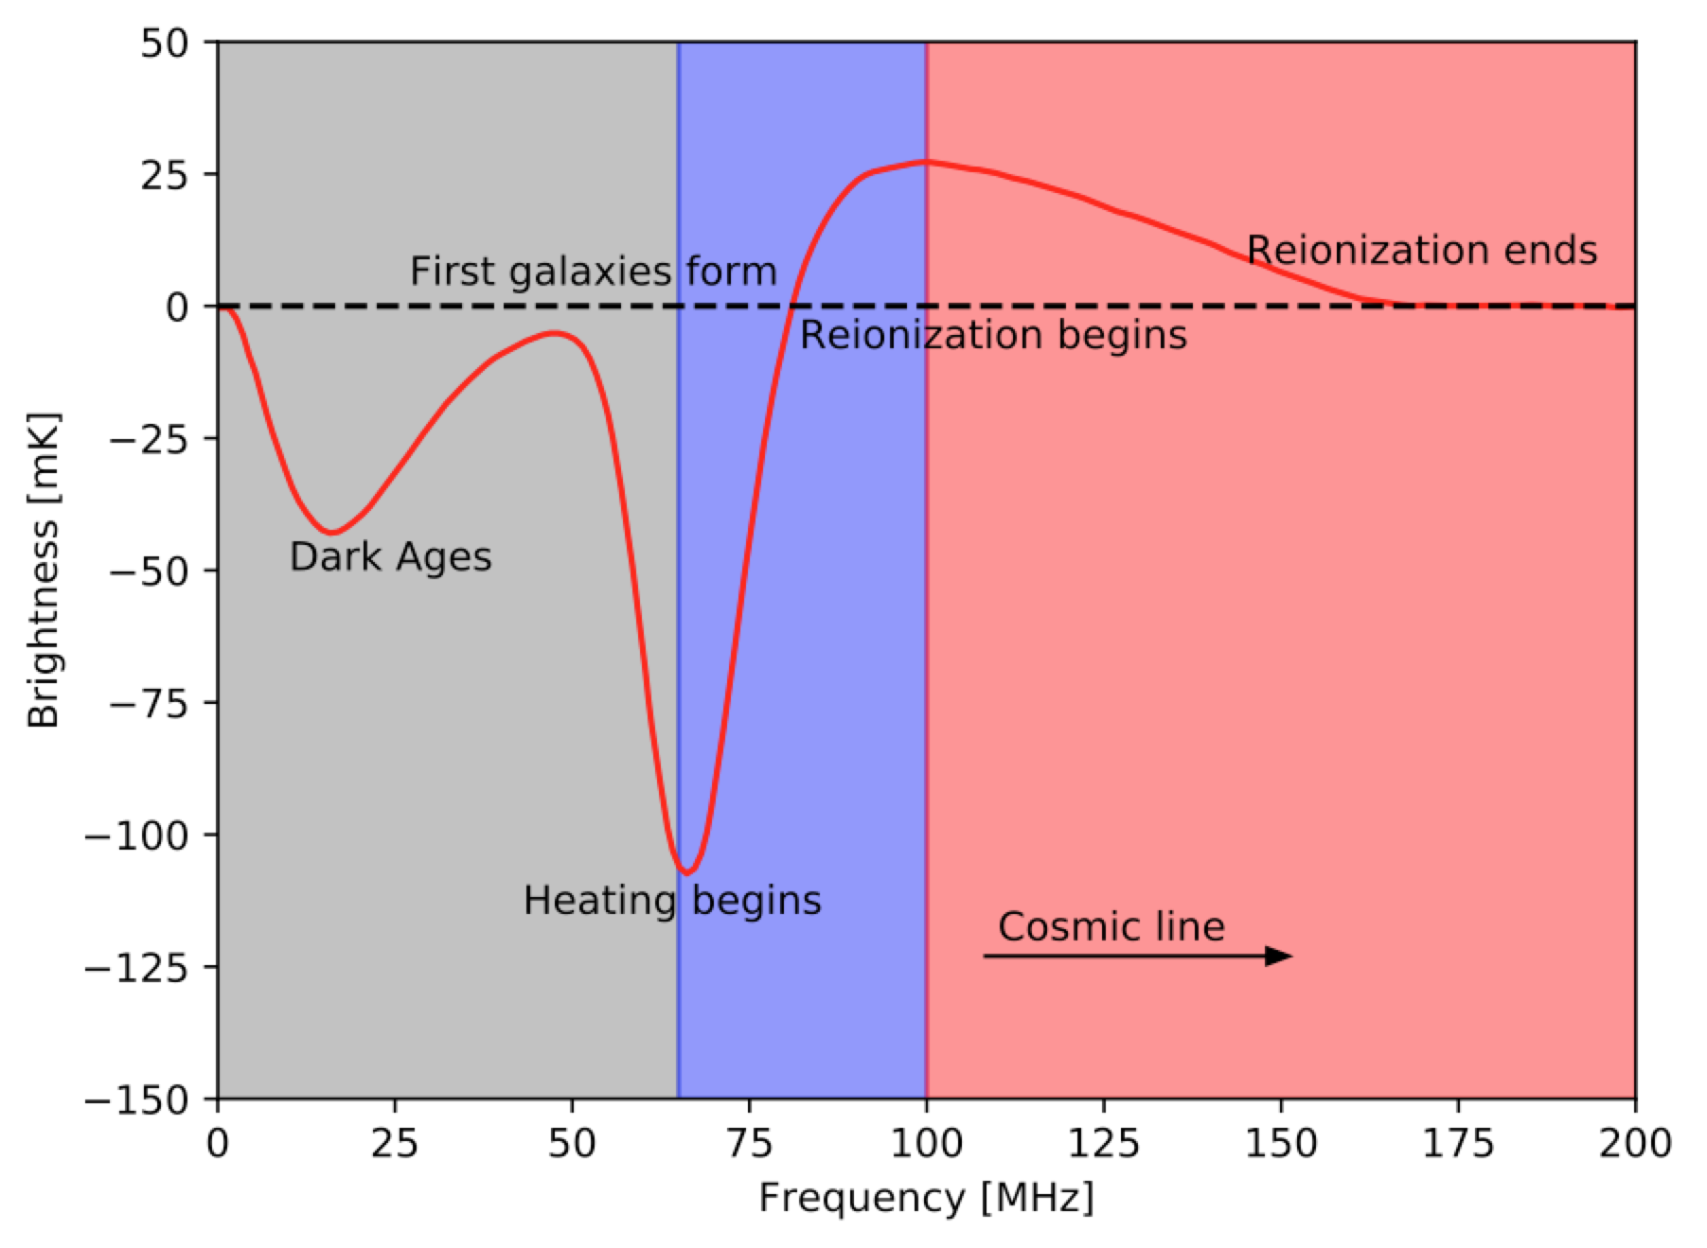
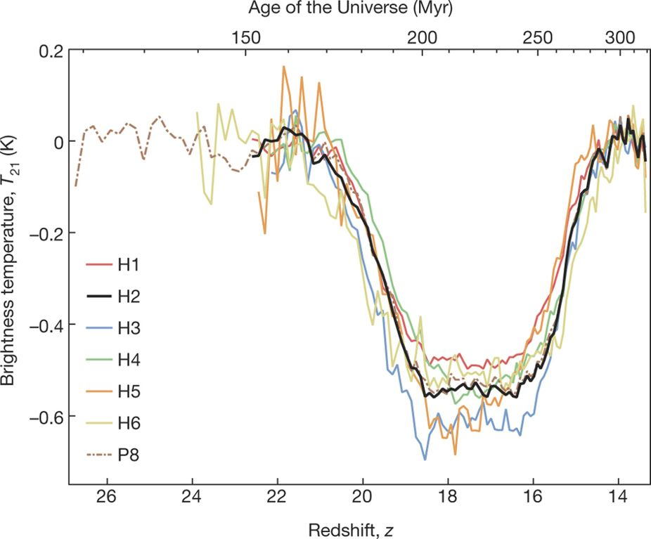
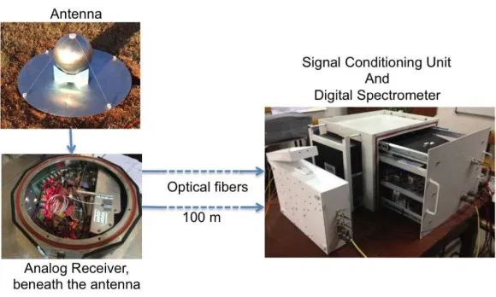
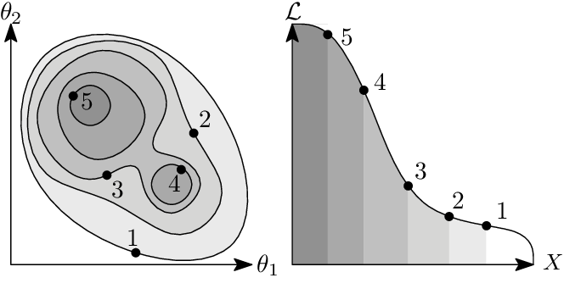
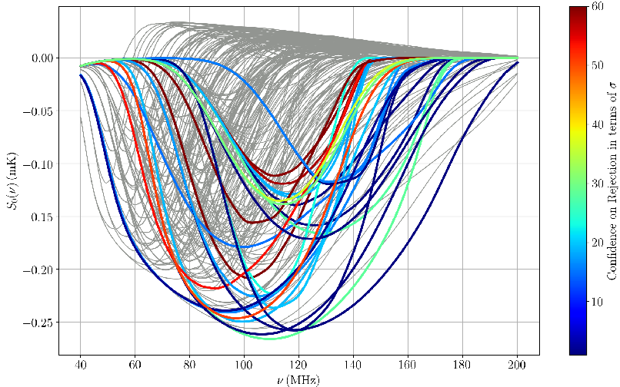
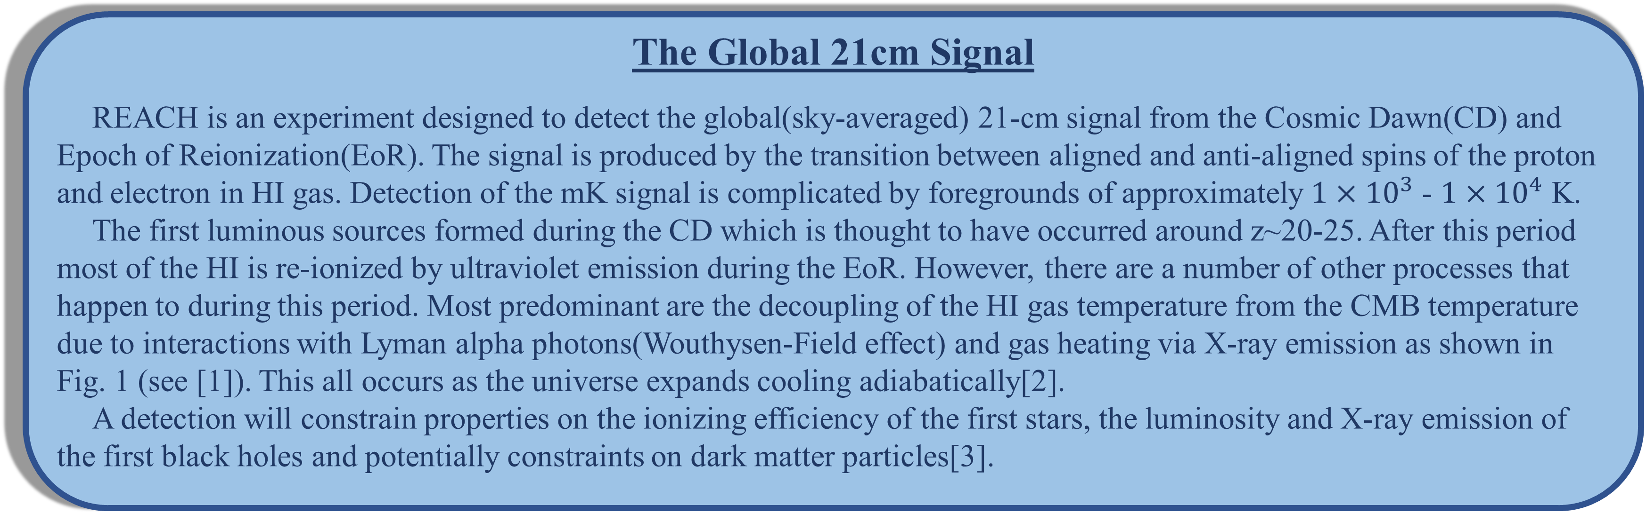
REACH: Radio Experiment for the Analysis of Cosmic Hydrogen
Harry Bevins
On behalf of the REACH collaboration, [1]
Cavendish Astrophysics, Cambridge
The Global 21cm Signal
REACH is an experiment designed to detect the global(sky-averaged) 21-cm signal from the Cosmic Dawn(CD) and Epoch of Reionization(EoR). The signal is produced by the transition between aligned and anti-aligned spins of the proton and electron in HI gas. Detection of the mK signal is complicated by foregrounds of approximately $1×{10}^{3}$ - $1×{10}^{4}$ K.
The first luminous sources formed during the CD which is thought to have occurred around z~20-25. After this period most of the HI is re-ionized by ultraviolet emission during the EoR. However, there are a number of other processes that happen to during this period. Most predominant are the decoupling of the HI gas temperature from the CMB temperature due to interactions with Lyman alpha photons(Wouthysen-Field effect) and gas heating via X-ray emission as shown in Fig. 1 (see [1]). This all occurs as the universe expands cooling adiabatically[2].
A detection will constrain properties on the ionizing efficiency of the first stars, the luminosity and X-ray emission of the first black holes and potentially constraints on dark matter particles[3].
Figure 1: An example global 21-cm signal[1].
A First Detection
In 2018 the Experiment to Detect the Global Epoch of Re-ionization Signal(EDGES) reported a detection of the global 21-cm signal shown in Fig. 2 (see [4]). The detected signal is yet to be confirmed and there are a number of concerns about the reported signal.
The concerns lie in the depth and width of the trough that forms the signal. To explain the depth, which is approximately two times larger than that predicted by current models[3], then you would need a higher than expected level of background radio radiation or new physics surrounding interactions between dark matter and baryons in the early universe[4]. While the ARCADE-2 experiment measured a radio background higher than predicted by current models and source counts this has not yet reached a consensus[5].
The EDGES analysis also predicts some unphysical properties for the foreground parameters[6]. There are also concerns surrounding the presence of systematics left in the EDGES data post foreground removal[7]. A confirmatory detection is sought after and REACH will be able to provide this.
Figure 2: The reported detection from EDGES
for different experimental configurations[4].
Other Experiments
There are many different experiments designed to detect the global 21-cm signal. SARAS2, shown in Fig. 3 (see [8]), is a high-band radiometer operating in the region of approximately 110-200 MHz and so is deigned to primarily detect the EoR[8].
Experiments to detect the global 21-cm signal either focus on a particular frequency range like the SARAS2 instrument or alternatively are designed to measure across a wideband. Many of these experiments work towards and assume a perfectly achromatic beam. However, this is difficult to achieve and any assumption of an achromatic beam can result in systematics being left in the data. These can intern hide any signal or worse be miss interpreted as a real 21-cm signal.
A handful of experiments have already recorded data and many use polynomial models of the foregrounds which can suppress signals in the data and may not best represent the spectral structure of the sky.
Figure 3: SARAS 2 antenna and radiometer[8].
What will REACH do differently?
REACH will operate over 50-230 MHz and will incorporate in to the analysis any chromatic effects left in the beam pattern.
The collaboration is also intending to use physically motivated foreground models based on all sky maps and corresponding derived spectral indices as a function of spatial location on the sky. Development of techniques to physically model the ionospheric contribution to the foreground are currently under way.
REACH aims to use Bayesian analysis techniques to fit the recorded sky temperature with a complex high dimensional foreground model and account for any systematics left in the data. Bayesian analysis will allow us to compare the evidences of models when a signal is present and absent providing a robust identification. Bayesian analysis uses the volume under a likelihood function as a function of the fit parameters to calculate evidences as shown in Fig. 4 (see [9]). More details on Bayesian analysis can be found in [10].
Figure 4: An example likelihood of a two parameter
function used in estimating Bayesian evidence[9].
Where next?
Upon deployment of the REACH antenna and radiometers, a short observation time should provide useable data from which we can ascertain a global 21-cm signal. The primary focus of the collaboration presently is the development and deployment of antenna with sufficient properties to allow for a successful detection. Alongside this, work on developing a data analysis pipeline continues.
Should REACH fail to detect a clear 21-cm signal, as described above, because the residual data after foreground subtraction is too noisy it will still give us clear constraints on conditions during the CD and EoR. For example the SARAS2 experiment did not detect a 21cm signal but their data was constrained sufficiently enough to rule out a subset of theoretical models as shown in Fig.5 (see [2]).
Figure 5: Rejection of models predicted in [3] based on
the SARAS2 data[2].
References:
[1] REACH Collaboration. https://www.astro.phy.cam.ac.uk/research/research-projects/reach. [Accessed 24/11/2019]
[2]: S. Singh et al.. SARAS 2 Constraints on Global 21 cm Signals from the Epoch of Reionization. ApJ 858(1):54, 2018. doi:10.3847/1538-4357/aabae1
[3]: A. Cohen et al. Charting the parameter space of the global 21-cm signal. MNRAS, 472(2):1915-1913, 2017. doi:10.1093/mnras/stx2065
[4]: J.D. Bowman et al.. An Absorption profile centered at 78 megaherts in the sky-averaged spectrum. Nature, 555:67, 2018. doi:10.1038/nature25792
[5]: D.J. Fixsen et al.. ARCADE 2 Measurements of the Absolute Sky Brightness at 3-90 GHz. ApJ, 734(1):5, 2011. doi:10.1088/0004-637X/734/1/5
[6]: R. Hills et al.. Concerns about Modelling of Foregrounds and the 21-cm Signal in EDGES data. Nature, 555:E32-E34, 2018. doi:10.1038/s41586-018-0796-5
[7]: P. Sims et al.. Testing for calibration systematics in the EDGES low-band data using Bayesian model selection. arXiv e-prints, 2019. arXiv:1910.03165
[8]: S. Singh et al.. SARAS 2: A spectral radiometer for probing cosmic dawn and the epoch of reionization through detection of the global 21-cm signal. Experimental Astronomy, 45(2):269-314, 2018. doi:10.1007/s10686-018-9584-3
[9]: W.J. Handley et al.. Polychord: next-generation nested sampling. MNRAS, 452(4):4385-4399, 2015. doi:10.1093/mnras/stv1911
[10] D.S. Sivia and J. Skilling. Data Analysis: A Bayesian Tutorial. Oxford University Press, 2006.

