Slide 1


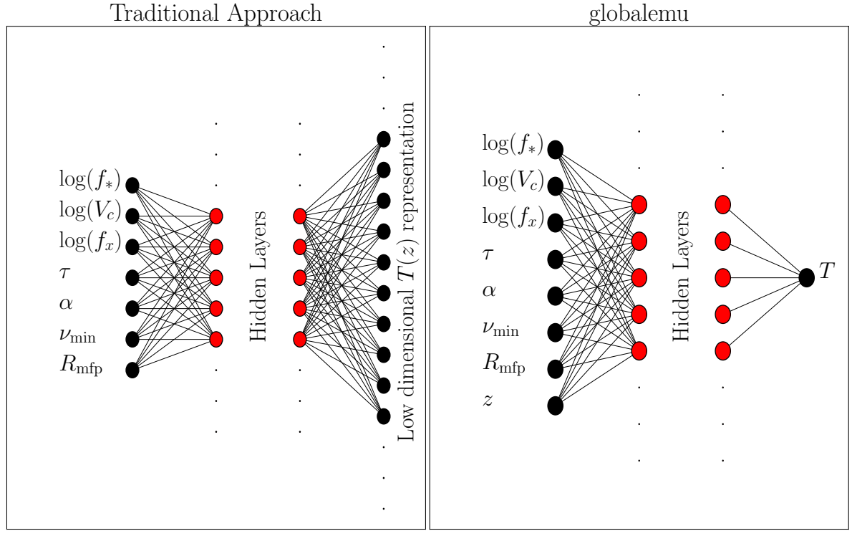
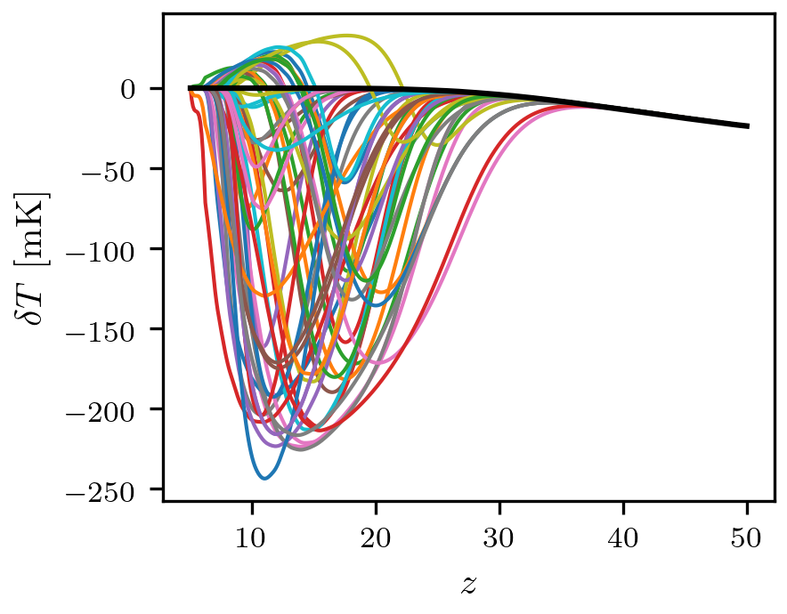
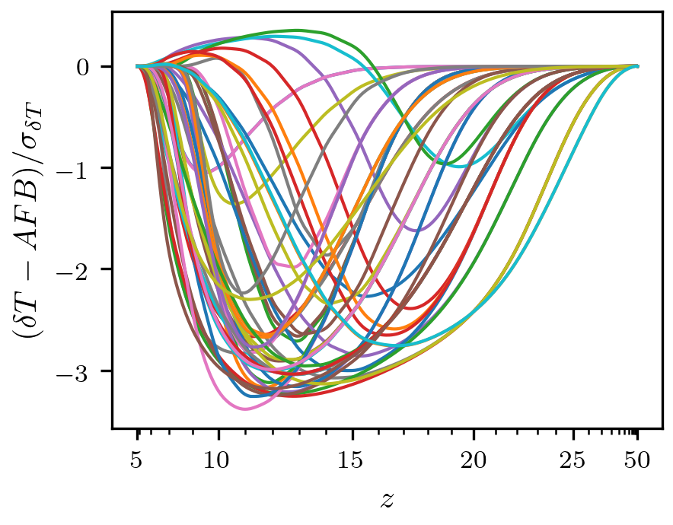
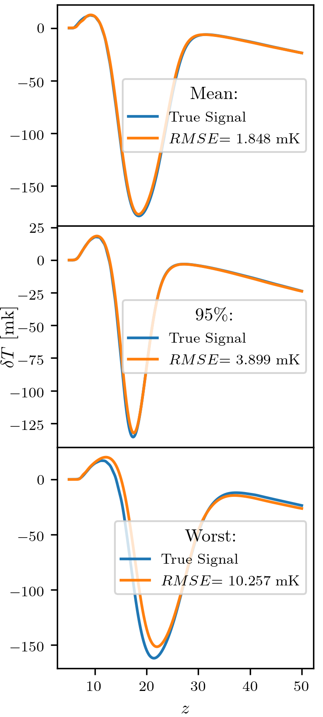
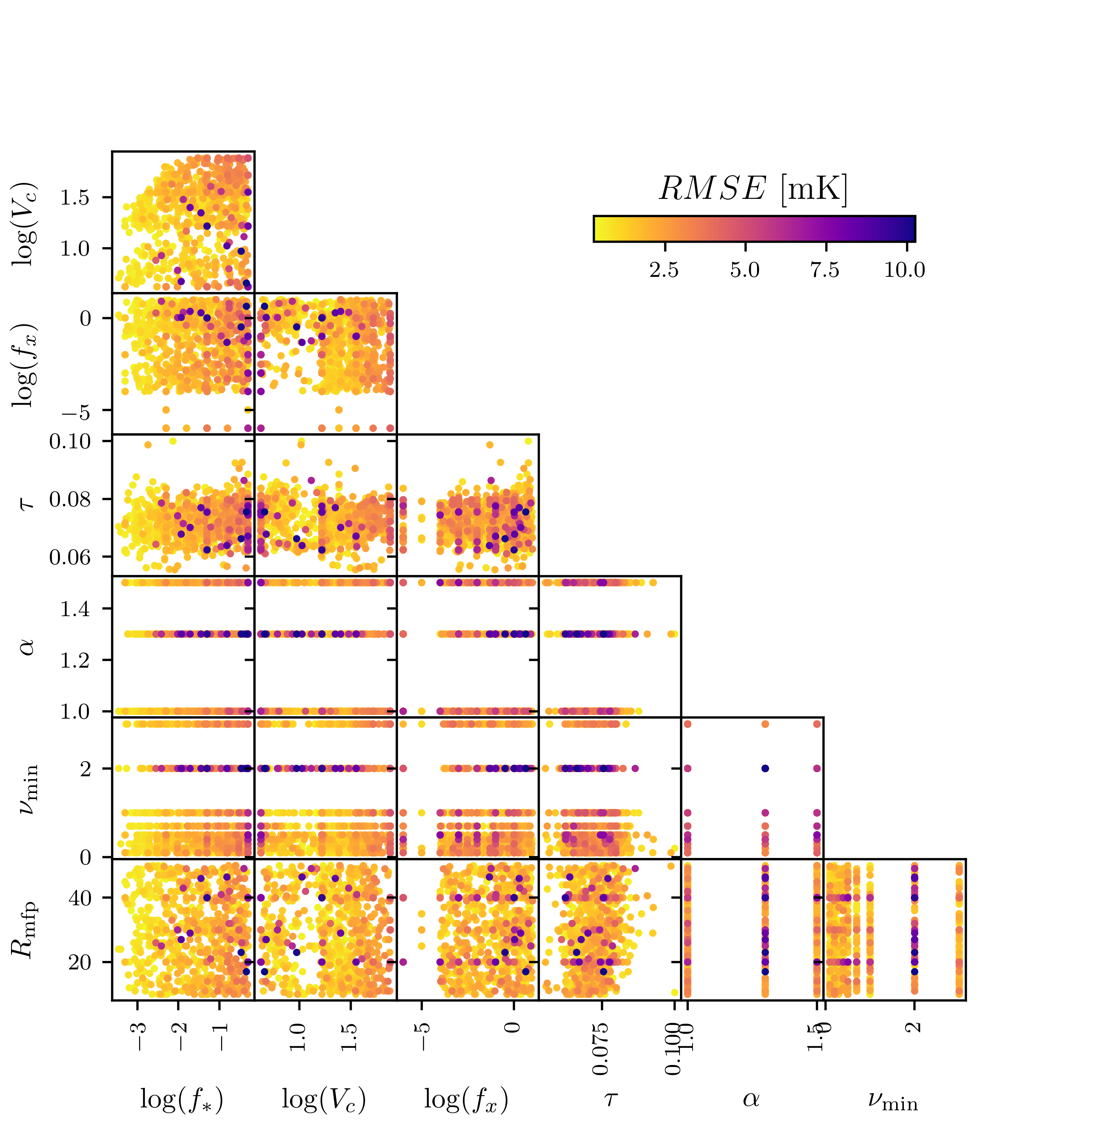
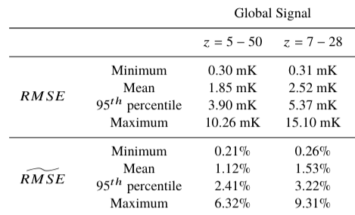
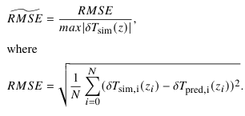
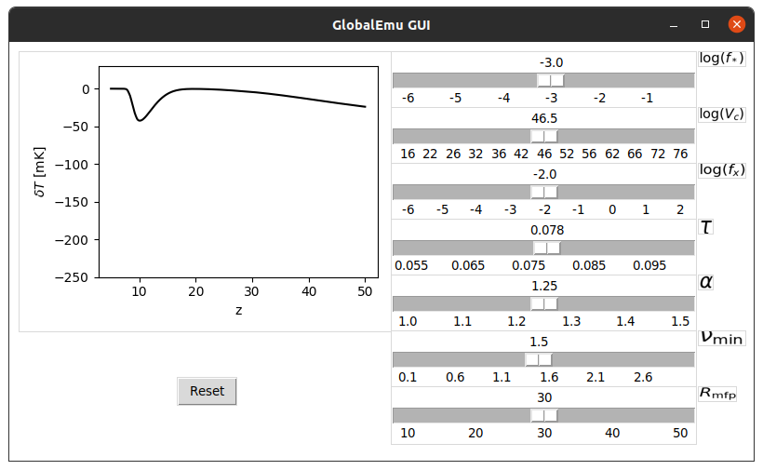
globalemu: A novel and robust approach for emulating the sky-averaged 21-cm signal from the cosmic dawn and epoch of reionisation
Harry Bevins (htjb2@cam.ac.uk), Will Handley, Anastasia Fialkov, Eloy de Lera Acedo
On behalf of the REACH¹ collaboration.
University of Cambridge, Cambridge, UK
Emulating the sky-averaged 21-cm signal
Global (sky-averaged) 21-cm signal emulators have been shown to be a useful tool for physical signal modelling and parameter estimation in global 21-cm experiments².
The existing state of the art emulator, 21cmGEM³, takes a set of astrophysical parameters and estimates a principle component decomposition of hybrid simulations of the global signal. It uses multiple regression and classifier neural networks. Compressed representations can lead to a loss of information and the large number of hyper-parameters that the emulator is dependent on can result in significant errors.
We present here globalemu which uses the novel approach of taking redshift as an input along with the astrophysical parameters and returning a corresponding brightness temperature. We demonstrate that with this approach and a physically motivated pre-processing we can emulate a high resolution signal in 8 ms, compared to 500 ms for 21cmGEM, to an accuracy of ≤ 6.32% compared to 10.55% using a single small neural network and avoiding ‘neural network magic’.
Figure 1. A traditional emulator design (left) compared with globalemu (right).
Data pre-processing
We assess the accuracy of globalemu using the same training and testing data sets used to assess 21cmGEM. There are ≈30,000 signals dependent on seven astrophysical inputs²: the star formation efficiency, f*, the minimal virial circular velocity, V_{c}, the X-ray efficiency, f_{x}, the CMB optical depth, τ, the slope and low energy cut off of the X-ray SED, α and ν_{min} and the mean free path of ionizing photons, R_{mfp}.
We use a physically motivated pre-processing of the training data in an attempt to simplify the complexity of the learnt relationship. We subtract off an astrophysics free baseline that dominates the structure at high z as it is a consistent feature in all models. We resample the signals with a higher rate where the signal variation is greatest in order for it to be properly emphasised. We then divide the signals by the standard deviation of the training set so that they are of order unity.
The input variables are normalised to be between 0 and 1 and we normalise the logarithm of f*, V_{c} and f_{x}.
Figure 2. Example Global signals from the 21cmGEM training data. Also shown in black is the astrophysics free baseline.
Figure 3. The pre-processed signals as seen by globalemu.
Results
The results found when emulating, with globalemu, 1,703 test models are shown below in the table. We use a fully connected network with 3 layers each of 16 nodes. We set a target RMSE of on average 2.5 mK, approximately 10% the expected noise of the Radio Experiment for the Analysis of Cosmic Hydrogen (REACH)¹. We achieve this target in both the full band z = 5 - 50 and the REACH band z = 7 - 28.
We find a mean normalised RMSE of 1.12% in comparison to 1.59% for 21cmGEM and note that the 95th percentile values are significantly lower than the maximum values. Only 85 models have an RMSE > 3.90 mK in the band z = 5 - 50. The graph on the far left shows the emulated results in the band z = 5 - 50 and we also show the RMSE as a function of the astrophysical parameters.
Figure 5. The emulator accuracy as a function of the parameters space.
Figure 4. The mean, 95th percentile and worst emulated signals using globalemu.
Table 1. The results of emulating the 21cmGEM test models with globalemu.
An adaptable emulator
globalemu is written in Python using tensorflow and the keras backend. It is pip installable and available for download at https://github.com/htjb/globalemu. It is a flexible emulator that can easily be retained on any set of simulated 21-cm signals whilst maintaining the novel approach, with redshift as an input, and physically motivated preprocessing.
We provide with the emulator an easy to use GUI (shown on the left) which is made possible by the speed of emulation. We also release with version 1.0.0 the trained Global signal model demonstrated here.
Two papers are in preparation to be submitted to MNRAS and the Journal of Open Source Software for a review of the code.
Figure 6. The globalemu GUI.
References
[1] - de Lera Acedo E., 2019, in 2019 International Conference on Elec-tromagnetics in Advanced Applications (ICEAA). pp 0626–0629,doi:10.1109/ICEAA.2019.8879199
[2] - Monsalve R. A., Fialkov A., Bowman J. D., Rogers A. E. E., Mozdzen T. J.,Cohen A., Barkana R., Mahesh N., 2019, ApJ, 875, 67
[3] - Cohen A., Fialkov A., Barkana R., Monsalve R. A., 2020, MNRAS, 495,4845

