Slide 1

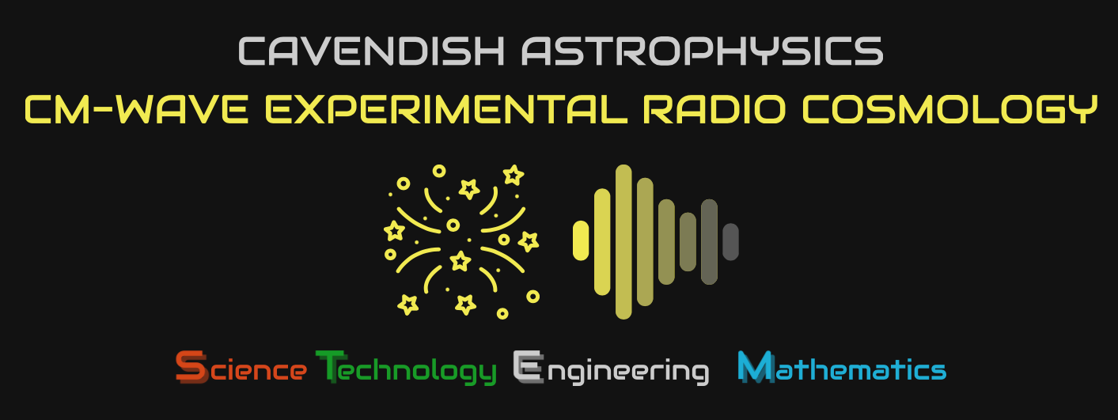
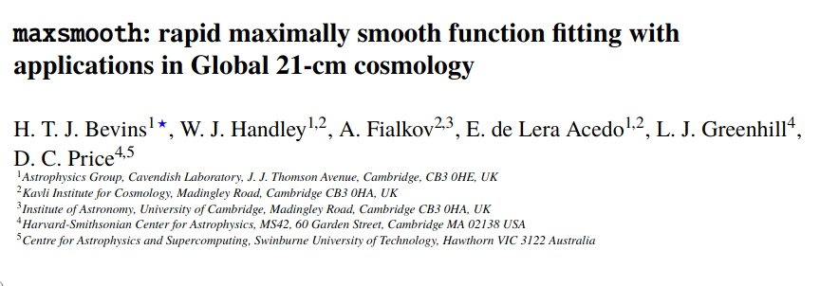
maxsmooth and its applications in
21-cm cosmology
https://arxiv.org/abs/2007.14970
3rd Global 21-cm Workshop 2020 – Harry Bevins (htjb2@cam.ac.uk)
Slide 1

Slide 2
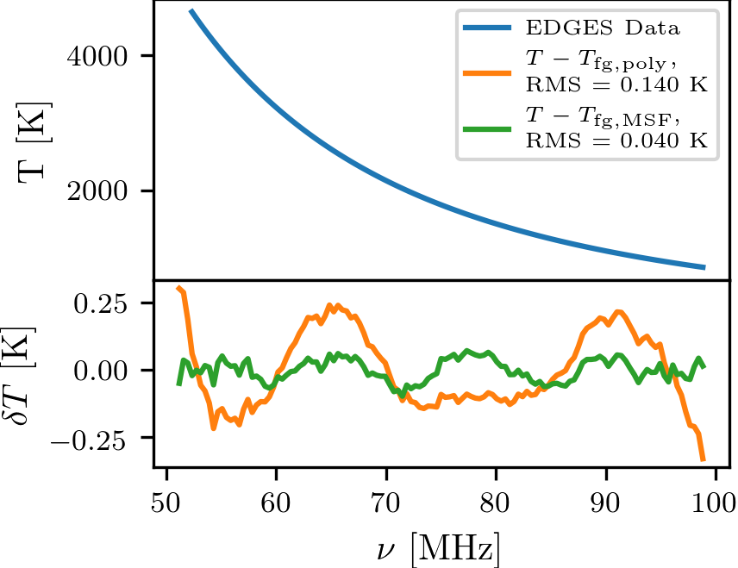
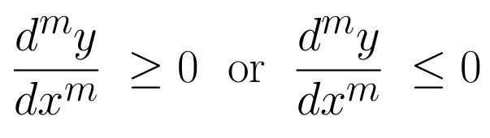
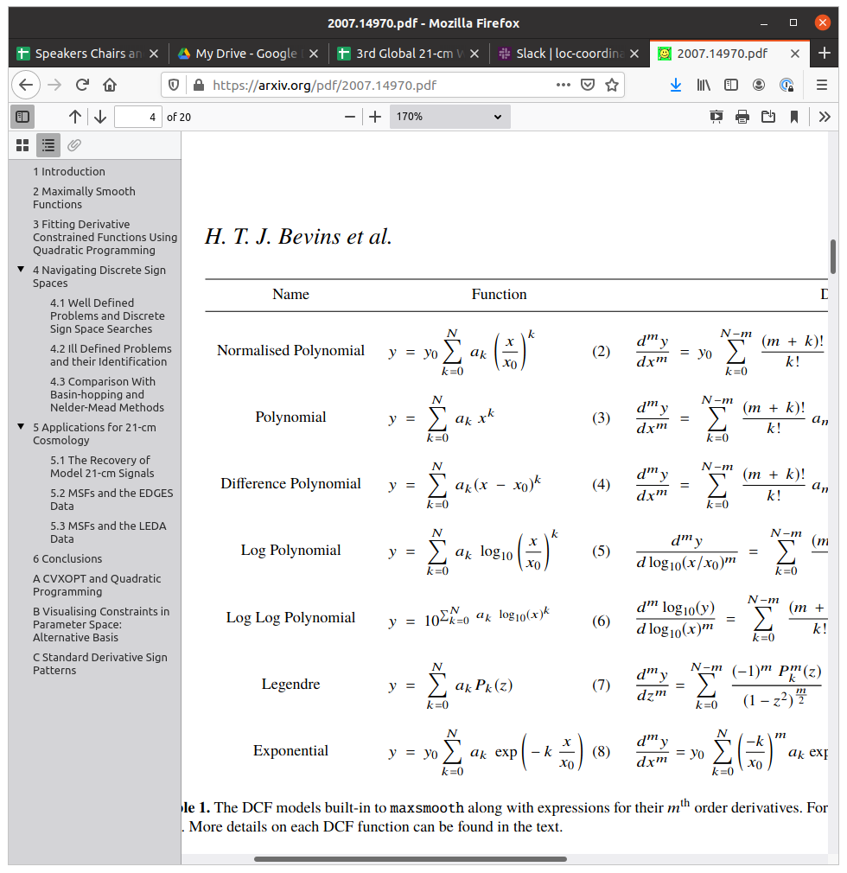
What are Maximally Smooth Functions?
Originally proposed in Sathyanarayana Rao et al. (2015, 2017)
Functions constrained by:
with m≥2.
Example function
Smooth properties ideal for modelling foregrounds
Generalise to Derivative Constrained Functions (DCFs) with different constraints on derivatives
Example using the EDGES data
3rd Global 21-cm Workshop 2020 – Harry Bevins (htjb2@cam.ac.uk)
Slide 2

Slide 3
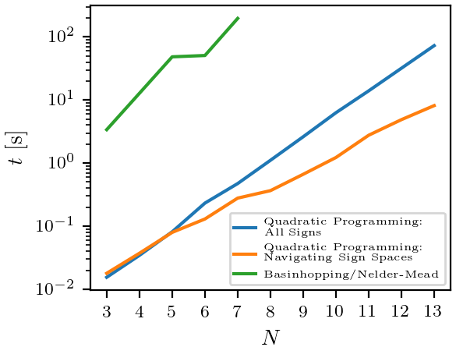
What is maxsmooth?
Robust and fast algorithm for fitting DCFs
2 orders of magnitude faster than historically used Basin-hopping/Nelder-Mead routines
Based in quadratic programming and a division of the parameter space determined on the constraints (more details in the paper)
3rd Global 21-cm Workshop 2020 – Harry Bevins (htjb2@cam.ac.uk)
Slide 3

Slide 4
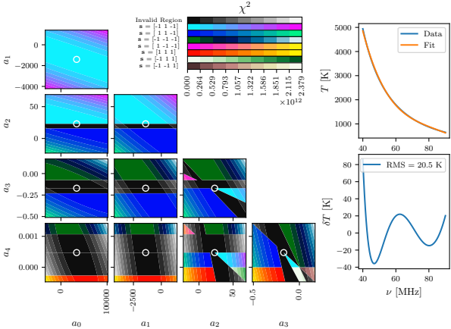
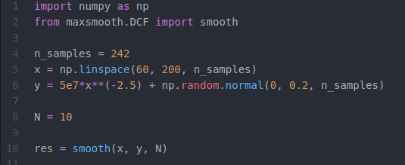
What is maxsmooth?
Division of the parameter space
For Basin-hopping each region acts as a basin but these aren’t always explored
maxsmooth allows you to explore the entire parameter space
Available on Github: https://github.com/htjb/maxsmooth
pip install maxsmooth
3rd Global 21-cm Workshop 2020 – Harry Bevins (htjb2@cam.ac.uk)
Slide 4

Slide 5
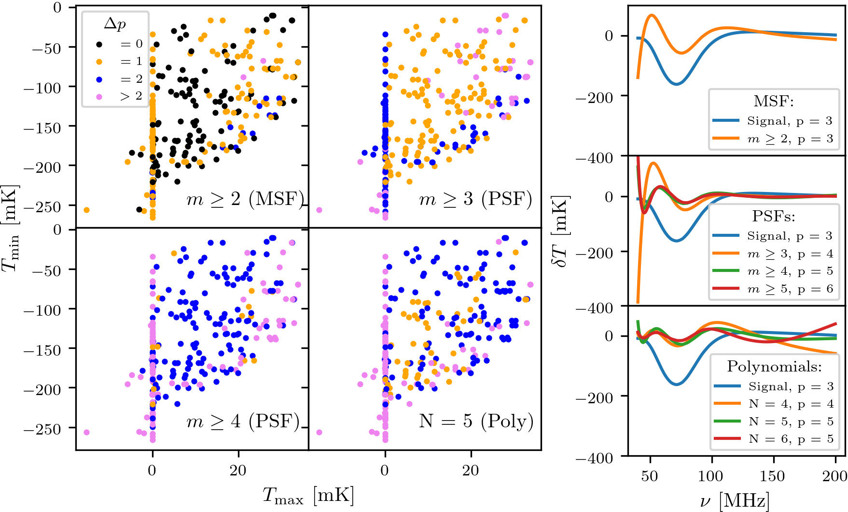
DCFs and 21-cm Cosmology
264 mock signals and a ν^{-2.5} power law foreground.
Models from Cohen et al. (2017) and used by Singh et al. (2018)
Fit and remove different foreground models
Count turning points, p, in residuals and compare with those in the signal
Δp=0 indicates a strong remnant of the signal in the residuals
3rd Global 21-cm Workshop 2020 – Harry Bevins (htjb2@cam.ac.uk)
Slide 5

Slide 6
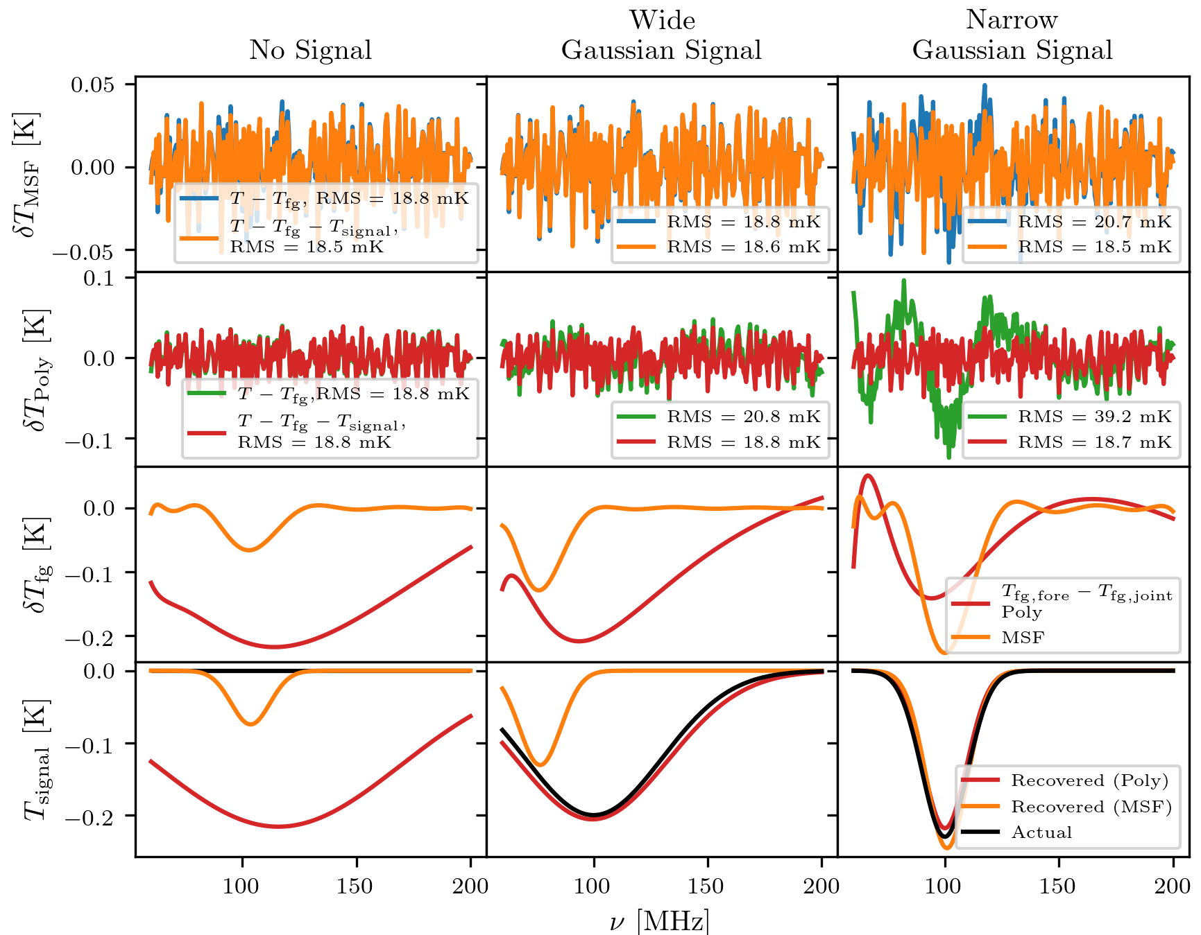
Limitations of DCFs
Three data sets with same foreground and noise but different signals
Pure foreground and Joint fits of signal with MSFs and an unconstrained polynomial
Find evidence that MSFs struggle with recovery of ‘smooth’ signals and identification of signals in the absence of any real signal
Similar problems with polynomials
Evidence is a strong indicator of presence of smooth signals
3rd Global 21-cm Workshop 2020 – Harry Bevins (htjb2@cam.ac.uk)
Slide 6

Slide 7
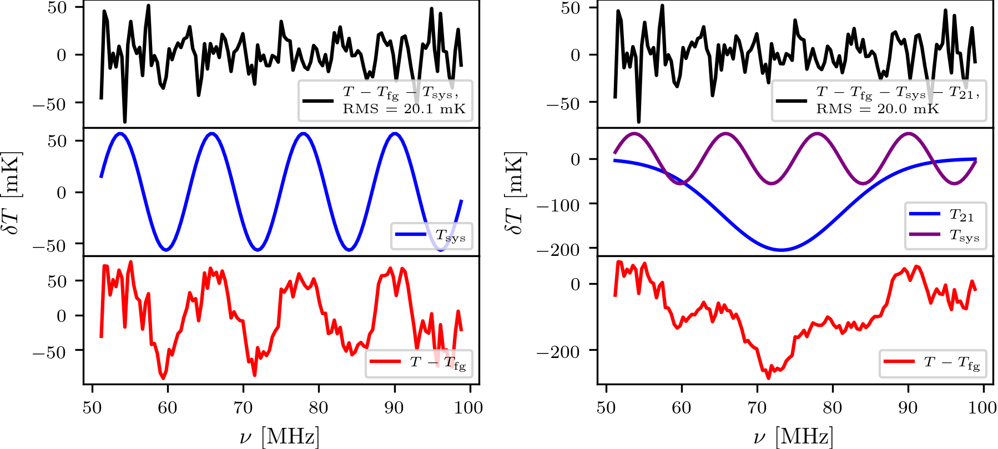
maxsmooth, DCFs and EDGES
Testing maxsmooth on the EDGES data
Previously analysed with MSFs by Singh and Subrahmanyan (2019)
Pure foreground fit has log(Z)=216.80±0.09
Found evidence for sinusoidal systematic, log(Z)=302.99±0.08
We can recover a theoretically plausible Gaussian signal
However the evidence is lower than for the systematic fit, log(Z)=292.67±017
N = 11
3rd Global 21-cm Workshop 2020 – Harry Bevins (htjb2@cam.ac.uk)
Slide 7

Slide 8
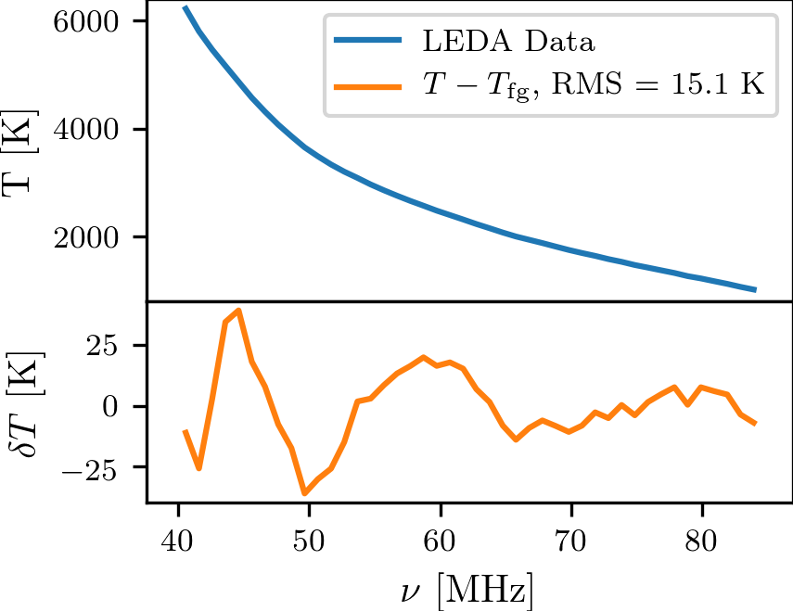
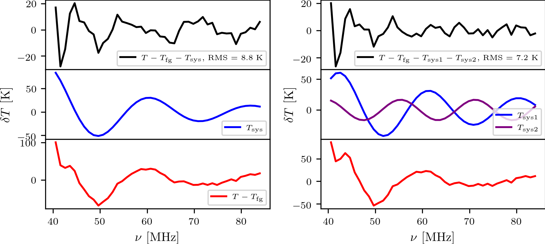
maxsmooth, DCFs and LEDA
Fit LEDA data, taken in 2016, for the first time with MSFs
Large RMS and log(Z)=-185.45±0.09
Perform Joint fit with a damped sinusoidal systematic and return log(Z)=-175.50±0.19
Additional sinusoidal structure which we can fit and find
log(Z)=-168.34±0.19
Systematic described by the leading order terms in a damped Fourier series
Similarities between the systematics here and in EDGES might highlight larger causes in Global 21-cm experimentation
3rd Global 21-cm Workshop 2020 – Harry Bevins (htjb2@cam.ac.uk)
Slide 8

Slide 9
Applications to REACH
Best Case Scenario:
maxsmooth can be used as an independent foreground modelling technique alongside the existing Bayesian pipeline to confirm a detection.
Worst Case Scenario:
maxsmooth can be used to confidently identify systematics in the data set leading to quicker identification and improvements to the REACH experiment.
3rd Global 21-cm Workshop 2020 – Harry Bevins (htjb2@cam.ac.uk)
Slide 9

Slide 10
Summary and Conclusions
maxsmooth is a fast and robust tool for fitting MSFs and related functions.
2 orders of magnitude faster than historically used methods for fitting MSFs
MSFs are shown to be better suited for modelling foregrounds than commonly used unconstrained polynomials.
There are limitations to the usefulness of MSFs
We can use MSFs to identify the presence of non-smooth systematics in 21-cm experiments like LEDA and EDGES
Paper: https://arxiv.org/abs/2007.14970
Github: https://github.com/htjb/maxsmooth
3rd Global 21-cm Workshop 2020 – Harry Bevins (htjb2@cam.ac.uk)
Slide 10

