Slide 1


Marginal Bayesian Statistics with Masked Autoregressive Flows and Kernel Density Estimators
Harry T. J. Bevins
University of Cambridge
With Will Handley, Pablo Lemos, Peter Sims, Eloy de Lera Acedo and Anastasia Fialkov
MaxEnt’22 – Harry Bevins (htjb2@cam.ac.uk)
Slide 1/12

Slide 2
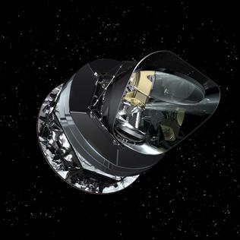
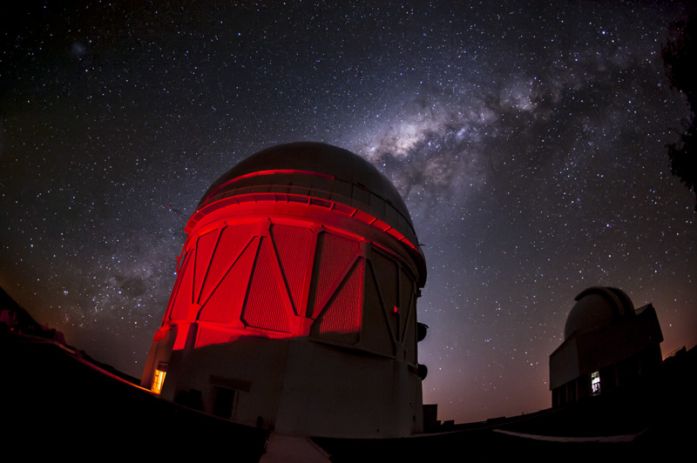
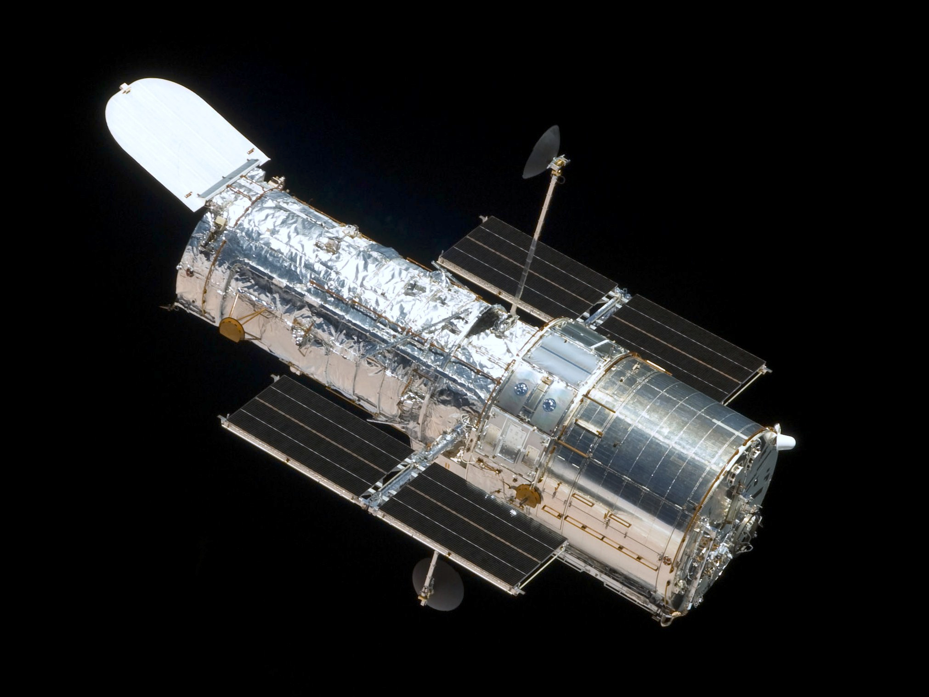
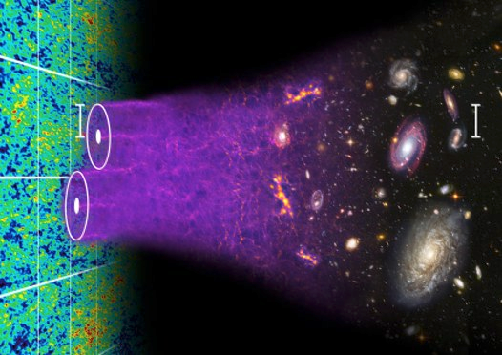
The Problem...
Combining constraints from experiments probing different aspects of the same physics is computationally expensive.
Often only interested in ~6 cosmological parameters, θ, where each experiment can have an additional ~20 ‘nuisance’ parameters, α, describing systematics and foregrounds.
Planck: θ=6, α=15
DES: θ=6, α=20
SH₀ES: θ=6, α=0
BOSS: θ=6, α=0
MaxEnt’22 – Harry Bevins (htjb2@cam.ac.uk)
Slide 2/12

Slide 3
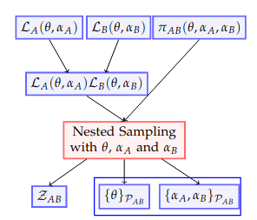
The Full Nested Sampling Approach
Typically combination of constraints is performed by sampling over a full joint likelihood.
Returns the Bayesian Evidence and posterior samples for both nuisance parameters and cosmological parameters.
MaxEnt’22 – Harry Bevins (htjb2@cam.ac.uk)
Slide 3/12

Slide 4
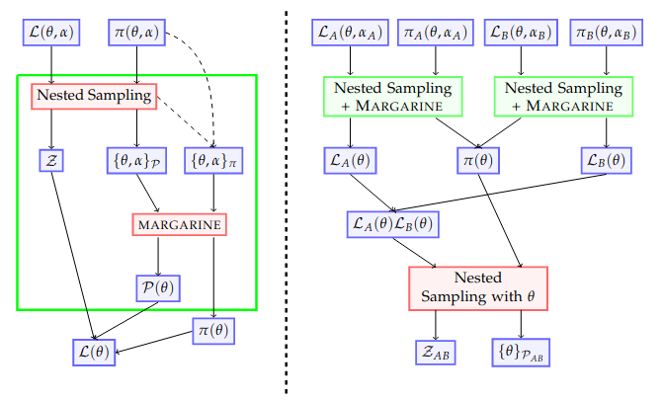
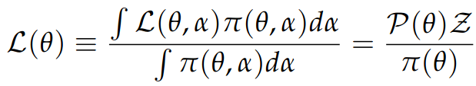
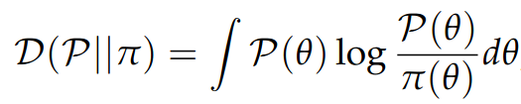
The margarine Approach
margarine uses density estimators to replicate samples output from nested sampling.
These density estimators are built from known base distributions meaning that we can use them to estimate P(θ) and π(θ).
This can then give us the nuisance-free likelihood along with the KL divergence.
MaxEnt’22 – Harry Bevins (htjb2@cam.ac.uk)
Slide 4/12

Slide 5

The margarine Approach
We can therefore combine nuisance-free likelihoods calculated from samples for experiment A and B.
We show mathematically that the method is consistent with a full nested sampling run.
MaxEnt’22 – Harry Bevins (htjb2@cam.ac.uk)
Slide 5/12

Slide 6
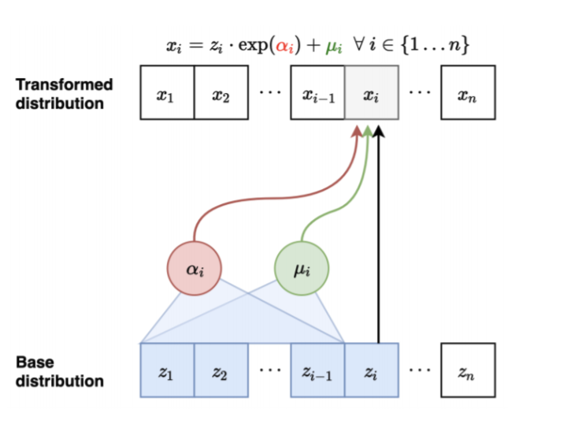
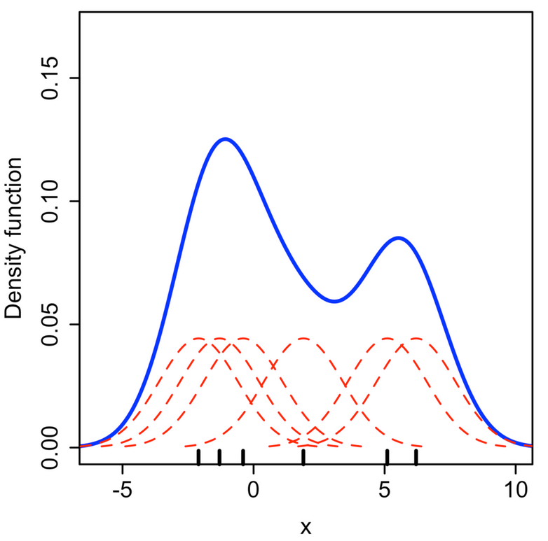
Types of Density Estimators
Masked Autoregressive Flows which shift and scale a base distribution to look like the target posterior or prior.
Kernel Density Estimator which models the posterior or prior distribution using Gaussian kernels.
MaxEnt’22 – Harry Bevins (htjb2@cam.ac.uk)
Slide 6/12

Slide 7
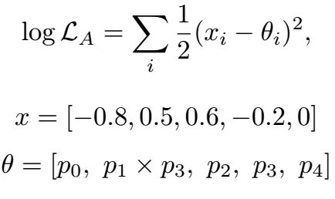
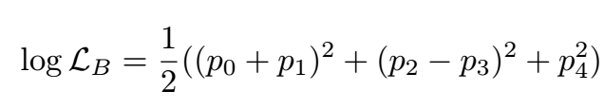
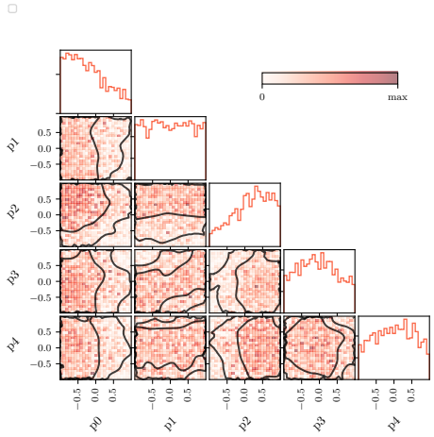
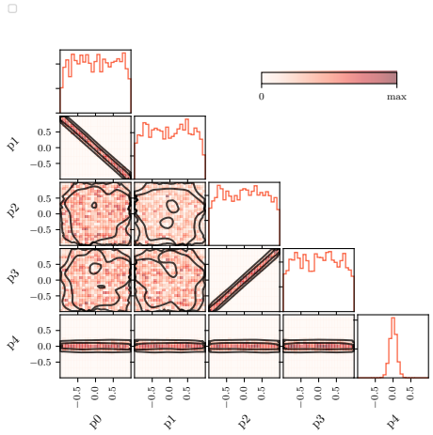
Toy Example
Experiment A:
Experiment B:
MaxEnt’22 – Harry Bevins (htjb2@cam.ac.uk)
Slide 7/12

Slide 8
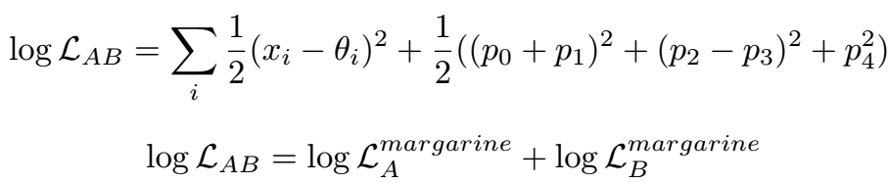
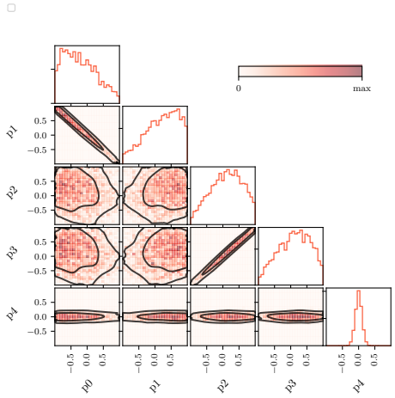
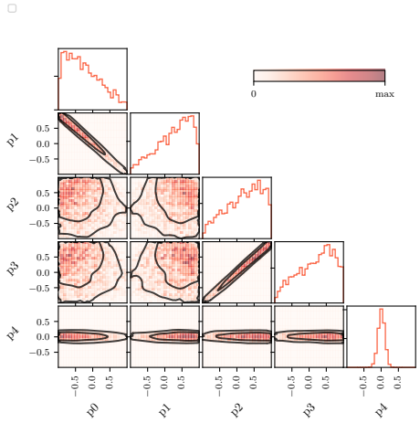
Toy Example
Combined w/ Nested Sampling
log(Z) = -11.7 ± 0.1
Combined w/ Nested Sampling + margarine log(Z) = -11.8 ± 0.1
MaxEnt’22 – Harry Bevins (htjb2@cam.ac.uk)
Slide 8/12

Slide 9
Planck + DES
To model both DES and Planck we have to fit 41 parameters of which 35 are nuisance parameters…
Previously been done in Handley and Lemos 2019a and 2019b
log(Z) = -5965.7 ± 0.3
D = 6.17 ± 0.36
MaxEnt’22 – Harry Bevins (htjb2@cam.ac.uk)
Slide 9/12

Slide 10
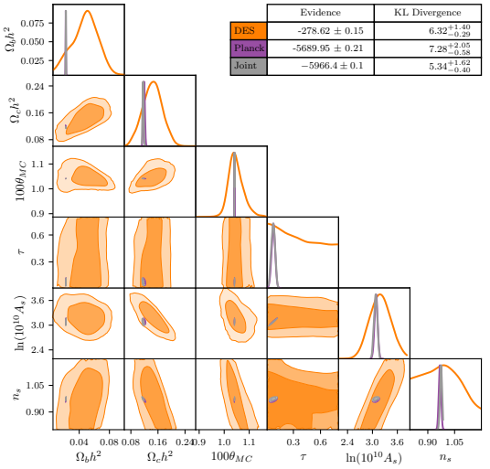
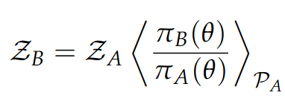
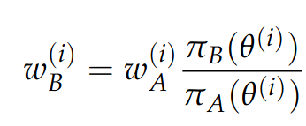
Planck + DES
margarine is much more computationally efficient than fitting for 41 parameters.
Using nuisance-free likelihoods we can sample over just the six cosmological parameters.
log(Z) = -5966.4 ± 0.1
D = 5.34 +(-) 1.62(0.40)
We use margarine to perform importance sampling.
MaxEnt’22 – Harry Bevins (htjb2@cam.ac.uk)
Slide 10/12

Slide 11
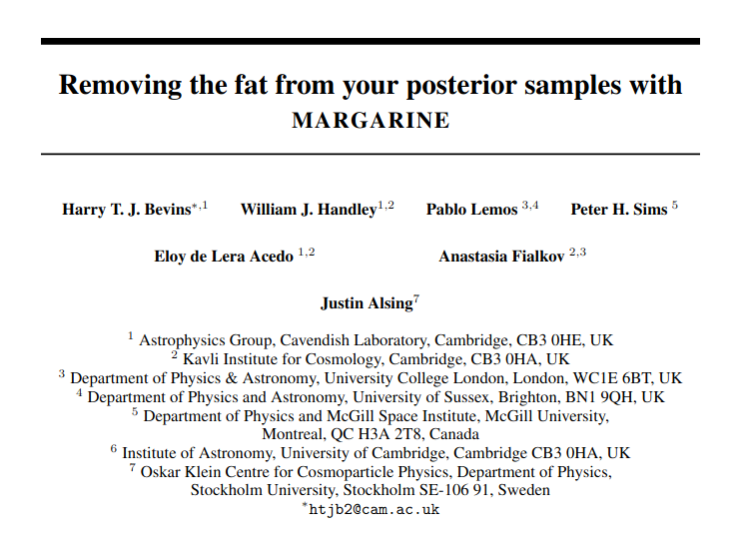
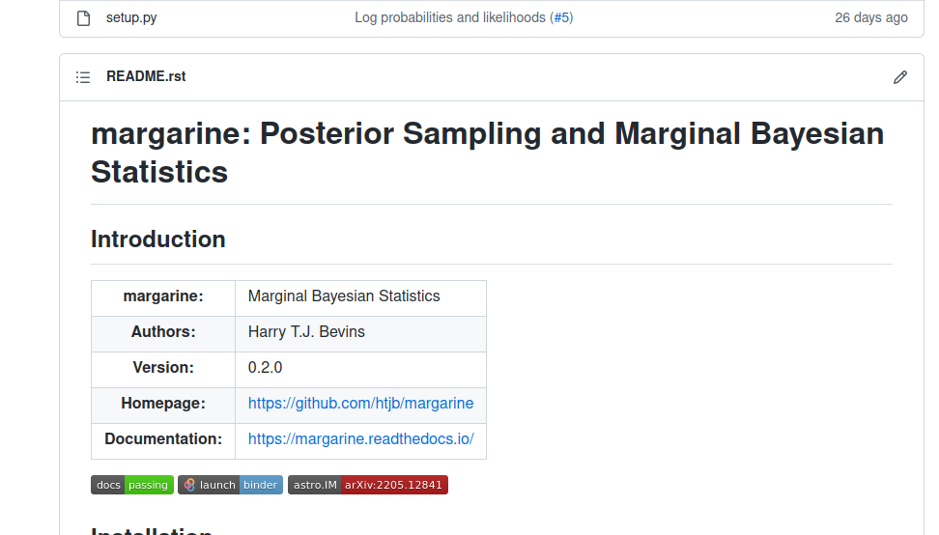
margarine
https://github.com/htjb/margarine
https://arxiv.org/abs/2205.12841
MaxEnt’22 – Harry Bevins (htjb2@cam.ac.uk)
Slide 11/12

Slide 12
Conclusions
margarine offers a computationally more efficient path to combined Bayesian analysis that is consistent with a full Nested Sampling run.
Our approach is lossless in θ as it recovers the same marginal posterior and total evidence.
The work paves the way for the development of a publicly available library of cosmological likelihood emulators.
There are applications beyond cosmology.
MaxEnt’22 – Harry Bevins (htjb2@cam.ac.uk)
Slide 12/12

