Slide 1
SISG-CFG Low Power Verification Plan
John Pratheep Kulanthai Samy

Slide 2
Why important?
Power aware verification has become an increasingly critical issue for the semiconductor industry.
Total power consumption
Power _{Total} = Power _{Dynamic} + Power _{Static} + Power _{Short-circuit}
Static power consumption is a function of supply voltage, transistor threshold voltage and transistor size.
When operating at a higher frequency, dynamic power consumption contributes significantly to overall power consumption and is given by:
Power _{Dynamic} = a F C_{load} VDD²
Notes:
Shrinking process geometries have led designers to use various approaches to minimize static and dynamic power and has put immense burdens on verification teams to ensure power aware verification is complete.
Power management scheme is built by the power architect of the SoC in order to reduce the current consumption of the chip
Power _{Dynamic} = a F C_{load} VDD²
C_{load} = Load capacitance of the CMOS
VDD = Supply voltage
F = Operating frequency at which the transition happens
a = Switching activity constant
Dynamic power dissipation is directly proportional to operating frequency and supply voltage of the devices.

Slide 3
Clock Gating Vs Power Gating
Power gating is used for reducing LEAKAGE POWER
Clock gating is used for reducing DYNAMIC POWER
Clock Domain
- Independent of Power Domains
Voltage Domain (VDDs)
- Different voltage domains must have different clock domains.
Power Domain
- Can have 1 or more Voltage Domains and Clock Domains
Notes:
Power gating is used for reducing LEAKAGE POWER by switching off power supply to the non operational power domain of the chip during certain mode of operation. Header and footer switches, isolation cells and state retention flip flips (SRFFs) are used for implementing power gating. Clock gating is used for reducing DYNAMIC POWER by controlling switching activities on the clock path. Generally Gate or Latch or FF based clock gating cells are used for implementing clock gating.
Clock domains are subset of voltage domains, i.e. NoC elements with same voltage domain may have same or different clock domains but NoC elements with different voltage domains must have different clock domains.

Slide 4
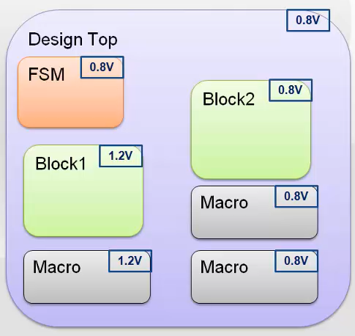
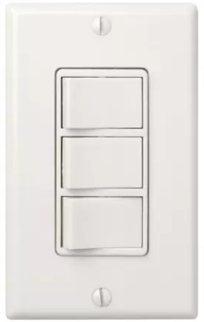
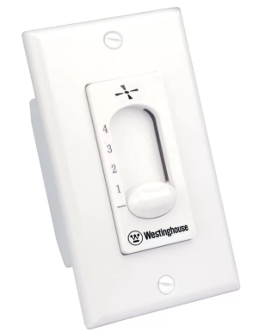
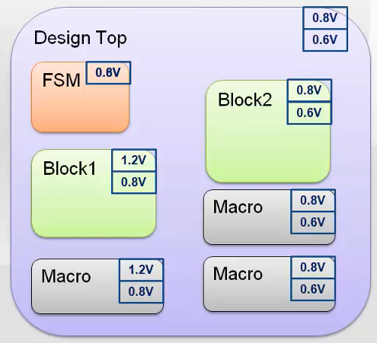
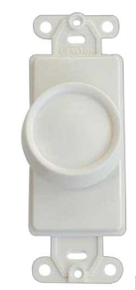
Power Management Techniques
Power Gating
- shut down when is not active
Multi Voltage
- Multi VDDs in the design
- Multi Threshold Voltage per domain
Dynamic Voltage and Frequency Scaling (DVFS)
- change dynamically as per
the different operating modes of the design
Notes:
In the DVFS technique, operating voltage, as well as the frequency, change dynamically as per the different operating modes of the design.
By varying the voltage with frequency, we can reduce the power consumption.
this technique optimizes both voltage and frequency, it is highly effective for static and dynamic power consumption.

Slide 5

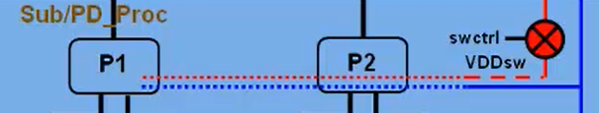

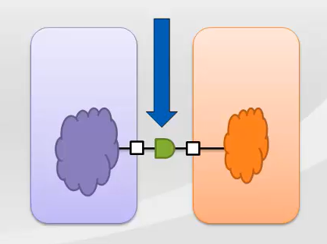
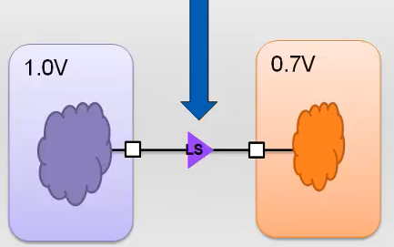


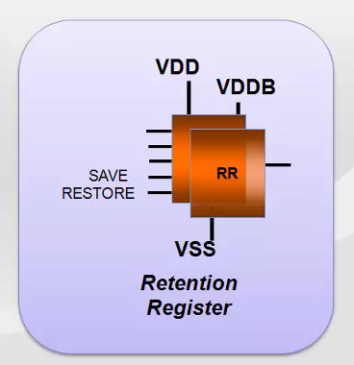
Power Management Cells
Power Switch
Switch to OFF or ON
Isolation
Either output ports of ON or input ports of OFF domains
Clamp logical value to output ports of OFF domains to ON
Level Shifter
to convert the signal from one to another voltage level (from low voltage level to high voltage level and vice versa).
Retention
to save content of a power gated block before it switches off.
register contains one shadow register along with the main register
Notes:
This isolation cell is always a ‘power up’ cell and it prevents any unknown logic level to reach to the ‘always on’ logic.
A retention register is also needed while doing power gating to save content of a power gated block before it switches off.
The shadow register is powered by the ‘always on’ supply which stores the logic value of the block being power gated when “SAVE” is asserted high. It restores this logic value to the main register when “RESTORE” is asserted high.

Slide 6
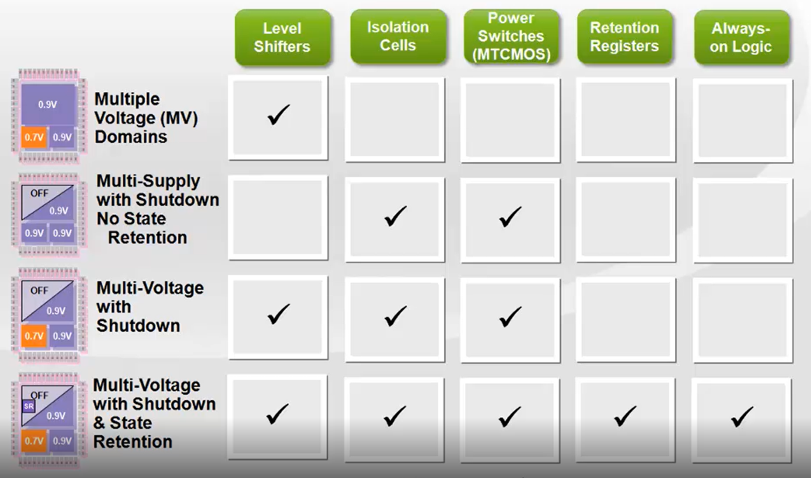
Multi Voltage with cell requirements

Slide 7
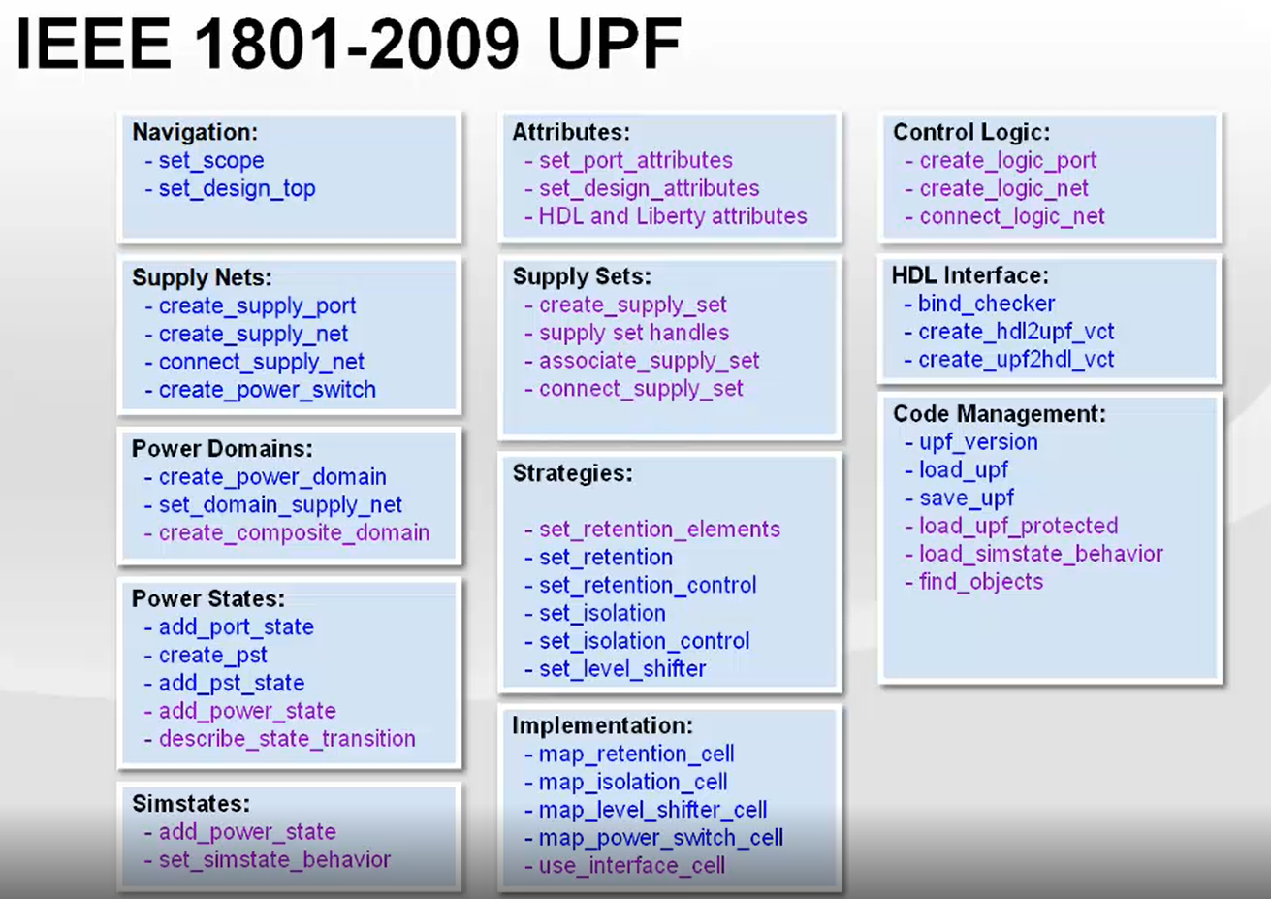
UPF 2.0

Slide 8
LP TB Block Diagram
S
Y
N
C
U
N
I
T
req
CXT
NoC
AXI SLV
ack
req
UFI
AHB SLV
ack
req
IDI
APB SLV
ack
req
CMI
CMIS SLV
ack
global reset and gclocks
NSPS
host clk/rst/pwr controls
QC
I/f
rst_<pd>
pwr controls
host clk/rst/pwr controls
req
PMXTOR
ClkGen
ack
clocks

Slide 9
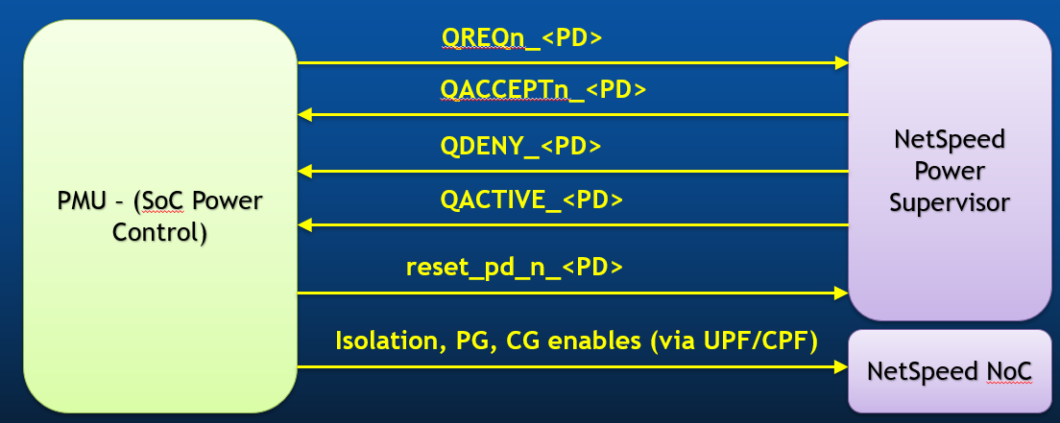
PMU/PMXTOR ⬄ NSPS

Slide 10
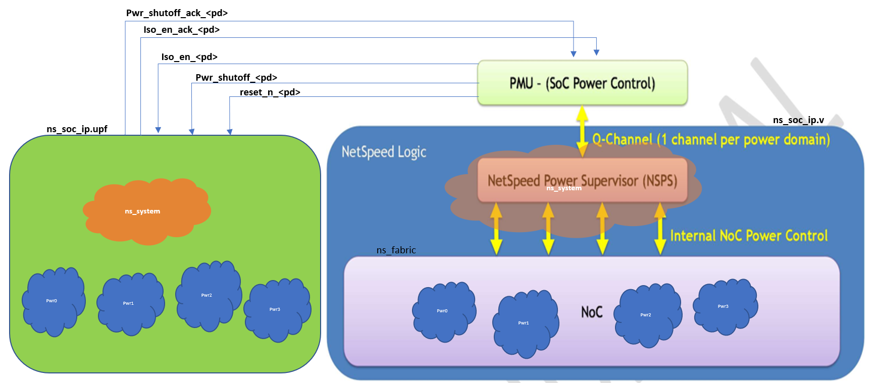



PMU/PMXTOR ⬄ UPF
ns_soc_ip.v
ns_fabric.upf

Slide 11
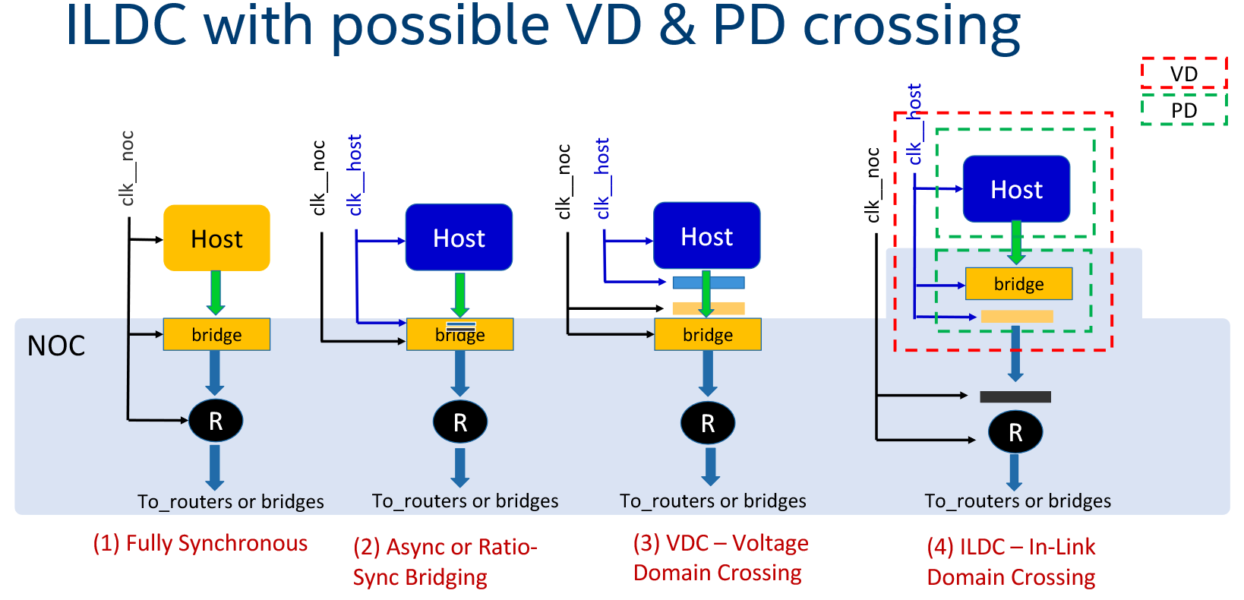
Refer: https://wiki.ith.intel.com/pages/viewpage.action?spaceKey=EN&title=CFG+Engineering+Home&preview=/1340616179/1545289333/CFG%20Domain%20Crossing%20Support.pptx

Slide 12
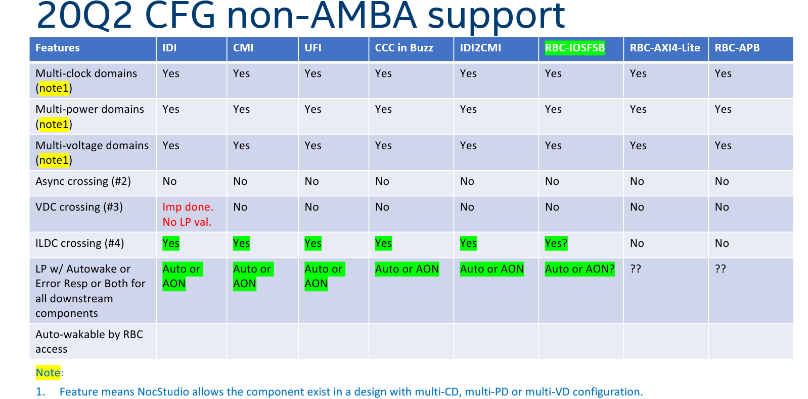

Slide 13
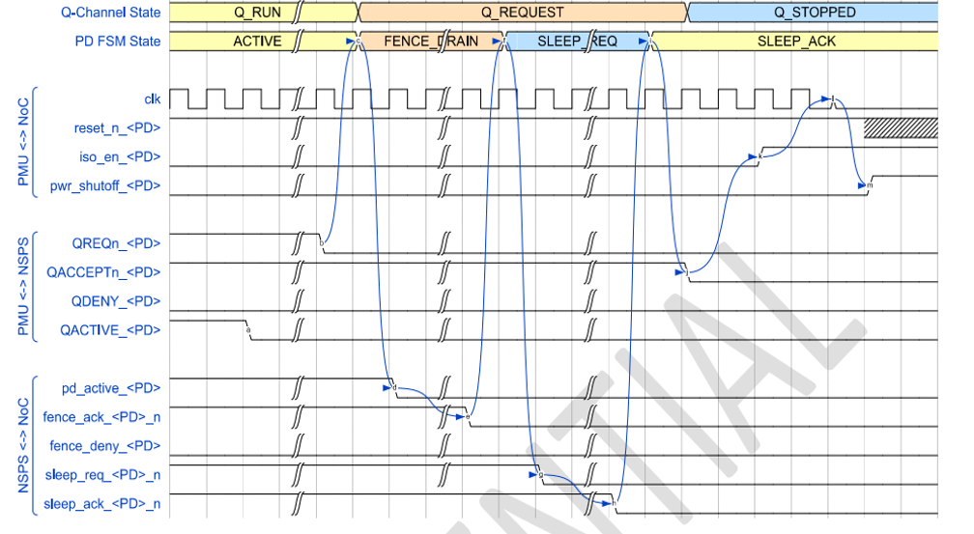
Power Down Accept Sequence..

Slide 14
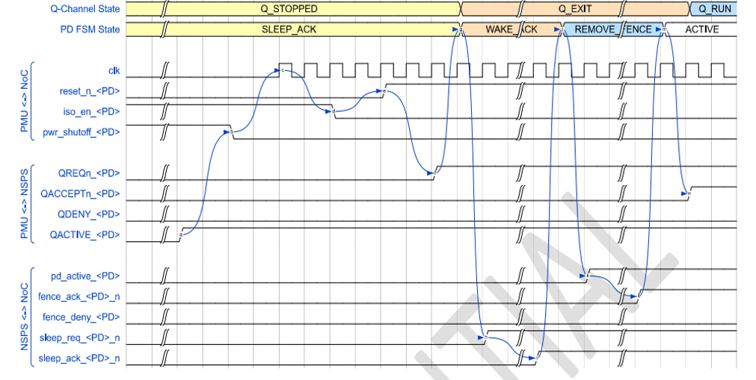
Power Up Accept Sequence

Slide 15
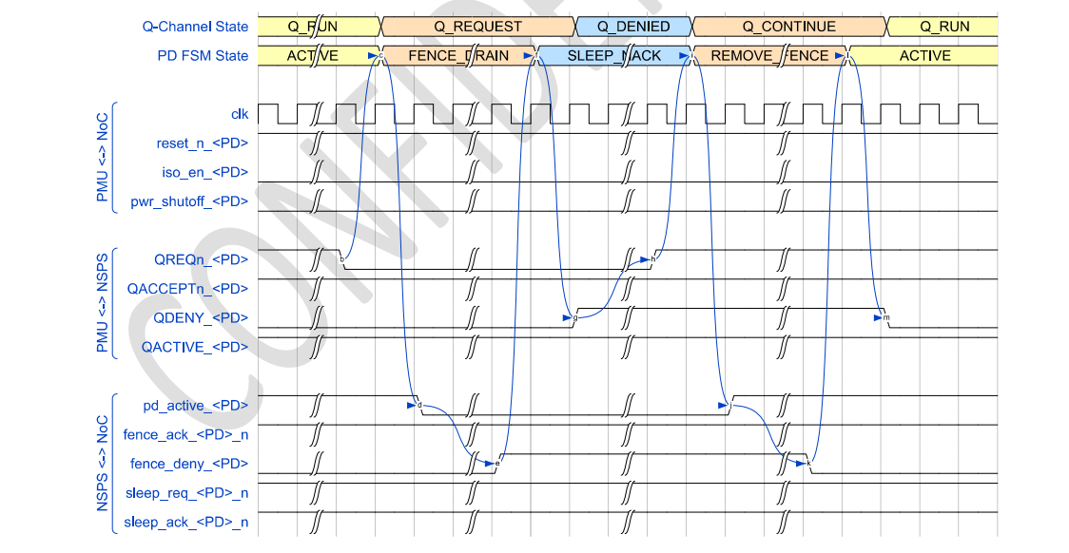
Power Down Deny Sequence

Slide 16
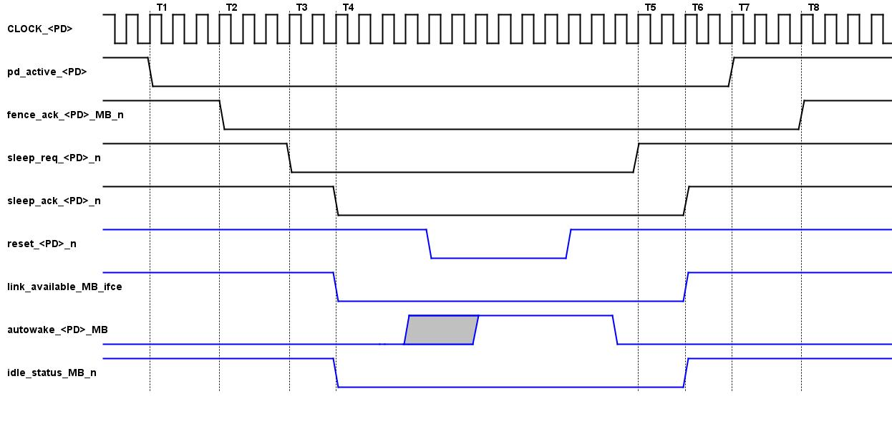
Master Bridge Power Down & Up Seq

Slide 17
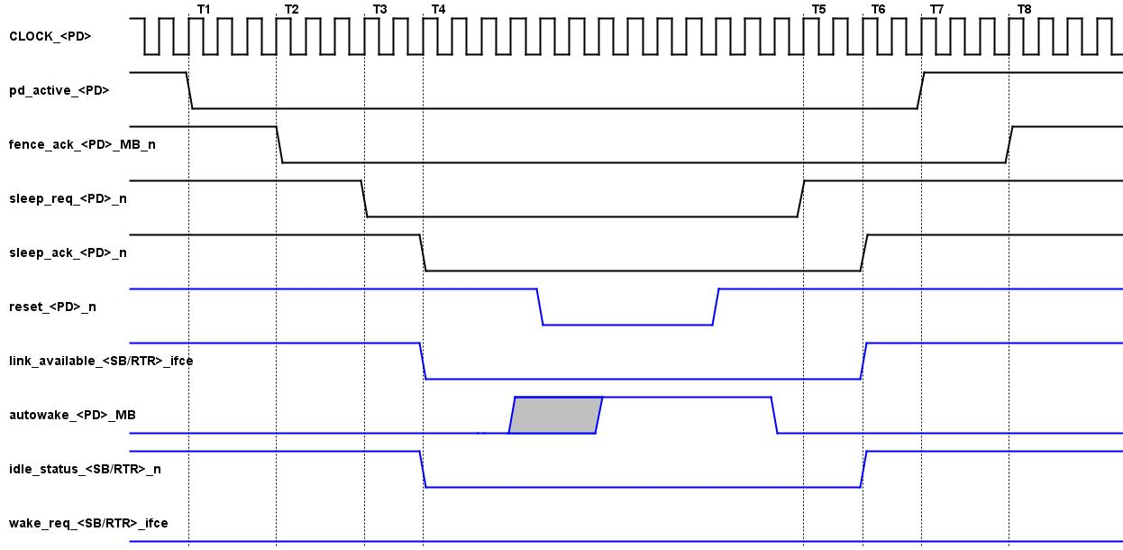
Slave Bridge Power Down & Up Seq

Slide 18
JIRA’s
•NS-40734 – Multi voltage Enable – 20Q2 - Done
•NS-40932 –UPF Power Switch with ACK ports - 20Q2 - Done
•NS-40825 - VCLP for all NoCs - 20Q2 - On going
•NS-5495 – Corekit Support in UPF - 20Q2 - On going
•NS-40460 – IDI Power on & Req -> Ack sequence - 20Q2 - On going
•NS-40892 – VCP upgrade (Service Package upgrade) - 20Q2 - Done •NS-6719 – Low Power Tracker (RBM) - 20Q3
•NS-6396 – Save/Restore (Retention) - 20Q3/4
•NS-27484 – Multi Hop (Decode Error) - 20Q4

Slide 19
Features per Protocol
Low Power Features | IDI | CMI | UFI
Multi Clock Domain Support | YES | YES | YES
Clock Domain Crossing (Host <=> Bridges/ Within Bridges) Support | NO | NO | NO
Multi Voltage Domain Support | YES | YES | YES
Voltage Domain Crossing (Host <=> Bridges/ Within Bridges) Support | YES | NO | NO
Multi Power Domain Support | YES | YES | YES
Power Domain Crossing (Host <=> Bridges/ Within Bridges) Support | YES | YES | YES
Autowake / Decode Error Support | AUTO | AUTO | AUTO
Host and Converters are same power domain | YES | YES | YES

Slide 20
Power simulation Tools
Static
CLP (Cadence)
confrml/191/19.10.300
VCLP (Synopsys)
vcsmx/P-2019.06-SP2
Dynamic
Xcelium (Cadence)
xcelium/19.03-s003
NLP (Synopsys)
verdi/P-2019.06-SP2

Slide 21
Test Flow & Plan
NocWeaver,
Generates NocStudio configs, based on Nocweaver constraint
NocStudio,
Generates RTL & UPF, based NocStudio configs
GenStreamX
Instantiate PMXTOR & QCD at Top
Stitch XTORs and UPFs
Bind checkers
Nemesis
Generates random tests and checks
Verification & Test Plan
SISG_CFG_Low_Power_Test_Plan.xlsx
Located at <>/doc/internal_docs/Low_Power_Docs

Slide 22
Where are we?
LPV
Single Voltage
PSW
DVFS
ISO
LS
Retention
Multi Voltage
UPF 2.0
Host & Bridge are same voltage domain
Autowake
Decode Error (Multi Hub)
AMBA
IDI
CMI
Static
Dynamic
CLP
VCLP
Netlist + UPF
RTL + UPF
NLP
XCE
UPF 2.1
Host & Bridge are different voltage domain
UFI
Techniques
Technologies
Standards
Stages
Features
Protocols
Power Aware
Tools

