Slide 1

Qualcomm - NetSpeed Systems Follow-up Meeting
July 27th, 2016

Slide 2
Multicast Feature Description Example Mesh Layout

Slide 3
Multicast Feature Description Trees can be drawn for multicast

Slide 4
Multicast Feature Description Trees can be drawn for multicast

Slide 5
Multicast Feature Description User specifications for targets
User specifies how many multicast targets
Determines multicast destination id width (one hot encoded)
Each output port has output mask
Indicating the destinations reachable from that output port on the MC tree
Packets destination id is ANDed with an output port’s mask
If result is not 0 then packet is transmitted on that port
Output mask
1101100001000001
Dest.
1010000011101111
Output mask
0001000001000101
Output mask
0001101101000000

Slide 6
Multicast Feature Description User specifications for targets
Knob to reduce the destination id width:
Users can group various targets to reduce the number of destination bits in a multicast destination vector
Any arbitrary grouping is allowed – can be specified in NocStudio
Upon grouping, we OR the bits corresponding to each group in both destination id and all output masks
Output mask
1101100001000001 > 1111
Dest.
1010000011101111 > 1011
Output mask
0001000001000101 > 1011
Output mask
0001101101000000 > 1110

Slide 7
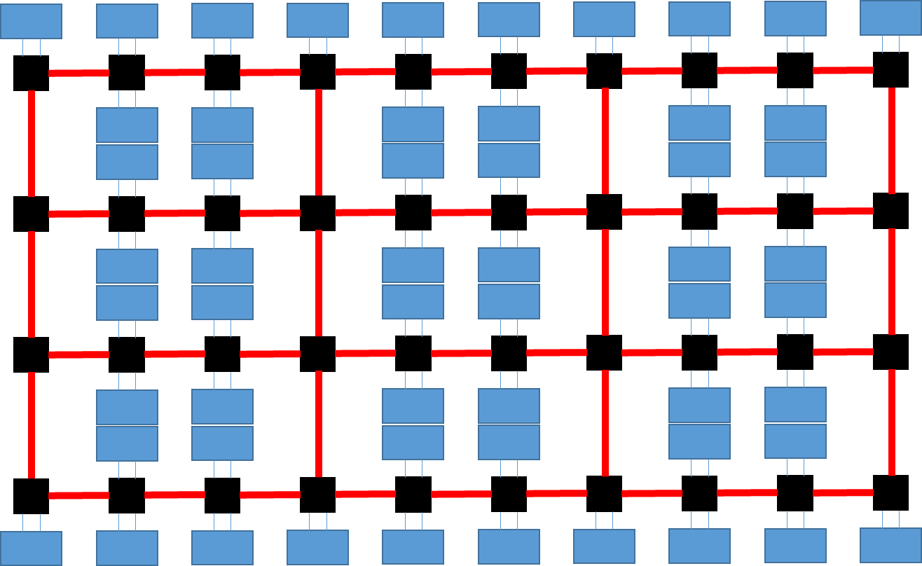
Multicast Feature Description Other options
With tree, packets may not always take the shortest path
A design is possible where multicast packets generally take shortest path for every target
In this design, per input mask at each output are kept and used to ensure no packet follows a cycle

